Slide 1
Dental procedures and movie star kisses: Dread looms larger than savoring
David Hardisty¹, Shane Frederick², & Elke Weber³
¹ Stanford Graduate School of Business, ²Yale School of Management,
and ³Columbia University
BDRM Annual Meeting 2012
NSF SES-0820496
Notes:
Images from unsplash.com

Slide 2
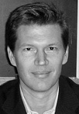
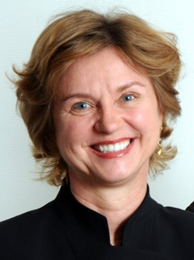
Co-Authors
Shane Frederick
Elke Weber
‹#›

Slide 3
Gain/loss assymetries
Receive $70 now or $70 in a month? 100% choose now
Pay $70 now or $70 in a month? 53% choose now
Why?
Dread is stronger than savoring

Slide 4
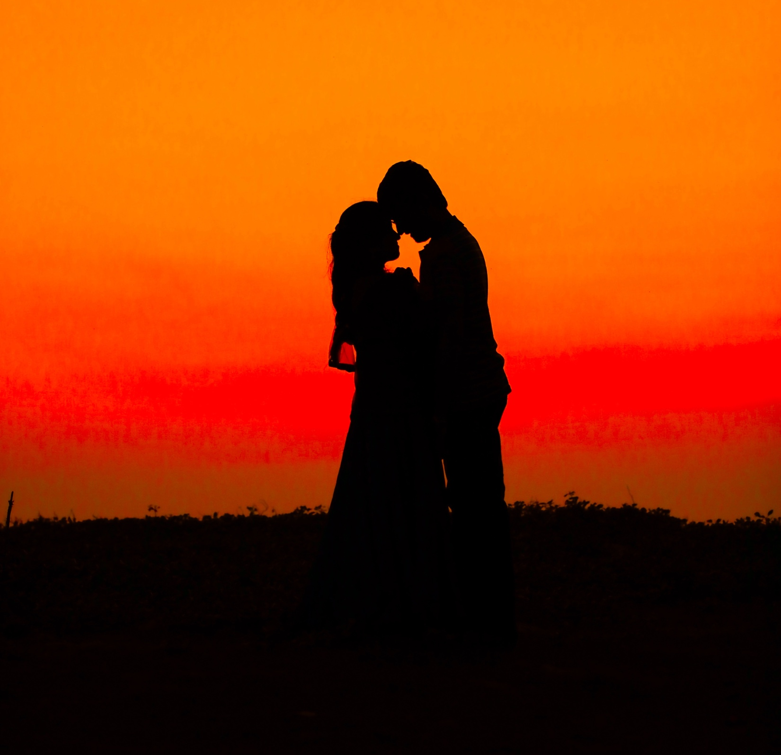
Kiss from a movie star: today or next week? (Loewenstein, 1987)
Discounting
Anticipation
Notes:
Image from unsplash.com

Slide 5
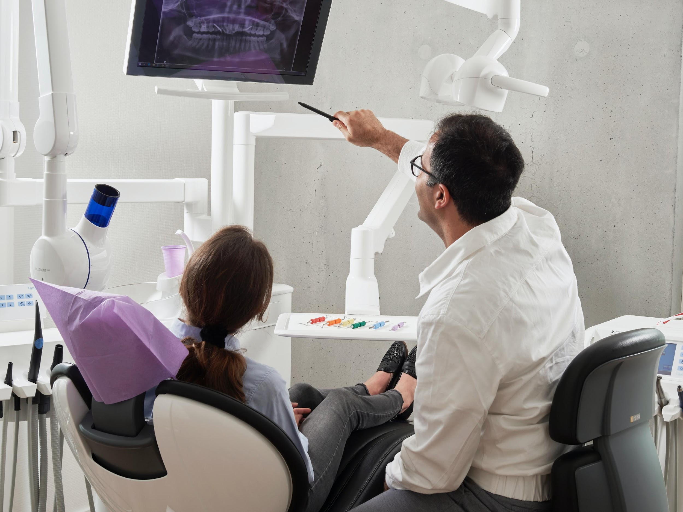
Scheduling a dental procedure
Discounting
Anticipation
Notes:
Image from unsplash.com

Slide 6
Pilot research: savoring?
Savoring: Only 6 out of 103 students would pay more for a kiss next week than one today
Dread: 20 out of 56 students preferred eating 9 worms today rather than 8 next week (see also Harris, 2010 & Berns et al 2006)
Does dread loom larger?
Notes:
Students who liked eating worms were screened out. In this sample, at any rate, we failed to replicate Loewenstein’s finding; meal worms isn’t the best control for kissing movie stars

Slide 7
Anticipation: what do we call it?
 | Aversive Anticipation | Pleasurable Anticipation
Positive Event | Impatience
Negative Event
Notes:
“enjoying the moment”

Slide 8
Anticipation: what do we call it?
 | Aversive Anticipation | Pleasurable Anticipation
Positive Event | Impatience | Savoring
Negative Event
Notes:
“enjoying the moment”

Slide 9
Anticipation: what do we call it?
 | Aversive Anticipation | Pleasurable Anticipation
Positive Event | Impatience | Savoring
Negative Event | Dread
Notes:
“enjoying the moment”

Slide 10
Anticipation: what do we call it?
 | Aversive Anticipation | Pleasurable Anticipation
Positive Event | Impatience | Savoring
Negative Event | Dread | ???
Notes:
“enjoying the moment”

Slide 11
Overview
Study 1
Exploration of anticipation of gains vs losses
Study 2
Anticipation predicting time preferences
Study 3
Controlling for loss aversion

Slide 12
Study 1: Overview
120 students and online participants
Participants brainstormed events, and then rated the anticipation

Slide 13
Study 1: Examples of Positive Events
Prefer now:
“going out with friends”
“get paid for doing a survey”
Prefer later:
“hawaii vacation”
“eating a great dessert”

Slide 14
Study 1: Examples of Negative Events
Prefer now:
“going to the dentist”
“paying bills”
Prefer later:
“Serious Illness”
“bathing our cats”

Slide 15
“If this thing were one week away, how would you feel about anticipating it?”
3.00
2.00
1.00
mean anticipation value
sooner
.00
later
-1.00
-2.00
-3.00
negative events
positive events
interaction: F(1,113)=5.6, p=.02
Notes:
Participants are using both sides of the scale for gains

Slide 16
Study 1: Discussion
Anticipation of negative events: negative
Anticipation of positive events: mixed
But does this predict time preference?

Slide 17
Study 2: Overview
CDS Vlab sample of 169 participants
20 intertemporal choice scenarios (10 gain, 10 loss)
Measured anticipation utility and time preference

Slide 18
Study 2: Events
Some Positive Events:
receiving a $50 check
spending time with your best friend
kiss from a movie star
Some Negative Events:
paying a $50 fine
a confrontation with your co-worker or family member
painful dental procedure

Slide 19
Study 2: Stimulus
Please imagine the following event:
[receiving a $50 check]
1. Assuming this event would definitely happen to you and you knew it were coming, when would you prefer it to happen? immediately OR don’t care when OR [one month] from now
2. If this event were [one month] away, how psychologically pleasurable or unpleasurable would the anticipation be? strongly dislike the strongly like the feeling of waiting neutral feeling of waiting |-------------------------------------|-------------------------------------|

Slide 20
Results: Time preference
 | Negative Events | Positive Events
Now | 41% | 62%
Indifferent | 22% | 31%
Later | 37% | 7%
Total N=5,420 events (20 events for each of 169 participants)
Notes:
Collapsing across delay

Slide 21
The “sign effect”
 | Negative Events | Positive Events
Now | 41% | 62%
Indifferent | 22% | 31%
Later | 37% | 7%
Total N=5,420 events (20 events for each of 169 participants)

Slide 22
Negative time preference
 | Negative Events | Positive Events
Now | 41% | 62%
Indifferent | 22% | 31%
Later | 37% | 7%
Total N=5,420 events (20 events for each of 169 participants)

Slide 23
Anticipation

Slide 24
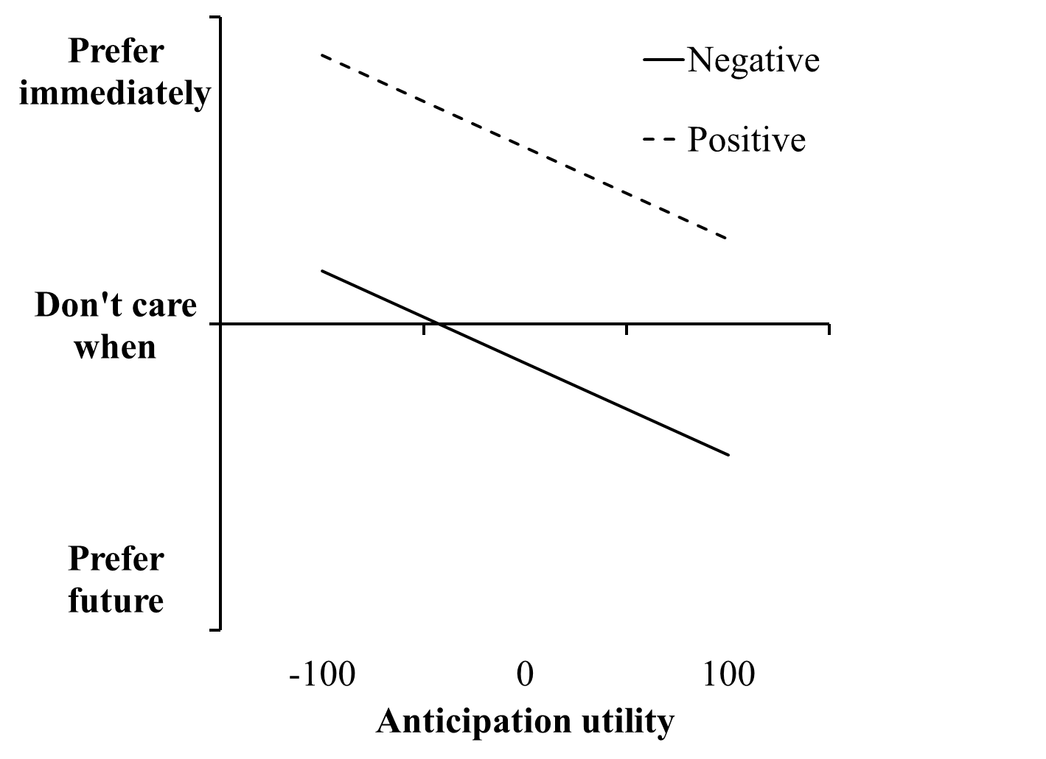
Anticipation predicts time preferences
Notes:
This relationship was significant for all 20 events; average standardized beta = -.3

Slide 25
Study 2: Summary
Dread is more pronounced than savoring
Anticipation value predicts time preference, for both gains and losses
Together, this explains the “sign effect” in intertemporal choice

Slide 26
Study 3
Is it just loss aversion?

Slide 27
Study 3: Overview
106 participants from Amazon MTurk
Dynamically identify subjectively equivalent gains and losses for each subject
Compare dread and savoring for these subjectively equivalent pairs

Slide 28
Accept this pair of events?
50% chance of receiving 25 dollars
AND
50% chance of paying 25 dollars
Yes Unsure No

Slide 29
Accept this pair of events?
50% chance of receiving 500 dollars
AND
50% chance of paying 25 dollars
Yes Unsure No

Slide 30
Accept this pair of events?
50% chance of receiving 49 dollars
AND
50% chance of paying 25 dollars
Yes Unsure No

Slide 31
Study 3: Stimulus
Please consider the following event:
[50% chance of receiving a $49]
Assuming this event would definitely happen to you and you knew it were coming, when would you prefer it to happen?
Immediately OR in one week

Slide 32
Time preferences
 | Gains | Losses
Now | 79% | 57%
In one week | 21% | 43%

Slide 33
Time preferences
 | Gains | Losses
Now | 79% | 57%
In one week | 21% | 43%

Slide 34
Study 3: Stimulus
2.a. Please imagine this event happening one week from now. Would experiencing this event be pleasurable or unpleasurable?
Pleasurable experience OR unpleasurable experience
2.b. How strongly would experiencing this event affect your feelings at that time?
not at all strongly extremely |--------------------------------------------------------------------------|
(Wording based on McGraw et al, 2010)

Slide 35
Study 3: Stimulus
3.a. If this event were one week away, would the anticipation be psychologically pleasurable or unpleasurable? In other words, how would you feel while waiting for it?
Like the feeling of waiting OR Dislike the feeling of waiting
3.b. How strongly would anticipating this event affect your feelings while waiting for the event?
not at all strongly extremely |--------------------------------------------------------------------------|

Slide 36
Utility for experience and anticipation

Slide 37
Summary
Dread is more pronounced than savoring
This explains the “sign effect”
Even when subjective experience utility is matched

Slide 38
Limitations and Future Directions
When do we feel impatience vs savoring?
What exactly is dread (affective vs cognitive resources)?
Mixed gain/loss tradeoffs

Slide 39
Special Thanks To…
The National Science Foundation (SES-0820496, SES-0345840, and Graduate Research Fellowship)
The Behavioral Lab at Stanford GSB
The Center for Research on Environmental Decisions (CRED)
The Center for Decision Sciences (CDS)

Slide 40
Thank You!

Slide 41
References
Hardisty, D. J. & Weber, E. U. (2009). Discounting future green: Money vs the environment. Journal of Experimental Psychology: General, 138(3), 329-340.
Harris, C. R. (2010). Feelings of dread and intertemporal choice. Journal of Behavioral Decision Making, n/a. doi: 10.1002/bdm.709
Loewenstein, G. (1987). Anticipation and the valuation of delayed consumption. The Economic Journal, 97, 666-684.
McGraw, A. P., Larsen, J. T., Kahneman, D. & Schkade, D. A. (2010). Comparing gains and losses. Psychological Science.
Thaler, R. H. (1981). Some empirical evidence on dynamic inconsistency. Economics Letters, 8, 201-207.

Slide 42
Study 2: Events
Positive Events:
receiving a $50 check
receiving a good grade or performance review
spending time with your best friend
improved energy and health for 10 days
a free 5-day vacation to the destination of your choice
watching your favorite TV show or reading a good book for an hour
getting a gift in the mail from a family member
eating a nice meal out at a restaurant
winning the lottery
a kiss from the movie star of your choice
Negative Events:
paying a $50 fine
receiving a bad grade or performance review
a confrontation with your co-worker or family member
being sick for 10 days
doing difficult home cleaning and renovation for 5 days
filling out paperwork and waiting around for an hour at the local Department of Motor Vehicles (DMV)
giving a stressful 60 minute improvised speech
a painful dental procedure
having one of your legs amputated
getting twenty painful (but harmless) electric shocks in a research experiment

Slide 43
Extra Slides

Slide 44
Study 4: Evidence with real money
+$7 now vs +$7 in one month 100% choose now
-$7 now vs -$7 in one month 56% choose now
+$70 now vs +$70 in one month 100% choose now
-$70 now vs -$70 in one month 53% choose now

Slide 45
Typical Event Pair
Event | Anticipation | Experience | Choice (1=prefer now) | Regression Beta
receiving a good grade or performance review | 21 | 68 | .68 | -.22**
receiving a bad grade or performance review | -55 | -65 | .15 | -.38**

Slide 46
Differences between items
“Doing difficult home cleaning and renovation for 5 days” anticipation: -19 percent choosing now: 38% beta: -.36**
“Having one of your legs amputated” anticipation: -63 percent choosing now: 19% beta: -.24**

Slide 47
event | a | e | Corr(a,e) | c | beta (a) | beta (e)
a free 5-day vacation to the destination of your choice | 28 | 75 | .27** | .19 | -.40** | .00
eating a nice meal out at a restaurant | 28 | 59 | .42** | .29 | -.31** | .15
a kiss from the movie star of your choice | 22 | 46 | .38** | .32 | -.17* | .34**
receiving a good grade or performance review | 21 | 68 | .33** | .68 | -.22** | -.01
getting a gift in the mail from a family member | 21 | 64 | .43** | .49 | -.35** | .15
spending time with your best friend | 21 | 67 | .24** | .44 | -.21** | .14
watching your favorite TV show or reading a good book for an hour | 13 | 52 | .39** | .57 | -.27** | .18*
receiving a $50 check | 13 | 66 | .25** | .78 | -.17* | .04
improved energy and health for 10 days | 9 | 67 | .24** | .69 | -.31** | .12
winning the lottery | 6 | 83 | .20* | .79 | -.31** | .15*
doing difficult home cleaning and renovation for 5 days | -19 | -13 | .51** | .02 | -.36** | .32**
filling out paperwork and waiting around for an hour at the local Department of Motor Vehicles (DMV) | -26 | -35 | .43** | .11 | -.30** | .26**
paying a $50 fine | -27 | -39 | .39** | .02 | -.28** | .16
giving a stressful 60 minute improvised speech | -45 | -37 | .45** | -.10 | -.20* | .26**
being sick for 10 days | -47 | -65 | .28** | -.15 | -.32** | .22**
a painful dental procedure | -53 | -63 | .37** | .18 | -.44** | .39**
receiving a bad grade or performance review | -55 | -65 | .43** | .15 | -.38** | .31**
a confrontation with your co-worker or family member | -57 | -60 | .55** | .18 | -.35** | .32**
getting twenty painful (but harmless) electric shocks in a research experiment | -58 | -66 | .41** | .13 | -.36** | .33**
having one of your legs amputated | -63 | -86 | .31** | -.56 | -.24** | .33**

Slide 48
Study 1: Proportion of events classified by participants as provoking dread, pleasurable anticipation, or neither, depending on what type of events participants had generated (positive events vs negative events that they would prefer to happen immediately vs later). Total N = 433 events.
 | Positive Event |  | Negative Event
Classification | Prefer Now | Prefer Later | Prefer Now | Prefer Later | Average
Negative Anticipation | 74% | 22% | 75% | 63% | 58%
Neutral Anticipation | 15% | 14% | 13% | 18% | 15%
Positive Anticipation | 11% | 64% | 12% | 19% | 27%
Total | 100% | 100% | 100% | 100% | 100%

Slide 49
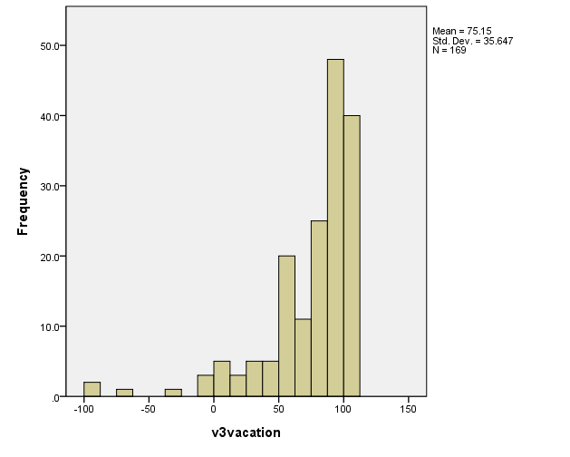
Histogram of Vacation Experience Utility

Slide 50
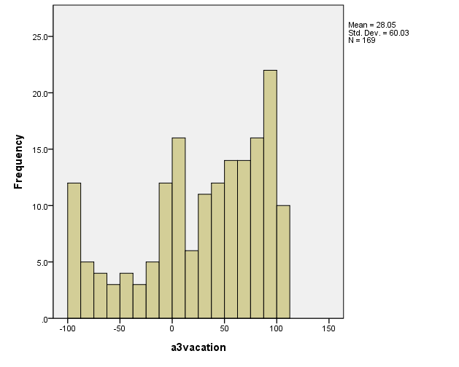
Histogram of Vacation Anticipation Utility

Slide 51
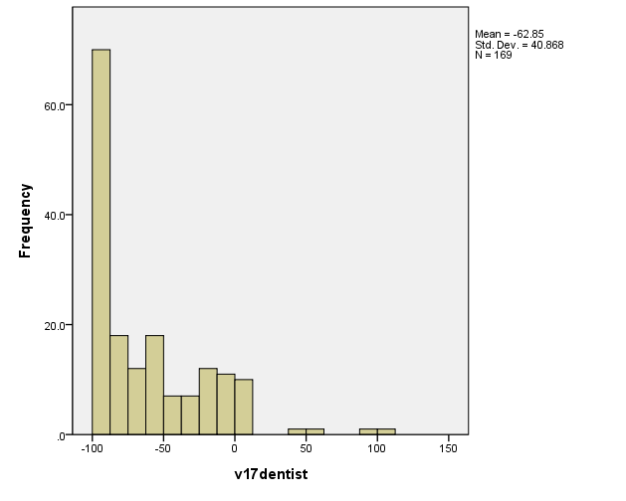
Histogram of Dentist Experience Utility

Slide 52
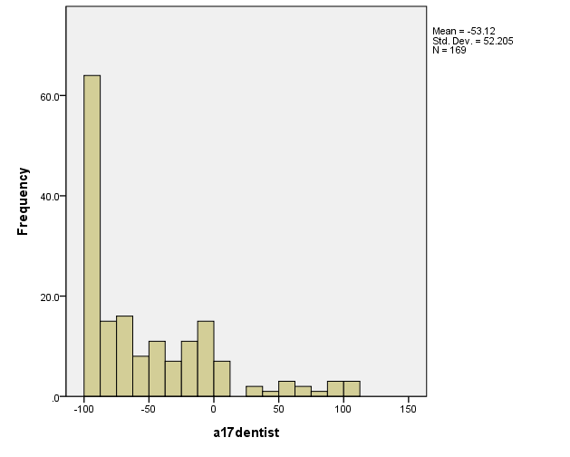
Histogram of Dentist Anticipation Utility

