Slide 1
Choosing energy efficiency
David J. Hardisty
Sauder School of Business
University of British Columbia

Slide 2
Project Overview
How can we nudge people towards more energy efficient products?
Partnering with local utility company (BC Hydro)
Many people want to minimize future costs → Let’s make future costs more salient
Three studies of energy cost framing:
10-year cost display
Energy / Dollars x Gain / Loss
Continuous vs Dichotomous

Slide 3
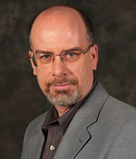
People
Dale Griffin
Yoonji Shim
Daniel Sun

Slide 4
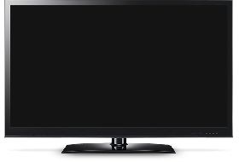
Study 1 methods
Price: $999.95
Estimated Electricity Use (W): 121
Standby energy consumption: 0.2w
Brand: Samsung
Size: 50”
Resolution: 1080p
Price: $749.95
Estimated Electricity Use (W): 181
Standby energy consumption: 0.4w
Brand: Samsung
Size: 50”
Resolution: 1080p
Notes:
Tv - https://www.indiamart.com/proddetail/32-inch-lg-television-18470908188.html

Slide 5
Study 1 methods
Price: $999.95
10-year estimated cost: $600
Estimated Electricity Use (W): 121
Standby energy consumption: 0.2w
Brand: Samsung
Size: 50”
Resolution: 1080p
Price: $749.95
10-year estimated cost: $1,000
Estimated Electricity Use (W): 181
Standby energy consumption: 0.4w
Brand: Samsung
Size: 50”
Resolution: 1080p
Notes:
Tv - https://www.indiamart.com/proddetail/32-inch-lg-television-18470908188.html

Slide 6
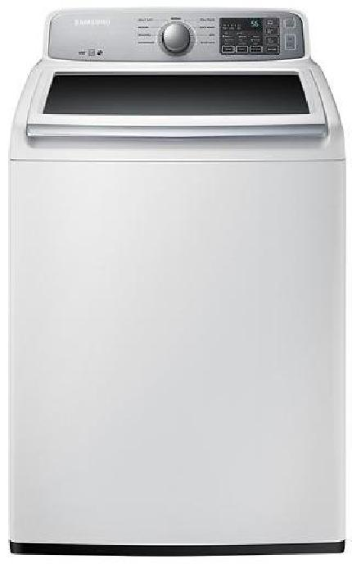
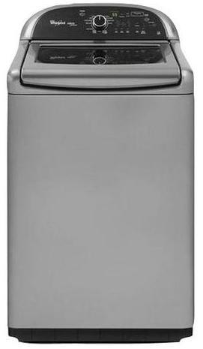
Price: $629.99
Estimated Yearly Electricity Use (kWh): 169
Model: 4.5 Cu. Ft. 9 cycle Top Load Washer
Brand: Samsung
Price: $899.99
Estimated Yearly Electricity Use (kWh): 150
Model: 4.8 Cu. Ft. 13 cycle Top Load Washer
Brand: Whirlpool
Notes:
Image source left: https://image-us.samsung.com/SamsungUS/home/home-appliances/washers/top-load/pd/wa50m7450aw/01_Washer-TopLoader_WA50M7450AW_Front_Closed-White.jpg?$product-details-jpg$
Image source right: https://www.energycenterappliance.com/product/whirlpool-cabrio-platinum-top-load-washer-chrome-shadow-wtw8500bc-23606

Slide 7
Price: $629.99
10-year estimated cost: $180
Estimated Yearly Electricity Use (kWh): 169
Model: 4.5 Cu. Ft. 9 cycle Top Load Washer
Brand: Samsung
Price: $899.99
10-year estimated cost: $100
Estimated Yearly Electricity Use (kWh): 150
Model: 4.8 Cu. Ft. 13 cycle Top Load Washer
Brand: Whirlpool
Notes:
Image source left: https://image-us.samsung.com/SamsungUS/home/home-appliances/washers/top-load/pd/wa50m7450aw/01_Washer-TopLoader_WA50M7450AW_Front_Closed-White.jpg?$product-details-jpg$
Image source right: https://www.energycenterappliance.com/product/whirlpool-cabrio-platinum-top-load-washer-chrome-shadow-wtw8500bc-23606

Slide 8
Study 1 Results: Clean

Slide 9
Study 1 Results: Real

Slide 10
Study 1: Why? (Mediation)
Not discount rates or environmental attitudes
Goal matching?
Goal activation?
Cost under-estimation?
Increased time horizon?
Other ideas?

Slide 11
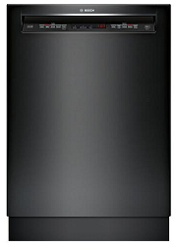
Study 2: Methods
Price: $764.99
Estimated Yearly Dollar [Energy] Savings [Cost]: $27 [259 kWh]
Interior Capacity: Up to 16 place settings
Dishwasher Type: Full-size built-in
Brand: Bosch
Price: $649.99
Estimated Yearly Dollar [Energy] Savings [Cost]: $0 [279 kWh]
Interior Capacity: Up to 14 place settings
Dishwasher Type: Full-size built-in
Brand: LG
Notes:
Image source left: https://pisces.bbystatic.com/image2/BestBuy_US/images/products/5710/5710312_sd.jpg
Image source right: https://www.ajmadison.com/cgi-bin/ajmadison/LDS4821BB.html

Slide 12
Study 2: Results (Clean)

Slide 13
Study 2: Results (Real)

Slide 14
Study 2: Why? (Mediation)
Not discounting, environmental attitudes, or political orientation
Loss aversion?
Construal level theory?
Goal matching/activation?
Other ideas?

Slide 15
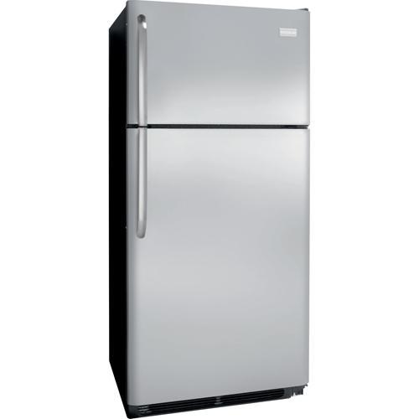
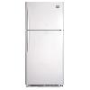
Study 3: Methods
Price: $799.97
[Energy Star Certified: No]
[Energy Usage (kWh/year): 479]
Top mount refrigerator
18.2 Cu. Ft.
Price: $799.97
[Energy Star Certified: Yes]
[Energy Usage (kWh/year): 383]
Top mount refrigerator
18.2 Cu. Ft.
Notes:
Image source left: https://www.frigidaire.com/Owner-Center/Product-Support/FFTR18G2QS
Image source right: https://dufresne.ca/products/whirlpool-18-cu-ft-top-mount-fridge-wrt318fzdm-stainless

Slide 16
Study 3: Results

Slide 17
Study 3: Why? (Mediation)
Not maximizing/satisficing
Translated attributes?
Goals?
Other ideas?

Slide 18
Going forward
Test with Vancouver residential sample
Explore mediators
Compare with & against existing methods (social norms, defaults, etc)
Field studies & implementation

Slide 19
Thank you!

