Slide 1
Tackling temporal tradeoffs in energy efficiency
David J. Hardisty
Nicholas Institute for Environmental Policy Solutions and UPEP Environmental Institutions Seminar Series co-sponsored by Richard Larrick, Michael W. Krzyzewski University Professor in Leadership, Professor of Management and Organizations at the Fuqua School of Business
Duke University
Oct 31, 2014

Slide 2
Notes:
Image source: https://unsplash.com/

Slide 3
Overview
Temporal tradeoffs
Integrative framework
Fresh data on labeling and energy efficiency
Comments & questions throughout, please!

Slide 4
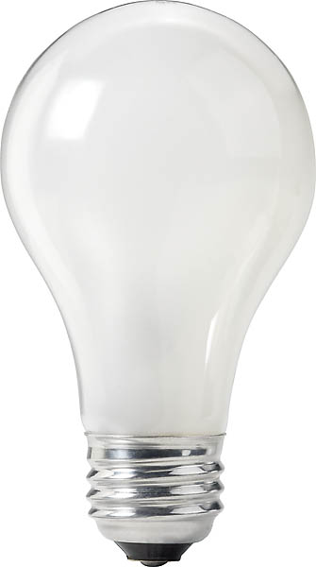
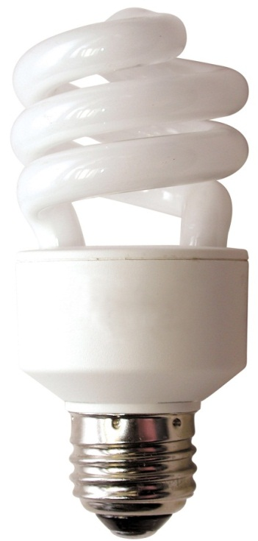
About time
100 watt incandescent
25 watt CFL
19 watt LED
$0.60 now
$113 for 10,000 hrs of use
1600 lbs of CO₂
$3.40 now
$28 for 10,000 hrs of use
400 lbs of CO₂
$28.23 now
$21 for 10,000 hrs of use
304 lbs of CO₂
Notes:
at 3 hours a day, 10,000 hours is about 9 years
calculations use 11.3 cents/kWh
Image source (left): https://www.rona.ca/en/product/feit-electric-light-bulb-bright-white-a15-bulb-shape-40-watt-bp40a15-can-31925045
Image source (middle): https://www.bulbconnection.com/product/4909-TCP-80101450-14W-SPRINGLIGHT-50K-14w-Spiral
Image source right: https://www.lighting.philips.com.eg/prof/led-lamps-and-tubes/led-lamps/master-ledbulb/929000276802_EU/product

Slide 5
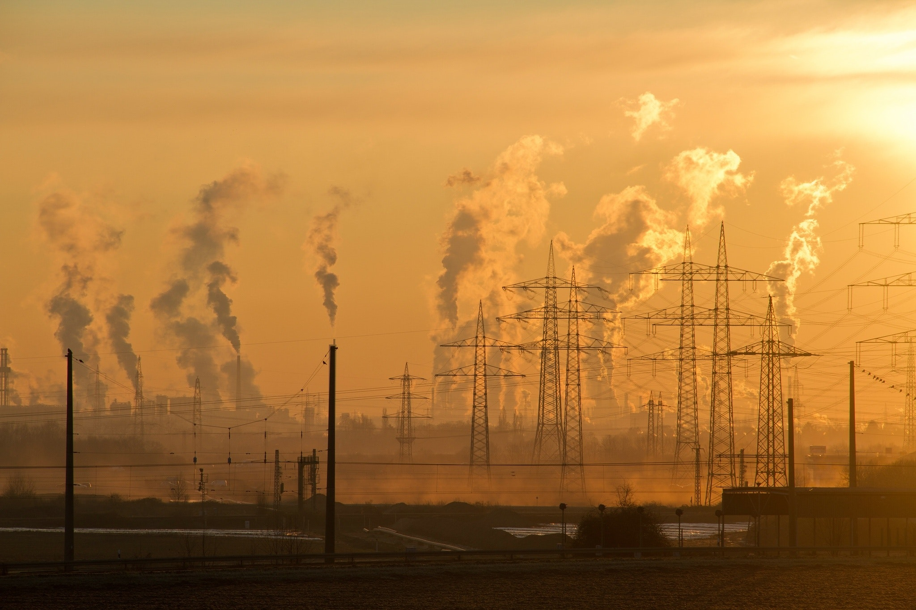
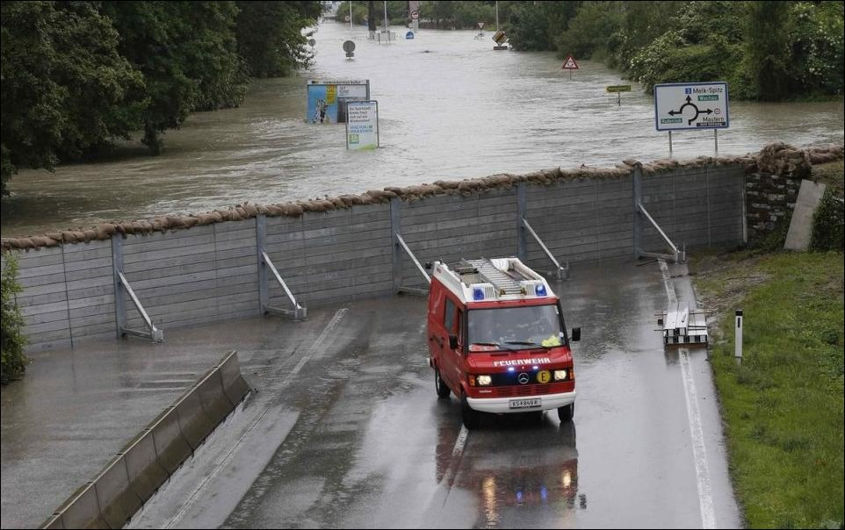
Notes:
Image source top left and right: Pexels
Image source flooding: http://archive.boston.com/bigpicture/2013/06/flooding_in_europe.html

Slide 6
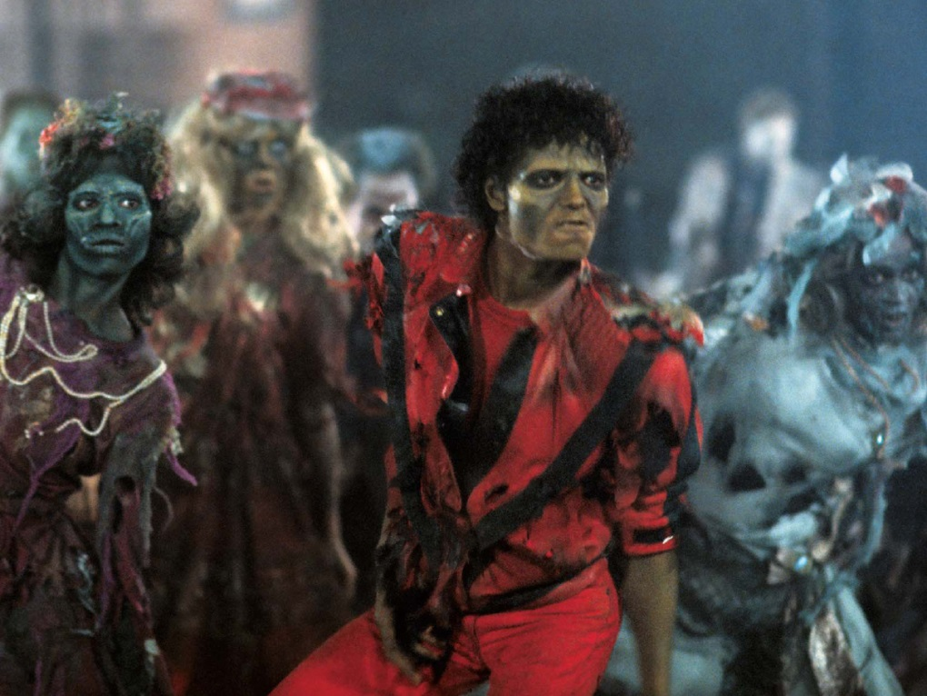
Notes:
Image source top left: https://www.fandango.com/movie-news/robert-pattinson-is-related-to-the-real-life-dracula-637501
Image source top right: https://maditsmadfunny.fandom.com/wiki/Casper_the_Friendly_Ghost
Image source bottom: https://www.newstalk.com/news/is-thriller-the-best-halloween-song-716566

Slide 7
Interdisciplinary work to the rescue!
Iterative combination of Econ, Psych, & Anthro
Econ: quantitative modeling of costs and benefits (normative?)
Psych: general mental processes & tools
Anthro: cultural modes in a particular time, place, and social group
Econ + Psych + Anthro = Marketing!
(Hardisty, Orlove, Krantz, Small, Milch, & Osgood, 2012)

Slide 8
Co-authors
Ben Orlove
Dave Krantz
Art Small
Kerry Milch
Dan Osgood

Slide 9
 | Economics | Psychology | Anthropology
Paradigm | Mathematically evaluate expected outcome streams over time; discounted utility is maximized | Choice between an immediate, small reward versus a larger, delayed reward | Culturally and institutionally defined choices and ways of reasoning
Models | Exponential | Hyperbolic | Cyclical, sacred, routine
Temporal preferences | Known, stable preference exists between any two outcome streams | Preferences are constructed in the situation, and depend on perceptions and self-control | Preferences are culturally determined
Method | Mathematical models with clearly specified assumptions to make predictions | Experimental research | Ethnography, based on interviews and participant observation
Strength | Systematic framework to prescribe choices under given assumptions about utility and growth | Describes the emotional and cognitive factors that shape intertemporal choices | Explores unique cultural and institutional sources of time preference; legitimacy and consent are critical
Blind Spots | Overly reliant on quantitative cost benefit analysis; unrealistic assumptions may lead to poor predictions | Weak prescription for choices | No universally applicable guidelines for prescribing or describing choices

Slide 10
Notes:
Rational reasons to discount the future:
Opportunity cost / opportunities for investment
Growth and inequality aversion
Pure time preference (infinite investment problem)
(NOTE: Uncertainty is NOT part of this)
Discount rates are important. The present discounted value of a given global-warming loss from a century hence at an interest rate of 6 percent is one hundreth of the present discounted value of the same loss at Stern’s annual interest rate of 1.4 percent (Weitzman, 2007)

Slide 11
Notes:
Humans do it, so do rats and pigeons
Think about getting $1000 now vs next year. Now what about 20 years from now vs 21 years from now.
These graphs use an exponential k of .18 per month, hyperbolic k of .6 per month

Slide 12
Notes:
Cyclical time: Think about the value of your time in the winter (teaching classes) vs the summer
Also consider sacred time

Slide 13
 | Economics | Psychology | Anthropology
Paradigm | Mathematically evaluate expected outcome streams over time; discounted utility is maximized | Choice between an immediate, small reward versus a larger, delayed reward | Culturally and institutionally defined choices and ways of reasoning
Models | Exponential | Hyperbolic | Cyclical, sacred, routine
Temporal preferences | Known, stable preference exists between any two outcome streams | Preferences are constructed in the situation, and depend on perceptions and self-control | Preferences are culturally determined
Method | Mathematical models with clearly specified assumptions to make predictions | Experimental research | Ethnography, based on interviews and participant observation
Strength | Systematic framework to prescribe choices under given assumptions about utility and growth | Describes the emotional and cognitive factors that shape intertemporal choices | Explores unique cultural and institutional sources of time preference; legitimacy and consent are critical
Blind Spots | Overly reliant on quantitative cost benefit analysis; unrealistic assumptions may lead to poor predictions | Weak prescription for choices | No universally applicable guidelines for prescribing or describing choices

Slide 14
Case Study: Light bulb purchase
Econ: Efficiency upgrades are quite effective, but people aren't choosing them (Hausman, 1979). Why?
Anthro: When asked, most people don't think about efficiency upgrades (Attari, DeKay, Davidson, & de Bruin, 2010)
Psych: Which tools can nudge consumers to make more energy efficient choices?
Social norms (Schultz, Nolan, Cialdini, Goldstein, & Griskevicius, 2007)
Defaults (Dinner, Johnson, Goldstein, & Liu, 2011)
Energy cost labeling (Camilleri & Larrick, 2014)

Slide 15
Co-authors
Dale Griffin
Yoonji Shim
Daniel Sun

Slide 16
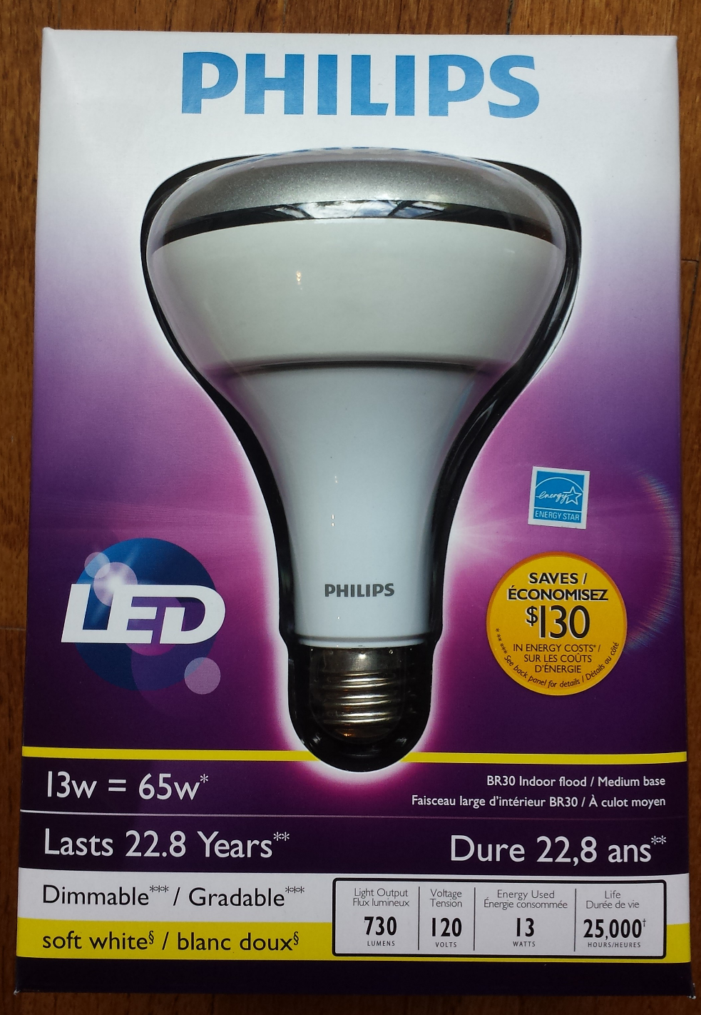
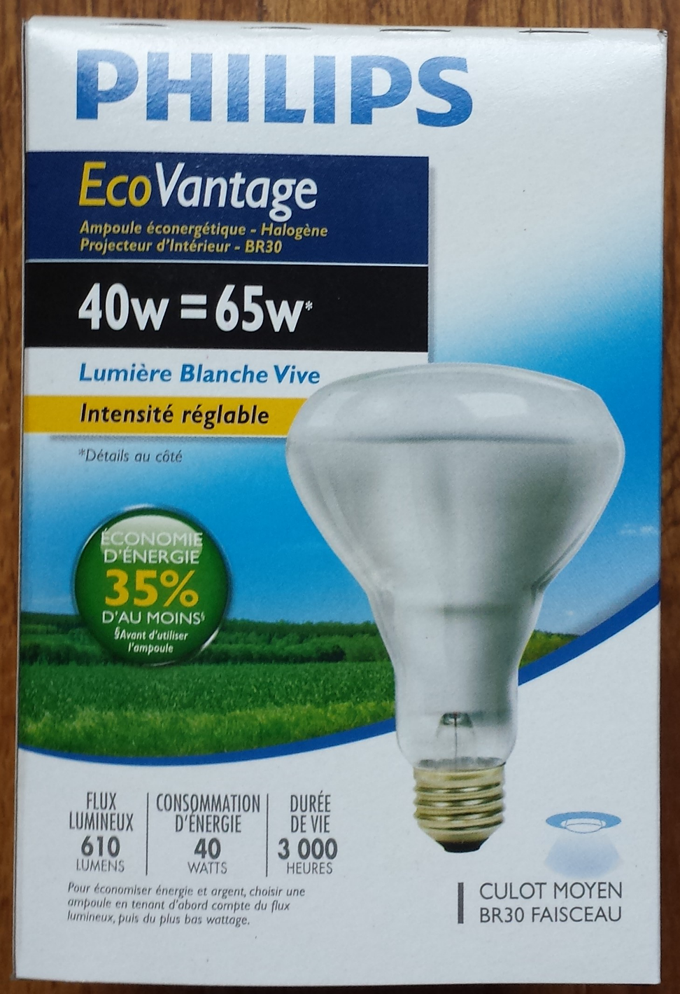
Notes:
Here is the labeling you currently see for energy efficiency
Also, an aside from anthro: Different cultures prefer different light quality (Wilhite et al., 1996)
Image source left: https://www.amazon.ca/Philips-423798-10-5-Watt-13-Watt-Dimmable/dp/B008NNZSI0
Image source right: https://www.closeoutking.ca/product-p/bulb-philips-46677150426.htm

Slide 17
10-year cost labelling
People care about minimizing long term losses (as opposed to gains) (Hardisty & Weber, 2009)
Can be applied to multiple products
Similar idea works for fuel labelling on cars (Camilleri & Larrick, 2014; Ungemach, Camilleri, Johnson, Larrick, & Weber, working paper)

Slide 18
Study 1 methods
Price: $999.95
Estimated Electricity Use (W): 121
Standby energy consumption: 0.2w
Brand: Samsung
Size: 50”
Resolution: 1080p
Price: $749.95
Estimated Electricity Use (W): 181
Standby energy consumption: 0.4w
Brand: Samsung
Size: 50”
Resolution: 1080p
Notes:
Tv - https://www.indiamart.com/proddetail/32-inch-lg-television-18470908188.html

Slide 19
Study 1 methods
Price: $999.95
10-year estimated cost: $600
Estimated Electricity Use (W): 121
Standby energy consumption: 0.2w
Brand: Samsung
Size: 50”
Resolution: 1080p
Price: $749.95
10-year estimated cost: $1,000
Estimated Electricity Use (W): 181
Standby energy consumption: 0.4w
Brand: Samsung
Size: 50”
Resolution: 1080p
Notes:
Tv - https://www.indiamart.com/proddetail/32-inch-lg-television-18470908188.html

Slide 20
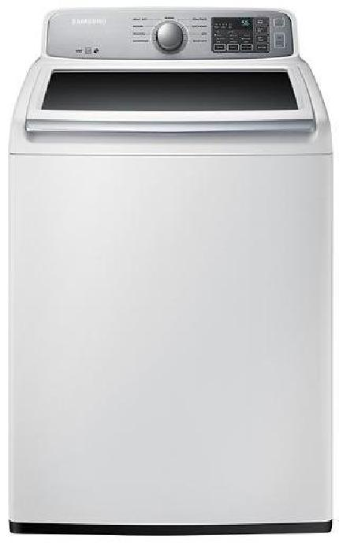
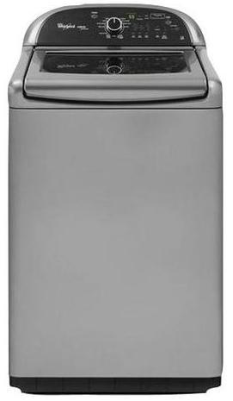
Price: $629.99
Estimated Yearly Electricity Use (kWh): 169
Model: 4.5 Cu. Ft. 9 cycle Top Load Washer
Brand: Samsung
Price: $899.99
Estimated Yearly Electricity Use (kWh): 150
Model: 4.8 Cu. Ft. 13 cycle Top Load Washer
Brand: Whirlpool
Notes:
Image source left: https://image-us.samsung.com/SamsungUS/home/home-appliances/washers/top-load/pd/wa50m7450aw/01_Washer-TopLoader_WA50M7450AW_Front_Closed-White.jpg?$product-details-jpg$
Image source right: https://www.energycenterappliance.com/product/whirlpool-cabrio-platinum-top-load-washer-chrome-shadow-wtw8500bc-23606

Slide 21
Price: $629.99
10-year estimated cost: $180
Estimated Yearly Electricity Use (kWh): 169
Model: 4.5 Cu. Ft. 9 cycle Top Load Washer
Brand: Samsung
Price: $899.99
10-year estimated cost: $100
Estimated Yearly Electricity Use (kWh): 150
Model: 4.8 Cu. Ft. 13 cycle Top Load Washer
Brand: Whirlpool
Notes:
Image source left: https://image-us.samsung.com/SamsungUS/home/home-appliances/washers/top-load/pd/wa50m7450aw/01_Washer-TopLoader_WA50M7450AW_Front_Closed-White.jpg?$product-details-jpg$
Image source right: https://www.energycenterappliance.com/product/whirlpool-cabrio-platinum-top-load-washer-chrome-shadow-wtw8500bc-23606

Slide 22
Study 1a Results: Clean

Slide 23
Study 1a Results: Real

Slide 25
Study 1b Results: BC Hydro

Slide 26
Why is the 10-year cost label effective?
Goal activation
Planning horizon
Information provision
Scaling (10-yr cost is better than 1-yr cost)
Trust/legitimacy
Attribute counting
Other?

Slide 27
Why is the 10-year cost label effective?
Goal activation
Planning horizon
Information provision
Scaling (10-yr cost is better than 1-yr cost)
Trust/legitimacy
Attribute counting
Other?

Slide 28
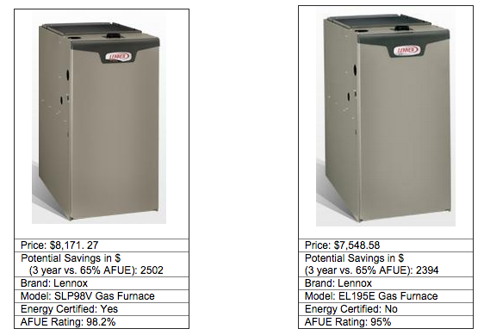
As you consider purchasing a new furnace, what product features are most important to you? Please list the three most important product features.

Slide 29
When purchasing a new furnace, roughly how far ahead do you plan?
Not at all
Up to one week
More than one week up to one month
More than one month up to one year
More than one year up to five years
More than five years up to ten years
Ten years or more

Slide 30
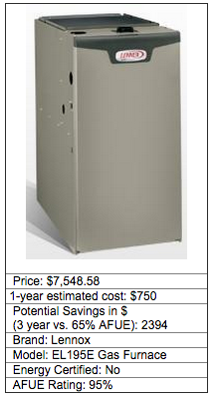
Please imagine that you purchased the furnace above. How much do you estimate your household would spend on energy to use this furnace in your home, over a period of 1 year?
$_______

Slide 35
Modelling
 | Bulb |  | TV |  | Furnace |  | Vacuum
 | p | r² | p | r² | p | r² | p | r²
cost estimate | .43 | .00 | .03 | .02 | .39 | .00 | .87 | .00
planning horizon | .002 | .04 | .22 | .01 | .59 | .00 | .08 | .01
goal prominence | <.001 | .11 | <.001 | .08 | <.001 | .06 | <.001 | .15
condition | .01 | .05 | .25 | .02 | .24 | .02 | .09 | .03

Slide 36
Study 1 Summary
10-yr cost labeling is effective
Why?
activates energy cost reduction goal
For bulbs, also increases planning horizon
Improved cost estimation is NOT an important factor for influencing choices
Large magnitude scaling (10yr vs 5yr vs 1yr) is helpful

Slide 37
Energy study 2:
Psych: people have much lower temporal discount rates for losses than for gains (Hardisty & Weber, 2009)
Anthro: when asked about product goals people mention saving money more often than saving energy
Let's see how much these matter with energy labeling

Slide 38
Notes:
Here is the labeling you currently see for energy efficiency
Also, an aside from anthro: Different cultures prefer different light quality (Wilhite et al., 1996)
Image source left: https://www.amazon.ca/Philips-423798-10-5-Watt-13-Watt-Dimmable/dp/B008NNZSI0
Image source right: https://www.closeoutking.ca/product-p/bulb-philips-46677150426.htm

Slide 39
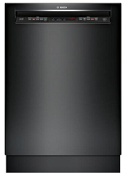
Study 2: Methods
Price: $764.99
Estimated Yearly Dollar [Energy] Savings [Cost]: $27 [259 kWh]
Interior Capacity: Up to 16 place settings
Dishwasher Type: Full-size built-in
Brand: Bosch
Price: $649.99
Estimated Yearly Dollar [Energy] Savings [Cost]: $0 [279 kWh]
Interior Capacity: Up to 14 place settings
Dishwasher Type: Full-size built-in
Brand: LG
Notes:
Image source left: https://pisces.bbystatic.com/image2/BestBuy_US/images/products/5710/5710312_sd.jpg
Image source right: https://www.ajmadison.com/cgi-bin/ajmadison/LDS4821BB.html

Slide 40
Study 2: Results
Notes:
We need a control condition with no energy information

Slide 41
Energy Study 3:
The same attribute (energy efficiency) can be presented in a continuous (kW) or dichotomous (energy star) way.
Which is better? Or should we use both? (Larrick says yes)

Slide 42
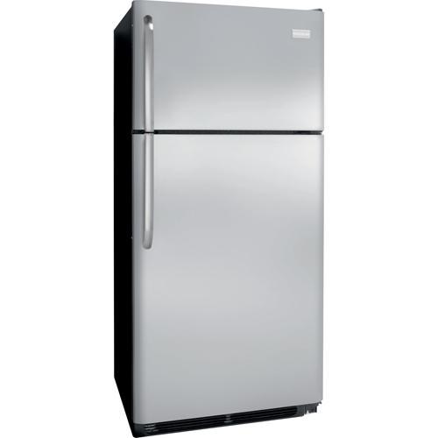
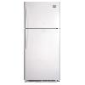
Study 3: Methods
Price: $699.99
[Energy Star Certified: No]
[Energy Usage (kWh/year): 479]
Top mount refrigerator
18.2 Cu. Ft.
Price: $799.97
[Energy Star Certified: Yes]
[Energy Usage (kWh/year): 383]
Top mount refrigerator
18.2 Cu. Ft.
Notes:
Image source left: https://www.frigidaire.com/Owner-Center/Product-Support/FFTR18G2QS
Image source right: https://dufresne.ca/products/whirlpool-18-cu-ft-top-mount-fridge-wrt318fzdm-stainless

Slide 43
Study 3: Results

Slide 44
Going forward
Policy implications:
For energy intensive products, stores should put the 10-year cost on the price tag (similar to unit cost labeling)
This can supplement, rather than replace, existing labelling
Research:
Further explore mediators & moderators
Compare with & against existing methods (social norms, defaults, etc)
Field studies

Slide 45
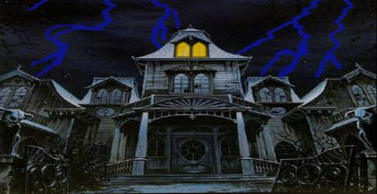
Notes:
Image source: https://marketplace.secondlife.com/p/WZ-Halloween-Haunted-house-with-animated-lightning-and-sound-co/4056287

Slide 46
Thank you!

