Slide 1
Encouraging Energy Efficiency: Product Labels Facilitate Temporal Tradeoffs
David J. Hardisty, University of British Columbia
Yoonji Shim, University of British Columbia
Daniel Sun, University of Calgary
Dale Griffin, University of British Columbia
Behavioural Insights in Canada, Toronto

Slide 2
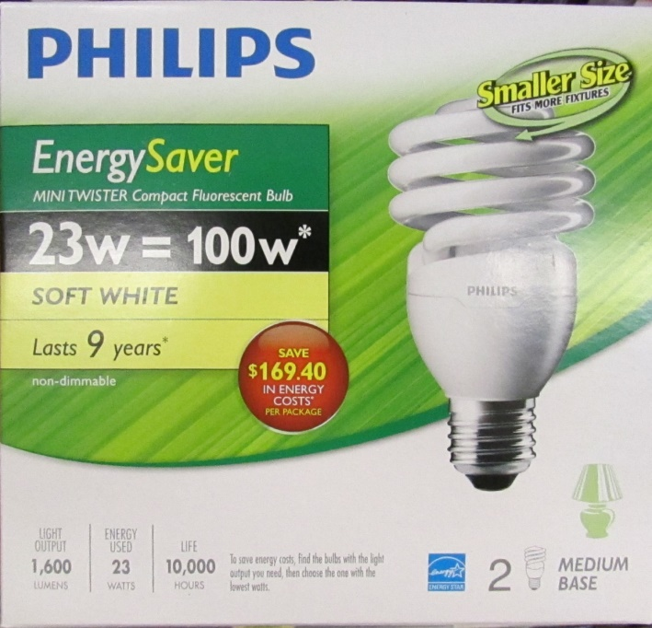
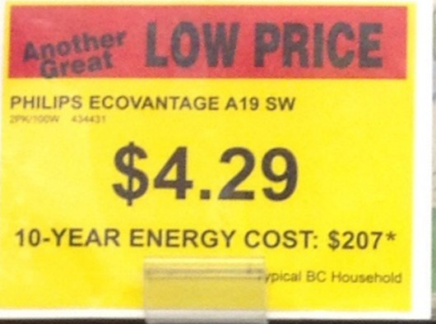
Our Nudge: 10-year energy cost
Consumer don’t know? Or don’t care?
Why does it work? Multiple reasons, but in particular:
Consumers have a latent goal to minimize long term dollar costs
“10-year energy cost” labels activate this goal, leading to more energy efficient choices

Slide 3
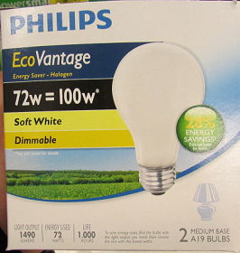
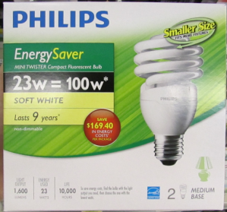
Study 1: MTurk Experiment (N = 1,155)
Price: $4.29
[10-year energy cost:] [$207] [1837 kWh] [28% less]
[10-year energy saved:] [$81] [718 kWh] [28% more]
Lumens: 1490
Watts: 72
Number of bulbs: 2
Price: $12.99
[10-year energy cost:] [$66] [586 kWh] [77% less]
[10-year energy saved:] [$222] [1969 kwh] [77% more]
Lumens: 1600
Watts: 23
Number of bulbs: 2

Slide 4
Study 1: Results

Slide 5
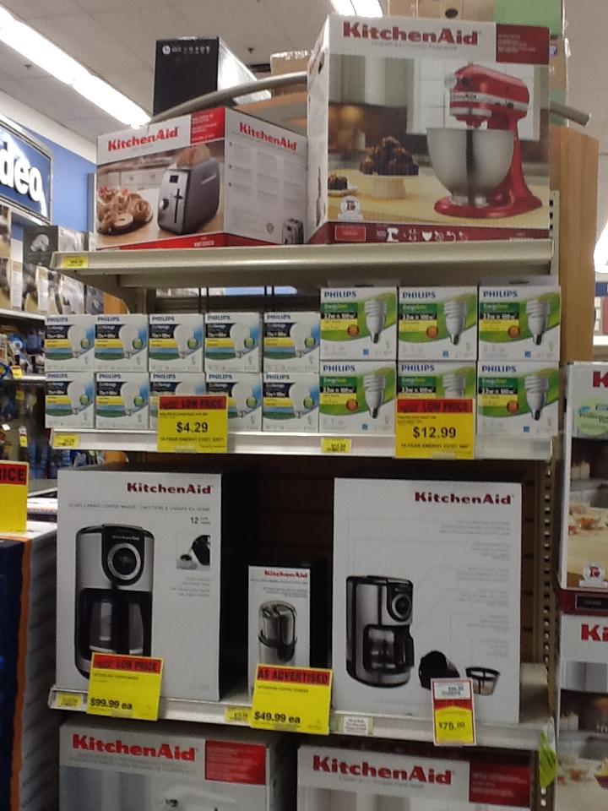
Study 2: Methods
Run in 5 drug stores over 6 weeks
Two types of lightbulbs on store endcaps:
72w Halogen bulb (2-pack) for $4.29
23w CFL bulb (2-pack) for $12.99
Labels switched once per week, counterbalanced across stores
DV: proportion of CFLs purchased
Notes:
55

Slide 6
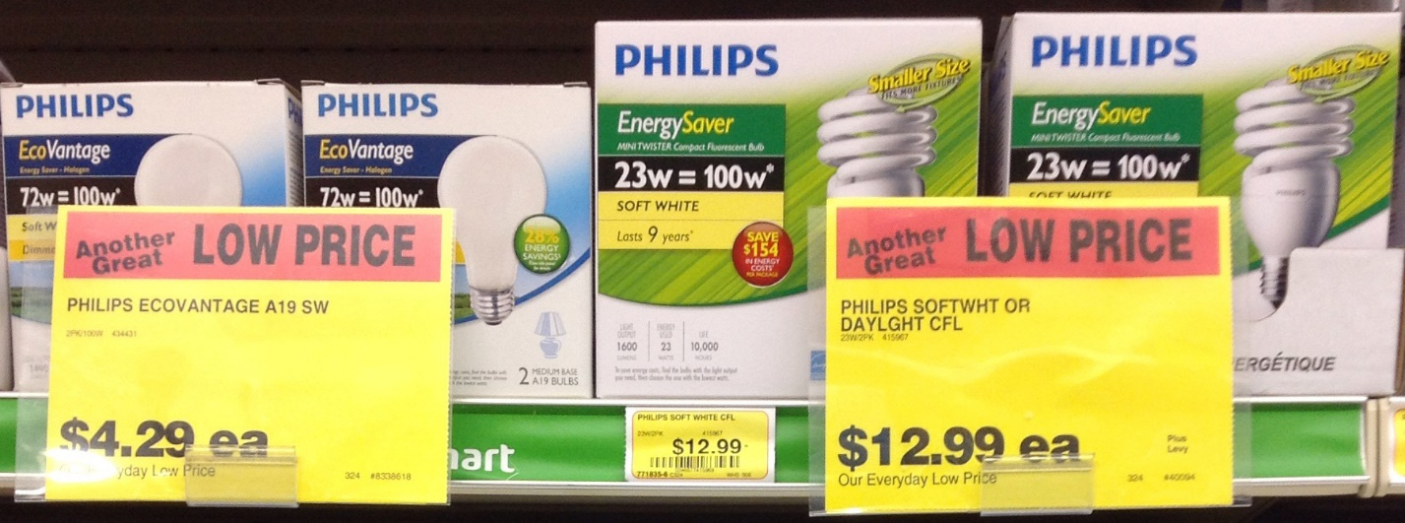
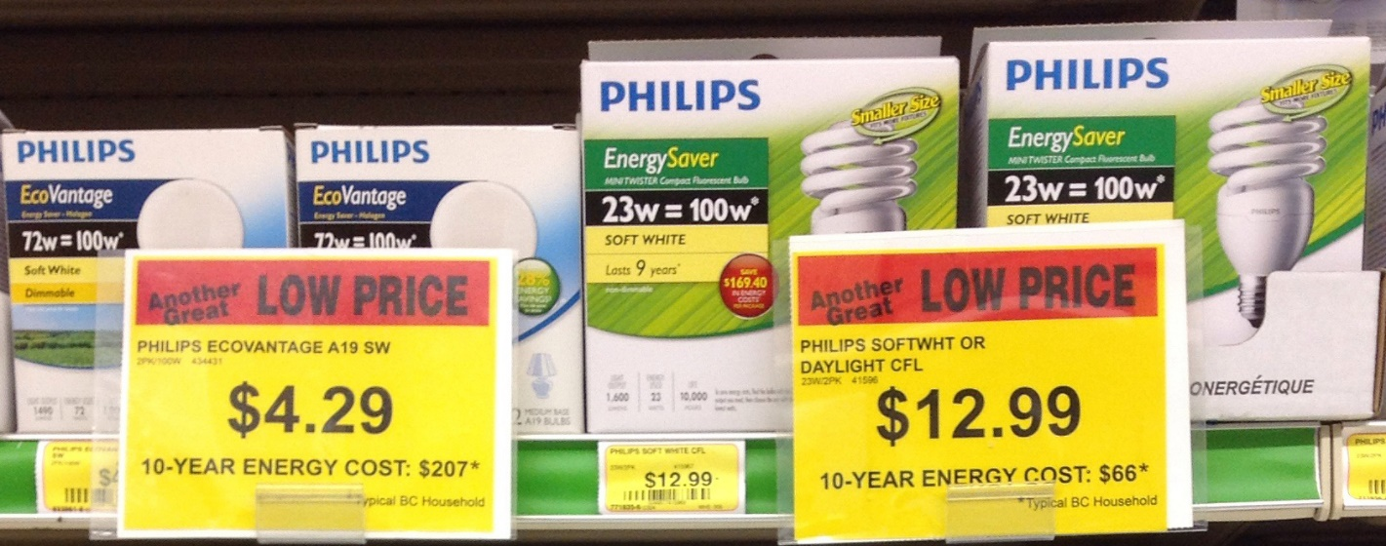
Study 2: Results
12%
chose efficient option
(n = 26)
48%
chose efficient option
(n = 29)

