Slide 1
Green Biases: Consumer Evaluations of Renewable and Non-Renewable Energy Sources
Nathan Dhaliwal, David J. Hardisty, Jiaying Zhao
UBC Sauder
Funding support from NSF and SSHRC
Association for Consumer Research
Dallas, TX
Oct, 2018
Notes:
Images from unsplash.com

Slide 2
Green vs. Brown, The Facts
In the United States, electricity contributes 28% of all greenhouse gas emissions (EPA, 2018 ).
Consumers believe that green products are higher cost and lower in efficacy (Griskevicius, Tybur, & Van den Bergh, 2010; Lin & Chang, 2012; Luchs et al., 2010)
In reality, the physical properties of electricity are exactly the same regardless of production method
Price of renewable energy is currently competitive with non-renewable energy (International Renewable Energy Agency, 2017):
onshore wind costs $0.06 per kWh and solar costs $0.10 per KwH
fossil fuels range from $0.05 to $0.17 per KwH

Slide 3
Research Questions
Do consumers perceive green (renewable) vs brown (non-renewable) energy differently?
How do answers change in single evaluation vs joint evaluation?
In SE, green attribute is harder to evaluate and less salient
In JE, green vs brown is a salient difference, self-perception and signaling become important

Slide 4
Study 1A: Methods
305 UBC students
Read a description of green (renewable) vs brown (non-renewable) energy
Indicated beliefs about green vs brown energy

Slide 5
If your home were powered by green energy (rather than brown), do you think the lights in your home would be brighter or dimmer?
If your home were powered by green energy (rather than brown), do you think the quality of the light produced by your lightbulbs would be more soft or more harsh?
If your home were powered by green energy (rather than brown), do you think your washing machine would work better or worse?
If your home were powered by green energy (rather than brown), do you think the electricity would be more reliable or less reliable?
If your home were powered by green energy (rather than brown), do you think the electricity would be more expensive or less expensive?
Imagine there is an electrical problem in your home, and you get an electric shock. Which do you think would be safer, green energy or brown energy?

Slide 6
Study 1A: Results
 | N | Mean | t | p
Brighter | 305 | 4.07 | 1.02 | .31
Harsher | 305 | 3.52 | -7.62 | < .001*
Work better | 305 | 4.00 | .00 | 1.00
Reliable | 305 | 4.00 | -.04 | .97
Expensive | 305 | 3.85 | 1.43 | .15
Safer | 305 | 4.66 | 9.52 | <.001*
Are UBC students just weird?

Slide 7
Study 1B: Methods
478 MTurkers
Answered same questions

Slide 8
Study 1B: Results
 | N | Mean | t | p
Brighter | 478 | 4.03 | 0.62 | .54
Harsher | 478 | 3.69 | -6.60 | < .001*
Work better | 478 | 4.27 | 4.99 | < .001*
Reliable | 478 | 4.14 | 2.32 | .02*
Expensive | 478 | 3.85 | -1.81 | .07
Safer | 478 | 4.47 | 10.13 | < .001*

Slide 9
Study 1: Summary
Both UBC students and MTurkers showed a pro-green bias in hypothetical scenarios
What about real product evaluations?
What about separate evaluation vs joint evaluation?

Slide 10
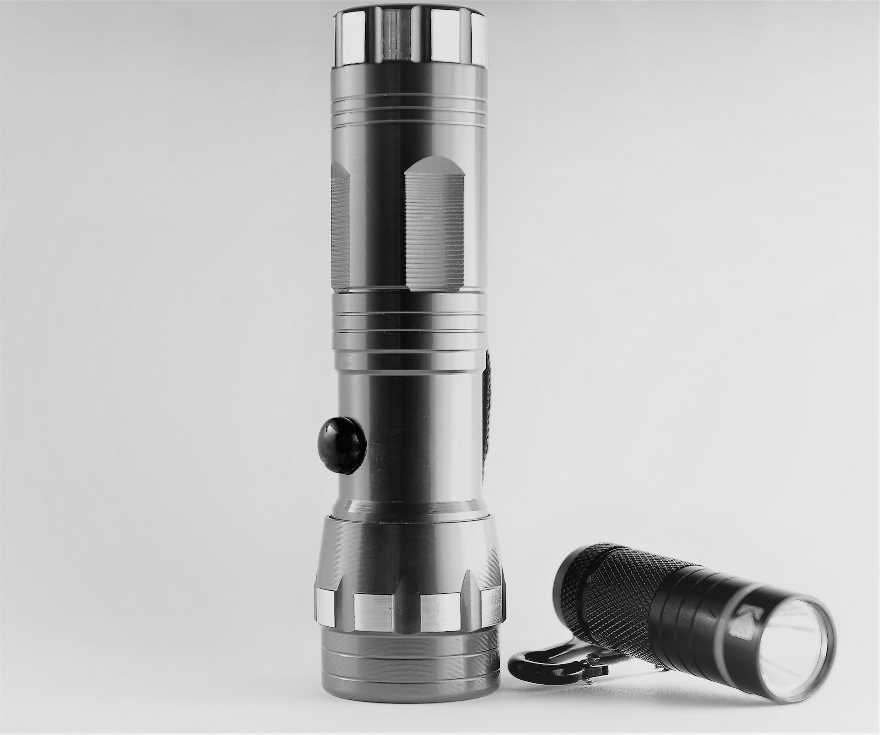
Study 2: Product Experience

Slide 11
Study 2: Methods
164 UBC students
Experimenter tested battery charges before each session
IV: “Renewable” vs “Non-renewable” energy (showed them the batteries)
Order counterbalanced
Test flashlight in light vs dark room
DVs: 1-7 scales of the flashlight, rating how: powerful, safe, efficient, intense, strong, durable, reliable, pleasant, quality, and WTP

Slide 12
Study 2: Between-Subject Results
Nothing

Slide 13
Study 2: Within-Subject Results
 | Brown First | p | Green First | p
Power | Brown: 4.88 Green: 4.99 | .32 | Green: 4.92 Brown: 4.54 | .002*
Safe | Brown: 5.48 Green: 5.40 | .56 | Green: 5.77 Brown: 5.08 | <.001*
Efficient | Brown: 4.68 Green: 4.99 | .11 | Green: 5.46 Brown: 4.35 | <.001*
Intense | Brown: 4.59 Green: 4.74 | .23 | Green: 4.50 Brown: 4.24 | .09
Strong | Brown: 4.64 Green: 4.80 | .29 | Green: 4.61 Brown: 4.22 | .005*
Durable | Brown: 4.89 Green: 4.80 | .62 | Green: 5.12 Brown: 4.51 | <.001*
Reliable | Brown: 5.04 Green: 4.83 | .26 | Green: 5.22 Brown: 4.87 | .02*
Quality | Brown: 5.04 Green: 5.06 | .90 | Green: 4.97 Brown: 4.45 | <.001*
Pleasant | Brown: 4.53 Green: 4.69 | .27 | Green: 5.01 Brown: 4.41 | <.001*
LN WTP | Brown: 10.80 Green: 11.35 | .17 | Green: 10.97 Brown: 7.98 | <.001*

Slide 14
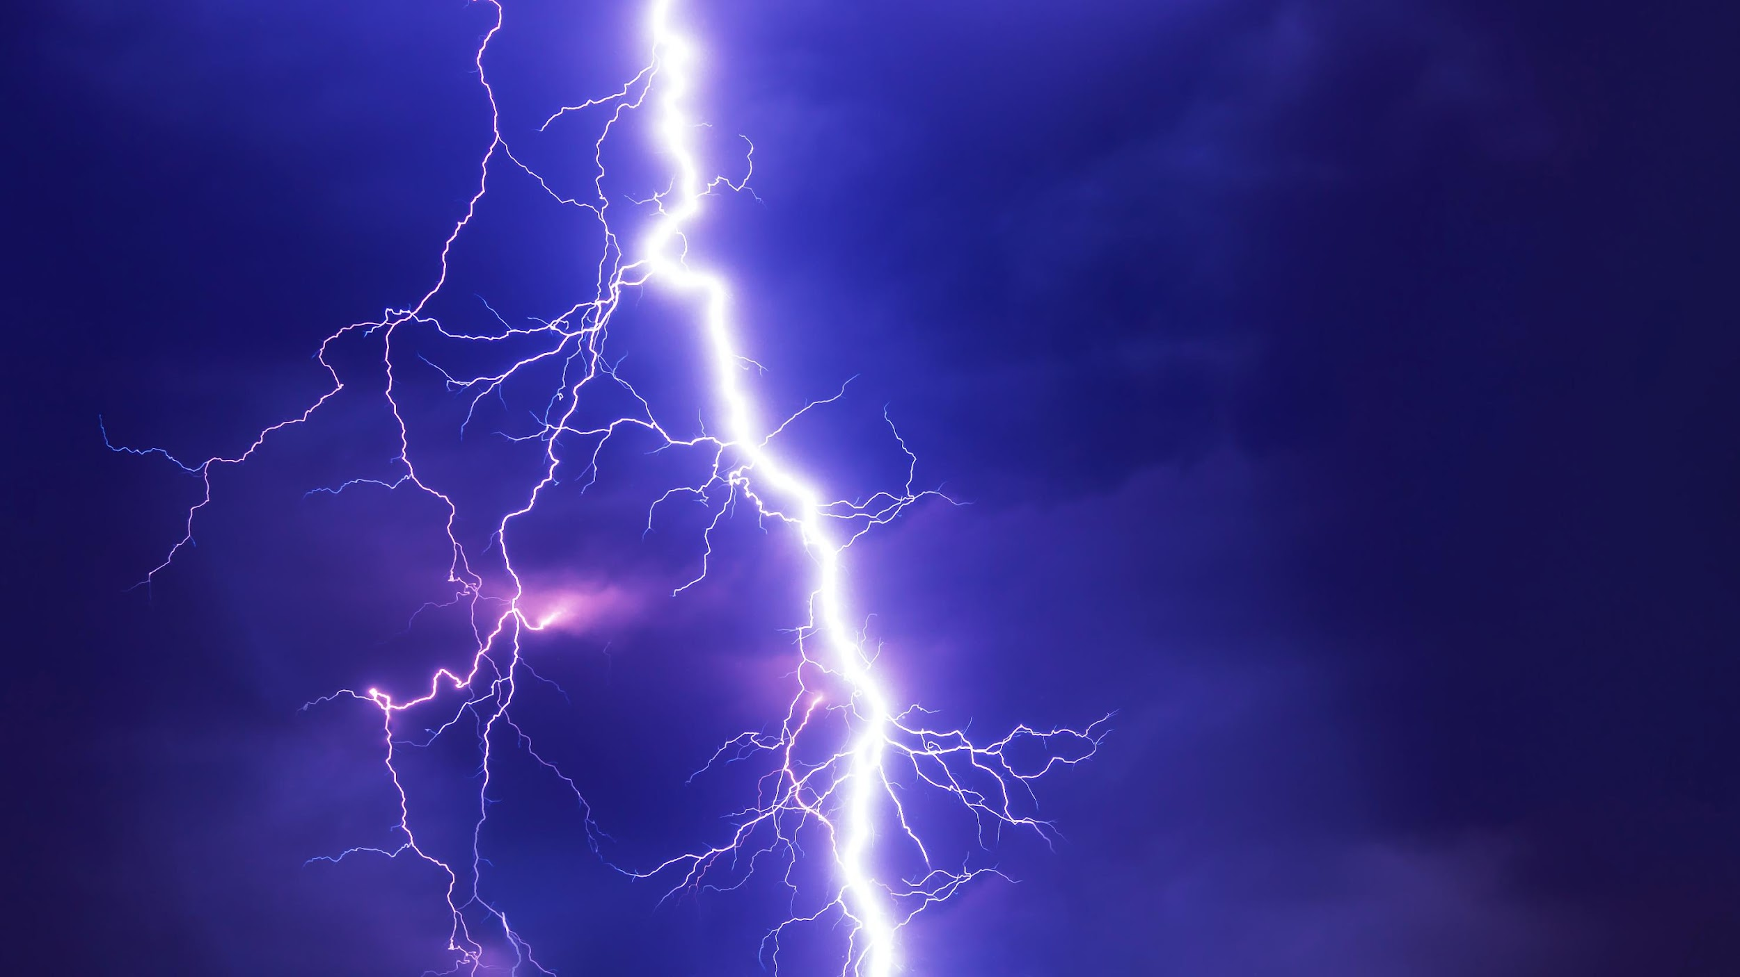
Study 3: Direct Experience of Energy
Notes:
Image from unsplash.com

Slide 15
Study 3: Methods
165 UBC students
IV: Renewable vs Non-renewable energy
IV: Counterbalanced order
Fixed 10 secs of low intensity stimulation
Rated: power, safe, efficient, strong, quality, pleasant, painful, WTP
Free stimulation of up to 60 sec, any intensity (no differences on this measure)

Slide 16
Study 3: Between-Subjects Results
Nothing

Slide 17
Study 3: Within-Subjects Results
Green first
Brown first:
Green | Brown | t | p
Safe: 4.91 | Safe: 4.62 | 1.28 | .21
Efficient: 5.89 | Efficient: 5.09 | 2.31 | .03*
WTP: 7.25 | WTP: 6.38 | 2.51 | .02*
Green | Brown | t | p
Safe: 5.13 | Safe: 4.63 | 2.21 | .03*
Efficient: 5.65 | Efficient: 5.73 | .38 | .71
WTP: 6.14 | WTP: 6.00 | 1.47 | .15

Slide 18
Study 3: Summary
When actually experiencing green vs brown energy:
Between subjects, no differences
Within subjects, green was rated:
Safer
More efficient
Higher WTP

Slide 19
Implications
“Powered by green energy” “Sign up for green energy” Not so effective
“Powered by green energy, unlike our competitors” “Sign up for green energy and stop using brown energy” More effective
More broadly, SE vs JE may differentially tap into conscious vs unconscious attitudes

Slide 20
Thank You!

