Slide 1
"I can't stand waiting!"
Dread looms larger than pleasurable anticipation
David Hardisty¹, Shane Frederick², & Elke Weber¹
¹Columbia University and ²Yale School of Management
SJDM Annual Meeting 2010
NSF SES-0820496
Notes:
Images from unsplash.com

Slide 2
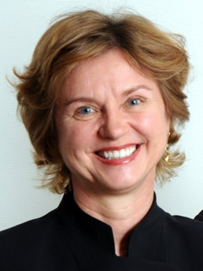
Co-Authors
Shane Frederick
Elke Weber
Super Awesome!
‹#›

Slide 3
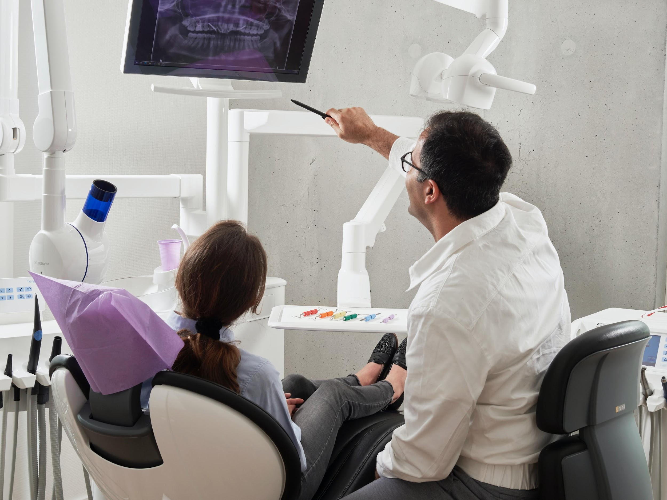
Scheduling a dental procedure
Discounting
Anticipation
Notes:
Image from unsplash.com

Slide 4
Scheduling a vacation
Discounting
Anticipation
Notes:
Image from unsplash.com

Slide 5
Research on anticipation
Loewenstein (1987): - anticipation reduces discounting - especially at short delays - especially for brief, highly “imaginable” events
Harris (2010): - vivid losses (bee sting, embarrassment, rejection) often preferred sooner - dread was stronger at shorter delays
Notes:
You’ll might put your vacation off for a couple weeks, but not for ten years;

Slide 6
Pilot studies: eating worms and kissing movie stars
Dread: 20 out of 56 students preferred eating 9 worms today rather than 8 next week
Savoring: Only 6 out of 103 students would pay more for a kiss next week than one today
Does dread loom larger?
Notes:
Students who liked eating worms were screened out. In this sample, at any rate, we failed to replicate Loewenstein’s finding; meal worms isn’t the best control for kissing movie stars

Slide 7
Explaining the “Sign Effect”
Sign effect: losses are discounted less than gains (Thaler, 1981; Hardisty & Weber, 2009)
Translation: we want gains now more strongly than we want to postpone losses
Why? Dread makes us want to get losses over with immediately

Slide 8
Study 1: Overview
Convenience sample of 120 students and online participants
Participants brainstormed events, and then rated the anticipation values
2x2 between-subjects design: sign X delay

Slide 9
Study 1: Examples of Positive Events
Prefer now:
“going out with friends”
“getting a package in the mail”
“get paid for doing a survey”
Prefer later:
“hawaii vacation”
“Christmas shopping”
“eating a great dessert”

Slide 10
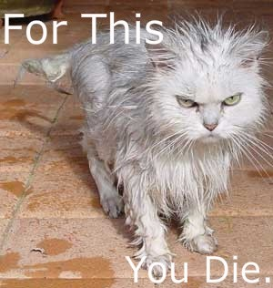
Study 1: Examples of Negative Events
Prefer now:
“going to the dentist”
“paying bills”
“visit the inlaws”
Prefer later:
“Serious Illness”
“paying taxes”
“bathing our cats”

Slide 11
“If this thing were one week away, how would you feel about anticipating it?”
3.00
2.00
1.00
mean anticipation value
sooner
.00
later
-1.00
-2.00
-3.00
negative events
positive events
interaction: F(1,113)=5.6, p=.02
Notes:
Participants are using both sides of the scale for gains

Slide 12
Anticipation: what do we call it?
 | Pleasurable Anticipation | Aversive Anticipation
Positive Event
Negative Event

Slide 13
Anticipation: what do we call it?
 | Pleasurable Anticipation | Aversive Anticipation
Positive Event | Savoring
Negative Event
Notes:
keep it short

Slide 14
Anticipation: what do we call it?
 | Pleasurable Anticipation | Aversive Anticipation
Positive Event | Savoring | Impatience
Negative Event

Slide 15
Anticipation: what do we call it?
 | Pleasurable Anticipation | Aversive Anticipation
Positive Event | Savoring | Impatience
Negative Event |  | Dread

Slide 16
Anticipation: what do we call it?
 | Pleasurable Anticipation | Aversive Anticipation
Positive Event | Savoring | Impatience
Negative Event | ??? | Dread
Notes:
“enjoying the moment”

Slide 17
Study 1: Discussion
Anticipation of negative events: negative
Anticipation of positive events: mixed
But does this predict time preference?
…even when controlling for event magnitude?
How does the pattern change over time?

Slide 18
Study 2: Overview
National sample of 169 participants
20 intertemporal choice scenarios (10 gain, 10 loss)
Measured anticipation utility, experience utility, and time preference
Delay manipulated between subjects: 3 days, 1 week, 1 month, 1 year, or 5 years

Slide 19
Study 2: Events
Some Positive Events:
receiving a $50 check
spending time with your best friend
winning the lottery
Some Negative Events:
paying a $50 fine
a confrontation with your co-worker or family member
having one of your legs amputated

Slide 20
Study 2: Stimulus
Please imagine the following event:
[receiving a $50 check]
Assuming this event would definitely happen to you and you knew it were coming, when would you prefer it to happen? immediately OR don’t care when OR [one month] from now
If this event were to happen to you [one month] from now, how positive or negative would the event be at that time? extremely negative neutral extremely positive |-------------------------------------|-------------------------------------|
If this event were [one month] away, how psychologically pleasurable or unpleasurable would the anticipation be? In other words, how would you feel while waiting for it? strongly dislike the strongly like the feeling of waiting neutral feeling of waiting |-------------------------------------|-------------------------------------|

Slide 21
Results: Time preference
 | Negative Events | Positive Events
Now | 41% | 62%
Indifferent | 22% | 31%
Later | 37% | 7%
Total N=5,420 events (20 events for each of 169 participants)
Notes:
Collapsing across delay

Slide 22
The “sign effect”
 | Negative Events | Positive Events
Now | 41% | 62%
Indifferent | 22% | 31%
Later | 37% | 7%
Total N=5,420 events (20 events for each of 169 participants)

Slide 23
Negative time preference
 | Negative Events | Positive Events
Now | 41% | 62%
Indifferent | 22% | 31%
Later | 37% | 7%
Total N=5,420 events (20 events for each of 169 participants)

Slide 24
Ratings of experience utility and anticipation utility
100
80
60
40
20
negative
utility
0
positive
-20
-40
-60
-80
-100
experience utility
anticipation utility
Notes:
Collapsing across time

Slide 25
Anticipation and experience over time

Slide 26
Anticipation and experience over time

Slide 27
Study 2 Results: associations
For all 20 events, anticipation and experience utility were modestly correlated, average r = .36
For all 20 events, anticipation utility negatively predicted “now” preference, average standardized slope = -.30
Notes:
even while controlling for experience utility

Slide 28
Anticipation predicts time preference

Slide 29
Differences between items
Significant heterogeneity
Example: leg amputation -most dreaded -yet most postponed

Slide 30
Summary
Dread is more common than savoring - anticipation of losses is negative -anticipation of gains can be positive or negative
Anticipation value predicts time preference
Together, this may explain the “sign effect”

Slide 31
Future Directions
Explaining between-item differences
Effect of uncertainty on anticipation
Gain/loss tradeoffs

Slide 32
Special Thanks To…
The National Science Foundation (SES-0820496, SES-0345840, and Graduate Research Fellowship)
The Center for Research on Environmental Decisions (CRED)
The Center for Decision Sciences (CDS)

Slide 33
Thank You!

Slide 34
References
Hardisty, D. J. & Weber, E. U. (2009). Discounting future green: Money vs the environment. Journal of Experimental Psychology: General, 138(3), 329-340.
Harris, C. R. (2010). Feelings of dread and intertemporal choice. Journal of Behavioral Decision Making, n/a. doi: 10.1002/bdm.709
Loewenstein, G. (1987). Anticipation and the valuation of delayed consumption. The Economic Journal, 97, 666-684.
McGraw, A. P., Larsen, J. T., Kahneman, D. & Schkade, D. A. (2010). Comparing gains and losses. Psychological Science.
Thaler, R. H. (1981). Some empirical evidence on dynamic inconsistency. Economics Letters, 8, 201-207.

Slide 35
Extra Slides

Slide 36
Study 2: Events
Positive Events:
receiving a $50 check
receiving a good grade or performance review
spending time with your best friend
improved energy and health for 10 days
a free 5-day vacation to the destination of your choice
watching your favorite TV show or reading a good book for an hour
getting a gift in the mail from a family member
eating a nice meal out at a restaurant
winning the lottery
a kiss from the movie star of your choice
Negative Events:
paying a $50 fine
receiving a bad grade or performance review
a confrontation with your co-worker or family member
being sick for 10 days
doing difficult home cleaning and renovation for 5 days
filling out paperwork and waiting around for an hour at the local Department of Motor Vehicles (DMV)
giving a stressful 60 minute improvised speech
a painful dental procedure
having one of your legs amputated
getting twenty painful (but harmless) electric shocks in a research experiment

Slide 37
Typical Event Pair
Event | Anticipation | Experience | Choice (1=prefer now) | Regression Beta
receiving a good grade or performance review | 21 | 68 | .68 | -.22**
receiving a bad grade or performance review | -55 | -65 | .15 | -.38**

Slide 38
Differences between items
“Doing difficult home cleaning and renovation for 5 days” anticipation: -19 percent choosing now: 38% beta: -.36**
“Having one of your legs amputated” anticipation: -63 percent choosing now: 19% beta: -.24**

Slide 39
event | a | e | Corr(a,e) | c | beta (a) | beta (e)
a free 5-day vacation to the destination of your choice | 28 | 75 | .27** | .19 | -.40** | .00
eating a nice meal out at a restaurant | 28 | 59 | .42** | .29 | -.31** | .15
a kiss from the movie star of your choice | 22 | 46 | .38** | .32 | -.17* | .34**
receiving a good grade or performance review | 21 | 68 | .33** | .68 | -.22** | -.01
getting a gift in the mail from a family member | 21 | 64 | .43** | .49 | -.35** | .15
spending time with your best friend | 21 | 67 | .24** | .44 | -.21** | .14
watching your favorite TV show or reading a good book for an hour | 13 | 52 | .39** | .57 | -.27** | .18*
receiving a $50 check | 13 | 66 | .25** | .78 | -.17* | .04
improved energy and health for 10 days | 9 | 67 | .24** | .69 | -.31** | .12
winning the lottery | 6 | 83 | .20* | .79 | -.31** | .15*
doing difficult home cleaning and renovation for 5 days | -19 | -13 | .51** | .02 | -.36** | .32**
filling out paperwork and waiting around for an hour at the local Department of Motor Vehicles (DMV) | -26 | -35 | .43** | .11 | -.30** | .26**
paying a $50 fine | -27 | -39 | .39** | .02 | -.28** | .16
giving a stressful 60 minute improvised speech | -45 | -37 | .45** | -.10 | -.20* | .26**
being sick for 10 days | -47 | -65 | .28** | -.15 | -.32** | .22**
a painful dental procedure | -53 | -63 | .37** | .18 | -.44** | .39**
receiving a bad grade or performance review | -55 | -65 | .43** | .15 | -.38** | .31**
a confrontation with your co-worker or family member | -57 | -60 | .55** | .18 | -.35** | .32**
getting twenty painful (but harmless) electric shocks in a research experiment | -58 | -66 | .41** | .13 | -.36** | .33**
having one of your legs amputated | -63 | -86 | .31** | -.56 | -.24** | .33**

Slide 40
Study 1: Proportion of events classified by participants as provoking dread, pleasurable anticipation, or neither, depending on what type of events participants had generated (positive events vs negative events that they would prefer to happen immediately vs later). Total N = 433 events.
 | Positive Event |  | Negative Event
Classification | Prefer Now | Prefer Later | Prefer Now | Prefer Later | Average
Negative Anticipation | 74% | 22% | 75% | 63% | 58%
Neutral Anticipation | 15% | 14% | 13% | 18% | 15%
Positive Anticipation | 11% | 64% | 12% | 19% | 27%
Total | 100% | 100% | 100% | 100% | 100%

Slide 41
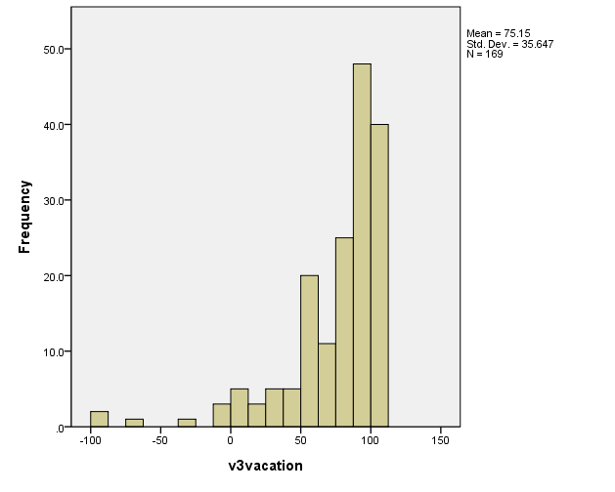
Histogram of Vacation Experience Utility

Slide 42
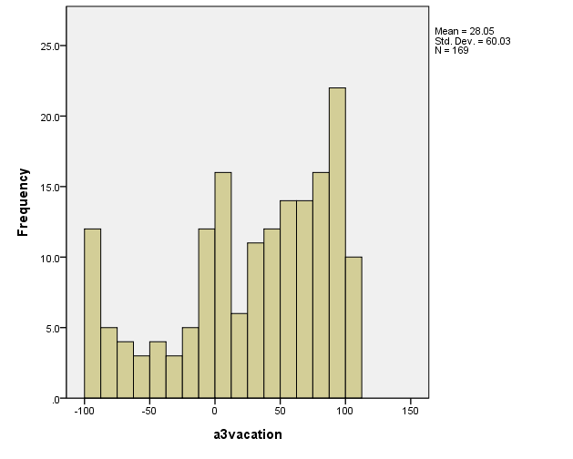
Histogram of Vacation Anticipation Utility

Slide 43
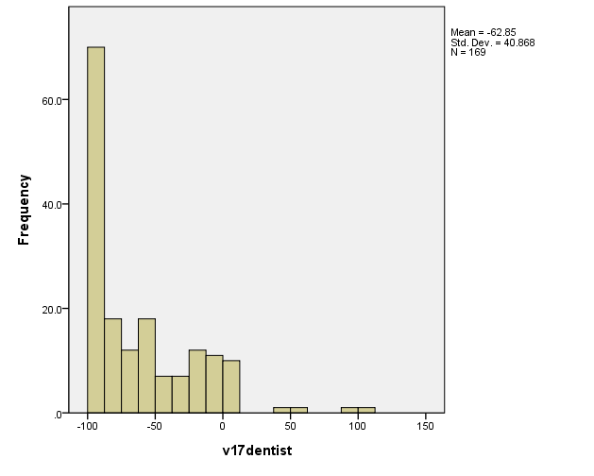
Histogram of Dentist Experience Utility

Slide 44
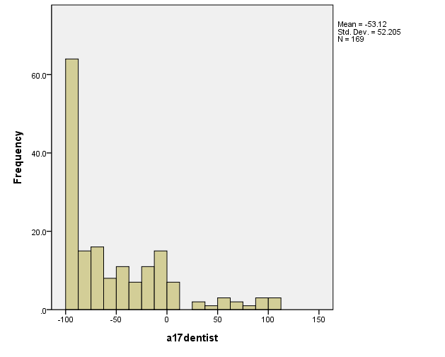
Histogram of Dentist Anticipation Utility

