Slide 1
Predicting consumer use (and mis-use) of payday loans
Conference on Emotions and Well-being
December 18th, 2014
Notes:
Images from unsplash.com

Slide 2
Acknowledgements
Co-authors: Abigail Sussman, Melissa Knoll, Franklin Shaddy, Chuck Howard
RAs: Sammie Chan, Mary Ho
Funding: SSHRC Insight Development Grant

Slide 3
Compelling Anecdote¹
Sandra Harris
Student in Head Start, later served on the board
Employee of the Year at UNC-Wilmington
Radio personality on WMNX
Husband lost his job
Could not afford the car insurance bill
¹ This story was featured in a report from the Center for Responsible Lending

Slide 4
The solution?
Cash from a payday loan for $250
She paid her insurance bill
Two weeks later, she was ready to repay the loan, plus the $50 fee
“You know, you can renew,” the payday clerk told her, and the thought of her unpaid electricity bill flashed into her head. Sandra thought, “You’re right. I do need it.”

Slide 5
The problem
Next month was no easier
She kept rolling over the loans and even the fees
Eventually, the lender required full repayment
She went to another payday lender and took out a loan to pay back the first lender
Within six months, she was paying rollover fees on six different loans
“Basically, we ended up having to use one loan to pay off another loan, and ended up paying $495 to $600 per month in fees, never paying the loans down”

Slide 6
What factors predict payday loan rollover use?

Slide 7
Hypotheses
H1: Consumers generally under-predict future expenses.
H2: This is driven by under-predicting the occurrence of future expenses, rather than the amount of each expense.
H3: This expense prediction bias may lead to problematic use of payday loans (and other high-interest loans).

Slide 8
Outline
Payday loan primer
Payday loan lit
Expense prediction lit
Study 1: Exploring payday loans (qualitative)
Study 2: Prediction bias study
Study 3: PD loan prediction study
Study 4: Prediction bias refinement study
Summary
Discussion questions

Slide 9
What is a payday loan?
A payday loan—which might also be called a "cash advance" or "check loan"—is a short-term loan, generally for $500 or less, that is typically due on your next payday.
~20% “fee”, due one repayment of the loan
Most people paid bi-weekly
Annualized interest rate: over 500%
There are more payday loan shops (23K) in the U.S. than McDonald’s (12k) and Starbucks (9k) combined.
$3.5 billion in fees every year in the U.S.
Three-quarters of all payday loan volume comes from rollovers

Slide 10
Other high interest loans
Pawn shop loans
Late fees & reconnect fees
Overdraft charges
Loan sharks

Slide 11
Why use a payday loan?
Fast, convenient cash
No access to other credit (e.g., credit cards)
Cheaper than some alternatives (lost job, bounced check, cancelled utilities, loan sharks)

Slide 12
How do payday loans affect consumer welfare?
Some studies find harmful effects from payday lending (Campbell, Martínez-Jerez, & Tufano, 2012; Carrell & Zinman, 2008; Carrell & Zinman, 2014; Melzer & Morgan, 2009; Melzer, 2011; Morgan, Strain, & Seblani, 2012; Skiba & Tobacman, 2009; Weaver & Galperin, 2014)
Others find beneficial effects (Karlan & Zinman, 2010; Lawrence & Elliehausen, 2008; Morgan, 2007; Morgan & Strain, 2007; Morse, 2011; Zinman 2010)
Perhaps single use is beneficial, but rollover use is harmful?
So, why might rollovers happen?

Slide 13
Expense prediction bias
The “Budget Fallacy”: people (mainly students) under-predict future expenses (Peetz and Buehler 2009; 2013)
Especially strong for those with a savings goal
Eliminated when focusing on competing goals
Eliminated when considering an event (rather than a time period)
Perhaps this bias leads to payday loan rollovers

Slide 14
Study 1: Qualitative Data on PD Loan Reasons

Slide 15
“What circumstances led you to take out the payday loan?”
“My car broke down and I needed finances to fix it.”
“I needed to pay for health insurance before the deadline.”
“Needed to pay rent.”
“Well, it's not the best reason at all but I wanted money to go to the casino.”

Slide 17
How did you avoid a PD loan?
I managed to borrow the money from a friend.
I got a loan from my brother
I waited to buy groceries and spent that alotted money on bills
I just ate ramen and didn't really do anything else.

Slide 20
Study 2: Future Expense Estimation

Slide 21
Study 2: Hypotheses & Methods
Under prediction of future (relative to past) expenses
Particularly among PD loan users
Two part study, 1 week apart
MTurk (N=194 part 1; N=140 part 2)

Slide 22
Recall and prediction of expenses
Approximately how much did you spend on optional expenses in the past week? $___ dollars
Approximately how much did you spend on required expenses in the past week? $___ dollars
Approximately how much do you anticipate spending on optional expenses in the next week? $___ dollars
Approximately how much do you anticipate spending on required expenses in the next week? $___ dollars

Slide 23
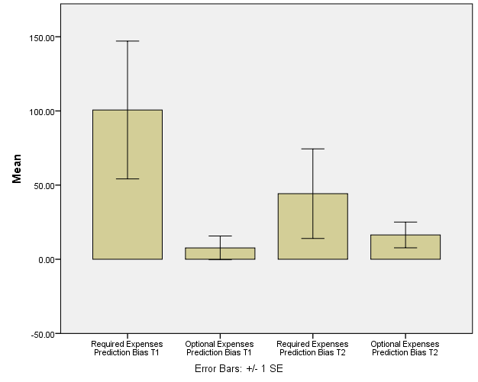
Expense Prediction Bias

Slide 24
Other results
Only 10% of sample used PD loans, but trend for greater bias among PD loan users
No “income prediction bias”

Slide 25
Study 2 Summary
Consumers under-predict future expenses
Particularly “required” expenses

Slide 26
Study 3: “Predicting” payday loan use and misuse

Slide 27
Study 3: Hypotheses
Expense prediction bias -> problematic payday loan use
Particularly true forunexpected expenses
How to define problematic use?
Rollover use
Wouldn’t use again
Wouldn’t recommend to a friend

Slide 28
Study 3: Methods
MTurk (N = 200). 100 PD loan users, 100 non-users
Screener questions: gender, age, PD loan
Recall and predict expenses (and income)
Detailed questions about PD loans and other debt
Also measured other individual differences:
Propensity to plan - Money - Short Run (Lynch et al 2010)
Discounting (Kirby 1997 subset)
Risk pref for gains & losses
Numeracy
Demographics, including “available resources”

Slide 29
Available resources Q
Imagine that you have to pay an unexpected bill immediately. For example, suppose that you use your vehicle for work, and you need to make an expensive repair that is not covered by insurance. Considering all possible resources available to you (including savings, borrowing, etc.), what is the maximum dollar amount that you could come up with on short notice?
$___

Slide 30
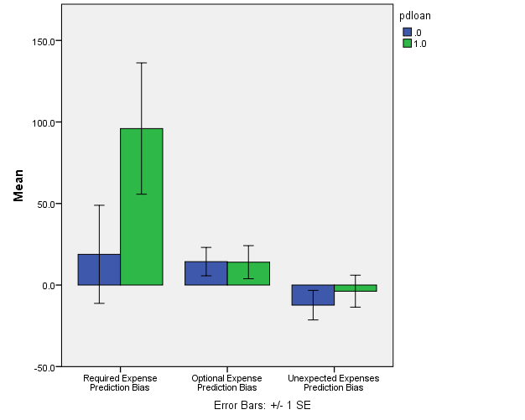
Prediction bias results: PD use

Slide 31
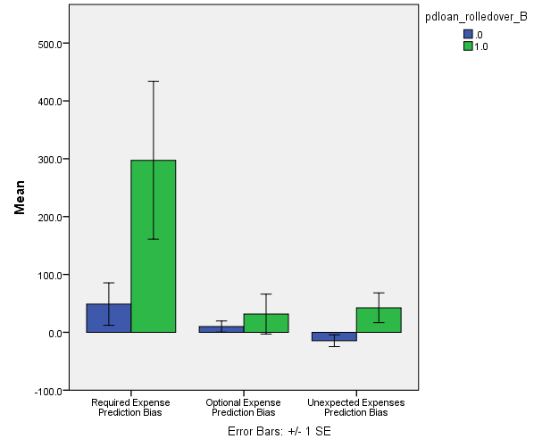
Prediction bias results: rollover use

Slide 32
Predicting payday loan use & problematic use
 | Payday loan use (N=200) | Payday loan rollover (N=100)
Required Expenses Prediction Bias | .11 | .24*
Optional Expenses Prediction Bias | .00 | .08
Unexpected Expenses Prediction Bias | .05 | .23*
Financial Resources Available for an Emergency | -.31** | -.15
Household Income | -.1 | .17†
Education | -.24** | -.09
Propensity to Plan (short term) | .15* | -.26**
Consideration of Future Consequences | -.10 | -.21*
Discounting of Gains | .21** | -.05
Risk Seeking for Gains | .05 | .08
Risk Seeking for Losses | .03 | -.15
Numeracy | -.13† | .03

Slide 33
Alternative metrics of PD loan misuse
 | Use payday loan again (N=100) | Recommend payday loan to friend (N=100)
Required Expenses Prediction Bias | .07 | -.07
Optional Expenses Prediction Bias | -.01 | -.05
Unexpected Expenses Prediction Bias | -.06 | -.12
Financial Resources Available for an Emergency | -.21* | -.04
Household Income | .00 | .11
Education | -.15 | -.10
Propensity to Plan (short term) | .02 | .06
Consideration of Future Consequences | -.05 | -.07
Discounting of Gains | -.05 | .02
Risk Seeking for Gains | -.02 | -.03
Risk Seeking for Losses | -.04 | .00
Numeracy | -.02 | -.14

Slide 34
Other results
Required expenses prediction bias is correlated with:
pawnshop loan use, .15*
number of pawnshop loans, .15*
car loan debt, .16*
Not much there on income

Slide 35
Study 3 Summary
Consumers under-predict future required expenses, replicating Study 2.
This bias is especially pronounced among payday loan rollover users.

Slide 36
Study 4: Refining measurement of prediction bias

Slide 37
Study 4: Hypotheses & methods
Simple vs categorical expense estimates
Simple version:
Expenses last week and next week
Category version (2x2):
Required vs Optional X Expected vs Unexpected
Lots of definitions
Hypothesis: unexpected required expense bias best predicts PD loan rollovers (false!)
MTurk (N=405; n=200 PD, n=200 non-PD)
Unique expense listing

Slide 38
Unique expense listing measure
What did you spend money on last week that you won’t next week?
What will you spend money on next week that you didn’t last week?
Measures:
average number of expenses
average value of expenses
Predictions:
Great number of unique expenses in future (than past)
Equal value of future vs past expenses

Slide 39
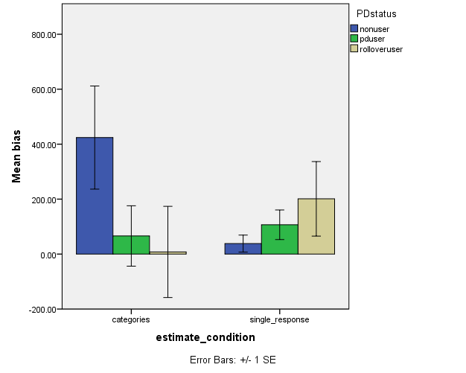
Study 4: Expense Prediction Bias

Slide 40
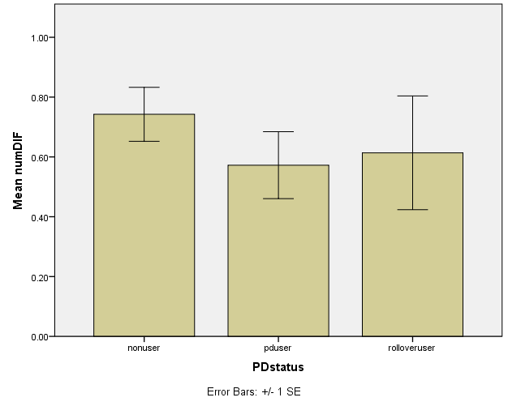
Study 4: Predicting the Number of Unique Expenses

Slide 41
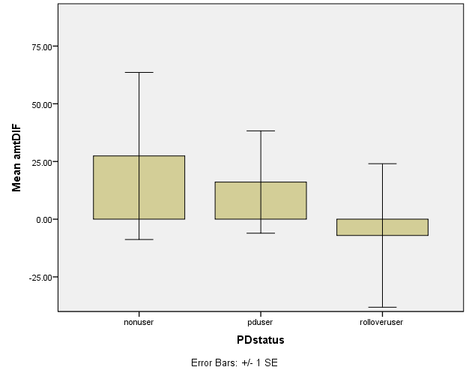
Study 4: Predicting the Value of Unique Expenses

Slide 42
Study 4: Predicting payday loan use & problematic use
Predictor | Payday loan status (1-3), N=405 | Payday loan user, N=405 | Rollover user, n=203
Simple expense bias | .12† | .11 | .08
Categorical expense bias | -.12† | -.13† | -.03
Propensity to Plan | .08 | .11* | -.07
Consideration of future consequences | -.11* | -.09 | -.08
Available financial resources | -.27** | -.27** | -.09
Income | -.04 | -.05 | .00
Education | -.16** | -.16** | -.06

Slide 43
What’s going on? Study 3 & 4, differences
Study 3 run in several batches, during the evening east-coast time (late afternoon pacific)
Study 4 run in one quick batch, during the morning and mid-day east coast time
Possible participant misrepresentation of PD-loan status? (Forums, etc.)
PD loan condition filled up before control condition!

Slide 44
Summary
Consumers under-predict future expenses
Driven by required expenses, more than optional expenses
A difference in the number of future expenses rather than the amount of future expenses
Unique to expenses – there is no bias for income
This bias may be especially pronounced among problematic payday loan users
Better with a simple question than a detailed breakdown

Slide 45
Discussion Questions
What sample sources do you recommend (other than MTurk), for studying PD loans?
How can we “de-bias” consumers in their expense predictions?
How do we define a “good” or “bad” use of payday loan? And how do we define a “good” or “better” decision?
What are your standards for study reporting?
What do you do with failed studies, conditions, or replications?
How do you set targets for data collection?
What do you require as a reviewer?
Best way to improve this social dilemma?

Slide 46
Thank you!

Slide 47
Fun PD Loan Video
John Oliver:
https://www.youtube.com/watch?v=PDylgzybWAw

