Slide 1
The bright side of dread: Anticipation asymmetries explain why losses are discounted less than gains
David Hardisty
UBC Sauder
SCP Annual Meeting 2016
Notes:
Images from unsplash.com

Slide 2
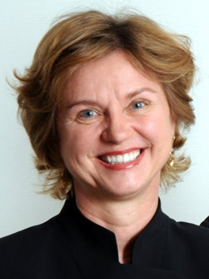
Co-Authors
Shane Frederick
Elke Weber
‹#›

Slide 3
The “sign” effect
Receive $70 now or $70 in a month? 100% choose now
Pay $70 now or $70 in a month? 47% choose later
Why?

Slide 4
Not loss aversion...
Receive $140 now or $140 in a month? 100% choose now
Pay $70 now or $70 in a month? 47% choose later
Why?
Anticipation asymmetries

Slide 5
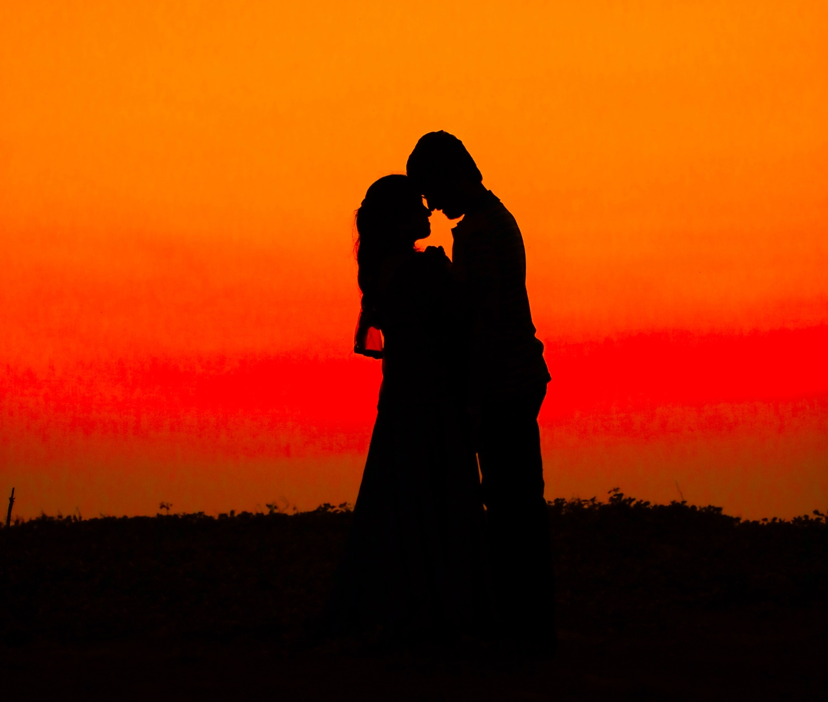
Kiss from a movie star: now or next week? (Loewenstein, 1987)
Discounting
Anticipation
Notes:
Image from unsplash.com

Slide 6
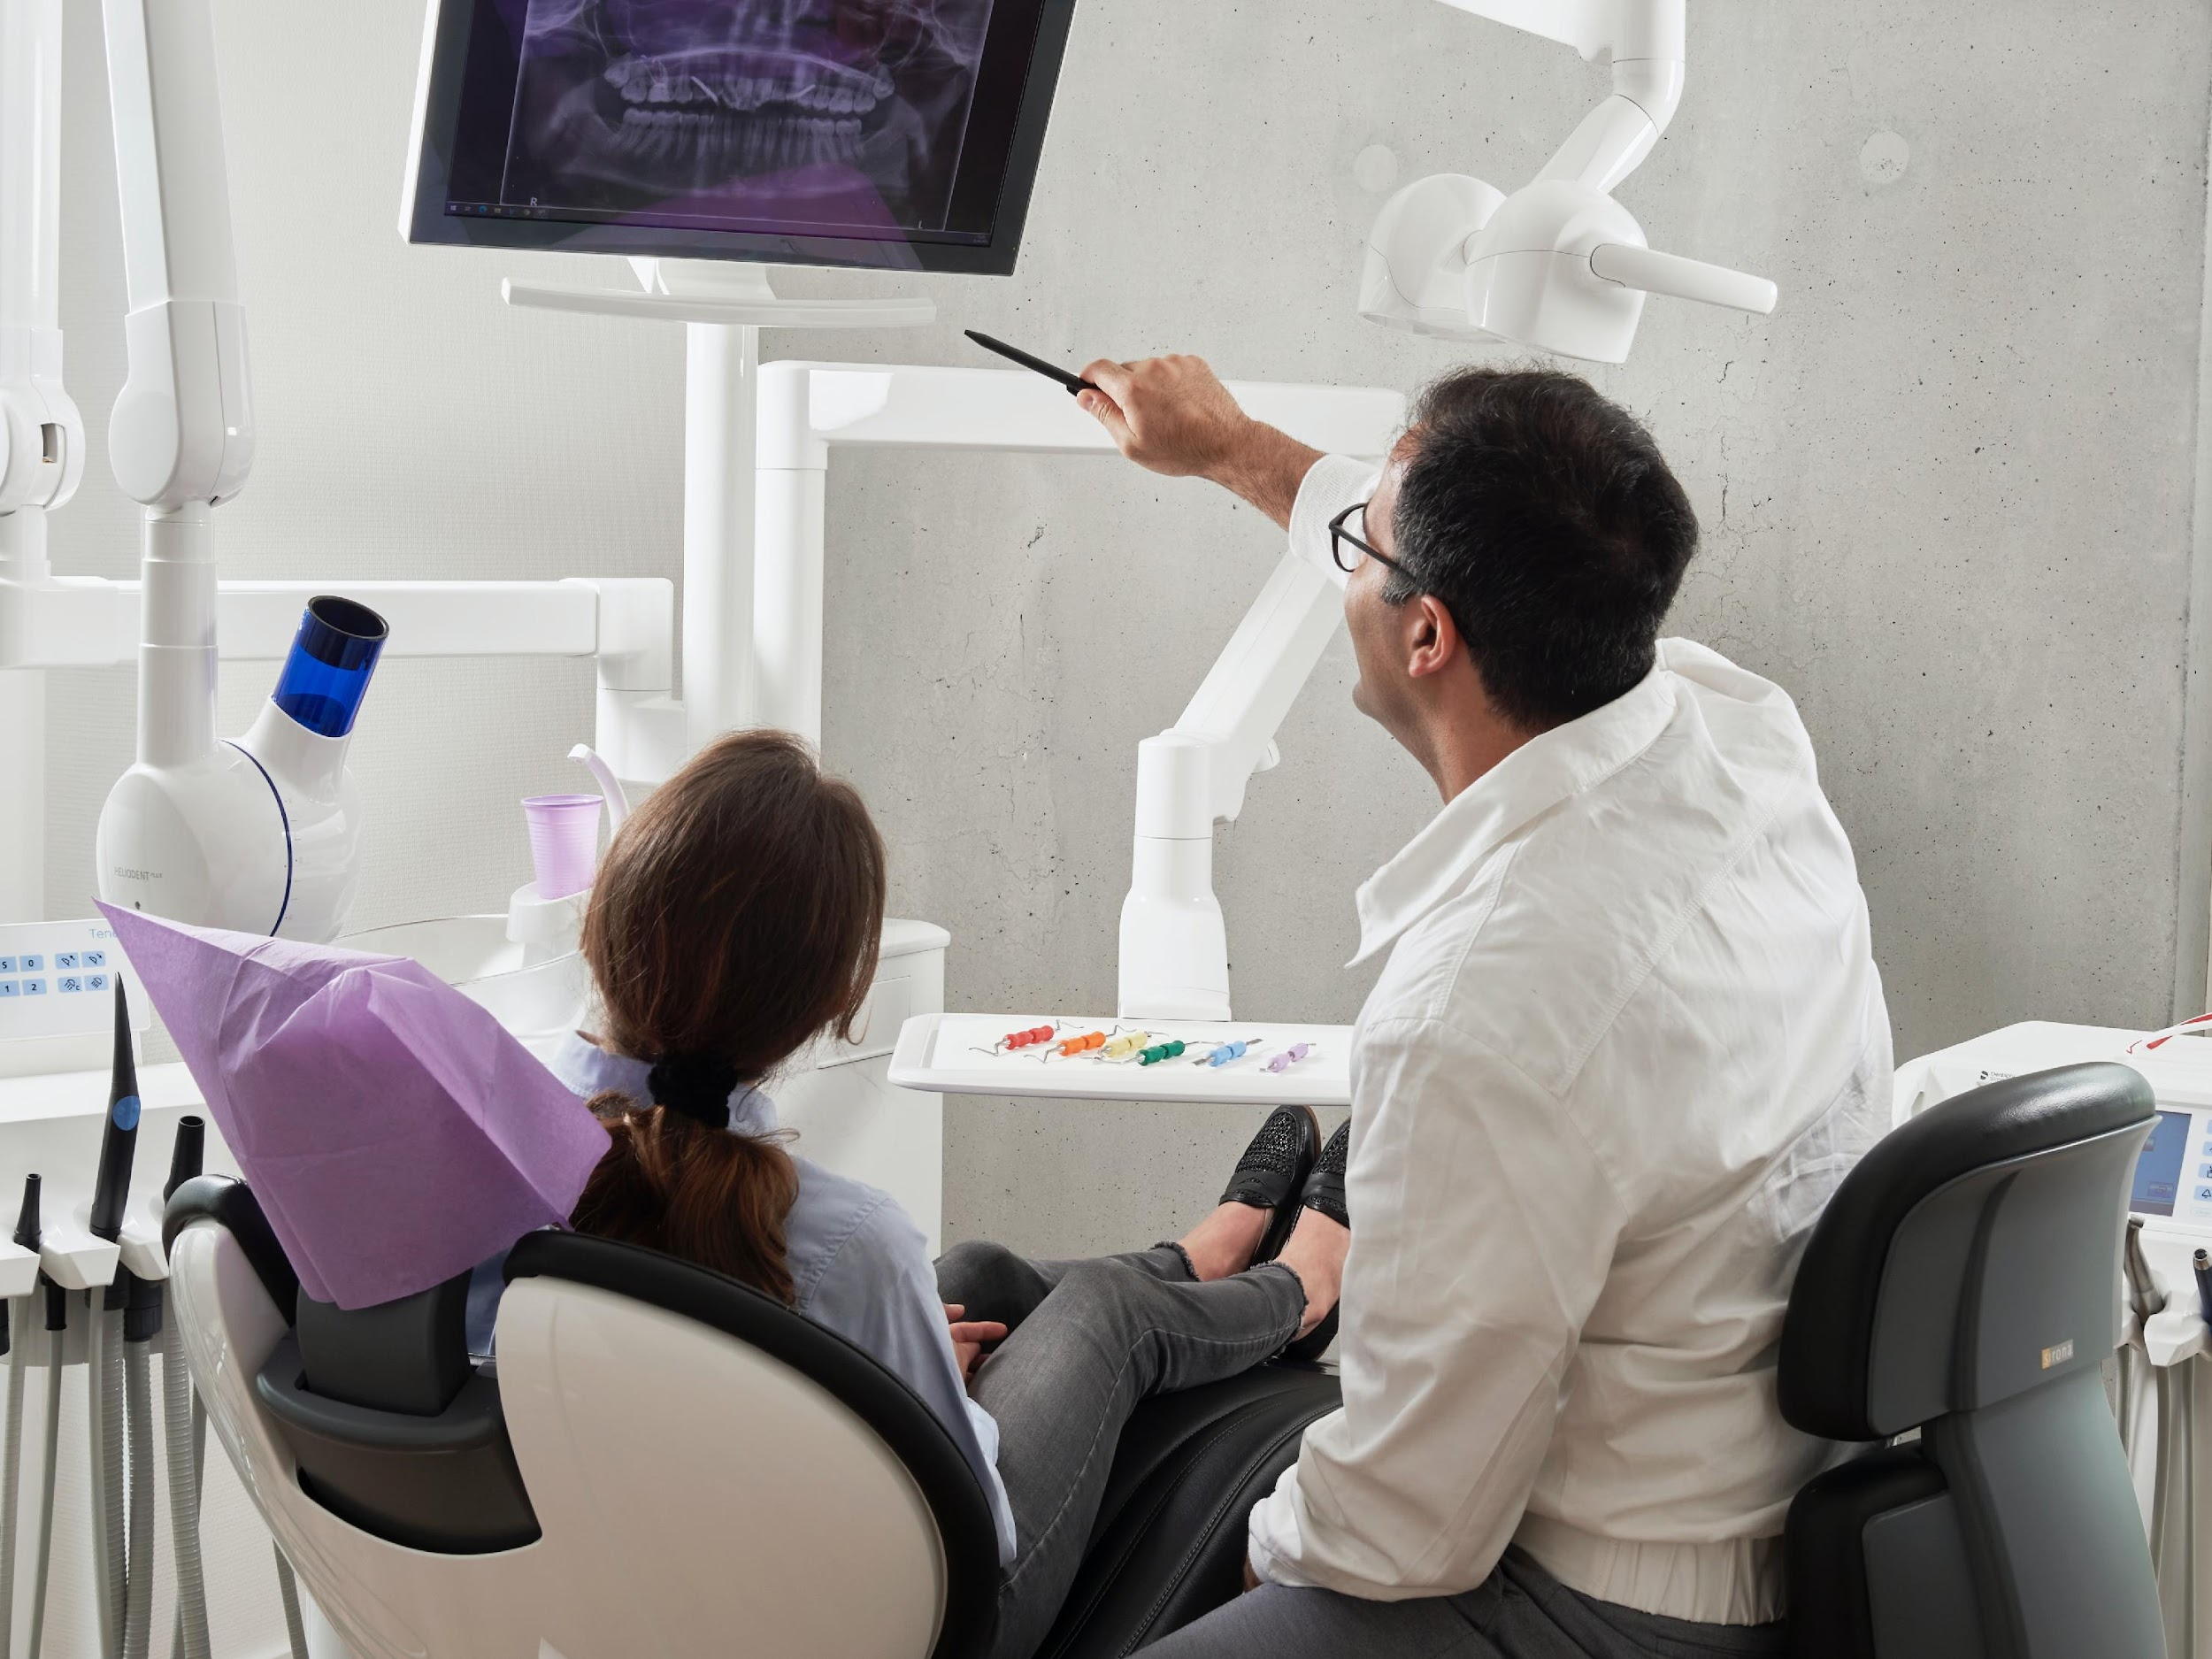
Scheduling a dental procedure
Discounting
Anticipation
Notes:
Image from unsplash.com

Slide 7
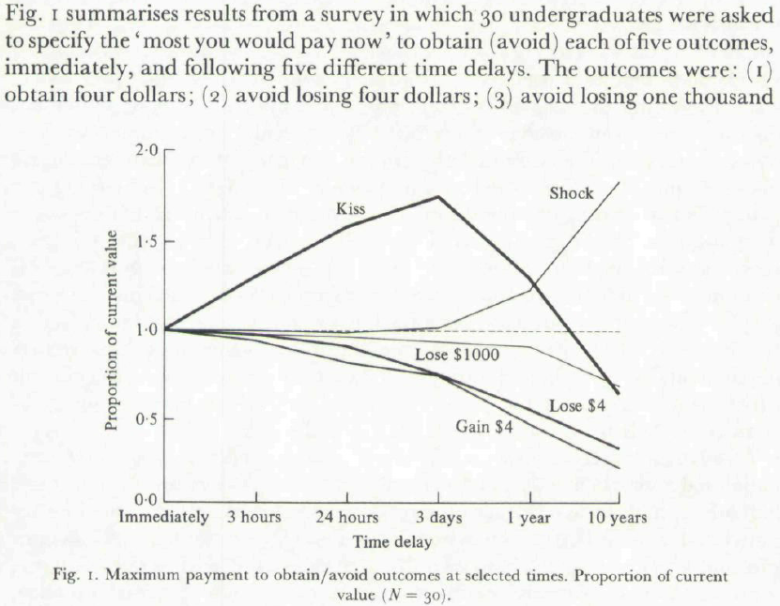
Loewenstein (1987)

Slide 8
Loewenstein (1987)

Slide 9
Replication Data

Slide 10
Hypotheses
Anticipation of losses > anticipation of gains
Even when controlling for loss aversion
Due to a qualitative difference
Anticipation predicts choices
This (partly) explains the “sign effect”

Slide 11
Anticipation: what do we call it?
 | Negative Utility | Positive Utility
Positive Event | Impatience
Negative Event
Notes:
“enjoying the moment”

Slide 12
Anticipation: what do we call it?
 | Negative Utility | Positive Utility
Positive Event | Impatience | Savoring
Negative Event
X
Notes:
“enjoying the moment”

Slide 13
Anticipation: what do we call it?
 | Negative Utility | Positive Utility
Positive Event | Impatience | Savouring
Negative Event
X
Notes:
“enjoying the moment”

Slide 14
Anticipation: what do we call it?
 | Negative Utility | Positive Utility
Positive Event | Impatience | Pleasurable Anticipation
Negative Event
Notes:
“enjoying the moment”

Slide 15
Anticipation: what do we call it?
 | Negative Utility | Positive Utility
Positive Event | Impatience | Pleasurable Anticipation
Negative Event | Dread
Notes:
“enjoying the moment”

Slide 16
Anticipation: what do we call it?
 | Negative Utility | Positive Utility
Positive Event | Impatience | Pleasurable Anticipation
Negative Event | Dread | ???
Notes:
“enjoying the moment”

Slide 17
Anticipation: what do we call it?
 | Negative Utility | Positive Utility
Positive Event | Impatience | Pleasurable Anticipation
Negative Event | Dread | Masochism
X
Notes:
“enjoying the moment”

Slide 18
Anticipation: what do we call it?
 | Negative Utility | Positive Utility
Positive Event | Impatience | Pleasurable Anticipation
Negative Event | Dread | Enjoying the Moment
Notes:
“enjoying the moment”

Slide 19
Overview
Study 1a & 1b: Anticipation of $$ gains vs losses
Study 2a: Real consumption
Study 2b: Generalizing across domains
Study 3: Controlling for loss aversion
Study 4: Why the asymmetry?

Slide 20
Study 1a: Anticipation of $$ gains vs losses

Slide 21
Study 1: Methods
Between subjects: gain vs. loss
201 MTurkers
+$49 today OR +$60 in 89 days?
-$49 today OR -$60 in 89 days?
Imagine expecting to receive [pay] $60 in 89 days. How psychologically pleasurable or displeasurable would the anticipation be? In other words, how would you feel while waiting for it?
strongly dislike the strongly like the feeling of waiting neutral feeling of waiting |-------------------------------------|-------------------------------------|
26 other intertemporal choices (Kirby, Petry, & Bickel 1999)

Slide 22
Study 1: Results
Choices
Gains: Chose SS gain 57% of the time (332% discount rate)
Losses: Chose LL loss 26% of the time (34% discount rate)
Anticipation
Gains: -5 (SD = 55)
Losses: -36 (SD = 46)

Slide 23
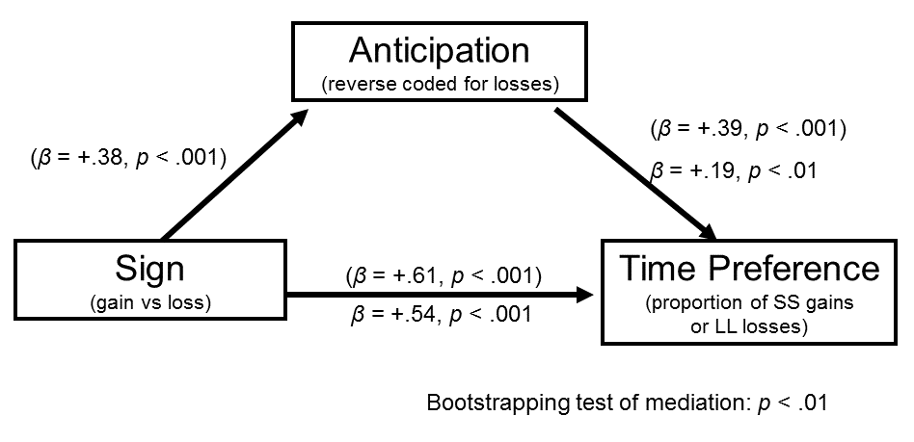
Study 1: Mediation

Slide 24
Study 1b: Consumer choice example

Slide 25
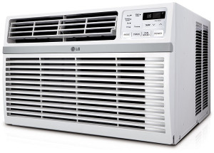
Suppose you were choosing between two window air conditioners, described below:
* Energy savings [wasted] is the estimated difference in energy usage between the two AC units, based on 4 hours usage per day, 182 days per year, with an electricity rate of $0.1264 per kWh.
Model A Price: $297 10-year energy savings*: $0 [10-year energy wasted*: $920] BTUs: 12,000 Watts: 2,000 Energy Efficiency Rating: 6.0 | Model B Price: $776 10-year energy savings*: $920 [10-year energy wasted*: $0] BTUs: 12,000 Watts: 1,000 Energy Efficiency Rating: 12.0

Slide 26
Study 1b: Methods
Which would you choose?
A choice of Model B over Model A [Model A over Model B] boils down to spending more [less] money up front in exchange for saving [wasting] money later. How would you feel while waiting for the future energy savings [waste]?
Negative (Strongly dislike the feeling of waiting)
Neutral (It is just a calculation; I'd feel nothing)
Positive (Strongly like the feeling of waiting)

Slide 27
Study 1b: Results
Choices:
Positive frame: 61% chose “impatient" Model A
Negative frame: 48% chose “impatient" Model A
Anticipation:
Positive frame:
21% positive anticipation, 50% neutral, 30% negative
Negative frame:
13% positive anticipation, 51% neutral, 36% negative
Anticipation mediates the effect of framing on choices

Slide 28
Study 1c: Real consumption, controlling for subjective value

Slide 29
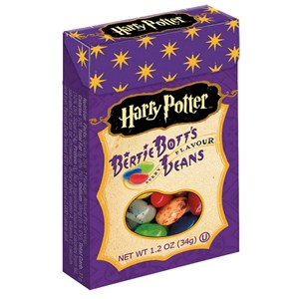
Study 1c: Methods
Randomly assigned to “Dirt” or “Toasted marshmallow” flavor jellybean (pretested)
(Jellybeans visible in the experimental room)
Everyone must wait one week to eat the jellybean
Rated predicted experience utility and anticipation utility

Slide 31
Study 2: Generalizing across domains

Slide 32
Study 2: Events
Positive Events:
receiving a $50 check
receiving a good grade or performance review
spending time with your best friend
improved energy and health for 10 days
a free 5-day vacation to the destination of your choice
watching your favorite TV show or reading a good book for an hour
getting a gift in the mail from a family member
eating a nice meal out at a restaurant
winning the lottery
a kiss from the movie star of your choice
Negative Events:
paying a $50 fine
receiving a bad grade or performance review
a confrontation with your co-worker or family member
being sick for 10 days
doing difficult home cleaning and renovation for 5 days
filling out paperwork and waiting around for an hour at the local Department of Motor Vehicles (DMV)
giving a stressful 60 minute improvised speech
a painful dental procedure
having one of your legs amputated
getting twenty painful (but harmless) electric shocks in a research experiment

Slide 33
Study 3: Controlling for loss aversion

Slide 34
Study 3: Overview
106 participants from Amazon MTurk
Dynamically identify subjectively equivalent gains and losses for each subject
Compare anticipation for these subjectively equivalent pairs

Slide 35
Accept this pair of events?
50% chance of receiving 25 dollars
AND
50% chance of paying 25 dollars
Yes Unsure No

Slide 36
Accept this pair of events?
50% chance of receiving 500 dollars
AND
50% chance of paying 25 dollars
Yes Unsure No

Slide 37
Accept this pair of events?
50% chance of receiving 49 dollars
AND
50% chance of paying 25 dollars
Yes Unsure No

Slide 38
Study 3: Stimulus
Please consider the following event:
[50% chance of receiving a $49]
Assuming this event would definitely happen to you and you knew it were coming, when would you prefer it to happen?
Immediately OR in one week

Slide 39
Time preferences
 | Gains | Losses
Now | 79% | 57%
In one week | 21% | 43%

Slide 40
Time preferences
 | Gains | Losses
Now | 79% | 57%
In one week | 21% | 43%

Slide 41
Study 3: Stimulus
2.a. Please imagine this event happening one week from now. Would experiencing this event be pleasurable or unpleasurable?
Pleasurable experience OR unpleasurable experience
2.b. How strongly would experiencing this event affect your feelings at that time?
not at all strongly extremely |--------------------------------------------------------------------------|
(Wording based on McGraw et al, 2010)

Slide 42
Study 3: Stimulus
3.a. If this event were one week away, would the anticipation be psychologically pleasurable or unpleasurable? In other words, how would you feel while waiting for it?
Like the feeling of waiting OR Dislike the feeling of waiting
3.b. How strongly would anticipating this event affect your feelings while waiting for the event?
not at all strongly extremely |--------------------------------------------------------------------------|

Slide 43
Utility for experience and anticipation

Slide 44
Study 4: Why the asymmetry?

Slide 45
Study 4: Methods
105 participants from Amazon MTurk
10 positive & 10 negative events (same as Study 2)
Time preference
Two questions for anticipation:
…how pleasurable or happy would the anticipation be?
…how displeasurable or unhappy would the anticipation be?

Slide 46
Study 4 Results

Slide 47
Summary
Anticipation of losses > anticipation of gains
Even when experience utility is matched
Anticipation of gains is emotionally mixed
Anticipation of losses is more unidimensional
Anticipation predicts choices
This (partly) explains the “sign effect”

Slide 48
Thank You!

Slide 49
Typical Event Pair
Event | Anticipation | Experience | Choice (1=prefer now) | Regression Beta
receiving a good grade or performance review | 21 | 68 | .68 | -.22**
receiving a bad grade or performance review | -55 | -65 | .15 | -.38**

Slide 50
event | a | e | Corr(a,e) | c | beta (a) | beta (e)
a free 5-day vacation to the destination of your choice | 28 | 75 | .27** | .19 | -.40** | .00
eating a nice meal out at a restaurant | 28 | 59 | .42** | .29 | -.31** | .15
a kiss from the movie star of your choice | 22 | 46 | .38** | .32 | -.17* | .34**
receiving a good grade or performance review | 21 | 68 | .33** | .68 | -.22** | -.01
getting a gift in the mail from a family member | 21 | 64 | .43** | .49 | -.35** | .15
spending time with your best friend | 21 | 67 | .24** | .44 | -.21** | .14
watching your favorite TV show or reading a good book for an hour | 13 | 52 | .39** | .57 | -.27** | .18*
receiving a $50 check | 13 | 66 | .25** | .78 | -.17* | .04
improved energy and health for 10 days | 9 | 67 | .24** | .69 | -.31** | .12
winning the lottery | 6 | 83 | .20* | .79 | -.31** | .15*
doing difficult home cleaning and renovation for 5 days | -19 | -13 | .51** | .02 | -.36** | .32**
filling out paperwork and waiting around for an hour at the local Department of Motor Vehicles (DMV) | -26 | -35 | .43** | .11 | -.30** | .26**
paying a $50 fine | -27 | -39 | .39** | .02 | -.28** | .16
giving a stressful 60 minute improvised speech | -45 | -37 | .45** | -.10 | -.20* | .26**
being sick for 10 days | -47 | -65 | .28** | -.15 | -.32** | .22**
a painful dental procedure | -53 | -63 | .37** | .18 | -.44** | .39**
receiving a bad grade or performance review | -55 | -65 | .43** | .15 | -.38** | .31**
a confrontation with your co-worker or family member | -57 | -60 | .55** | .18 | -.35** | .32**
getting twenty painful (but harmless) electric shocks in a research experiment | -58 | -66 | .41** | .13 | -.36** | .33**
having one of your legs amputated | -63 | -86 | .31** | -.56 | -.24** | .33**

Slide 51
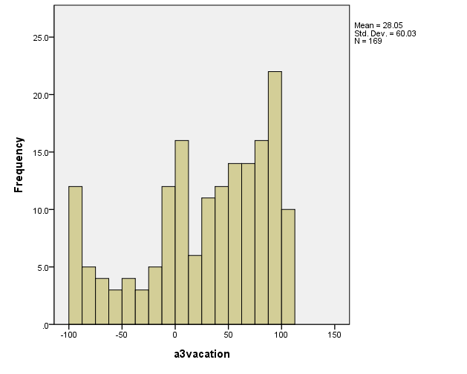
Histogram of Vacation Anticipation Utility

Slide 52
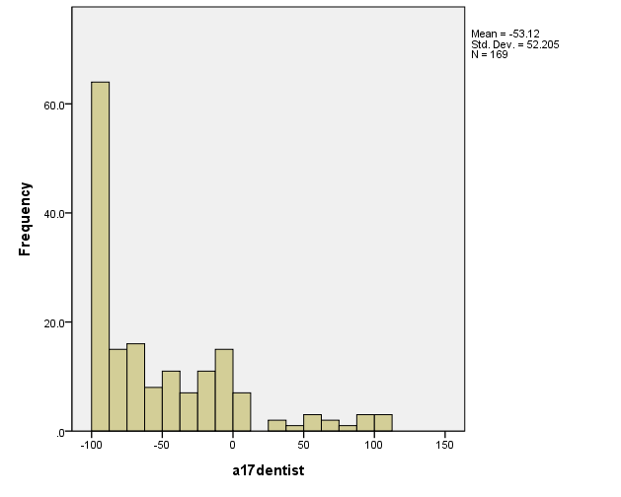
Histogram of Dentist Anticipation Utility

