Slide 1
Time and risk preferences for losses
David Hardisty
Sauder School of Business
Operations and Logistics Seminar
September 8th, 2014

Slide 2
Overview
Project 1: Does Prospect Theory hold in intertemporal choice? The interaction of time and risk in preferences for gains and losses.
Project 2: Time and uncertainty in repeated prisoner’s dilemmas
Project 3: Framing energy costs to promote energy efficiency and sustainability

Slide 3
1. Does Prospect Theory Hold in Intertemporal Choice?
The interaction of time and risk in preferences for gains and losses

Slide 4
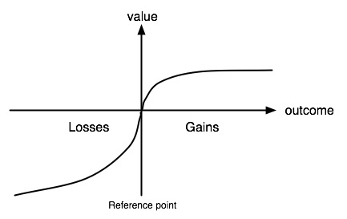
Prospect Theory
(Kahneman & Tversky, 1979)

Slide 5
Questions
Why do many people buy insurance, even bad insurance (such as travelers insurance)?
Why do many people pre-pay for gas in rental cars?

Slide 6
Preferences for gains and losses
 | Gains | Losses
Risk | +$100 or 50% chance of +$200 | -$100 or 50% chance of -$200
Time | +$100 now or +$100 next year | -$100 now or -$100 next year
Risk + Time | +$100 now or 50% chance of +$200 next year | -$100 now or 50% chance of -$200 next year

Slide 7
Time preferences for gains and losses: the “sign effect”
Receive $70 now or in a month? 100% choose now.
Pay $70 now or in a month? 53% choose now.
(Hardisty & Weber, 2009; Mischel, W., Grusec, & Masters, 1969; Thaler, 1981)

Slide 8
 | Gains | Losses
Risk | +$100 or 50% chance of +$200 | -$100 or 50% chance of -$200
Time | +$100 now or +$100 next year | -$100 now or -$100 next year
Risk + Time | +$100 now or 50% chance of +$200 next year | -$100 now or 50% chance of -$200 next year ????

Slide 9
Participants
Total N=1385 across 5 studies
National U.S. sample, average age = 38
Mix of Mturk, SSI, and Qualtrics

Slide 10
Study 1 Overview
Hypothetical scenarios
Gain vs Loss
Future “certainty” vs uncertainty
(Probability vs Variability)
(Medium vs Large Magnitude)
(Order)

Slide 11
Study 1: Gain Scenario
Please imagine you face a set of choices about receiving $100 from investments immediately, or another amount in one year.

Slide 12
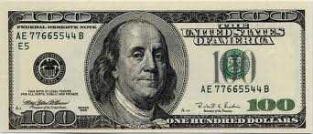
Study 1: Medium Gain Choices
Receive $100 immediately or receive $90 in one year?
Receive $100 immediately or receive $100 in one year?
Receive $100 immediately or receive $110 in one year?
…
Receive $100 immediately or receive $200 in one year?
Notes:
Image source: https://www.medpagetoday.com/popmedicine/celebritydiagnosis/24062

Slide 13
Study 1: Large Gain Choices
Receive $10,000 immediately or receive $9,000 in one year?
Receive $10,000 immediately or receive $10,000 in one year?
…
Receive $10,000 immediately or receive $20,000 in one year?
Notes:
Image source: https://www.opensecrets.org/news/2010/04/politicians-contribute-big-money-to/

Slide 14
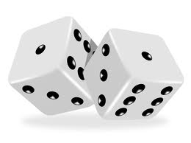
Study 1: Probabilistic Gain
Receive $100 immediately or 50% chance of receiving $180 in one year?
Receive $100 immediately or 50% chance of receiving $200 in one year?
…
Receive $100 immediately or 50% chance of receiving $400 in one year?
Notes:
Image credit: https://www.premiumtimesng.com/news/top-news/165856-nigerians-spend-n1-8-billion-on-sports-betting-daily-nan-investigation.html

Slide 15
Study 1: Variable Gain
Receive $100 immediately or receive $45 to $135 in one year?
Receive $100 immediately or receive $50 to $150 in one year?
…
Receive $100 immediately or receive $100 to $300 in one year?
Notes:
Image credit: https://www.premiumtimesng.com/news/top-news/165856-nigerians-spend-n1-8-billion-on-sports-betting-daily-nan-investigation.html

Slide 16
Study 1: Losses
Please imagine you face a set of choices about paying a $100 bill immediately, or another amount in one year.
Control: Pay $100 immediately or pay $150 in one year?
Probabilistic: Pay $100 immediately or 50% chance of paying $300 in one year?
Variable: Pay $100 immediately or pay $75 to $225 in one year?
Notes:
Image source: https://www.barrowbc.gov.uk/news/consultation-on-the-statement-of-gambling-policy-2019-2022/

Slide 17
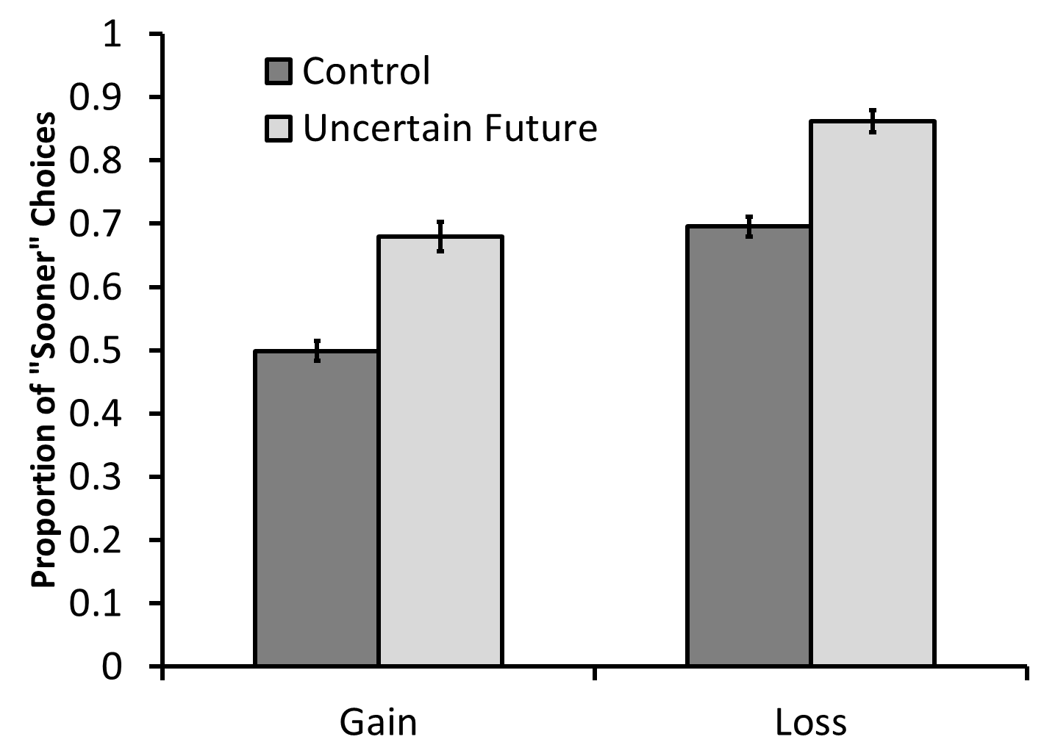
Study 1: Results

Slide 18
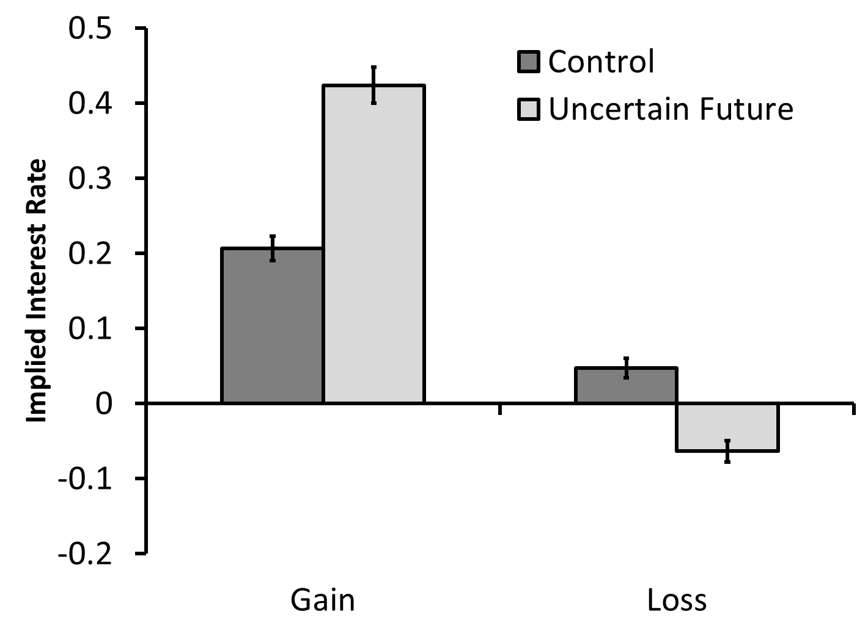
Study 1: Results

Slide 19
In Dollars
Today | In One Year | In One Year
+$100 | +$130 | .5*+$306
+$10,000 | +$11,600 | .5*+$30,720
-$100 | -$104 | .5*-$189
-$10,000 | -$10,600 | .5*-$18,700

Slide 20
Study 1: Summary
Participants were risk averse for future gains and future losses
Weird study or weird participants?
What about immediate uncertainty?

Slide 21
Study 2: Overview
Prospect theory questions (all immediate outcomes)
Immediate uncertainty vs future “certainty”
Hypothesis 1: Prospect theory preferences when all outcomes are immediate
Hypothesis 2: Risk aversion when making intertemporal choices

Slide 22
Study 2: Prospect Theory Methods
50% chance of receiving $200, or receive $100 for sure?
50% chance of receiving $20,000, or receive $10,000 for sure?
50% chance of paying $200, or pay $100 for sure?
50% chance of paying $20,000, or pay $10,000 for sure?

Slide 23
Prospect Theory: Results

Slide 24
Study 2: Intertemporal Choice Methods
Control: Receive $100 immediately or $150 in one year?
Immediate uncertainty: 50% chance of receiving $200 immediately or receive $150 for sure in one year?

Slide 25
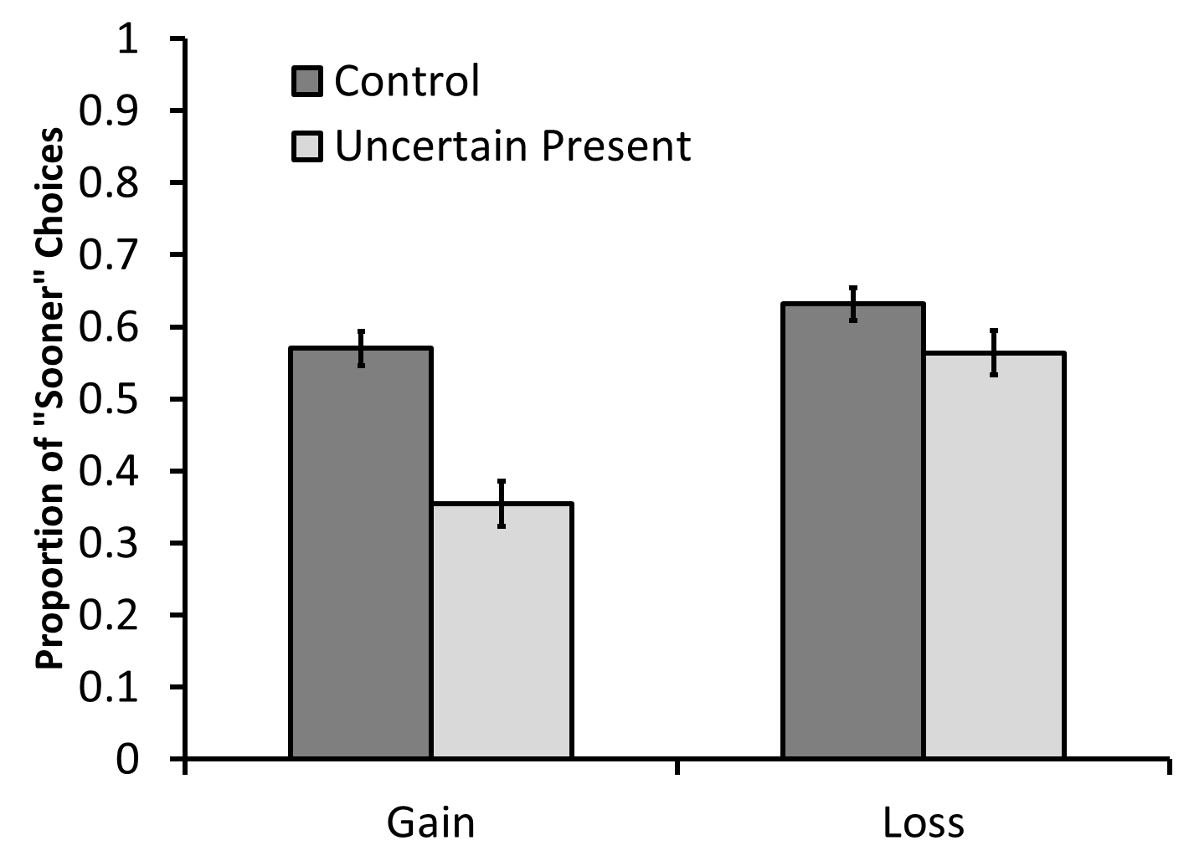
Study 2: Results

Slide 26
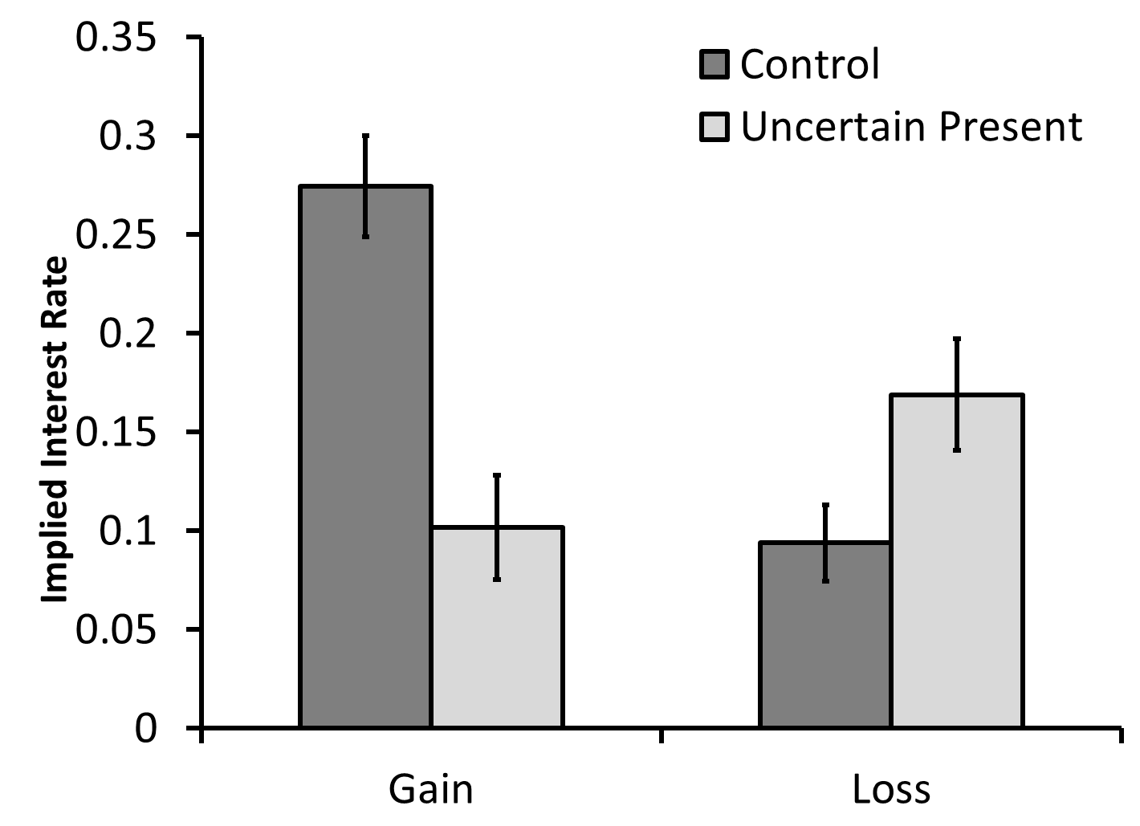
Study 2: Results

Slide 27
Study 2: Summary
When making intertemporal choices, participants showed risk aversion for gains and losses
What happens when both the immediate and future outcomes are uncertain?

Slide 28
Study 3: Intertemporal Choice Methods
Control: Receive $100 immediately or $150 in one year?
Immediate and future uncertainty: 50% chance of receiving $200 immediately or 50% chance of receiving $300 in one year?

Slide 29
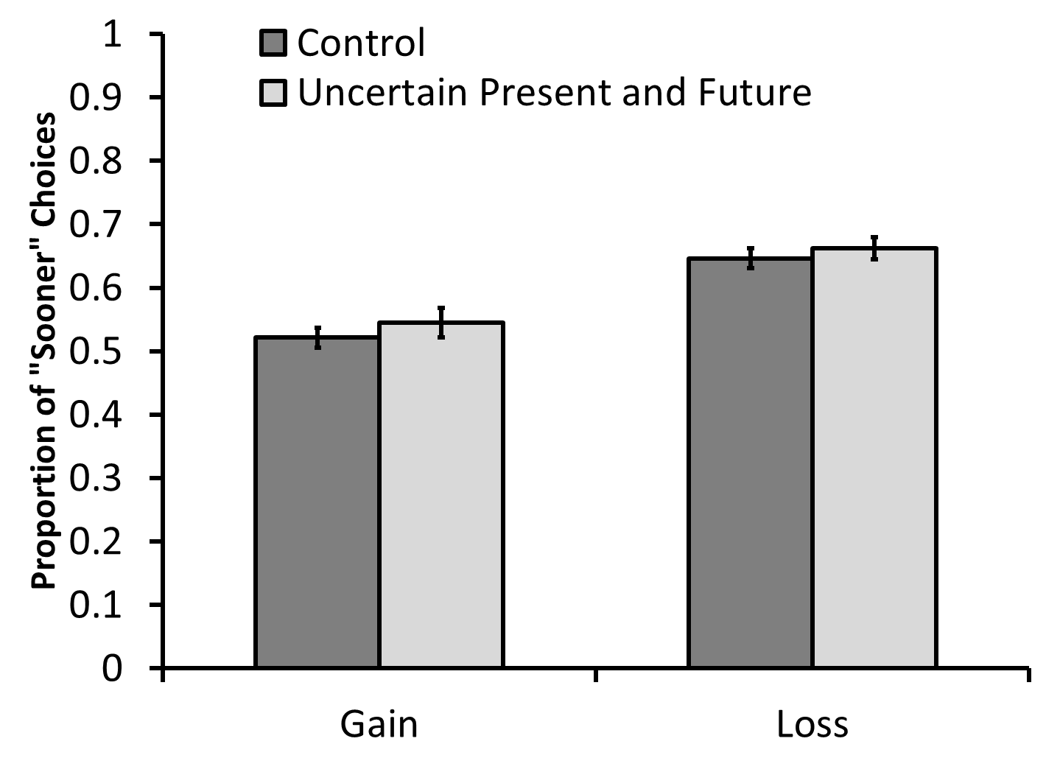
Study 3: Results

Slide 30
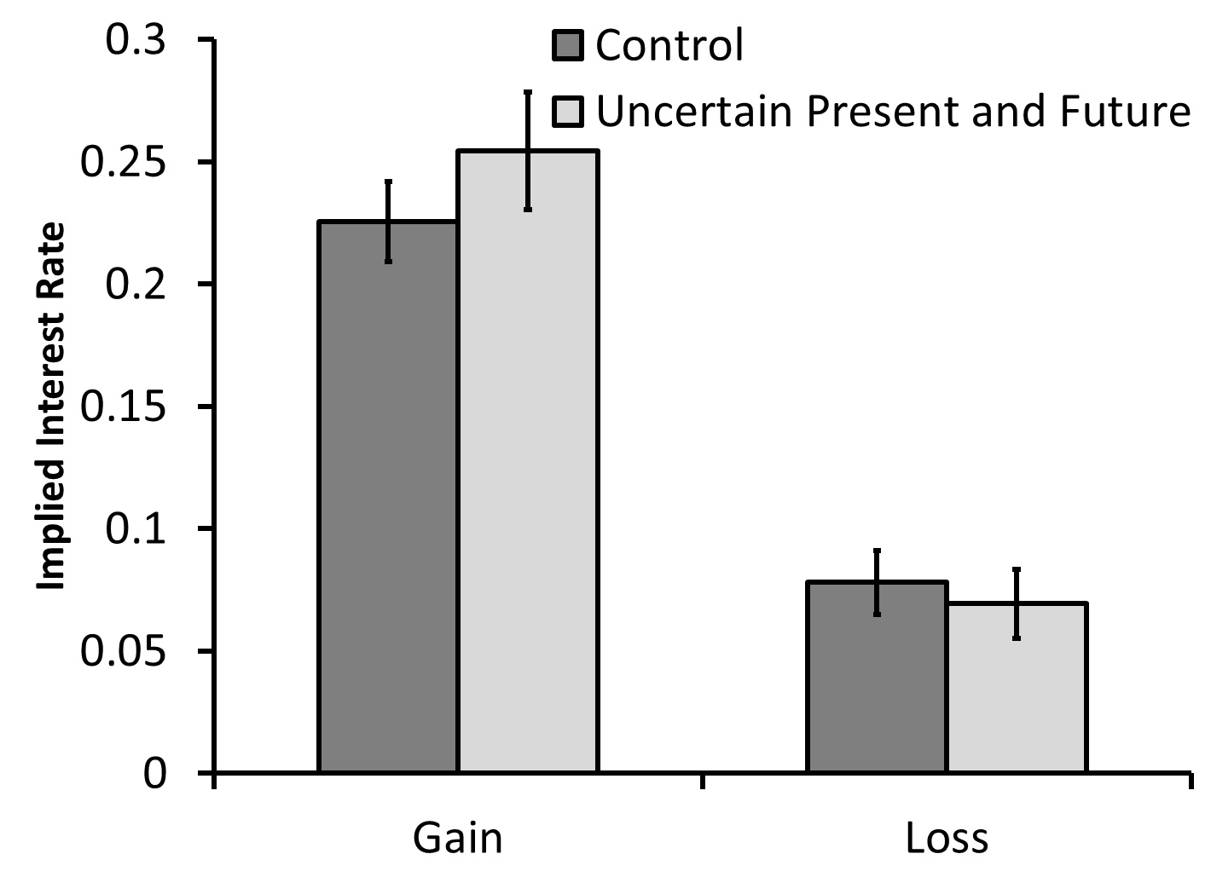
Study 3: Results

Slide 31
Individual differences
 | discounting of gains | discounting of losses
young company | .00 | .16*
employed part time | .11* | .14*
Financial resources | -.38** | -.23**
income | -.13* | -.03
feel secure | -.20* | -.22*
smoking | .16** | .02
Notes:
These are correlations

Slide 32
Study 4
We replicate our results all in one study, with both MBAs and non-MBAs

Slide 33
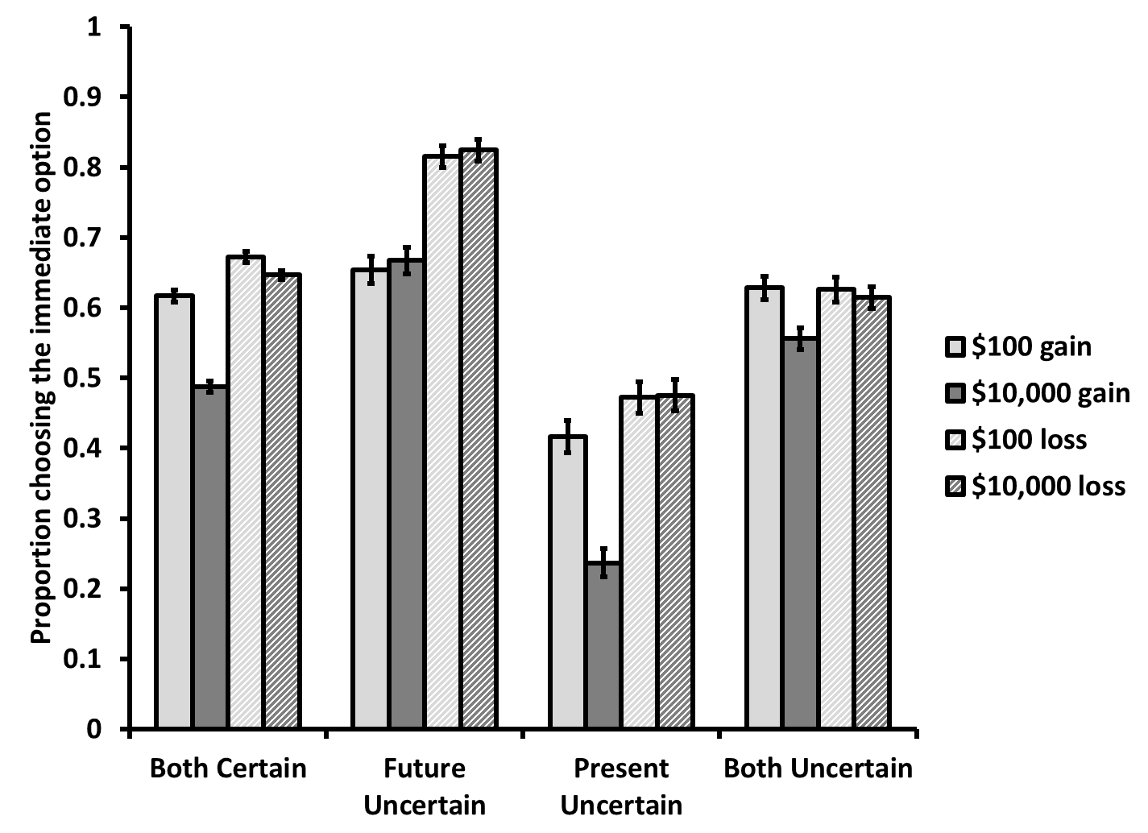

Slide 34
Study 5
Why is this happening?
One hypothesis: the combination of time and risk is complex, and most people prefer simple, straightforward outcomes. Ex:
$100 now (simple)
50% chance of $200 (pretty simple)
$100 next year (pretty simple)
50% chance of $200 next year (not so simple)
We asked people about outcome complexity
Also measured: numeracy & need for cognition

Slide 35
Study 5: Methods
$100 now | $110 in one year
How simple and straightforward do you find the option on the left?
very simple very complicated
1 2 3 4 5 6 7
How simple and straightforward do you find the option on the right?
very simple very complicated
1 2 3 4 5 6 7

Slide 36
Study 5: Methods
$100 now | 50% chance of $220 in one year
How simple and straightforward do you find the option on the left?
very simple very complicated
1 2 3 4 5 6 7
How simple and straightforward do you find the option on the right?
very simple very complicated
1 2 3 4 5 6 7

Slide 37
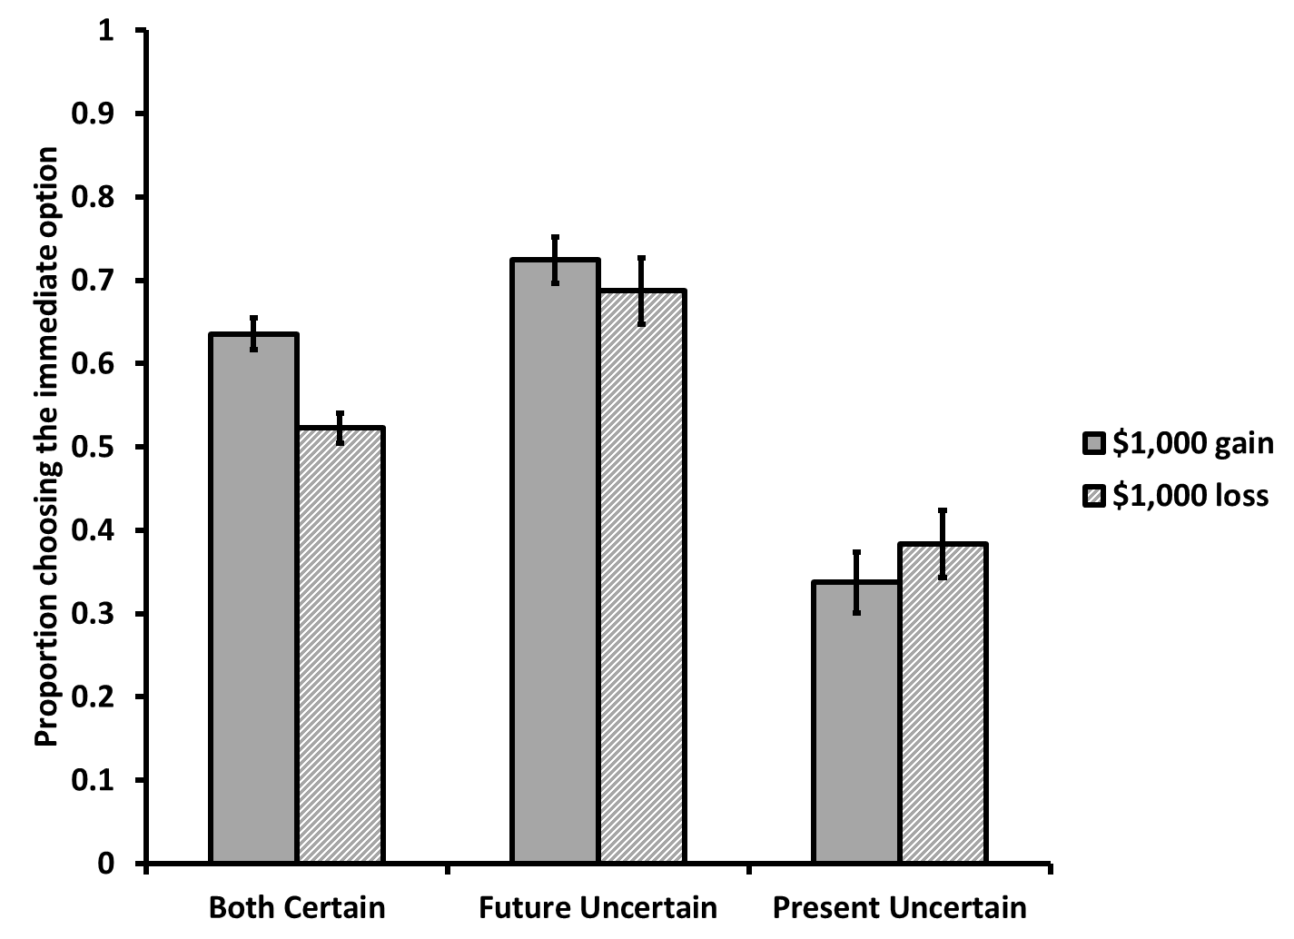
Study 5: Results

Slide 38
Study 5: Mediation
Complexity Shift
(β = 0.07, p < .001)
β = 0.04, p = .01
(β = 2.59, p < .001)
Change in Time Preference
Uncertainty Timing
(β = 0.34, p < .001)
β = 0.24, p < .001
Bootstrapped test of mediation: p < .01

Slide 39
Study 5: Moderation
Need for cognition did not predict anything
Highly numerate individuals are less likely to avoid intertemporal uncertainty, F(1, 202) = 4.6, p = .03

Slide 40
Overall Summary
In intertemporal contexts, participants are risk averse for gains and losses (in contrast to prospect theory predictions)
This is partially driven by a preference for simple, straightforward outcomes in “complex” situations.

Slide 41
Implications & Applications
When combined with “implicit future uncertainty”, our results may explain the “sign effect” in intertemporal choice
Our results are consistent with the “equity premium puzzle” may explain the “annuity puzzle” and also suggest an “ARM-premium puzzle” may exist
Also may explain pre-buying gas for rental cars

Slide 42
Questions
Any other ideas on why people do this?
Any other suggestions for the paper?

Slide 43
2. Time and uncertainty in repeated prisoner’s dilemmas

Slide 44
IDS Background
Interdependent Security (IDS) is a social dilemma with stochastic losses (Kunreuther & Heal, 2003)
Examples:
border security
airline security
pest/disease control
risky investment
Individuals generally cooperate less in IDS (Kunreuther & Heal, 2003; Gong, Baron, & Kunreuther, 2009)

Slide 45
Research Motivation
In real life, players often precommit their strategy (whether to invest in protection) for several years in advance at a time
examples: CO² reductions, fishing licenses

Slide 46
Research Motivation
Normally, greater delay is associated with increased uncertainty
example: $10 promised today or in 20 years
However, with repeated low probability events, increasing time horizon may increase subjective probability
example: fire insurance for tomorrow, or for the next 20 years

Slide 47
Methods Overview
4 studies
Sample of Columbia students (N=271)
Anonymous, repeated prisoners dilemma
4 blocks of 20 rounds
Switching partners between each block
Comprehension quiz after instructions
Incentive compatible payouts

Slide 48
Study 1
Does precommitment raise investment rates in interdependent security?

Slide 49
Study 1 Overview
Between subjects: - Regular, repeated PD - Regular, repeated IDS - Precommitted IDS
Expected values and nash equilibria are the same in all conditions

Slide 50
IDS instructions (pg 1)
Scenario: Imagine you are an investor in Indonesia and you have a risky joint venture that earns 8,500 Rp per year. However, there is a small chance that you and/or your counterpart will suffer a loss of 40,000 Rp in a given year. You have the option to pay 1,400 Rp for a safety measure each year to protect against the possible loss. However, you will only be fully protected if both you and your counterpart invest in protection. The loss has an equal chance of happening each year, regardless of whether it occurred in the previous year.

Slide 51
IDS payoff matrix
 |  | Your Counterpart
 |  | INVEST | NOT INVEST
You | INVEST | - You definitely lose 1,400 Rp, and have a 0% chance of the large loss occurring. - Your counterpart definitely loses 1,400 Rp, and has a 0% chance of the large loss occurring. | - You definitely lose 1,400 Rp and have a 1% chance of losing an additional 40,000 Rp. - Your counterpart has a 3% chance of losing 40,000 Rp and a 97% chance of losing 0 Rp.
 | NOT INVEST | - You have a 3% chance of losing 40,000 Rp and a 97% chance of losing 0 Rp. - Your counterpart definitely loses 1,400 Rp and has a 1% chance of losing an additional 40,000 Rp. | - You have a 4% chance of losing 40,000 Rp and a 96% chance of losing 0 Rp. - Your counterpart has a 4% chance of losing 40,000 Rp and a 96% chance of losing 0 Rp.

Slide 52
PD payoff matrix
 |  | Your Counterpart
 |  | INVEST | NOT INVEST
You | INVEST | - You lose 1,400 Rp. - Your counterpart loses 1,400 Rp. | - You lose 1,800 Rp. - Your counterpart loses 1,200 Rp.
 | NOT INVEST | - You lose 1,200 Rp. - Your counterpart loses 1,800 Rp. | - You lose 1,600 Rp. - Your counterpart loses 1,600 Rp.

Slide 53
IDS: Choices
Will you invest in protection this year?
INVEST | NOT INVEST
Do you think your counterpart will invest in protection this year?
DEFINITELY | PROBABLY | PROBABLY NOT | DEFINITELY NOT

Slide 54
Precommitted Condition
Will you invest in protection in year 1?
INVEST | NOT INVEST
Do you think your counterpart will invest in protection in year 1?
DEFINITELY | PROBABLY | PROBABLY NOT | DEFINITELY NOT
~~~~~~~~~~~~~~~~~~~~~~~~~~~~~~~~~~~~~~~~~~~~~~~~~~~~~~~~~~~~~~~~~~~~~~ Will you invest in protection in year 2?
INVEST | NOT INVEST
Do you think your counterpart will invest in protection in year 2?
DEFINITELY | PROBABLY | PROBABLY NOT | DEFINITELY NOT
~~~~~~~~~~~~~~~~~~~~~~~~~~~~~~~~~~~~~~~~~~~~~~~~~~~~~~~~~~~~~~~~~~~~~~ [...]
Will you invest in protection in year 20?
INVEST | NOT INVEST
Do you think your counterpart will invest in protection in year 20?
DEFINITELY | PROBABLY | PROBABLY NOT | DEFINITELY NOT

Slide 55
Feedback
Year 1 Results
Your choice: INVEST
Your counterpart's choice: NOT INVEST
The random number was: 88
This Means
For you, the large loss: did not occur
For your counterpart, the large loss: did not occur
Result: You lost 1,400 Rp, and your counterpart lost 0 Rp

Slide 56
PD vs IDS
1
0.9
0.8
0.7
0.6
IDS rep
Investment Proportion
0.5
0.4
PD rep
0.3
0.2
0.1
0
Block 1
Block 2
Block 3
Block 4

Slide 57
PD vs IDS
1
0.9
0.8
0.7
0.6
IDS rep
Investment Proportion
0.5
0.4
PD rep
0.3
0.2
0.1
0
Block 1
Block 2
Block 3
Block 4

Slide 58
PD vs IDS
1
0.9
0.8
0.7
0.6
IDS rep
Investment Proportion
0.5
0.4
PD rep
0.3
0.2
0.1
0
Block 1
Block 2
Block 3
Block 4

Slide 59
IDS: repeated vs precommitted
1
0.9
0.8
0.7
0.6
IDS rep
Investment Proportion
0.5
IDS pre
0.4
PD rep
0.3
0.2
0.1
0
Block 1
Block 2
Block 3
Block 4

Slide 60
IDS: repeated vs precommitted
1
0.9
0.8
0.7
0.6
IDS rep
Investment Proportion
0.5
IDS pre
0.4
PD rep
0.3
0.2
0.1
0
Block 1
Block 2
Block 3
Block 4

Slide 61
Study 1 Discussion
Uncertainty lowers cooperation between individuals playing loss framed dilemma
Why? - Perhaps uncertainty transforms the game from a social dilemma to a game of chance
Under uncertainty, precommitment raises cooperation
Why? - Perhaps precommitment raises subjective probability of the loss - We know that in intertemporal contexts, people are risk averse for losses (Project 1)
We can investigate these in a solo game

Slide 62
Study 2
Question: Do individuals playing a (non-dilemma) solo game invest more often when precommitting?

Slide 63
Solo payoff matrix
INVEST | - You definitely lose 1,400 Rp, and have a 0% chance of the large loss occurring.
NOT INVEST | - You have a 4% chance of losing 40,000 Rp and a 96% chance of losing 0 Rp.
Notes:
Tversky & Samuelson

Slide 64
IDS repeated vs Solo repeated

Slide 65
IDS repeated vs Solo repeated

Slide 66
Conclusion
IDS players are mostly playing a game of chance, showing risk-seeking for losses

Slide 67
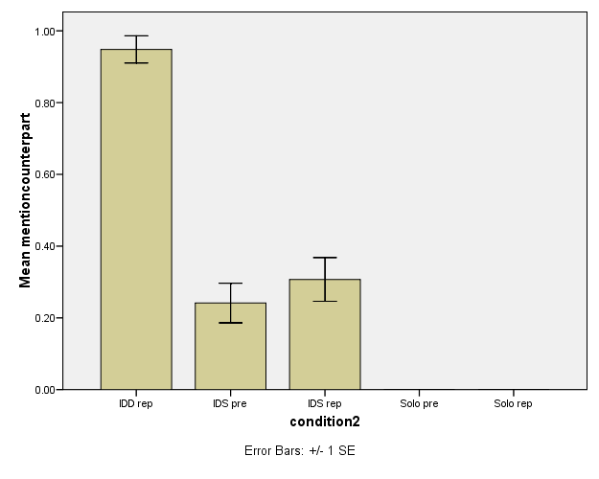
Support

Slide 68
Solo: repeated vs precommited

Slide 69
Solo: repeated vs precommited
1
0.9
0.8
0.7
0.6
IDS rep
Investment Proportion
IDS pre
0.5
Solo rep
0.4
Solo pre
0.3
0.2
0.1
0
Block 1
Block 2
Block 3
Block 4

Slide 70
Conclusion
Precommitment raises investment rates by individuals
Why? - Perhaps subjective probability is increased - People are risk seeking for losses in intertemporal situations

Slide 71
How else can we improve investment under uncertainty?
Perhaps environmental framing can highlight social goals and raise investment rates

Slide 72
Study 3
Question: Will environmental framing will increase investment rates?

Slide 73
IDS environmental instructions
Scenario: Imagine you are a farmer in Indonesia. You get an annual yield of 8,500 Rupiah (Rp) from your potato crops. Both you and a neighboring farmer use the pesticide Aldicarb on your potato crops. However, there is a small risk of groundwater contamination each year from this pesticide, which is toxic. If contamination occurs, you and/or your neighboring farmer will suffer a loss of 40,000 Rp, to pay for groundwater cleanup. You have the option to switch to a more expensive, though safer, pesticide, at the cost of 1,400 Rp annually, to avoid groundwater contamination. However, you will only be fully protected if both you and your counterpart invest in the safer pesticide. The groundwater contamination has an equal chance of happening each year, regardless of whether it occurred in the previous year.

Slide 74
IDS environmental payoff matrix
 |  | Your Counterpart
 |  | INVEST | NOT INVEST
You | INVEST | - You definitely lose 1,400 Rp, and have a 0% chance of groundwater contamination. - Your counterpart definitely loses 1,400 Rp, and has a 0% chance of groundwater contamination. | - You definitely lose 1,400 Rp and have a 1% chance of groundwater contamination occuring and losing an additional 40,000 Rp. - Your counterpart has a 3% chance of losing 40,000 Rp due to groundwater contamination and a 97% chance of losing 0 Rp.
 | NOT INVEST | - You have a 3% chance of losing 40,000 Rp due to groundwater contamination and a 97% chance of losing 0 Rp. - Your counterpart definitely loses 1,400 Rp and has a 1% chance of groundwater contamination occuring and losing an additional 40,000 Rp. | - You have a 4% chance of groundwater contamination occurring and losing 40,000 Rp and a 96% chance of losing 0 Rp. - Your counterpart has a 4% chance of groundwater contamination occurring and losing 40,000 Rp and a 96% chance of losing 0 Rp.

Slide 75
IDS Environmental: Choices
Will you invest in the safer pesticide this year?
INVEST | NOT INVEST
Do you think your counterpart will invest in the safer pesticide this year?
DEFINITELY | PROBABLY | PROBABLY NOT | DEFINITELY NOT

Slide 76
Feedback
Year 1 Results
Your choice: INVEST
Your counterpart's choice: NOT INVEST
The random number was: 88
This Means
For you, groundwater contamination: did not occur
For your counterpart, groundwater contamination : did not occur
Result: You lost 1,400 Rp, and your counterpart lost 0 Rp

Slide 77
Environmental Frame Results

Slide 78
Environmental Frame Results

Slide 79
Conclusion
Environmental framing may not have a significant effect on investment rates

Slide 80
Study 4
Question: How does precommitment affect investment rates in a deterministic prisoners dilemma

Slide 81
IDD payoff matrix
 |  | Your Counterpart
 |  | INVEST | NOT INVEST
You | INVEST | - You lose 1,400 Rp. - Your counterpart loses 1,400 Rp. | - You lose 1,800 Rp. - Your counterpart loses 1,200 Rp.
 | NOT INVEST | - You lose 1,200 Rp. - Your counterpart loses 1,800 Rp. | - You lose 1,600 Rp. - Your counterpart loses 1,600 Rp.

Slide 82
PD: Repeated vs Precommitted
1
0.9
0.8
0.7
0.6
Investment Proportion
PD rep
0.5
PD pre
0.4
0.3
0.2
0.1
0
Block 1
Block 2
Block 3
Block 4

Slide 83
PD: Repeated vs Precommitted
1
0.9
0.8
0.7
0.6
Investment Proportion
PD rep
0.5
PD pre
0.4
0.3
0.2
0.1
0
Block 1
Block 2
Block 3
Block 4

Slide 84
Conclusion
Precommitment reduces investment rates in deterministic social dilemmas
Why? Perhaps individuals realize there is no opportunity for reciprocity and are worried about being a sucker

Slide 85
Summary
Precommitment lowers cooperation in regular prisoner’s dilemma, but raises it in interdependent security situations
Why?
In IDS, precommitment raises subjective probability of loss
In IDS, people are risk averse when making intertemporal choices
In deterministic PD, precommitment removes the possibility of reciprocity

Slide 86
Questions
Is this project worth pursuing?
What would you recommend for next steps?
What journals would you target?

Slide 87
3. Framing energy costs to promote energy efficiency and sustainability

Slide 88
Project Overview
How can we nudge people towards more energy efficient products?
Partnering with local utility company (BC Hydro)
Many people want to minimize future costs → Let’s make future costs more salient
Three studies of energy cost framing:
10-year cost display
Energy / Dollars x Gain / Loss
Continuous vs Dichotomous

Slide 89
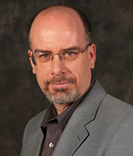
People
Dale Griffin
Yoonji Shim

Slide 90
Study 1 methods
Price: $999.95
Estimated Electricity Use (W): 121
Standby energy consumption: 0.2w
Brand: Samsung
Size: 50”
Resolution: 1080p
Price: $749.95
Estimated Electricity Use (W): 181
Standby energy consumption: 0.4w
Brand: Samsung
Size: 50”
Resolution: 1080p
Notes:
Tv - https://www.indiamart.com/proddetail/32-inch-lg-television-18470908188.html

Slide 91
Study 1 methods
Price: $999.95
10-year estimated cost: $600
Estimated Electricity Use (W): 121
Standby energy consumption: 0.2w
Brand: Samsung
Size: 50”
Resolution: 1080p
Price: $749.95
10-year estimated cost: $1,000
Estimated Electricity Use (W): 181
Standby energy consumption: 0.4w
Brand: Samsung
Size: 50”
Resolution: 1080p
Notes:
Tv - https://www.indiamart.com/proddetail/32-inch-lg-television-18470908188.html

Slide 92
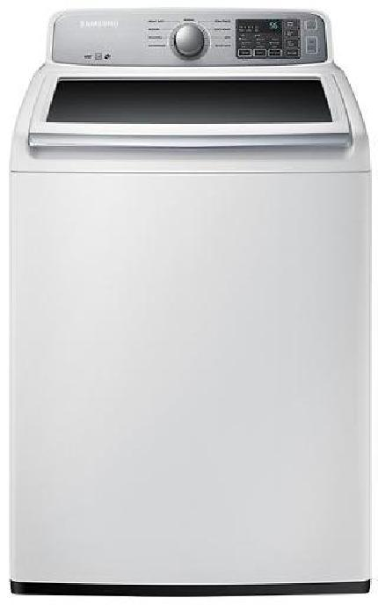
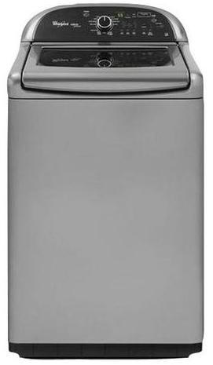
Price: $629.99
Estimated Yearly Electricity Use (kWh): 169
Model: 4.5 Cu. Ft. 9 cycle Top Load Washer
Brand: Samsung
Price: $899.99
Estimated Yearly Electricity Use (kWh): 150
Model: 4.8 Cu. Ft. 13 cycle Top Load Washer
Brand: Whirlpool
Notes:
Image source left: https://image-us.samsung.com/SamsungUS/home/home-appliances/washers/top-load/pd/wa50m7450aw/01_Washer-TopLoader_WA50M7450AW_Front_Closed-White.jpg?$product-details-jpg$
Image source right: https://www.energycenterappliance.com/product/whirlpool-cabrio-platinum-top-load-washer-chrome-shadow-wtw8500bc-23606

Slide 93
Price: $629.99
10-year estimated cost: $180
Estimated Yearly Electricity Use (kWh): 169
Model: 4.5 Cu. Ft. 9 cycle Top Load Washer
Brand: Samsung
Price: $899.99
10-year estimated cost: $100
Estimated Yearly Electricity Use (kWh): 150
Model: 4.8 Cu. Ft. 13 cycle Top Load Washer
Brand: Whirlpool
Notes:
Image source left: https://image-us.samsung.com/SamsungUS/home/home-appliances/washers/top-load/pd/wa50m7450aw/01_Washer-TopLoader_WA50M7450AW_Front_Closed-White.jpg?$product-details-jpg$
Image source right: https://www.energycenterappliance.com/product/whirlpool-cabrio-platinum-top-load-washer-chrome-shadow-wtw8500bc-23606

Slide 94
Study 1 Results: "Clean" Products

Slide 95
Study 1 Results: Real Products

Slide 96
Study 1: Why?
Not discount rates or environmental attitudes
(These predict choices, but are not affected by our manipulation.)
Goal activation?
Cost under-estimation?
Increased time horizon?

Slide 97
Study 2: Overview
Sample: BC Hydro customers
See if the effect replicates
Test why it works:
Improved estimation
Goal activation
Time horizon
URLs:
10-year cost: https://www.yourpowerpoll.ca/R.aspx?a=364&t=1
Control: https://www.yourpowerpoll.ca/R.aspx?a=365&t=1

Slide 98
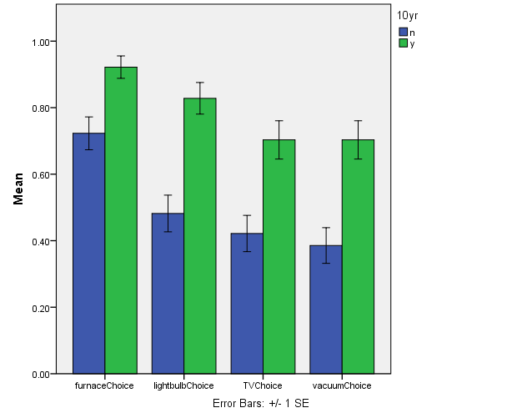
Study 2: Choice Results

Slide 99
Study 2: Goal activation
If you were purchasing a new [furnace], what product features would be most important to you? Please be as specific as possible.
Most important: ________________
Second most important: ________________
Third most important: ________________

Slide 100
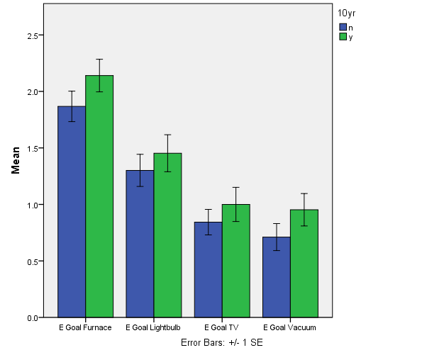
Study 2: Goal Activation Results

Slide 101
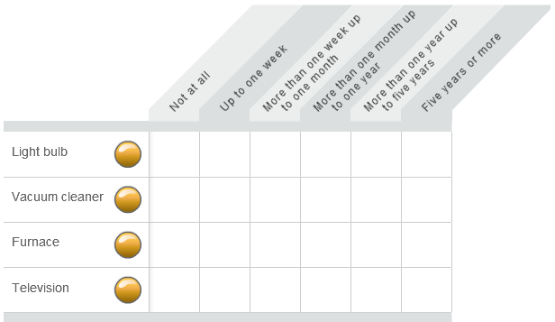
Study 2: Time Horizon
When you are purchasing any of the products below, how far ahead do you plan?

Slide 102
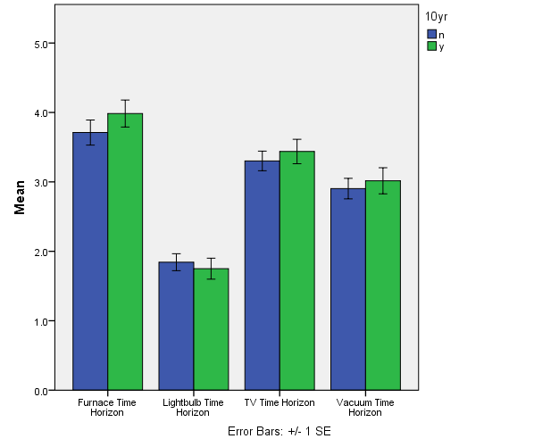
Study 2: Planning horizon results

Slide 103
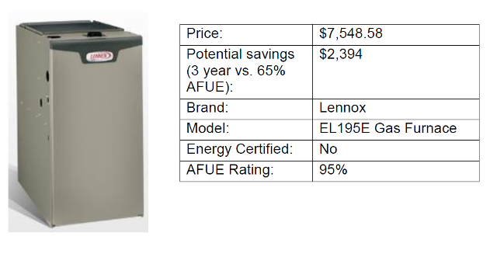
Study 2: Cost estimation
Please imagine that you purchased this [furnace] for use in your home:
​How much do you estimate you would spend on energy to use this furnace in your home, over a period of 10 years? $_______________

Slide 104
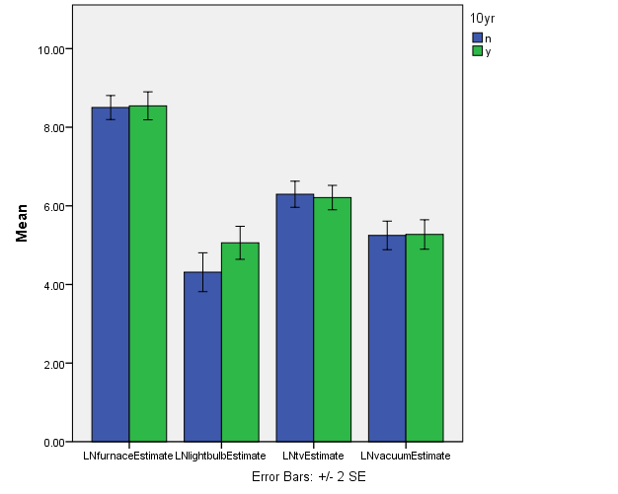
Study 2: Cost estimation results

Slide 105
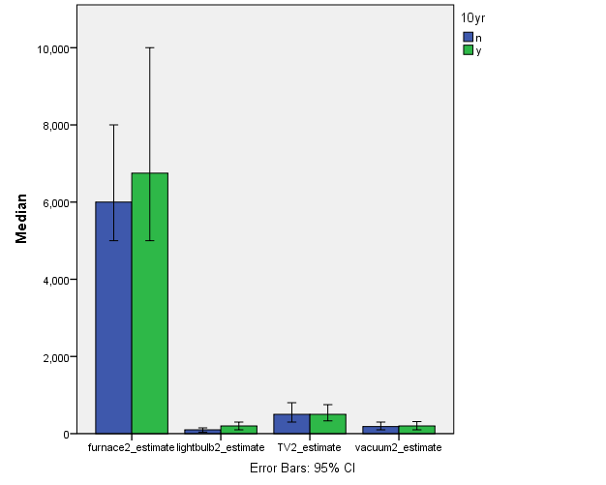
Study 2: Cost estimation results

Slide 106
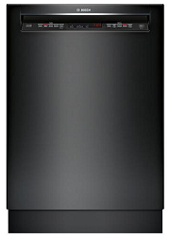
Study 3: Methods
Price: $764.99
Estimated Annual Dollars [Energy] Saved [Wasted]: $27 [259 kWh]
Interior Capacity: Up to 16 place settings
Dishwasher Type: Full-size built-in
Brand: Bosch
Price: $649.99
Estimated Annual Dollars [Energy] Saved [Wasted]: $0 [279 kWh]
Interior Capacity: Up to 14 place settings
Dishwasher Type: Full-size built-in
Brand: LG
Notes:
Image source left: https://www.ajmadison.com/cgi-bin/ajmadison/SHE53TL6UC.html
Image source right: https://www.ajmadison.com/cgi-bin/ajmadison/LDS4821BB.html

Slide 107
Study 3: Results (Real)

Slide 108
Going forward
Further explore mediators
Compare with & against existing methods (social norms, defaults, etc)
Field studies & implementation

Slide 109
Review
When making intertemporal decisions, people avoid uncertainty
In interdependent games under uncertainty, precommitment can raise investment rates
You can nudge consumers towards energy efficient options by making future operational costs salient on labels

Slide 110
Thank You!

