Slide 1
Understanding the Expense Prediction Bias
Chuck Howard
Sauder School of Business
University of British Columbia
David Hardisty
Sauder School of Business
University of British Columbia
Melissa Knoll
Consumer Financial Protection Bureau
US Federal Government
Abigail Sussman
Booth School of Business
University of Chicago
Notes:
Images from unsplash.com

Slide 2
What is Expense Prediction Bias?
Expense Prediction Bias (EPB) is the persistent underestimation of future expenses
Notes:
Image from unsplash.com

Slide 3
Background – Expense Misprediction
Previous research on expense misprediction has shown that people tend to under-predict their future expenses
Ulkumen, Thomas & Morowitz (2008): monthly (vs. yearly) budget forecasts are much lower than recorded expenses
Peetz & Buehler (2009): people underestimate future spending as a result of their savings goals
Sussman & Alter (2012): consumers underestimate their spending on exceptional expenses due to narrow categorization

Slide 4
Research Questions
Why is the bias important?
How big is it?
Does it predict negative financial outcomes?
How can we neutralize it?
If the answer to the questions above is “yes” how can make this thing go away?

Slide 5
Study 1 - Overview
How big is the expense prediction bias in an adult sample?
Is there a corresponding income bias?

Slide 6
Participants
Participants were adult Americans recruited
online via Amazon Mechanical Turk
Mean age = 34
Strong majority report having at least some college education (mode response is a 4 year degree)
Mode income is $30,000 - $39,999

Slide 7
Study 1 – Method
200 participants were asked to recall and predict their expenses and income for last week and next week
EPB score = recalled expenses minus predicted expenses

Slide 8
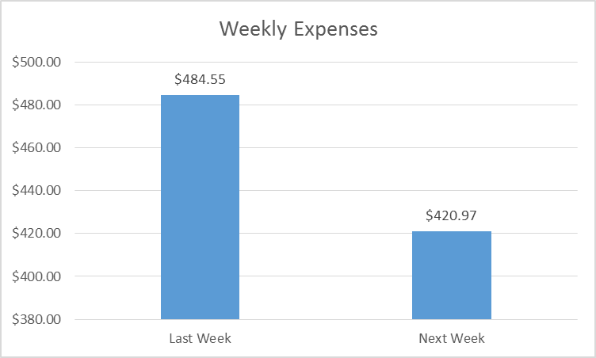
Study 1 – Results
Mean EPB = $63.58 (p=.03) 🡪 Predicted expenses were forecasted to be 13.0% lower than past expenses
No corresponding income bias was observed

Slide 9
Study 2 - Overview
Does EPB predict negative financial outcomes?
Intuition: This bias could have a negative impact on your household’s financial well-being, particularly if you’re low income
Notes:
Image from unsplash.com

Slide 10
Study 2 - Overview
Does considering past expenses neutralize EPB?
Planning fallacy: The underestimation of the time it will take to complete a future task, despite the knowledge that previous tasks have generally taken longer than planned (Kahneman & Tversky, 1979; Buehler, Griffin & Peetz, 2010)
People focus on plan-based scenarios rather than on relevant past experiences while generating their predictions (Buehler, Griffin & Ross, 1994)

Slide 11
Study 2 - Method
1514 participants recalled and predicted their expenses, then they were provided with a list of common expenses to consider and given the option to revise their initial estimates
Participants were also asked to report their experience with payday loans

Slide 12
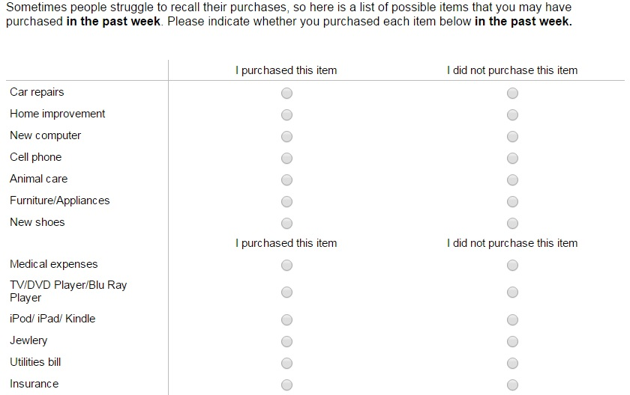
Study 2 - Method

Slide 13
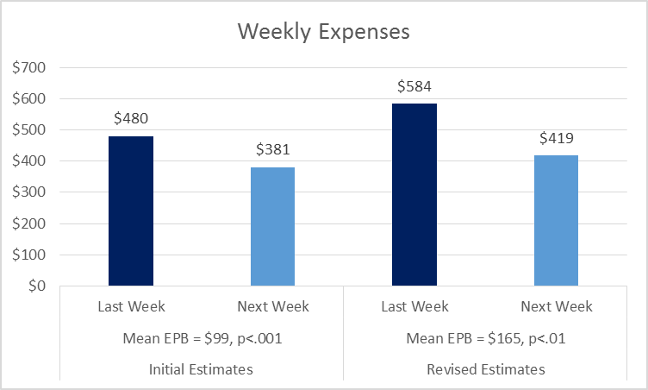
Study 2 – EPB Results

Slide 14
Study 2 – Payday Loan Results
Initially, EPB was modestly higher among payday loan users (mean difference =$74, p=.07)
After consideration and revision, the difference in EPB between payday loan users and non-users grew to $233 (p=.01)

Slide 15
Study 3 – Overview
Is EPB impacted by expense categorization?
The planning fallacy can be ameliorated when people “unpack” multifaceted tasks into subcomponents (Kruger & Evans, 2004)

Slide 16
Study 3 – Overview
Are people underestimating the dollar amount of future expenses, and/or the number of future expenses they will encounter?

Slide 17
Study 3 - Method
405 participants were randomly assigned to recall and predict expenses in either a single general expense category, or in multiple expense categories (required, optional, expected, unexpected)
Expense listing task

Slide 18
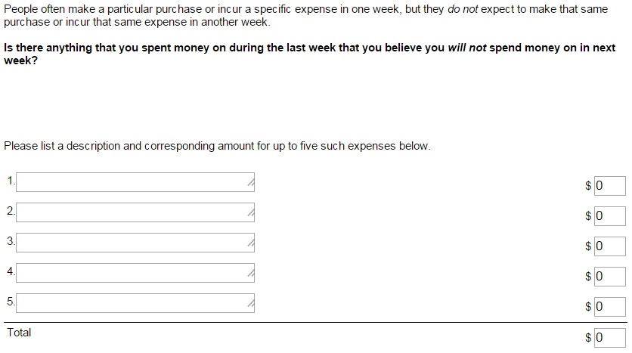
Study 3 - Method
Notes:
Expense listing task asked participants to estimate the dollar amount of up to five unique expenses that they had during the last week and believed they would not have during the next week, as well as five unique expenses that they anticipated having next week but did not have during the last week

Slide 19
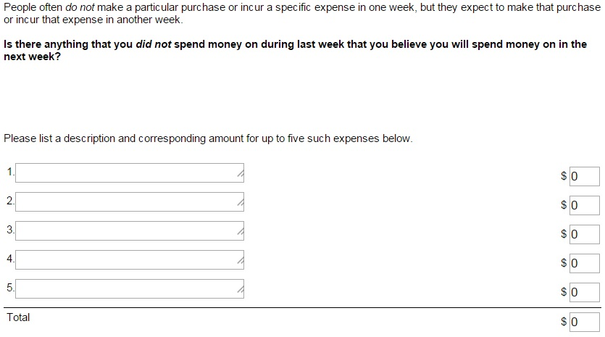
Study 3 - Method

Slide 20
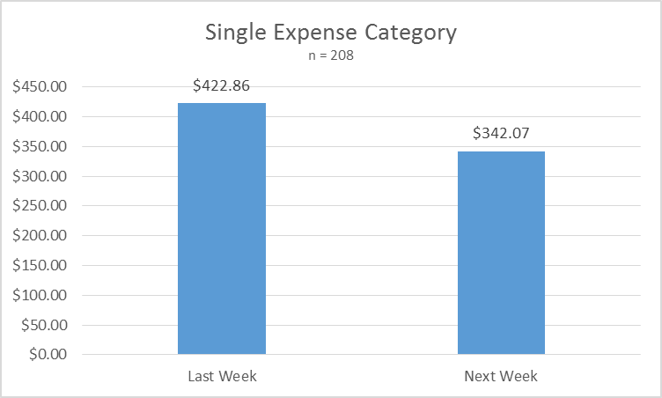
Study 3 - Results
EPB = $80.79, p<.01

Slide 21
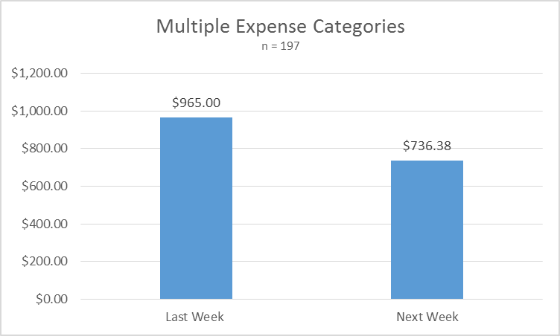
Study 3 - Results
EPB = $228.58, p=.02

Slide 22
Study 3 - Results
Participants underestimated the number but not the amount of unique expenses
Mean difference for number = 0.66, p<.001
Mean difference for average amount = $19.48, p=.34

Slide 23
Study 4 – Overview
Can perceived similarity or difference of upcoming expenses relative to past expense moderate EPB?

Slide 24
Study 4 - Method
295 Mturkers were randomly assigned to one of the following three conditions:
Control Condition
Recall and predict weekly expenses
Different Condition
Recall weekly expenses, provide three reasons why next week’s expenses might be different from any other week’s expenses, predict weekly expenses
Similar Condition
Recall weekly expenses, provide three reasons why next week’s expenses might be similar to any other week’s expenses, predict weekly expenses

Slide 25
Study 4 - Results
F(2, 292)=11.98, p<.001

Slide 26
Summary
EPB is a robust phenomenon that prevails in a variety of expense frames (e.g., single vs. multi-category frames)
Unique to expenses (no corresponding income bias has been observed)
Associated with risky financial outcomes such as payday loans use
Associated with consumers underestimating the number of future expenses, but not the amount of each one
May be reversed by the perceived differentness of future expenses to past expenses

Slide 27
Directions for Future Research
What are the downstream consequences of the bias?
Acceptability of payday loan rates
Sensitivity to APR

Slide 28
Thank you
chuck.howard@sauder.ubc.ca

