Slide 1
Imagine 2015: Meet a Prof Professor David J. Hardisty
Marketing & Behavioural Science
Notes:
5 minutes=
Welcome to your first university lecture at UBC!
This is what your classes will look like at UBC. Look around the room…there are a lot of us! This is the new norm for you!
Introduce yourself as a Squad Leader, what you do who you are, what you ate today etc.
Introduce the Orientation professor or have him/her introduce him/herself
Image source: https://www.universitymagazine.ca/university-british-columbia/

Slide 2
Outline
About me & my research
3 tips for student life at UBC
Q & A

Slide 3
About me
Grew up in Seattle
Undergrad at Stanford
Taught English in Osaka, Japan
Worked as a freelance web developer in Paris, France
Masters in psychology at Paris Descartes
PhD in psychology at Columbia University in New York
Post-doc at Stanford Graduate School of Business
Began as Assistant Prof of Marketing at UBC in July, 2013
Research on decisions about the future, especially sustainability
Hobbies: hiking/skiing, games, beer, soccer

Slide 4
>
Notes:
this will be on the midterm
Logo source:
https://www.kickalgor.com/team/us-teams/us-clubs/seattle-sounders-fc/
https://www.geappliances.ca/pressroom/ge-appliances-newest-partner-vancouver-whitecaps

Slide 5
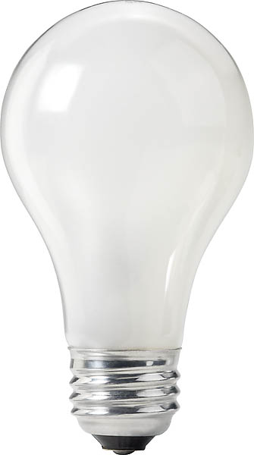
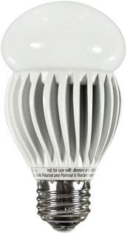
An economic mystery
Price: $0.97
Watts: 60
Lumens: 820
Price: $17.99
Watts: 13
Lumens: 800
(Saves $188 on energy)
Notes:
Image source (left): https://www.rona.ca/en/product/feit-electric-light-bulb-bright-white-a15-bulb-shape-40-watt-bp40a15-can-31925045
Image source (right): https://www.bulbconnection.com/product/4909-TCP-80101450-14W-SPRINGLIGHT-50K-14w-Spiral

Slide 6
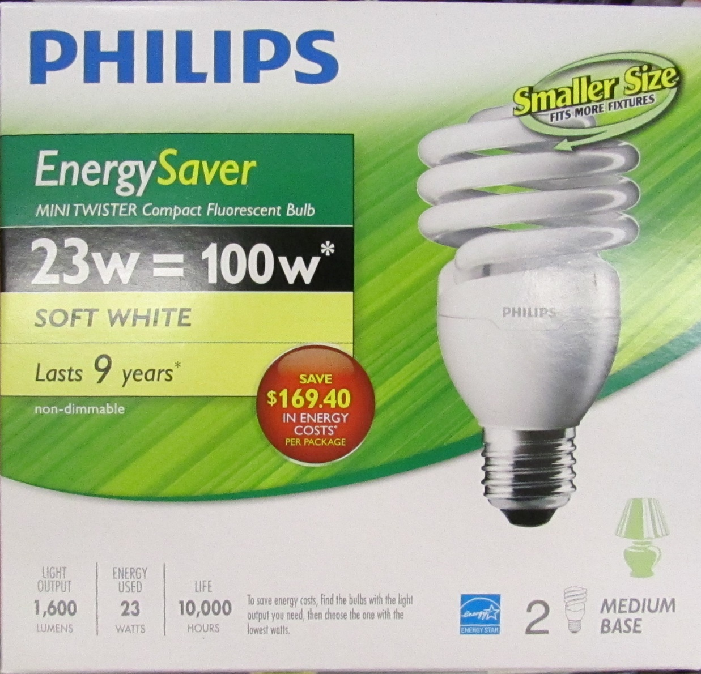
Consumers don’t care about the future?
Notes:
Image source: https://www.walmart.ca/en/ip/philips-23w-100w-mini-twister-soft-white-cfl-bulb-2-pack-soft-white/6000200197323

Slide 7
Our theory
Consumers have a latent goal to reduce long-term costs
Price: $0.97
10-year energy cost: $239
Watts: 60
Lumens: 820
Price: $17.99
10-year energy cost: $52
Watts: 13
Lumens: 800
Notes:
Image source (left): https://www.rona.ca/en/product/feit-electric-light-bulb-bright-white-a15-bulb-shape-40-watt-bp40a15-can-31925045
Image source (right): https://www.bulbconnection.com/product/4909-TCP-80101450-14W-SPRINGLIGHT-50K-14w-Spiral

Slide 8
Online Survey Results
Normal labels:
15% mention long-term cost or energy efficiency
30% choose the efficient bulb
10-year cost labels:
61% mention long-term cost or energy efficiency
67% choose the efficient bulb
Other survey results:
Works with other products: TVs, washing machines, etc.
Energy savings and dollar savings labels don’t do much
Asking consumers to estimate the 10-year cost of each product: equally effective

Slide 9
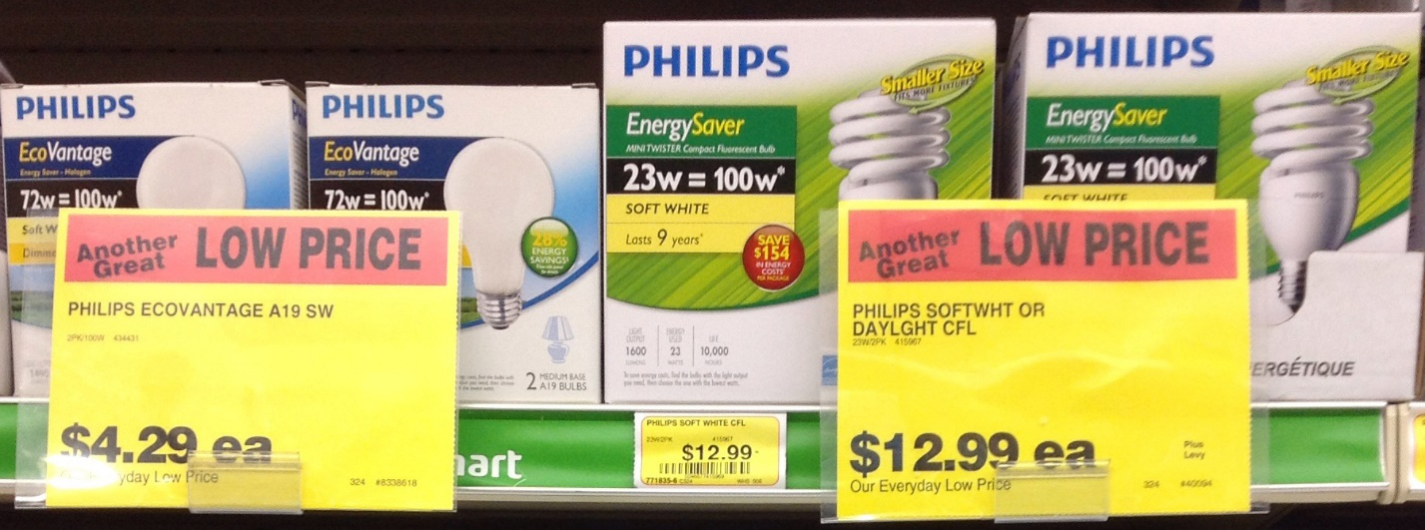
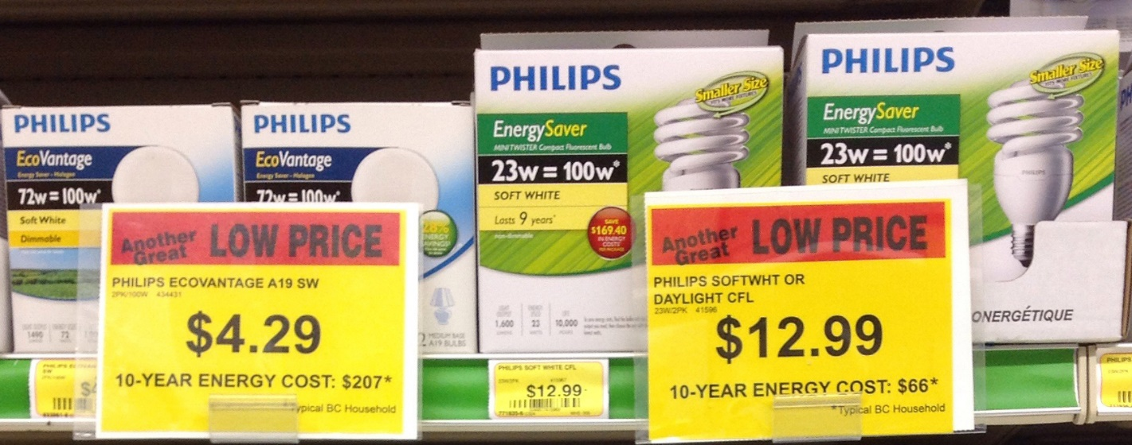
Does it work in real stores?
12%
chose efficient option
48%
chose efficient option
Notes:
Increased units sold by 47%, increased sales by 134%

Slide 10
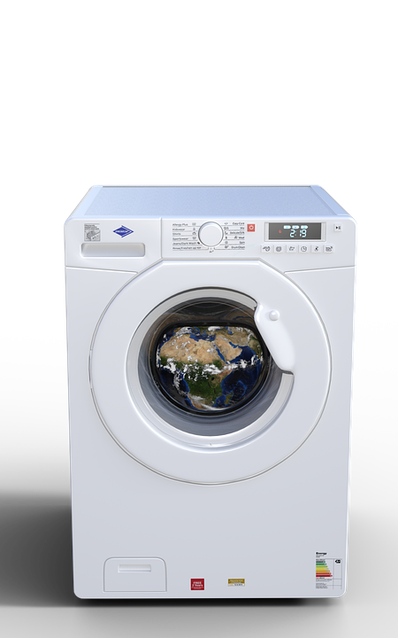
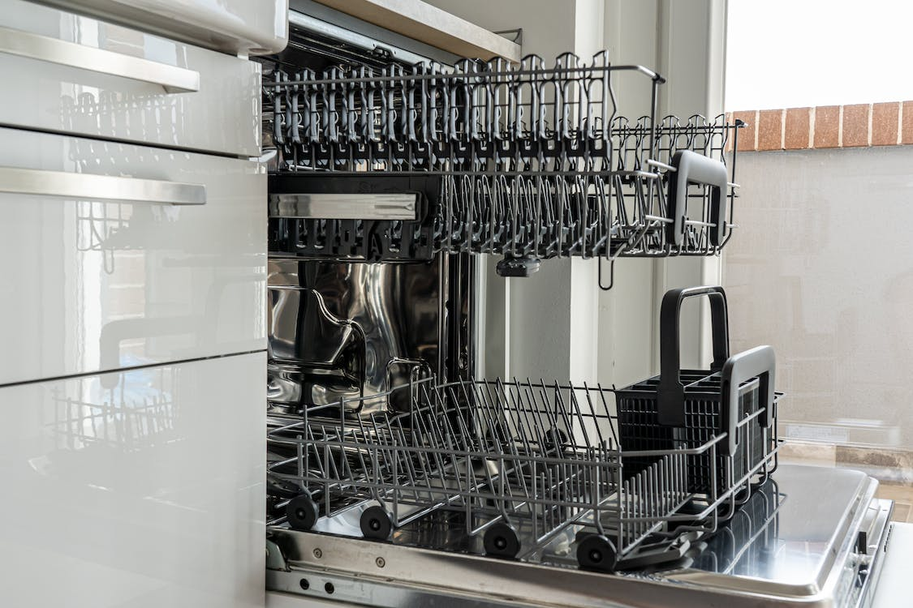
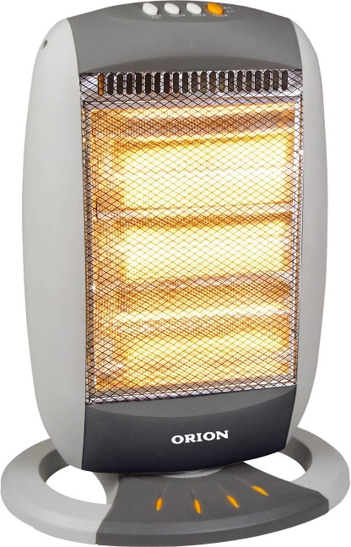
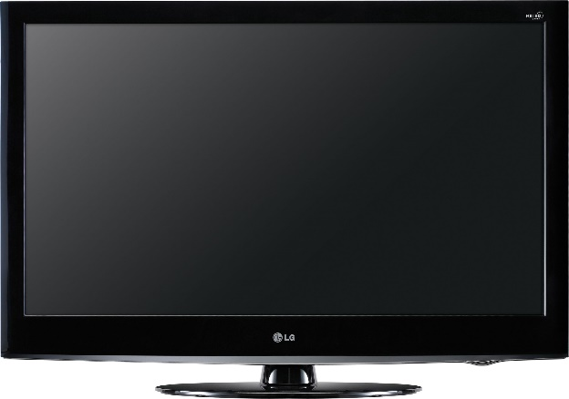
Let’s scale this up
Triple winner:
Good for the consumer
Good for the firm
Good for the environment
Notes:
Heater image source: https://www.differencebetween.info/difference-between-blower-and-heater
LG TV image source: https://www.cnet.com/a/img/resize/4b6be5faebc941174151e6c8d4def4ace53387ea/hub/2010/04/09/1f919ab4-cbf2-11e2-9a4a-0291187b029a/orig-42lh3000_front.jpg?auto=webp&width=768
The rest: https://unsplash.com/

Slide 11
3 Tips
Get ready to fail
Academically
Socially
Learn useful skills
Web development
Research
Languages
Participate
Classes
Clubs & events

Slide 12
Questions?
Feel free to ask anything
Notes:
https://www.youtube.com/watch?v=LJYVuXqg-Dg

