Slide 1

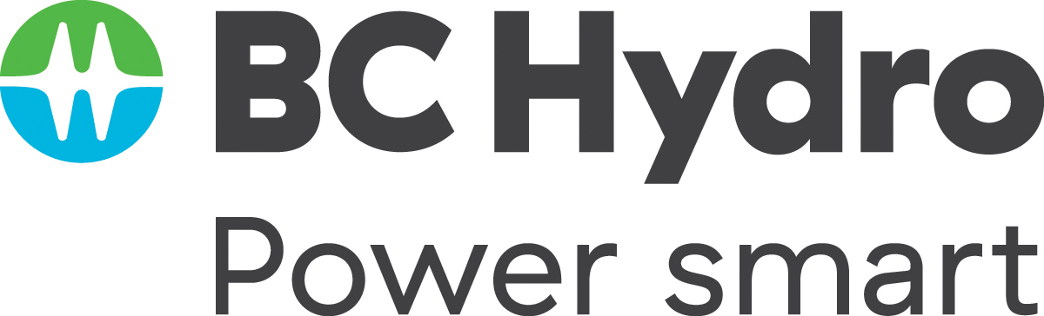
Twice as nice?
A Longitudinal Field Study of Separate vs. Combined Nudges for Household Laundry Behaviours

Slide 2
Co-Authors & Partners
UBC
David Hardisty
Kirstin Appelt
Sid Mookerjee
Yanwen Wang
Jiaying Zhao
BC Hydro
Arien Korteland
Valerie Rodrigues
Netu Sidhu

Slide 3
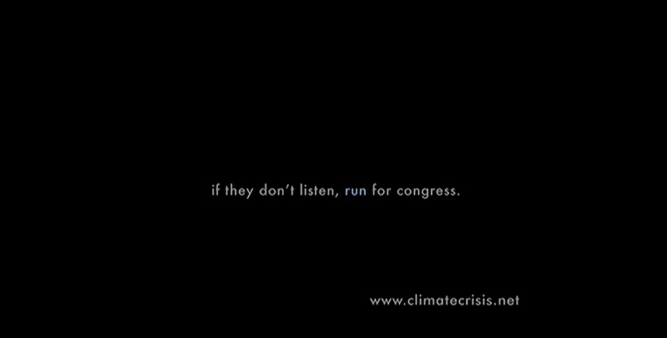
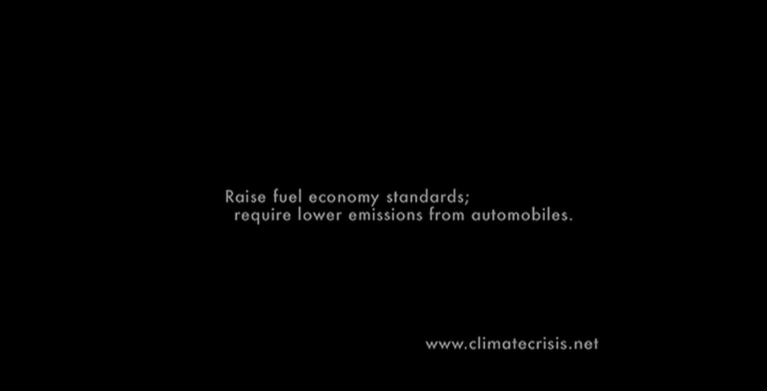
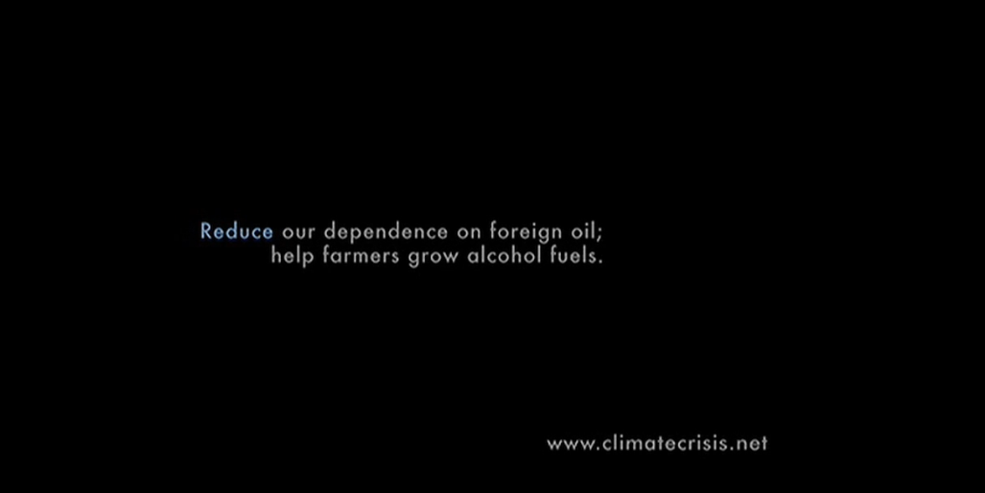
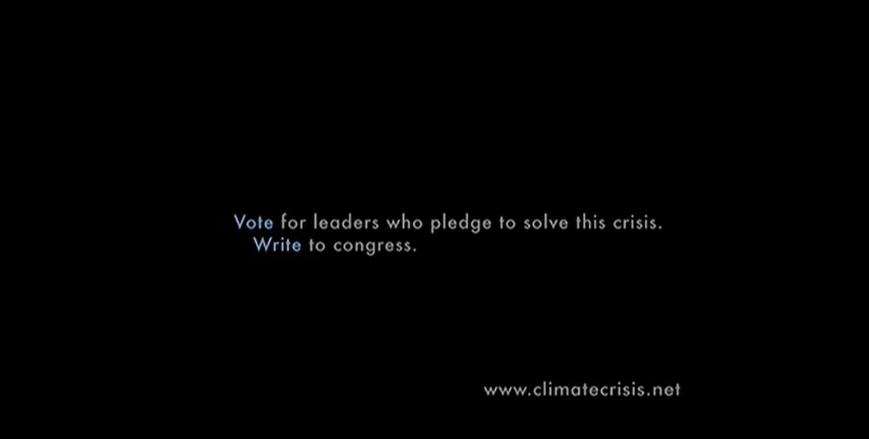
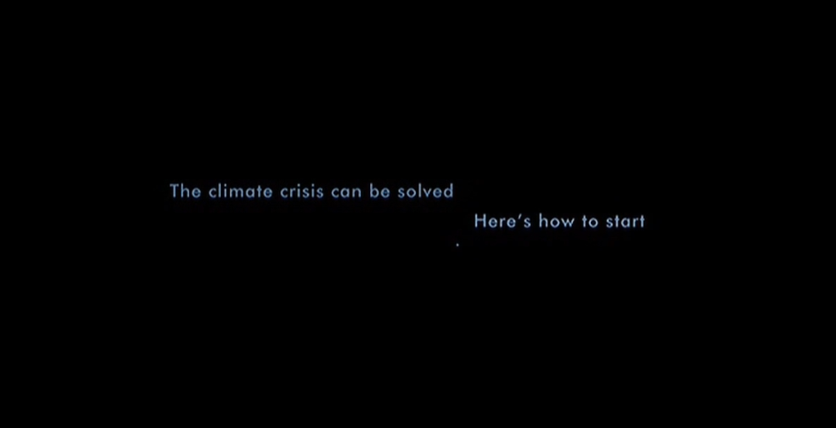
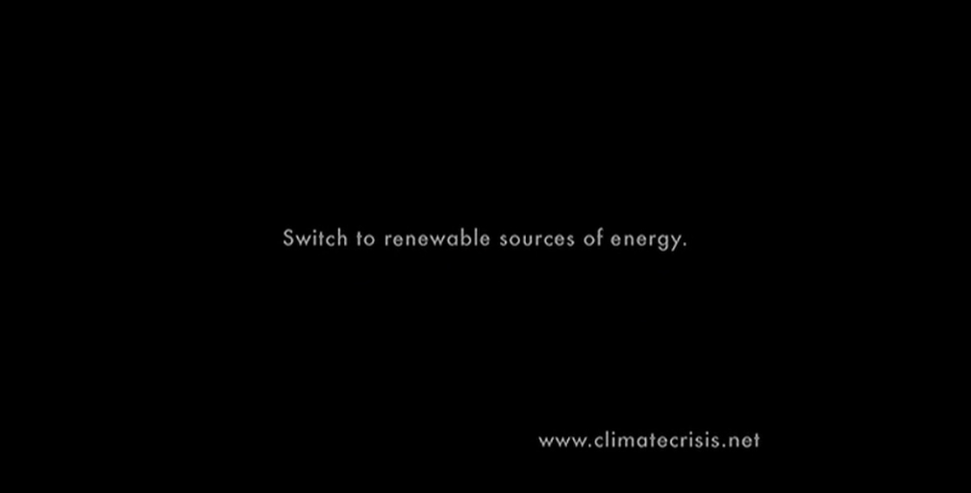
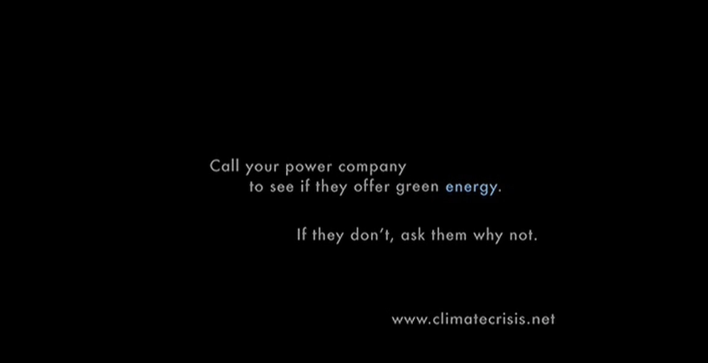
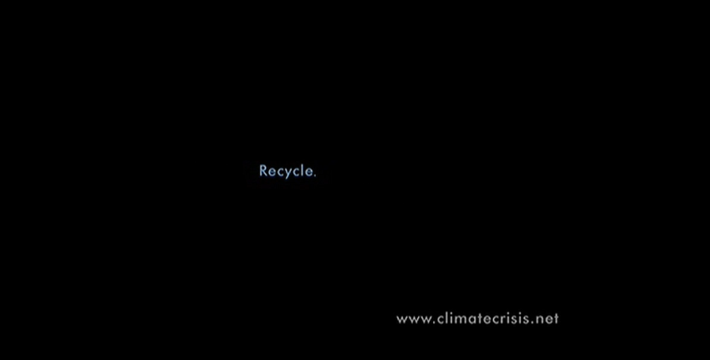
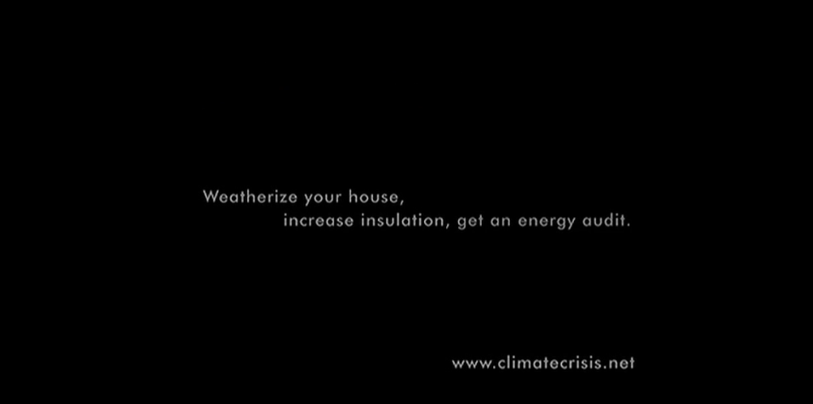
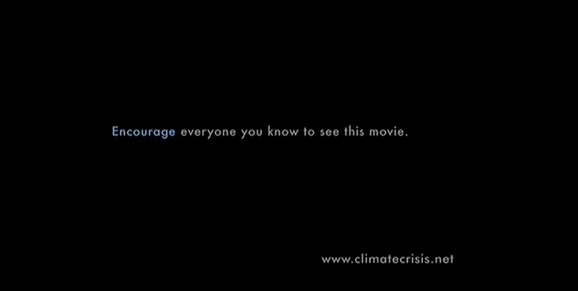
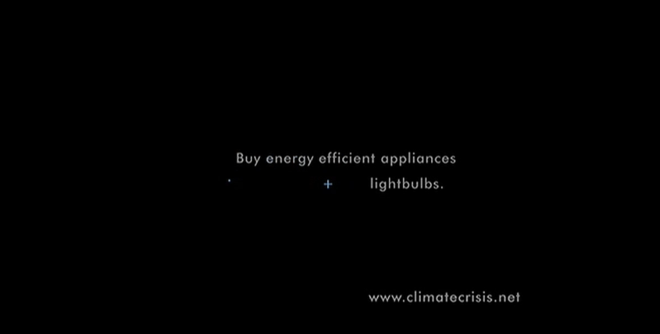
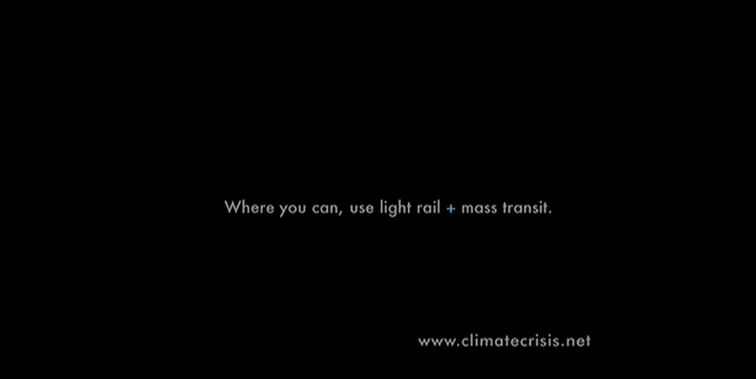
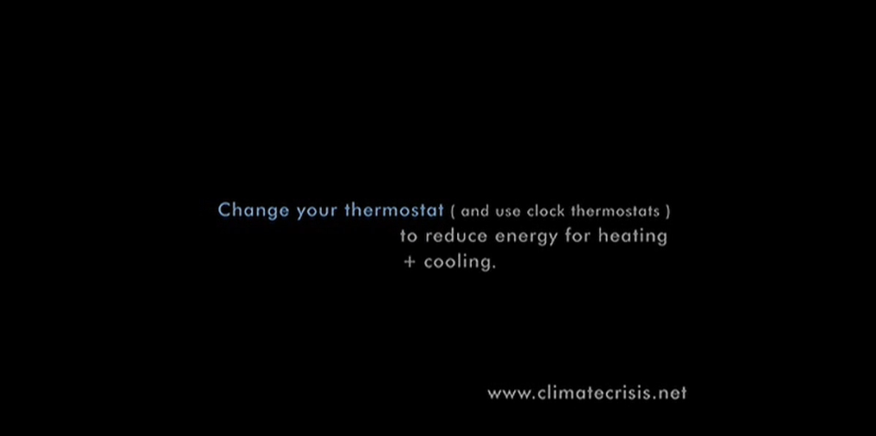
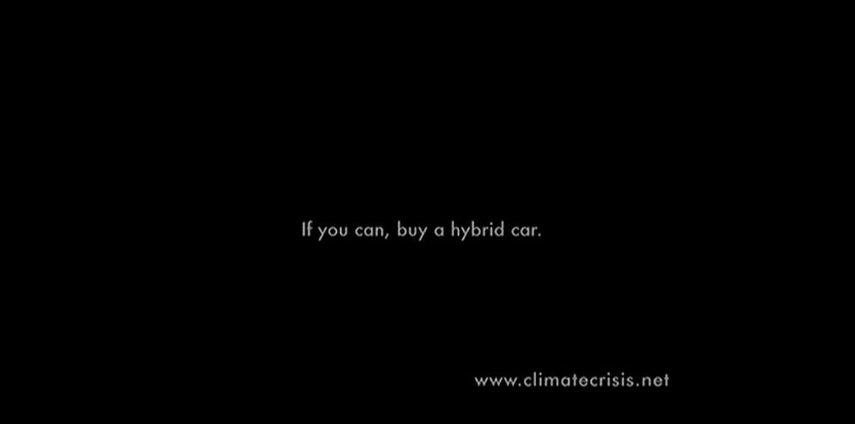
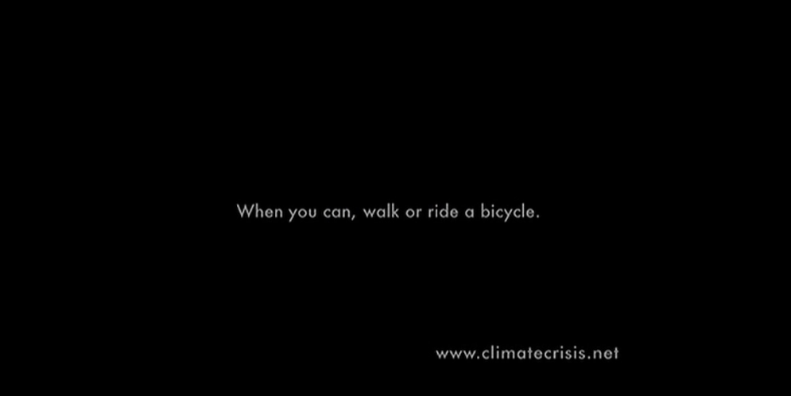
Motivation
Who’s seen An Inconvenient Truth?

Slide 4
Research Questions
In an applied, “Behavioural Insights” setting:
How to nudge sustainable behaviour change?
Better to use “prosocial” motivation, “pro-self” motivation, or both together?
Better to make many requests for behaviour change, or focus on one?

Slide 5
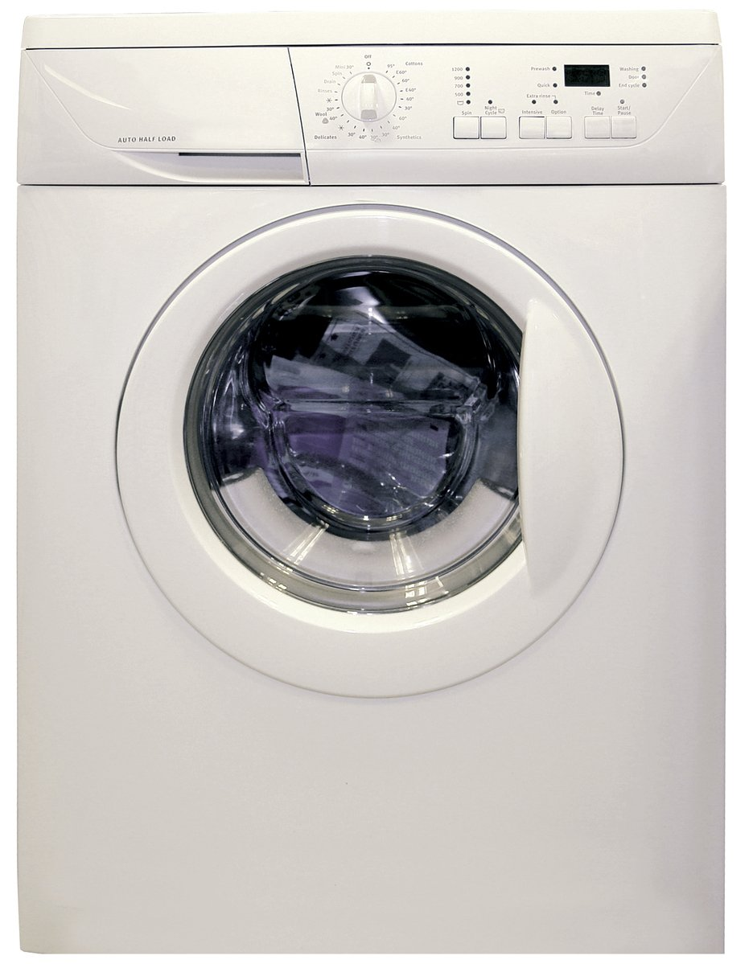
Target Behaviours
Laundry represents about 19% - 28% of home energy use in houses using electric water heating (BC Hydro calculations based on data from https://www.energystar.gov/ )
Little research on changing laundry behaviour
Target behaviours:
Re-wear
Combine loads
Use cold water
Hang dry clothes
Image credit: https://en.wikipedia.org/wiki/Clothes_dryer#/media/File:Clothes_Dryer.jpg
Notes:
Image source: https://www.freeimages.com/photo/washing-machine-1418432

Slide 6

Agenda
Literature review
Pilot surveys
Main study design
Hypotheses
Behavioural intention results
Self-report results
Behaviour logging results
Energy meter results
Summary & Conclusions
Notes:
Main study dates: June 2021 – May 2022

Slide 7
Brief Literature Review

Slide 8
Literature Review
Short-term vs. long-term effects
Most “nudging” studies only examine a single choice
Dynamic energy competitions can be effective long-term (Schultz et al 2007; Wemyss et al., 2019), but only while the feedback is maintained
Defaults and auto-escalation are effective long-term (e.g., Benartzi & Thaler 2013; Kaiser et al. 2020)
Spillover effects
Meta-analysis shows positive spillover effects on intentions, but small negative effects on actual behaviour and policy support (Maki et al., 2019)
Single request vs multiple simultaneous requests??
Monetary vs. environmental motivation
Financial and environmental framing can both improve energy efficient purchases, especially when scaled up (Camilleri & Larrick 2014; Hardisty et al. 2020; Ungemach et al 2018)
Though some studies find crowding out when both are used (Frey & Oberholzer-Gee, 1997)
Financial and environmental messaging both improve energy saving intentions (Steinhorst, Klöckner, & Matthies, 2015; Steinhorst & Klöckner, 2018), but not actual behaviour (Steinhorst & Klöckner, 2018)

Slide 9
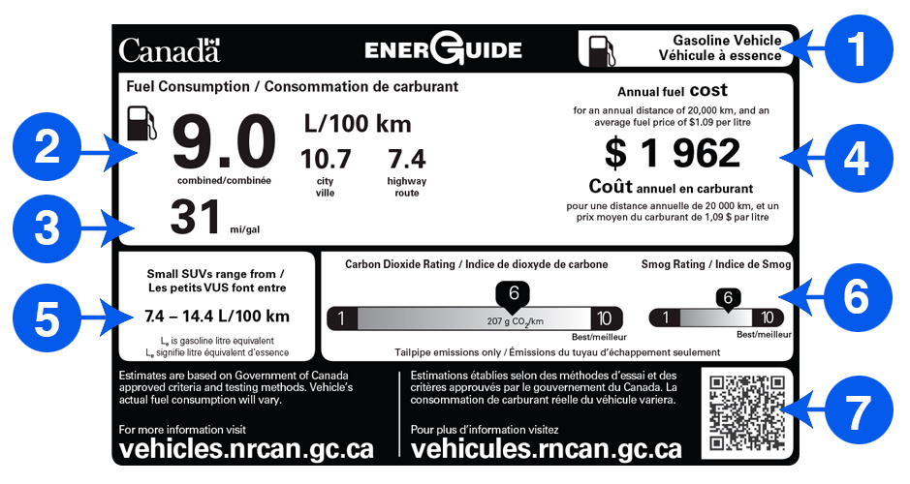
Literature Review
Image credit: https://www.nrcan.gc.ca/energy-efficiency/energuide-canada/energuide-vehicles/21010

Slide 10
Pilot Surveys

Slide 11
Pilot Surveys
Perhaps a decal on the laundry machine could provide a lasting nudge?
Constant reminder
Attractive
Low-cost
What‘s the right message?
Pilot surveys pre-tested ideas via hypothetical scenarios on Prolific
In qualitative pilot, most people said they care about their clothing, but not microplastics
Perhaps a novel motivation (microplastics) would be effective?
Vivid imagery might help?

Slide 12
Main Study Design
Pre-registration: https://aspredicted.org/WWZ_WQ3
*but most analyses I’ll show you are exploratory

Slide 13
Study Design: Participants
1,210 BC Hydro customers recruited from BC Hydro’s Team Power Smart program and completed the first survey
Follow-up surveys every 3 months, for 1 year total
Must have Washing Machine & Clothes Dryer and pay BC Hydro bill
64% women, mean age = 57
Research questions:
Long term impact of decal nudge?
Pro-environment message, pro-self, or both?
Request many behavior changes, or just one hard one?
Notes:
Note: 1,647 agreed to participate in advance, but only 1,158 completed the time 1 survey, mostly due to blocked emails from Microsoft-related email addresses (such as @hotmail, @outlook, @msn, and @live email addresses) blocking our emails.

Slide 14
Target Laundry Behaviours
Re-wear
Combine loads
Use cold water
Hang dry clothes

Slide 15
Study Design: Overview
Independent Variable: Participants randomly assigned to one of six conditions
Control (no decal)
Control (QR logging decal)
Turtle appeal to change 4 behaviours
Fleece appeal to change 4 behaviours
Turtle + fleece appeal to change 4 behaviours
Turtle + fleece appeal to hang dry
Dependent Variables:
Laundry behaviour change intentions to re-wear, combine loads, cold water, hang-dry
Retrospective self-report of efficiency behaviours, every 3 months for one year
Ongoing log of laundry behaviour for six months
Energy meter data (hourly level) for one year, including 1-year prior history

Slide 16
Control (no decal)
Notes:
The results from this condition were fairly similar to the Control Decal, so I won’t discuss it further, to simplify this short presentation

Slide 17
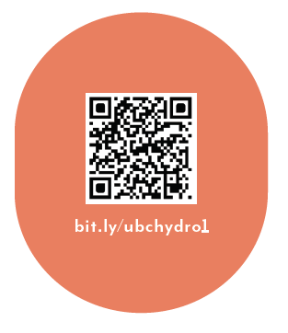
Control (logging decal only)
As part of your participation in this study, we will mail you a decal to put on your washer or dryer, which will look like the following:

Slide 18
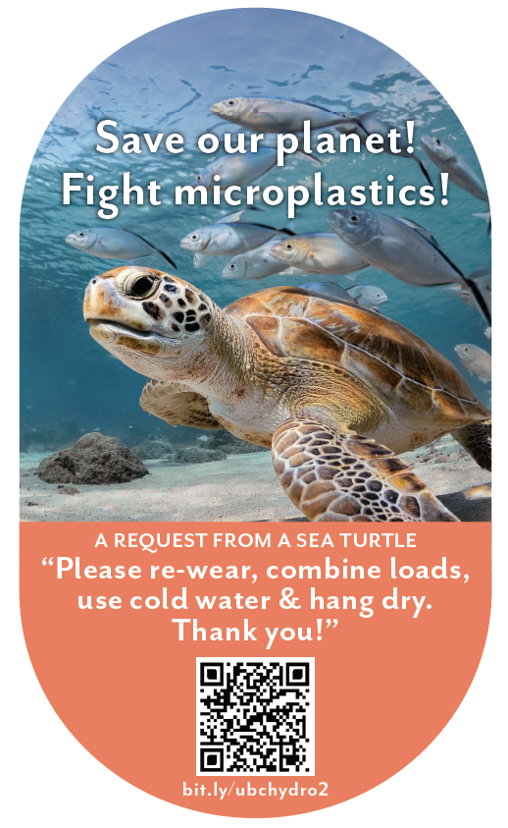
Sea Turtle + Bundled
When you machine wash and dry your clothes with hot water and hot air, “microplastics” come out of your clothes. In fact, experts say that between 700,000 and 12 million microfibres can be shed during one single load of laundry. It is estimated that laundry is responsible for 35% of microplastics in our oceans, seriously harming sea turtles and other marine life. You can save our planet by: - Re-wearing clothes more often - Combining loads to run fewer, larger loads of laundry - Washing laundry with cold water, rather than hot water or warm water - Hanging clothes to dry (inside or outside), rather than machine-drying clothes As part of your participation in this study, we will mail you a decal to put on your washer or dryer, which will look like the following:

Slide 19
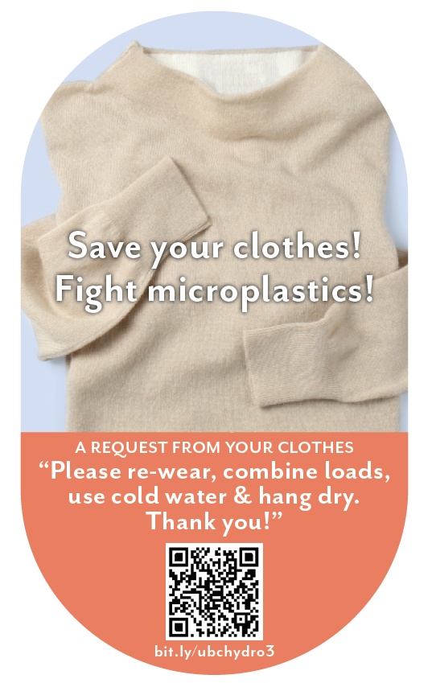
Clothing + Bundled
When you machine wash and dry your clothes with hot water and hot air, “microplastics” come out of your clothes. In fact, experts say that between 700,000 and 12 million microfibres can be shed during one single load of laundry. This breaks down the fabric in your clothes, damaging it and shortening the amount of time you’ll be able to enjoy wearing it. You can save your clothes by: - Re-wearing clothes more often - Combining loads to, run fewer, larger loads of laundry - Washing laundry with cold water, rather than hot water or warm water - Hanging clothes to dry (inside or outside), rather than machine-drying clothes
As part of your participation in this study, we will mail you a decal to put on your washer or dryer, which will look like the following:

Slide 20
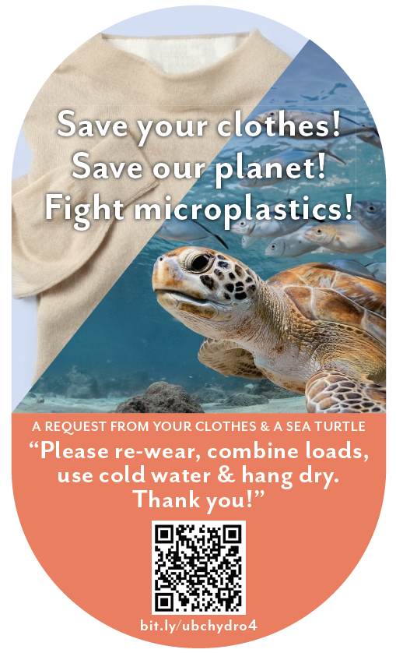
Turtle + Clothing + Bundled
When you machine wash and dry your clothes with hot water and hot air, “microplastics” come out of your clothes. In fact, experts say that between 700,000 and 12 million microfibres can be shed during one single load of laundry. This breaks down the fabric in your clothes, damaging it and shortening the amount of time you’ll be able to enjoy wearing it. It is also estimated that laundry is responsible for 35% of microplastics in our oceans, seriously harming sea turtles and other marine life. You can save your clothes and save our planet by: - Re-wearing clothes more often - Combining loads to, run fewer, larger loads of laundry - Washing laundry with cold water, rather than hot water or warm water - Hanging clothes to dry (inside or outside), rather than machine-drying clothes As part of your participation in this study, we will mail you a decal to put on your washer or dryer, which will look like the following:

Slide 21
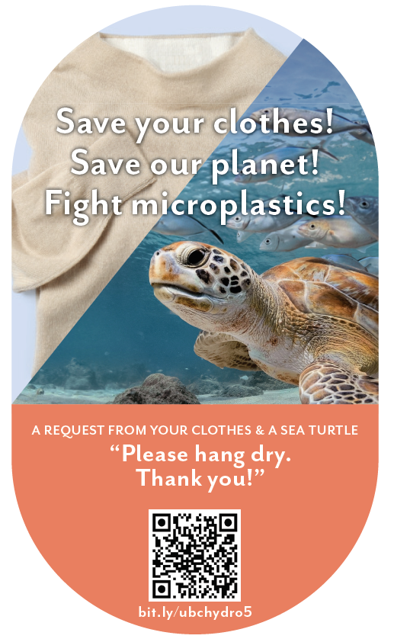
Turtle + Clothing + Hang Dry
When you machine wash and dry your clothes with hot water and hot air, “microplastics” come out of your clothes. In fact, experts say that between 700,000 and 12 million microfibres can be shed during one single load of laundry. This breaks down the fabric in your clothes, damaging it and shortening the amount of time you’ll be able to enjoy wearing it. It is also estimated that laundry is responsible for 35% of microplastics in our oceans, seriously harming sea turtles and other marine life.
You can save your clothes and save our planet by: - Hanging clothes to dry (inside or outside), rather than machine-drying clothes As part of your participation in this study, we will mail you a decal to put on your washer or dryer, which will look like the following:

Slide 22
Intentions Results

Slide 23
Intentions to engage in efficient laundry behaviours
Label | Cold Water | Rewear | Combine Load | Hang Dry | Average
QR Scan Only Control (n=185) | 3.25 | 3.10 | 3.19 | 3.44 | 3.25
Sea turtle + bundled msg (n=189) | 3.61* | 3.47* | 3.46* | 3.60 | 3.53*
Fleece + bundled msg (n=200) | 3.58* | 3.52* | 3.48* | 3.61* | 3.55*
Sea turtle + fleece + bundled msg (n=184) | 3.60* | 3.42* | 3.40* | 3.54 | 3.49*
Sea turtle + fleece + hang dry msg (n=189) | 3.56* | 3.42* | 3.38* | 3.77* | 3.53*
Note: Participants answered on a 1-5 scale from 1=“much less often” to 3=“the same” to 5=“much more often”. * indicates significant difference from control

Slide 24
Intentions to engage in efficient laundry behaviours
Summary:
All decals increased intentions to improve behaviours
Roughly equally effective on intentions

Slide 25
Summary: Decal Effectiveness vs Control
Condition | Intentions | Self-report | Logged Washing | Logged Drying | Metered Washing | Metered Drying
Turtle + Bundle | ✓
Fleece + Bundle | ✓
Turtle + Fleece + Bundle | ✓
Turtle + Fleece + Hang Dry | ✓

Slide 26
Retrospective Self-report Results

Slide 27
Retrospective Self-report Results
Takeaway:
From S2 to S5, participants in the control condition were less likely to report engaging in laundry efficient behaviours. “Sea turtle+bundled” message was more effective than control condition, p<.001

Slide 28
Self-report of efficient laundry behaviours
Summary:
Two decal messages marginally improved self-reported behaviours over time: Microplastics turtle + bundled msg and Microplastics turtle + fleece+hang-dry msg

Slide 29
Summary: Decal Effectiveness vs Control
Condition | Intentions | Self-report | Logged Washing | Logged Drying | Metered Washing | Metered Drying
Turtle + Bundle | ✓ | ✓
Fleece + Bundle | ✓
Turtle + Fleece + Bundle | ✓
Turtle + Fleece + Hang Dry | ✓

Slide 30
Behaviour Logging Results

Slide 31
Condition: p < .001
Month: p < .001
Condition X Month: p = .72

Slide 32
Condition: p < .001
Month: p = .61
Condition X Month: p = .88

Slide 33
Condition: p < .001
Month: p < .001
Condition X Month: p = .86

Slide 34
Summary: Decal Effectiveness vs Control
Condition | Intentions | Self-report | Logged Washing | Logged Drying | Metered Washing | Metered Drying
Turtle + Bundle | ✓ | ✓ | ✓ | ✓
Fleece + Bundle | ✓ |  | ✓
Turtle + Fleece + Bundle | ✓ |  | ✓
Turtle + Fleece + Hang Dry | ✓ |  |  | ✓

Slide 35
Energy Meter Results

Slide 36
Condition: p = .02
Month: p < .001
Condition X Month: p = .44

Slide 37
kWh During Laundry Log Times
Condition | n | Total Energy | Wash Energy | Dry Energy | Ratio (Dry/Wash)
Control (Decal only) | 94 | 15,168 | 139 | 121 | 0.81
Turtle + Bundle Msg | 91 | 14,704 | 105† | 79* | 0.68**
Fleece + Bundle Msg | 98 | 15,778 | 141 | 121 | 0.8
Turtle + Fleece + Bundle Msg | 72* | 14,240 | 102† | 82* | 0.79
Turtle + Fleece + Hang Dry Msg | 92 | 14,410 | 122 | 86* | 0.69**
Symbols indicate significant differences from control. † p < .1, * p < .05, ** p < .01

Slide 38
Metered efficient laundry behaviours
Summary:
Small significant change in total energy usage, but data is noisy
When isolating laundry times, two conditions were effective: Turtle + bundled msg Turtle + fleece + hang dry
(Turtle + fleece + bundled msg also possibly effective, but looks like self-selection issues)

Slide 39

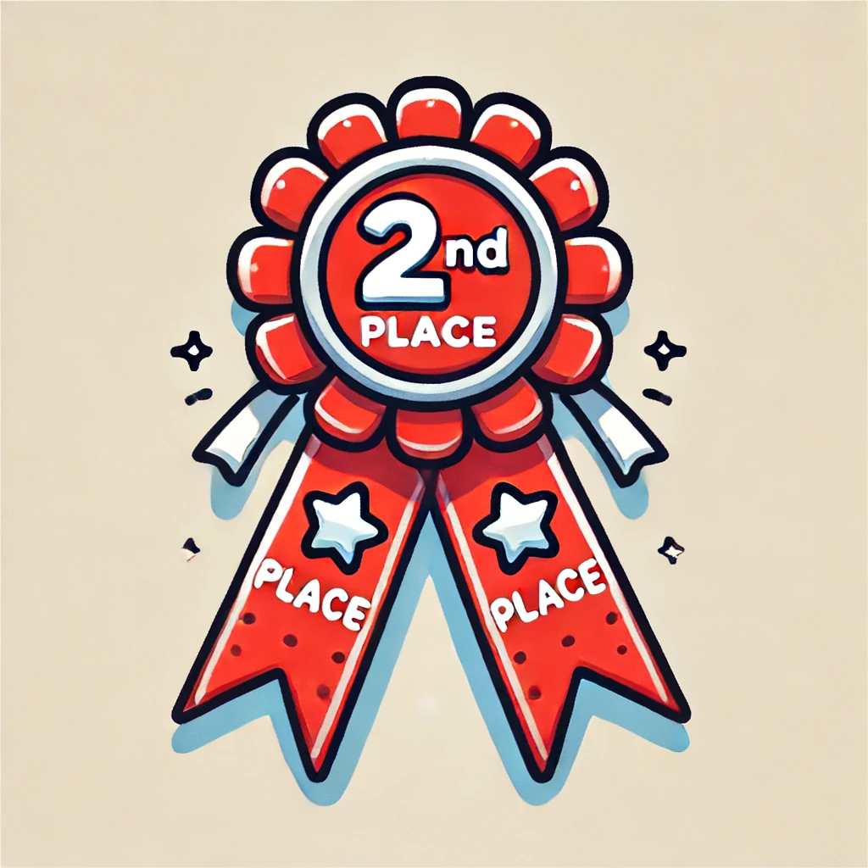
Summary: Decal Effectiveness vs Control
Condition | Intentions | Self-report | Logged Washing | Logged Drying | Metered Washing | Metered Drying
Turtle + Bundle | ✓ | ✓ | ✓ | ✓ | † | ✓
Fleece + Bundle | ✓ |  | ✓
Turtle + Fleece + Bundle | ✓ |  | ✓ |  | †
Turtle + Fleece + Hang Dry | ✓ |  |  | ✓ |  | ✓

Slide 40
Study Summary & Conclusions

Slide 41
Conclusions
In the context of a motivated sample of BC laundry doers, over a period of one year:
Intentions often do not translate into real behaviour change
Decals can be an effective nudging tool for sustaining efficient laundry behaviour over time
serves as a constant reminder & motivation
attractive image is important
Decal interventions did not significantly affect total household energy usage vs control, perhaps due to noise or negative spillover/licensing

Slide 42
Conclusions
Most effective: combining a single, novel motivator (microplastics turtle) with bundle of behaviour change requests
Not so effective in this context: self-interest (clothing, money), climate impacts
More broadly: To change behavior, Behavioural Science gives us some empirically supported ideas, but we always have to test in context

Slide 43
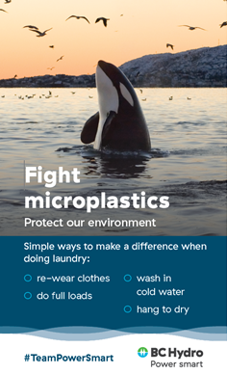
The Implemented Version

Slide 44
Thank You!

Slide 45
Questions?

Slide 46
References
Benartzi, S., & Thaler, R. H. (2013). Behavioral economics and the retirement savings crisis. Science, 339(6124), 1152-1153
Camilleri, A. R., & Larrick, R. P. (2014). Metric and scale design as choice architecture tools. Journal of Public Policy & Marketing, 33(1), 108-125.
Frey, B. S., & Oberholzer-Gee, F. (1997). The cost of price incentives: An empirical analysis of motivation crowding-out. The American economic review, 87(4), 746-755.
Hardisty, D. J., Shim, Y., Sun, D., & Griffin, D. W. (2020). Encouraging energy efficiency: Product labels activate temporal tradeoffs. Available at SSRN 3576266.
Kaiser, M., Bernauer, M., Sunstein, C. R., & Reisch, L. A. (2020). The power of green defaults: The impact of regional variation of opt-out tariffs on green energy demand in Germany. Ecological Economics, 174, 106685.
Maki, A., Carrico, A. R., Raimi, K. T., Truelove, H. B., Araujo, B., & Yeung, K. L. (2019). Meta-analysis of pro-environmental behaviour spillover. Nature Sustainability, 2(4), 307-315
Schultz, P. W., Nolan, J. M., Cialdini, R. B., Goldstein, N. J., & Griskevicius, V. (2007). The constructive, destructive, and reconstructive power of social norms. Psychological science, 18(5), 429-434.
Steinhorst, J., Klöckner, C. A., & Matthies, E. (2015). Saving electricity–For the money or the environment? Risks of limiting pro-environmental spillover when using monetary framing. Journal of Environmental Psychology, 43, 125-135.
Steinhorst, J., & Klöckner, C. A. (2018). Effects of monetary versus environmental information framing: Implications for long-term pro-environmental behavior and intrinsic motivation. Environment and Behavior, 50(9), 997-1031.
Ungemach, C., Camilleri, A. R., Johnson, E. J., Larrick, R. P., & Weber, E. U. (2018). Translated attributes as choice architecture: Aligning objectives and choices through decision signposts. Management Science, 64(5), 2445-2459.
Wemyss, D., Cellina, F., Lobsiger-Kägi, E., De Luca, V., & Castri, R. (2019). Does it last? Long-term impacts of an app-based behavior change intervention on household electricity savings in Switzerland. Energy Research & Social Science, 47, 16-27.

