Slide 1



I Want It Now!: Query Theory Explains Discounting Anomalies for Gains and Losses
Kirstin C. Appelt¹
David J. Hardisty²
Elke U. Weber¹
¹Columbia University Business School
²Stanford University GSB
Friday, October 13th, 2011
Association for Consumer Research
Notes:
Images from unsplash.com

Slide 2
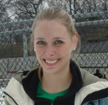
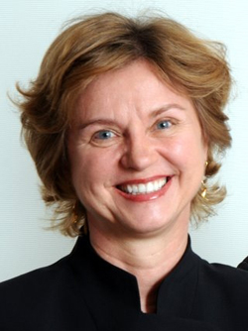
Co-Authors
Kirstin Appelt
Elke Weber
Appelt, K. C., Hardisty, D. J., & Weber, E. U. (2011). Asymmetric discounting of gains and losses:
A Query Theory account. Journal of Risk and Uncertainty, 43, 107-126.
DOI: 10.1007/s11166-011-9125-1
Notes:
I apologize that for the next 15 minutes, you’ll have to look at me instead of either of my lovely coauthors

Slide 3
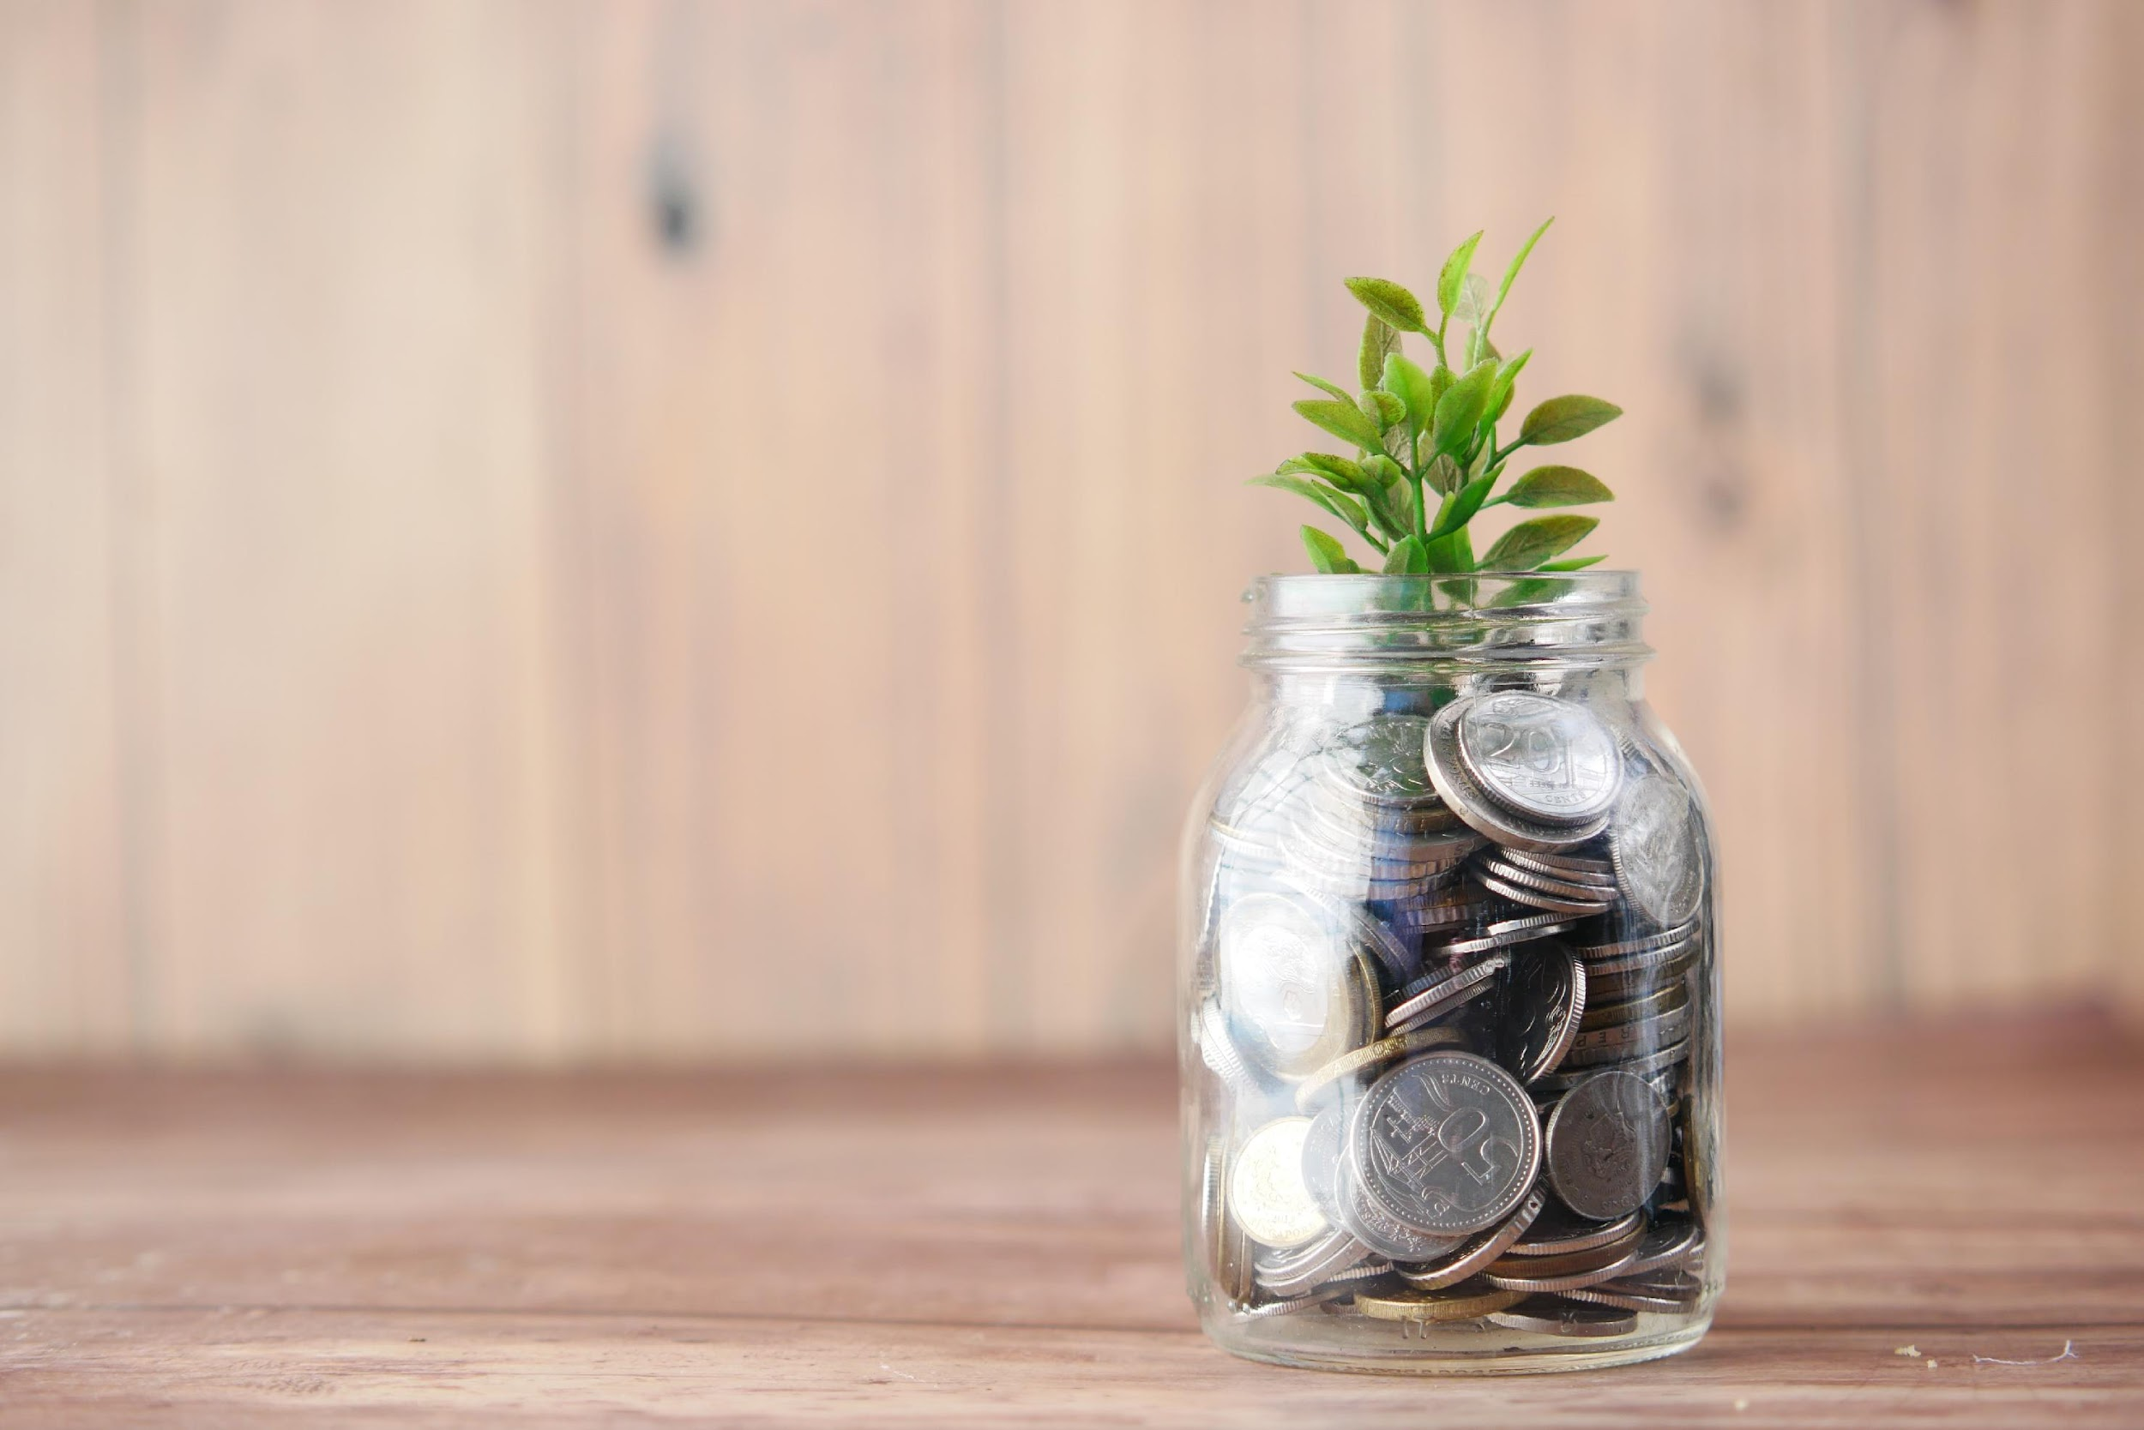
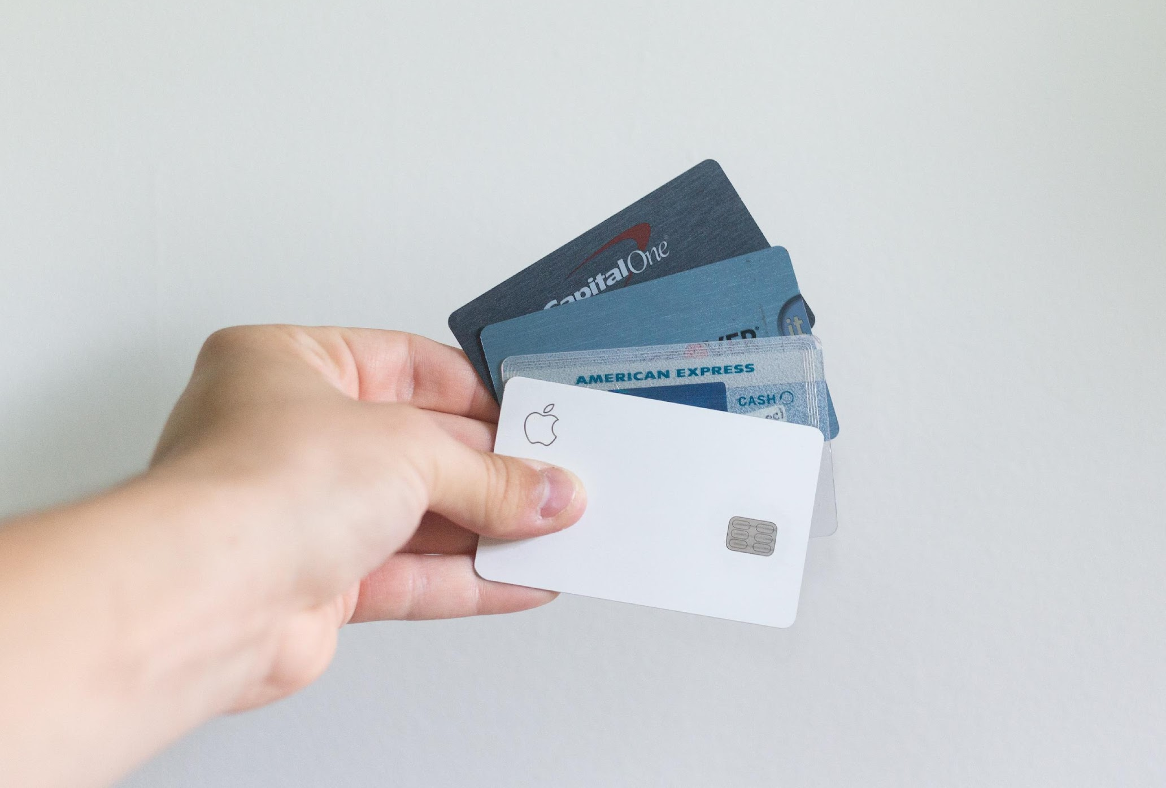
Notes:
Image from unsplash.com
How do we make these choices?

Slide 4
Discounting the Future
Discount rate: like an interest rate in reverse – the farther in the future something is, the less it is worth
High discounting means:
- wanting gains now
- wanting to postpone losses
Notes:
Some might say that the recent economic crises was caused by high discount rates – wanting a home now, and putting off costs until the future. How can we help consumers make responsible, future oriented choices?

Slide 5
“Frame The Future First”?
The “Direction Effect”: higher discount rates with a delay frame than an acceleration frame (Loewenstein, 1988; Thaler & Benartzi, 2004)
Delay: Get $50 today… or wait and get $75 in three months?
Accelerate: Get $75 in three months… or speed things up and get $50 today?
However, losses reverse the direction effect (Benzion et al., 1989; Shelley 1993)
Notes:
Why does this framing effect happen? We don’t have any process data.

Slide 6
Query Theory
(Johnson et al., 2007; Weber et al., 2007)
Preferences constructed from memory
Series of mental queries for and against each option
The resulting balance of evidence determines your preference
Order matters: due to output interference, the second query generates less support
Notes:
This process is both conscious and automatic/implicit. Use $50 today for St. Louis Cardinals playoff tickets, or maybe a fancy dinner. I’m not sure what I would do with it in three months, but it would be nice to have the extra money.

Slide 7
Loss Examples
Delay: Pay $50 today… or wait and pay $75 in three months?
Accel: Pay $75 in three months… or speed it up and pay $50 today?
Delay frame promotes the responsible choice

Slide 8
Study 1: Overview
2 (direction) x 2 (sign) between subjects design
Thought listing during decision making
Hypothesis: direction frame should affect the order and number of thoughts, in turn affecting choices

Slide 9
Study 1: Participants
607 US residents, run online
  75% women
  Range of ages, education, & income
Thought listing warm-up

Slide 10
Study 1: Gain Scenarios
delay Imagine you have been selected to receive a $50 gift certificate today. However, you also have the option of receiving a larger amount 3 months from now.
accelerate Imagine you have been selected to receive a $75 prize 3 months from today. However, you also have the option of receiving a smaller amount today.

Slide 11
Study 1: Gain Scenarios
delay Imagine you have been selected to receive a $50 gift certificate today. However, you also have the option of receiving a larger amount 3 months from now.
accelerate Imagine you have been selected to receive a $75 gift certificate 3 months from today. However, you also have the option of receiving a smaller amount today.

Slide 12
Study 2: Loss Scenarios
delay Imagine that you have been ticketed for a parking violation, and are required to pay $50 today. However, you also have the option of paying a larger amount 3 months from now.
accelerate Imagine that you have been ticketed for a parking violation, and are required to pay $75 3 months from today. However, you also have the option of paying a smaller amount today.

Slide 13
Study 1: Loss Scenarios
delay Imagine that you have been ticketed for a parking violation, and are required to pay $50 today. However, you also have the option of paying a larger amount 3 months from now.
accelerate Imagine that you have been ticketed for a parking violation, and are required to pay $75 3 months from today. However, you also have the option of paying a smaller amount today.

Slide 14
Gain Delay: Example Thought Listing
“If I get a gift cert today, I can use it for Christmas presents”
“It's less hassle to just accept the gift today”
“Delayed gratification would pay off, literally”
“I like instant gratification”

Slide 15
Study 1: Delay Titration
[ ] $50 gift certificate today | [ ] $45 gift certificate 3 months from today
[ ] $50 gift certificate today | [ ] $50 gift certificate 3 months from today
[ ] $50 gift certificate today | [ ] $55 gift certificate 3 months from today
[ ] $50 gift certificate today | [ ] $60 gift certificate 3 months from today
... | ...
[ ] $50 gift certificate today | [ ] $90 gift certificate 3 months from today

Slide 16
Study 1: Delay Titration
[x] $50 gift certificate today | [ ] $45 gift certificate 3 months from today
[x] $50 gift certificate today | [ ] $50 gift certificate 3 months from today
[x] $50 gift certificate today | [ ] $55 gift certificate 3 months from today
[ ] $50 gift certificate today | [x] $60 gift certificate 3 months from today
... | ...
[ ] $50 gift certificate today | [x] $90 gift certificate 3 months from today
Indifference point: $50 today = $57.50 in 3 months

Slide 17
Study 1: Accelerate Titration
[ ] $75 gift certificate 3 months from today | [ ] $85 gift certificate today
[ ] $75 gift certificate 3 months from today | [ ] $80 gift certificate today
[ ] $75 gift certificate 3 months from today | [ ] $75 gift certificate today
[ ] $75 gift certificate 3 months from today | [ ] $70 gift certificate today
… | …
[ ] $75 gift certificate 3 months from today | [ ] $35 gift certificate today
Notes:
The setup was the same for losses

Slide 18
Discount Parameter
V = A / (1 + kD)
k = (amount later - amount now)
amount now * delay
Increasing number indicates more discounting
(Mazur, 1987)

Slide 19
Study 1: Discounting
1.60
Delay
Accelerate
1.20
0.80
k
0.40
0.00
-0.40
Gain
Loss

Slide 20
Study 1: Discounting
1.60
Delay
Accelerate
1.20
0.80
k
0.40
0.00
-0.40
Gain
Loss
Sign: B = .34, p < .001
Direction: B = .07, p = .07
Sign X Direction: B = -.32, p < .001

Slide 21
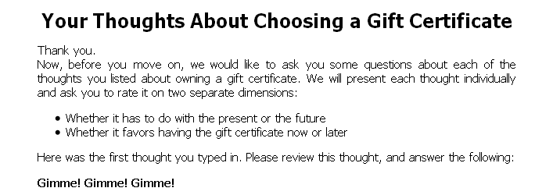
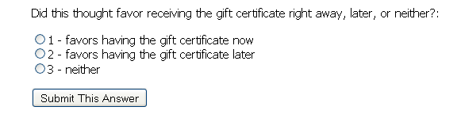
Study 1: Thought Coding

Slide 22
Study 1: Thought Measure
Prominence of Now Thoughts (Cronbach’s α = 0.91)
  Order of thoughts (SMRD)
  Proportion of now thoughts
  Proportion of later thoughts (reverse scored)
Increasing number indicates more and earlier thoughts in favor of now

Slide 23
Study 1: Thoughts
0.70
Delay
0.50
Accelerate
0.30
0.10
Prominence of Now Thoughts
-0.10
-0.30
-0.50
-0.70
Gain
Loss

Slide 24
Study 1: Thoughts
0.70
Delay
0.50
Accelerate
0.30
0.10
Prominence of Now Thoughts
-0.10
-0.30
-0.50
-0.70
Gain
Loss
Sign: B = .34, p < .001
Direction: B = .07, p = .07
Sign X Direction: B = -.32, p < .001

Slide 25
Study 1: Mediation for Gains
Prominence of “Now” Thoughts
β = -.20, p < .01
β = + .62, p < .001
Direction
Discounting
(β = -.15, p < .05)
β = -.05, p > .2
Notes:
We get significant mediation, using a bootstrapping test

Slide 26
Study 1: Mediation for Losses
Prominence of “Now” Thoughts
β = -.11, p = .04
β = - .60, p < .001
Direction
Discounting
(β = .31, p < .001)
β = .26, p < .001

Slide 27
Study 1: Summary
Direction frame influenced thought order and number, in turn affecting choices
For gains, the acceleration frame promotes responsible choices
For losses, the delay frame promotes responsible choices

Slide 28
Study 2: Overview
Study 1 mediation results are correlational
Study 2 manipulates thought order directly to test a causal mechanism

Slide 29
Study 2: Methods
617 Participants
2x2x2 design:
- sign (gain vs loss)
- direction (delay vs accelerate)
- thought order (natural or unnatural)

Slide 30
Study 2: Thought Order Manipulation (Delay Frame)
Natural: First list thoughts in favor of the $50 today, then the future $75
Unnatural: First list thoughts in favor of the future $75, then the $50 today

Slide 31
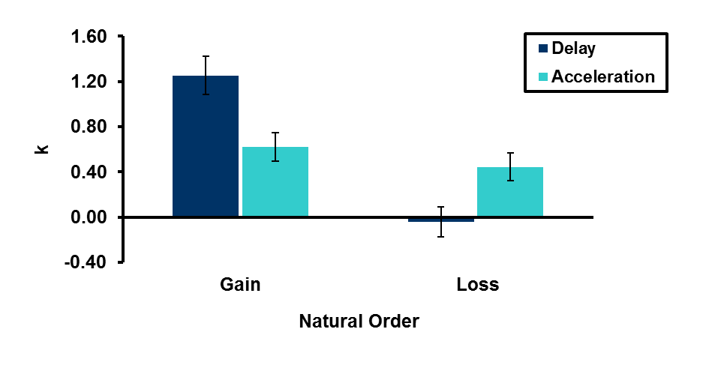
Study 2: Natural Order Results
Sign: F(1, 137)=28.50, p<.001
Direction: F(1, 137)=0.28, p>.5
Interaction: F(1, 137)=16.43, p<.001

Slide 32
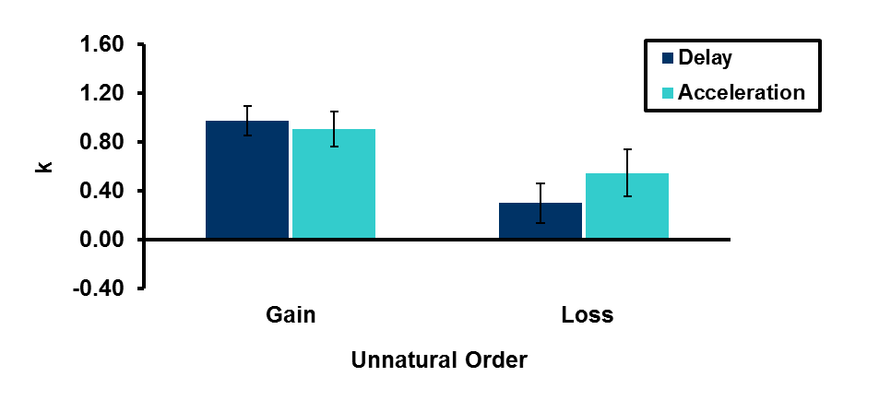
Study 2: Unnatural Order Results
Sign: F(1, 134)=11.00, p=.001
Direction: F(1, 134)=0.31, p>.5
Interaction: F(1, 134)=1.04, p>.2

Slide 33
General Conclusions
Changes in frame lead to changes in thought order, in turn influencing in time preference, consistent with Query Theory
“Responsible” frames are different for gains and losses

Slide 34
Thanks to…
NIA
NSF
The PAM lab and Center for Decision Sciences

Slide 35
Thank You!

