Slide 1


Tackling temporal tradeoffs in energy efficiency
David J. Hardisty
Behavioural Sustainability Group
Oct 21, 2014

Slide 2
Overview
About me and you
Temporal tradeoffs
Integrative framework
Fresh data on energy efficiency (partnering with BC Hydro)

Slide 3




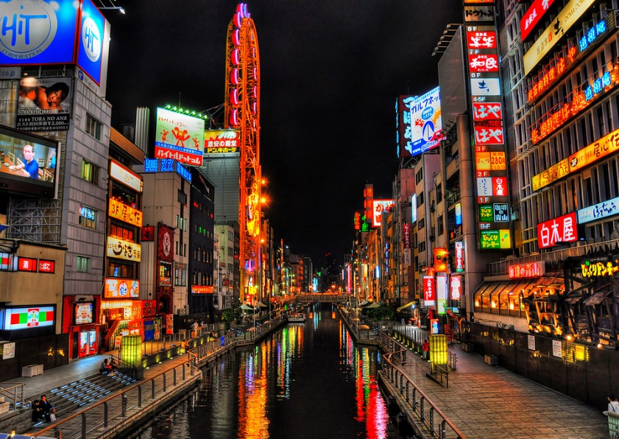

About me
Notes:
Beer image source: https://www.edreams.com/blog/9-curious-rules-of-oktoberfest/
Osaka image source: https://phys.org/news/2018-04-smart-cities.html

Slide 4
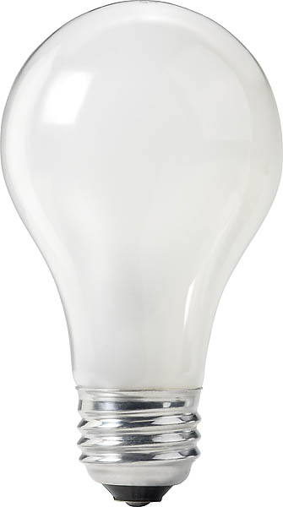
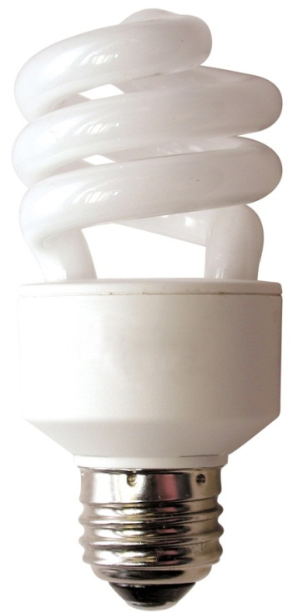
About time
100 watt incandescent
25 watt CFL
$0.60 now
$113 for 10,000 hrs of use
1600 lbs of CO₂
$3.40 now
$28 for 10,000 hrs of use
400 lbs of CO₂
Notes:
at 3 hours a day, 10,000 hours is about 9 years
calculations use 11.3 cents/kWh
Image source (left): https://www.rona.ca/en/product/feit-electric-light-bulb-bright-white-a15-bulb-shape-40-watt-bp40a15-can-31925045
Image source (right): https://www.bulbconnection.com/product/4909-TCP-80101450-14W-SPRINGLIGHT-50K-14w-Spiral

Slide 5

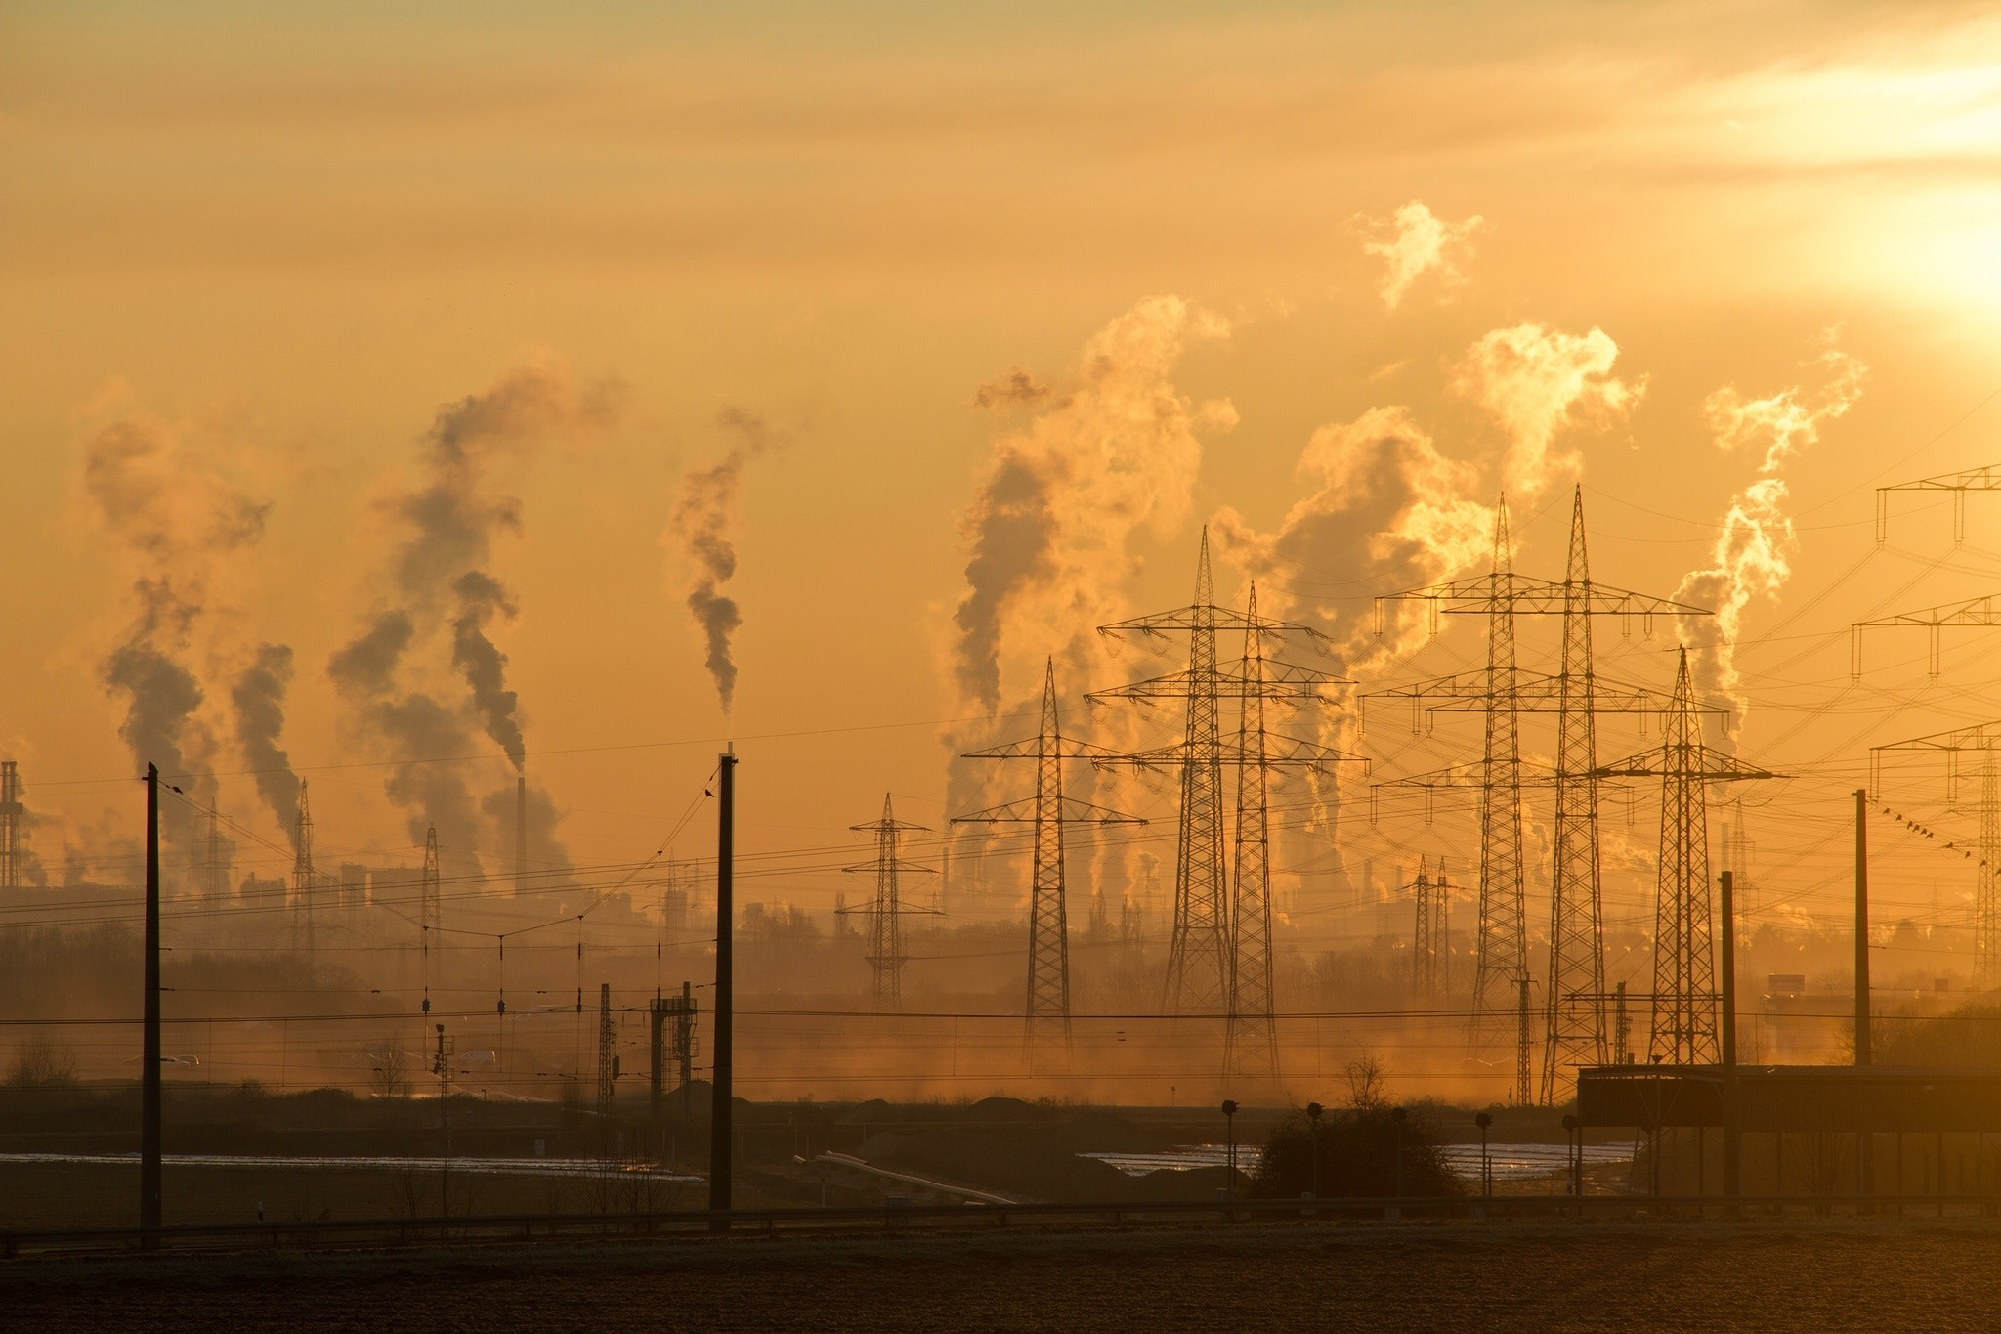
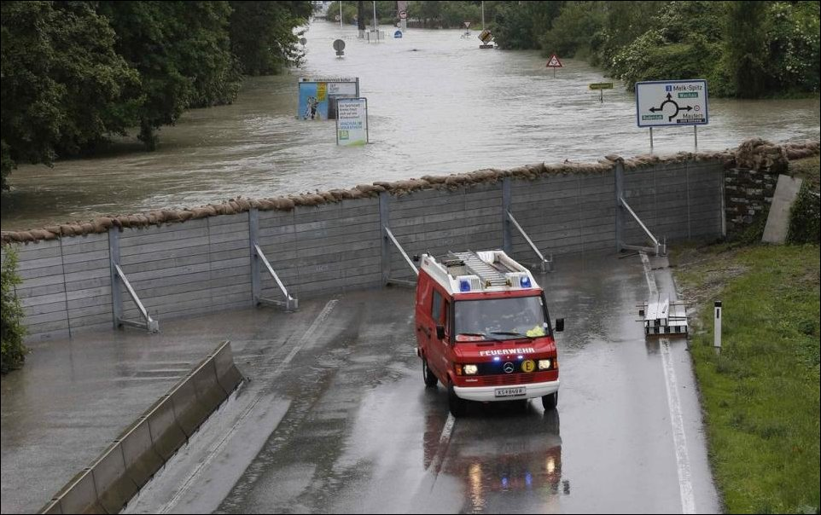
Notes:
Image source top left and right: Pexels
Image source flooding: http://archive.boston.com/bigpicture/2013/06/flooding_in_europe.html

Slide 6
Interdisciplinary work to the rescue!
Iterative combination of Econ, Psych, & Anthro
Econ: quantitative modeling of costs and benefits (normative?)
Psych: general mental processes & tools
Anthro: cultural modes in a particular time, place, and social group
Econ + Psych + Anthro = Marketing!
(Hardisty, Orlove, Krantz, Small, Milch, Osgood, 2012)

Slide 7
 | Economics | Psychology | Anthropology
Paradigm | Mathematically evaluate expected outcome streams over time; discounted utility is maximized | Choice between an immediate, small reward versus a larger, delayed reward | Culturally and institutionally defined choices and ways of reasoning
Models | Exponential | Hyperbolic | Cyclical, sacred, routine
Temporal preferences | Known, stable preference exists between any two outcome streams | Preferences are constructed in the situation, and depend on perceptions and self-control | Preferences are culturally determined
Method | Mathematical models with clearly specified assumptions to make predictions | Experimental research | Ethnography, based on interviews and participant observation
Strength | Systematic framework to prescribe choices under given assumptions about utility and growth | Describes the emotional and cognitive factors that shape intertemporal choices | Explores unique cultural and institutional sources of time preference; legitimacy and consent are critical
Blind Spots | Overly reliant on quantitative cost benefit analysis; unrealistic assumptions may lead to poor predictions | Weak prescription for choices | No universally applicable guidelines for prescribing or describing choices

Slide 10
Notes:
these graphs use an exponential k of .18 per month, hyperbolic k of .6 per month

Slide 11
Case Study: Light bulb purchase
Econ: Efficiency upgrades are quite effective, but people aren't choosing them (Hausman, 1979). Why?
Anthro: Most people don't think about efficiency upgrades (Attari, DeKay, Davidson, & de Bruin, 2010)
  Different cultures prefer different light quality (Wilhite et al., 1996)
Psych: Which tools can nudge consumers to make more energy efficient choices?
  Social norms (Schultz, Nolan, Cialdini, Goldstein, & Griskevicius, 2007)
  Defaults (Dinner, Johnson, Goldstein, & Liu, 2011)
  10-year cost labeling?

Slide 12
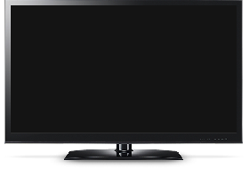
Study 1 methods
Price: $999.95
Estimated Electricity Use (W): 121
Standby energy consumption: 0.2w
Brand: Samsung
Size: 50”
Resolution: 1080p
Price: $749.95
Estimated Electricity Use (W): 181
Standby energy consumption: 0.4w
Brand: Samsung
Size: 50”
Resolution: 1080p
Notes:
Tv - https://www.indiamart.com/proddetail/32-inch-lg-television-18470908188.html

Slide 13
Study 1 methods
Price: $999.95
10-year estimated cost: $600
Estimated Electricity Use (W): 121
Standby energy consumption: 0.2w
Brand: Samsung
Size: 50”
Resolution: 1080p
Price: $749.95
10-year estimated cost: $1,000
Estimated Electricity Use (W): 181
Standby energy consumption: 0.4w
Brand: Samsung
Size: 50”
Resolution: 1080p
Notes:
Tv - https://www.indiamart.com/proddetail/32-inch-lg-television-18470908188.html

Slide 14
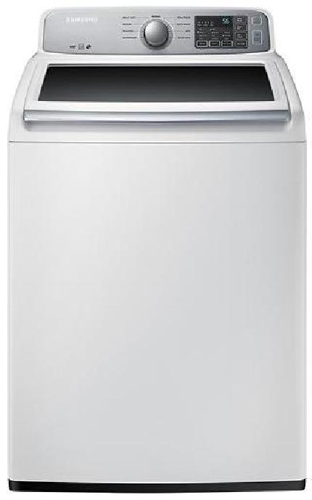
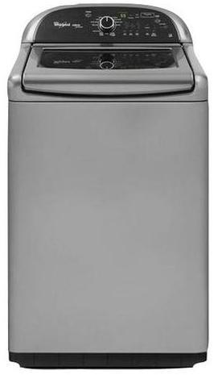
Price: $629.99
Estimated Yearly Electricity Use (kWh): 169
Model: 4.5 Cu. Ft.
9 cycle
Top Load Washer
Brand: Samsung
Price: $899.99
Estimated Yearly Electricity Use (kWh): 150
Model: 4.8 Cu. Ft.
13 cycle
Top Load Washer
Brand: Whirlpool
Notes:
Image source left: https://image-us.samsung.com/SamsungUS/home/home-appliances/washers/top-load/pd/wa50m7450aw/01_Washer-TopLoader_WA50M7450AW_Front_Closed-White.jpg?$product-details-jpg$
Image source right: https://www.energycenterappliance.com/product/whirlpool-cabrio-platinum-top-load-washer-chrome-shadow-wtw8500bc-23606

Slide 15
Price: $629.99
10-year estimated cost: $180
Estimated Yearly Electricity Use (kWh): 169
Model: 4.5 Cu. Ft.
9 cycle
Top Load Washer
Brand: Samsung
Price: $899.99
10-year estimated cost: $100
Estimated Yearly Electricity Use (kWh): 150
Model: 4.8 Cu. Ft.
13 cycle
Top Load Washer
Brand: Whirlpool
Notes:
Image source left: https://image-us.samsung.com/SamsungUS/home/home-appliances/washers/top-load/pd/wa50m7450aw/01_Washer-TopLoader_WA50M7450AW_Front_Closed-White.jpg?$product-details-jpg$
Image source right: https://www.energycenterappliance.com/product/whirlpool-cabrio-platinum-top-load-washer-chrome-shadow-wtw8500bc-23606

Slide 16
Study 1a Results: Clean

Slide 17
Study 1a Results: Real

Slide 18
Study 1b Results: BC Hydro

Slide 19
Why is the 10-year cost label effective?
Goal activation
Planning horizon
Information provision
Magnitude effect (10-yrs is better than 1-yr)
Other?

Slide 20
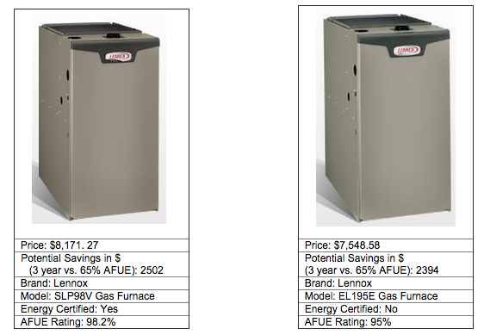
As you consider purchasing a new furnace, what product features are most important to you? Please list the three most important product features.

Slide 21
When purchasing a new furnace, roughly how far ahead do you plan?
Not at all
Up to one week
More than one week up to one month
More than one month up to one year
More than one year up to five years
More than five years up to ten years
Ten years or more

Slide 22
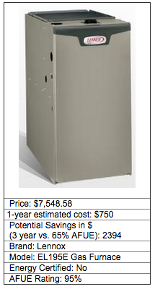
Please imagine that you purchased the furnace above. How much do you estimate your household would spend on energy to use this furnace in your home, over a period of 1 year?
$_______

Slide 23
Study 1c: Choice data

Slide 24
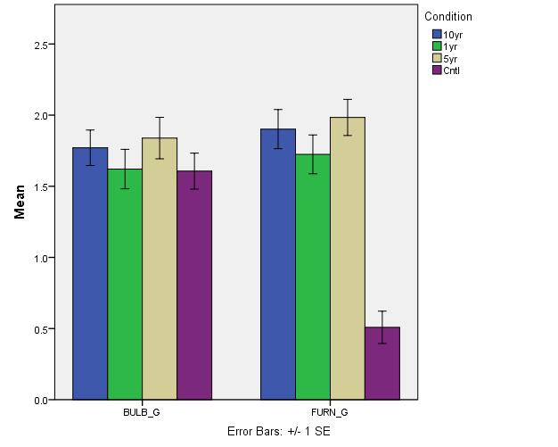
Study 1c: Energy goal prominence

Slide 25
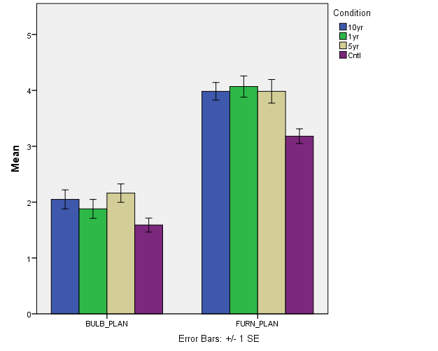
Study 1c: Planning horizons

Slide 26
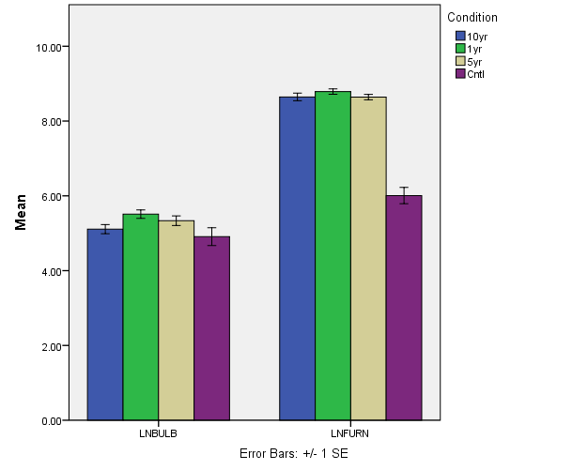
Study 1c: Estimation

Slide 27
Study 1 Summary
Operational cost labeling is effective
Why?
  For bulbs, it is driven by planning horizon
  For furnaces, it is driven by energy saving goals & improved estimation

Slide 28
Energy study 2:
Psych: people have much lower temporal discount rates for losses than for gains (Hardisty & Weber, 2009)
Let's see how much that matters with appliances

Slide 29
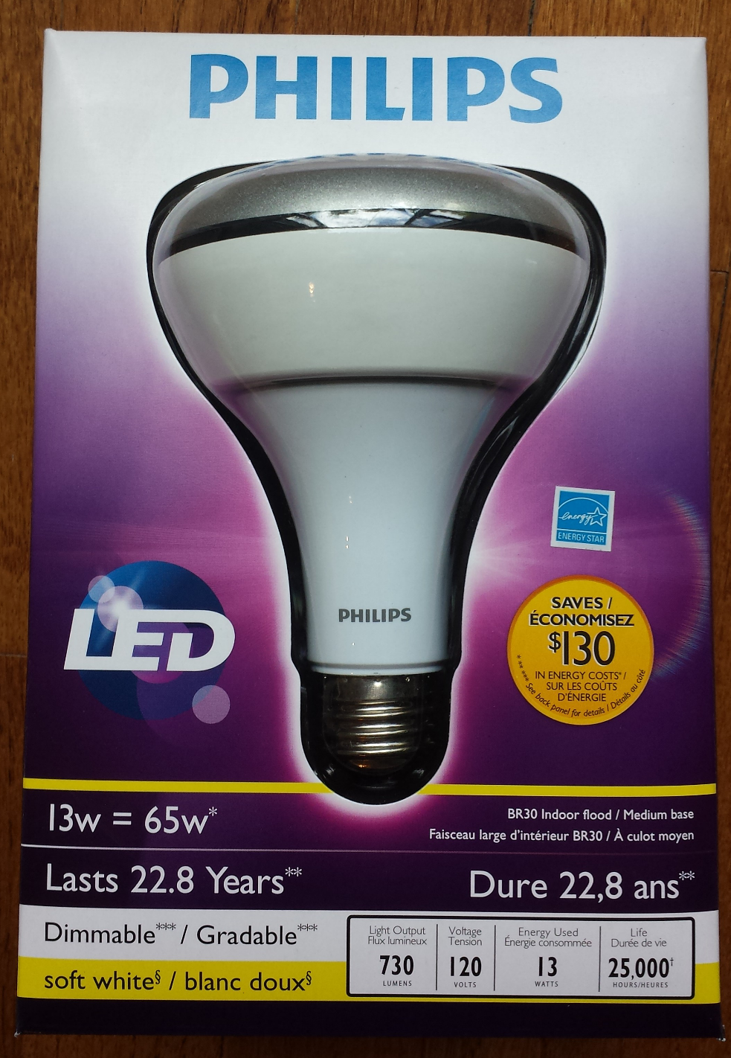
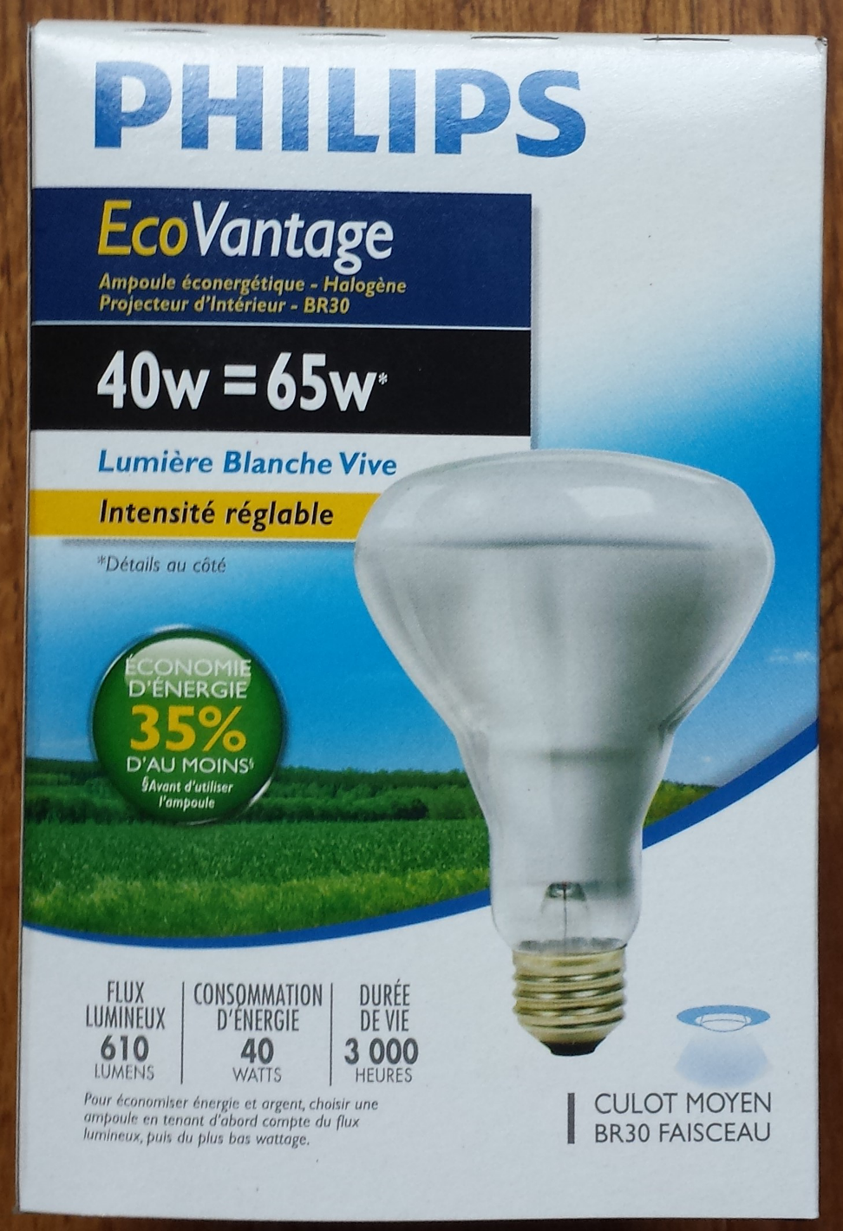
Notes:
Image source left: https://www.amazon.ca/Philips-423798-10-5-Watt-13-Watt-Dimmable/dp/B008NNZSI0
Image source right: https://www.closeoutking.ca/product-p/bulb-philips-46677150426.htm

Slide 30
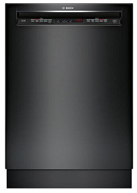
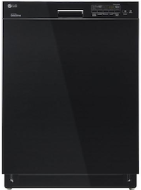
Study 2: Methods
Price: $764.99
Estimated Yearly Dollar [Energy] Savings [Cost]: $27 [259 kWh]
Interior Capacity: Up to 16 place settings
Dishwasher Type: Full-size built-in
Brand: Bosch
Price: $649.99
Estimated Yearly Dollar [Energy] Savings [Cost]: $0 [279 kWh]
Interior Capacity: Up to 14 place settings
Dishwasher Type: Full-size built-in
Brand: LG
Notes:
Image source left: https://pisces.bbystatic.com/image2/BestBuy_US/images/products/5710/5710312_sd.jpg
Image source right: https://www.ajmadison.com/cgi-bin/ajmadison/LDS4821BB.html

Slide 31
Study 2: Results

Slide 32
Going forward
Policy implications:
  For energy intensive products, stores should put the operational cost on the price tag (similar to unit cost labeling)
Research:
  Further explore mediators & moderators
  Compare with & against existing methods (social norms, defaults, etc)
  Field studies

Slide 33
Thank you!

