Slide 1
The bright side of dread: Anticipation asymmetries explain why losses are discounted less than gains
David Hardisty
UBC S&P Workshop
Jan 9th, 2017

Slide 2

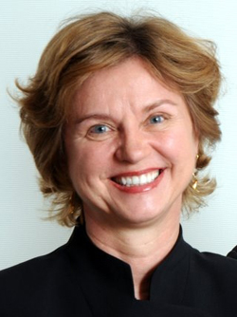
Co-Authors
Shane Frederick
Elke Weber
2

Slide 3
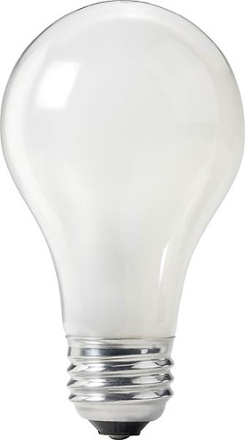
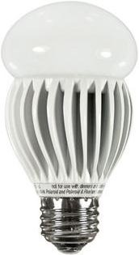
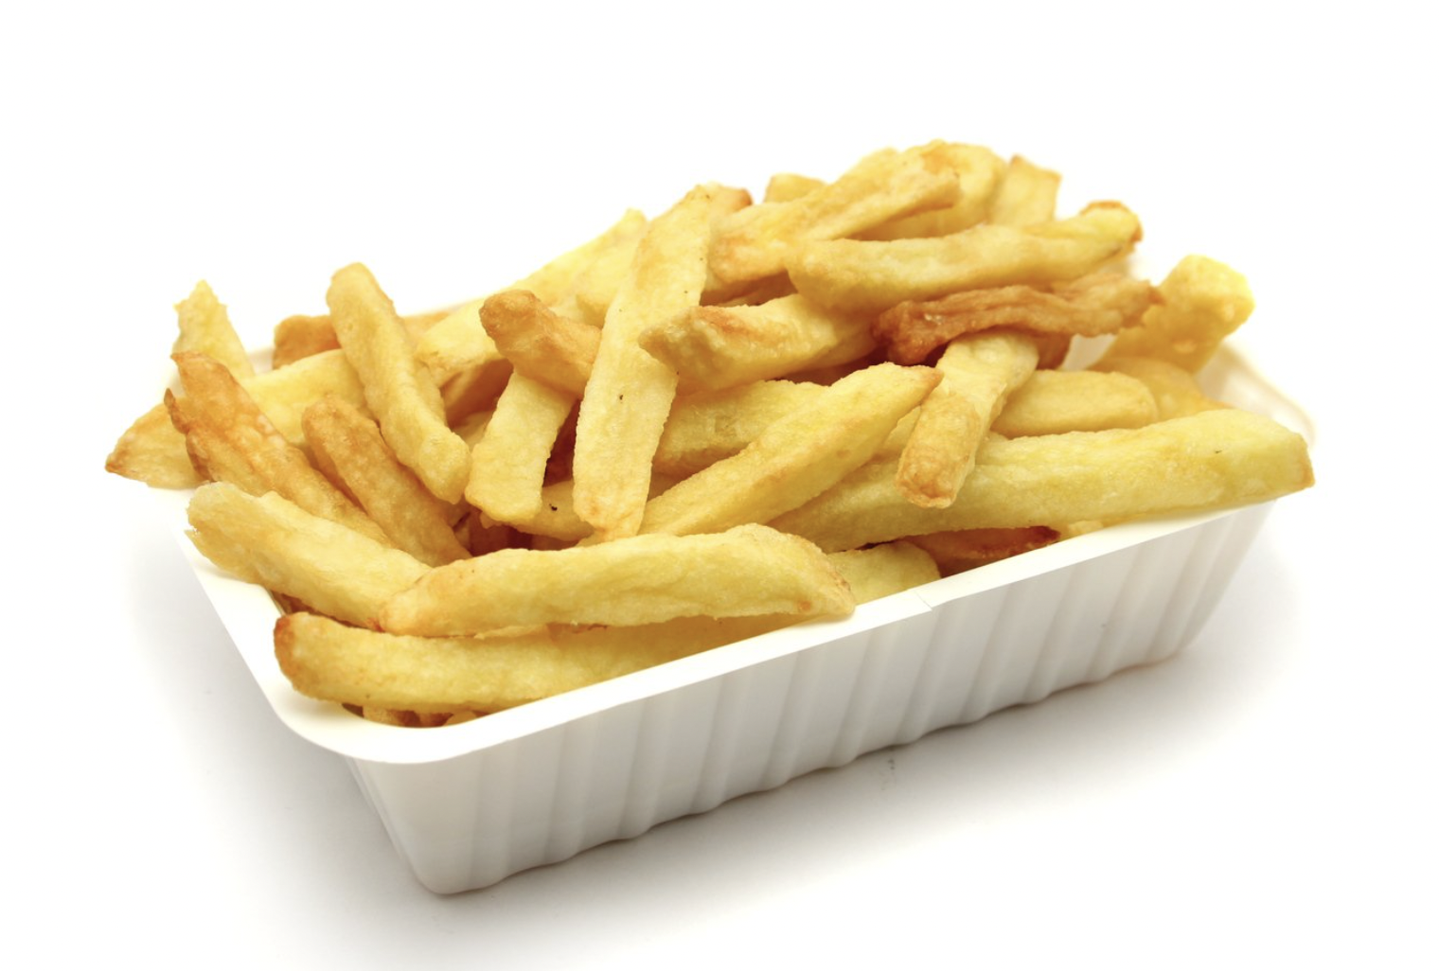

Intertemporal choices
Buy the cheaper lightbulb or the more energy efficient one?
Eat fries now or be healthy later?
Work on the paper now or later?
Notes:
Image source (fries and laptop): https://unsplash.com/
Image source lightbulbs:
- Image source (left): https://www.rona.ca/en/product/feit-electric-light-bulb-bright-white-a15-bulb-shape-40-watt-bp40a15-can-31925045
Image source (right): https://www.bulbconnection.com/product/4909-TCP-80101450-14W-SPRINGLIGHT-50K-14w-Spiral

Slide 4
Outline
Background literature
Non-replication inspiration
7 studies
Working paper
Please interrupt!

Slide 5
Temporal discounting
The higher the discount rate, the more people want gains now and losses later
Humans, pigeons, and rats all discount hyperbolically (Mazur 1987)
V=A/(1+kD)
Value
Notes:
This model doesn’t distinguish between gains and losses. This is surprising, given that a Nobel Prize was awarded for Prospect Theory, which differentiates gains and losses in intertemporal choice.
Why hasn’t more attention been paid to losses versus gains in intertemporal choice? One possibility is because there hasn’t been a process account or process data to explain the difference.
Today, I am going to show you that the difference between gains and losses is robust across domains, and then demonstrate why this difference happens.

Slide 6
Factors affecting discounting
Uncertainty (Bixter & Luhmann, 2012; Takahashi et al, 2007)
Opportunity cost (Franklin, 1748)
Resource slack (Zauberman & Lynch, 2005)
Anticipation (Loewenstein 1987)

Slide 7
The “sign” effect
Receive $70 now or $70 in a month?
100% choose now
Pay $70 now or $70 in a month?
45% choose later
(Mischel, Grusec & Masters, 1969; Thaler, 1981)

Slide 8
Discounting future green
(Hardisty & Weber 2009)

Slide 9
Discounting health
(Hardisty & Weber 2009)
Notes:
I’ve run around 20 studies of discounting, and they all show a striking effect: losses are discounted much less than gains. First, let me walk you through the study that got me started on this. This was an online study, with Elke Weber. Participants made a series of choices….
Remarkably, some participants actually showed negative discounting of losses. For example…
Previous studies of environmental discounting screwed this up....
In addition to this behavioral evidence of differences between gains and losses, we also have neural evidence

Slide 10
The “sign” effect
Receive $70 now or $70 in a month?
100% choose now
Pay $70 now or $70 in a month?
45% choose later
Why?

Slide 11
Not loss aversion...
Receive $70 now or $70 in a month?
100% choose now
Pay $5 now or $5 in a month?
40% choose later
Why?
Anticipation asymmetries

Slide 12
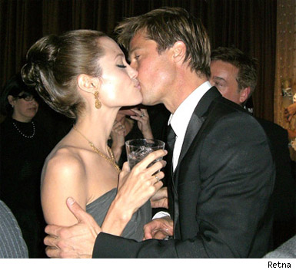
Kiss from a movie star: now or next week?
(Loewenstein, 1987)
Discounting
Anticipation
Notes:
Image source: https://www.pinterest.ca/pin/170292429635519019/

Slide 13
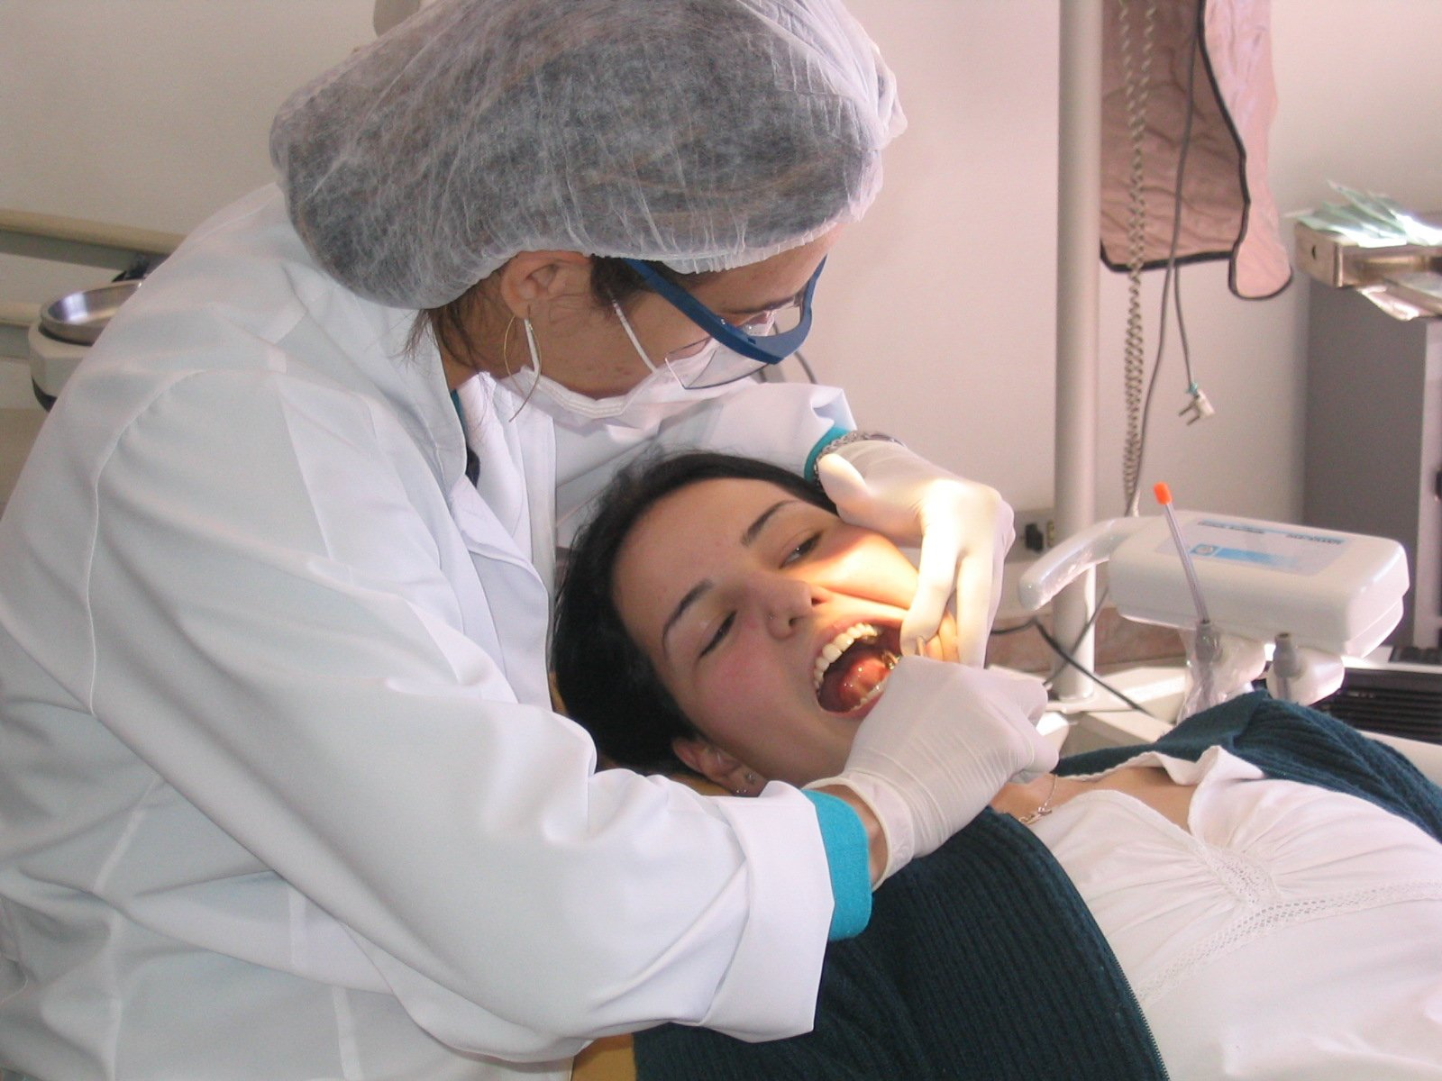
Scheduling a dental procedure
Discounting
Anticipation
Notes:
Image source: https://unsplash.com/

Slide 14
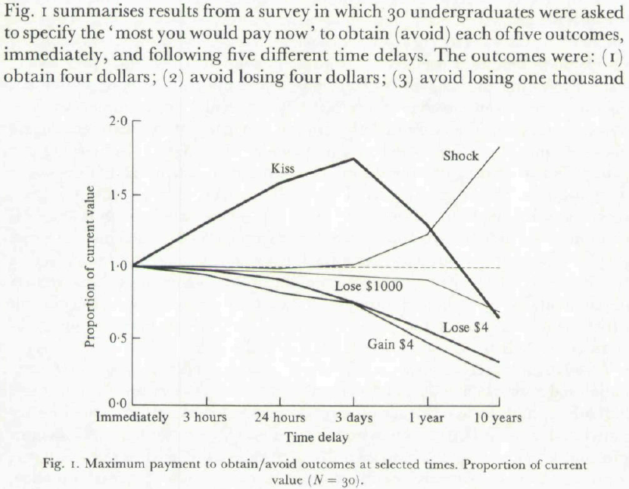
Loewenstein (1987)

Slide 15
Loewenstein (1987)

Slide 16
Replication Data

Slide 17
Hypotheses
Anticipation of losses > anticipation of gains
  Even when controlling for loss aversion
  Due to a qualitative difference
Anticipation predicts intertemporal choices
This (partly) explains the “sign effect”

Slide 18
Anticipation: what do we call it?
 | Negative Utility | Positive Utility
Positive Event | Impatience
Negative Event
Notes:
“enjoying the moment”

Slide 19
Anticipation: what do we call it?
 | Negative Utility | Positive Utility
Positive Event | Impatience | Savoring
Negative Event
X
Notes:
“enjoying the moment”

Slide 20
Anticipation: what do we call it?
 | Negative Utility | Positive Utility
Positive Event | Impatience | Savouring
Negative Event
X
Notes:
“enjoying the moment”

Slide 21
Anticipation: what do we call it?
 | Negative Utility | Positive Utility
Positive Event | Impatience | Pleasurable Anticipation
Negative Event
Notes:
“enjoying the moment”

Slide 22
Anticipation: what do we call it?
 | Negative Utility | Positive Utility
Positive Event | Impatience | Pleasurable Anticipation
Negative Event | Dread
Notes:
“enjoying the moment”

Slide 23
Anticipation: what do we call it?
 | Negative Utility | Positive Utility
Positive Event | Impatience | Pleasurable Anticipation
Negative Event | Dread | ???
Notes:
“enjoying the moment”

Slide 24
Anticipation: what do we call it?
 | Negative Utility | Positive Utility
Positive Event | Impatience | Pleasurable Anticipation
Negative Event | Dread | Masochism
X
Notes:
“enjoying the moment”

Slide 25
Anticipation: what do we call it?
 | Negative Utility | Positive Utility
Positive Event | Impatience | Pleasurable Anticipation
Negative Event | Dread | Enjoying the Moment
Notes:
“enjoying the moment”

Slide 26
Overview
Study 1a & 1b: Anticipation of $$ gains vs losses
Study 2a: Real consumption & generalizing across domains
Study 3: Controlling for loss aversion
Study 4: Why the asymmetry?

Slide 27
Study 1a: Anticipation of $$ gains vs losses

Slide 28
Study 1: Methods
Between subjects: gain vs. loss
201 MTurkers
+$49 today OR +$60 in 89 days?
-$49 today OR -$60 in 89 days?
Imagine expecting to receive [pay] $60 in 89 days. How psychologically pleasurable or displeasurable would the anticipation be? In other words, how would you feel while waiting for it?
strongly dislike the strongly like the
feeling of waiting neutral feeling of waiting
|-------------------------------------|-------------------------------------|
26 other intertemporal choices (Kirby, Petry, & Bickel 1999)

Slide 29
Study 1: Results
Choices
Gains: Chose SS gain 57% of the time
(332% discount rate)
Losses: Chose LL loss 26% of the time
(34% discount rate)
Anticipation
Gains: -5 (SD = 55)
Losses: -36 (SD = 46)

Slide 30
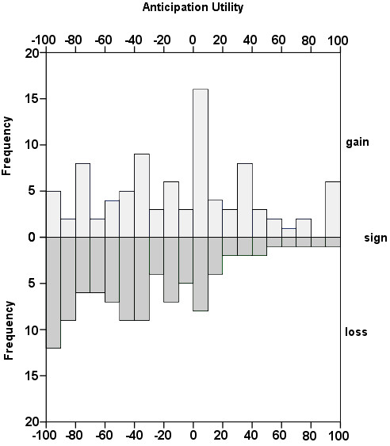
Notes:
Anticipation utility for $60 gain or loss in 89 days.

Slide 31
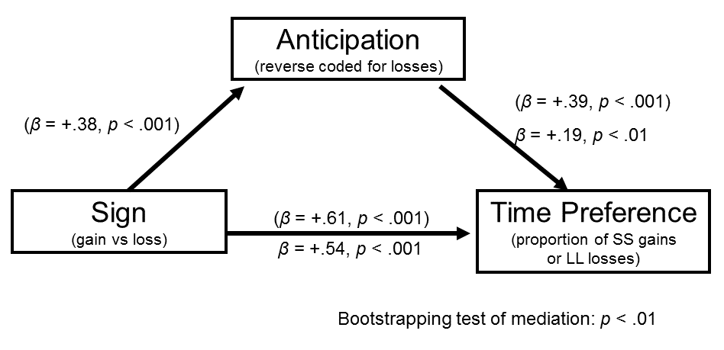
Study 1: Mediation

Slide 32
Study 1b: Consumer choice example

Slide 33
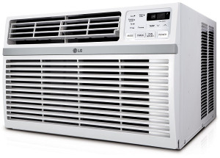
Suppose you were choosing between two window air conditioners, described below:
* Energy savings [wasted] is the estimated difference in energy usage between the two AC units, based on 4 hours usage per day, 182 days per year, with an electricity rate of $0.1264 per kWh.
Model A Price: $297 10-year energy savings*: $0 [10-year energy wasted*: $920] BTUs: 12,000 Watts: 2,000 Energy Efficiency Rating: 6.0 | Model B Price: $776 10-year energy savings*: $920 [10-year energy wasted*: $0] BTUs: 12,000 Watts: 1,000 Energy Efficiency Rating: 12.0
Notes:
Image source: https://www.amazon.ca/LG-Energy-Rated-Window-Conditioner/dp/B07NC2NRQR

Slide 34
Study 1b: Methods
Which would you choose?
A choice of Model B over Model A [Model A over Model B] boils down to spending more [less] money up front in exchange for saving [wasting] money later. How would you feel while waiting for the future energy savings [waste]?
Negative (Strongly dislike the feeling of waiting)
Neutral (It is just a calculation; I'd feel nothing)
Positive (Strongly like the feeling of waiting)

Slide 35
Study 1b: Results
Choices:
Positive frame: 61% chose “impatient" Model A
Negative frame: 48% chose “impatient" Model A
Anticipation:
Positive frame:
21% positive anticipation, 50% neutral, 30% negative
Negative frame:
13% positive anticipation, 51% neutral, 36% negative
Anticipation mediates the effect of framing on choices

Slide 36
Study 1c:
Real consumption, controlling for subjective value

Slide 37
Study 2: Generalizing across domains

Slide 38
Study 2a: Overview
CDS Vlab sample of 169 participants
20 intertemporal choice scenarios (10 gain, 10 loss)
Time delay: 3 days, one week, one month, one year, or five years

Slide 39
Study 2a: Events
Positive Events:
receiving a $50 check
receiving a good grade or performance review
spending time with your best friend
improved energy and health for 10 days
a free 5-day vacation to the destination of your choice
watching your favorite TV show or reading a good book for an hour
getting a gift in the mail from a family member
eating a nice meal out at a restaurant
winning the lottery
a kiss from the movie star of your choice
Negative Events:
paying a $50 fine
receiving a bad grade or performance review
a confrontation with your co-worker or family member
being sick for 10 days
doing difficult home cleaning and renovation for 5 days
filling out paperwork and waiting around for an hour at the local Department of Motor Vehicles (DMV)
giving a stressful 60 minute improvised speech
a painful dental procedure
having one of your legs amputated
getting twenty painful (but harmless) electric shocks in a research experiment

Slide 40
Study 2a: Events
Some Positive Events:
receiving a $50 check
spending time with your best friend
kiss from a movie star
(10 total)
Some Negative Events:
paying a $50 fine
a confrontation with your co-worker or family member
painful dental procedure
(10 total)

Slide 41
Study 2a: Stimulus
Please imagine the following event:
[receiving a $50 check]
1. Assuming this event would definitely happen to you and you knew it were coming, when would you prefer it to happen?
immediately OR don’t care when OR [one month] from now
2. If this event were [one month] away, how psychologically pleasurable or displeasurable would the anticipation be?
strongly dislike the strongly like the
feeling of waiting neutral feeling of waiting
|-------------------------------------|-------------------------------------|

Slide 42
Results: Time preference
 | Negative Events | Positive Events
Now | 41% | 62%
Indifferent | 22% | 31%
Later | 37% | 7%
Total N=5,420 events (20 events for each of 169 participants)
Notes:
Collapsing across delay

Slide 43
The “sign effect”
 | Negative Events | Positive Events
Now | 41% | 62%
Indifferent | 22% | 31%
Later | 37% | 7%
Total N=5,420 events (20 events for each of 169 participants)

Slide 44
Negative time preference
 | Negative Events | Positive Events
Now | 41% | 62%
Indifferent | 22% | 31%
Later | 37% | 7%
Total N=5,420 events (20 events for each of 169 participants)

Slide 45
Anticipation

Slide 46
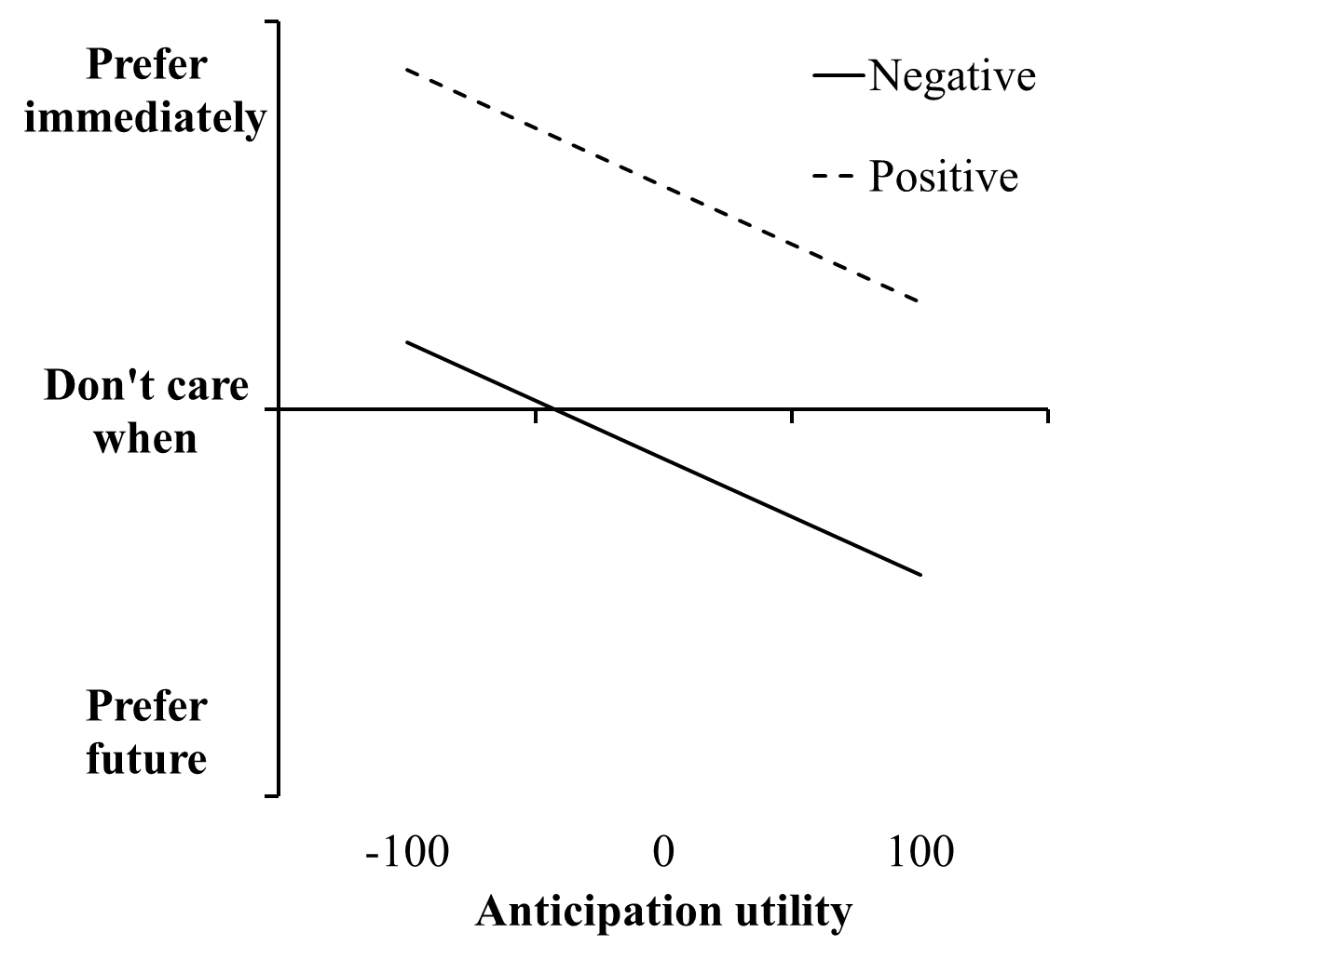
Anticipation predicts time preferences
Notes:
This relationship was significant for all 20 events; average standardized beta = -.3

Slide 47
Event | Anticipation Utility | Now Preference | beta
a free 5-day vacation to the destination of your choice | 28 | .19 | -.40**
eating a nice meal out at a restaurant | 28 | .29 | -.25**
a kiss from the movie star of your choice | 22 | .32 | -0.04
receiving a good grade or performance review | 21 | .68 | -.22**
getting a gift in the mail from a family member | 21 | .49 | -.29**
spending time with your best friend | 21 | .44 | -.18*
hour of favorite TV or book | 13 | .57 | -.20**
receiving a $50 check | 13 | .78 | -.16*
improved energy and health for 10 days | 9 | .69 | -.28**
winning the lottery | 6 | .79 | -.28**
doing difficult home cleaning and renovation for 5 days | -19 | .02 | -0.08
an hour at the local Department of Motor Vehicles | -26 | .11 | -.19*
paying a $50 fine | -27 | .02 | -.21**
giving a stressful 60 minute improvised speech | -45 | 0.1 | -.20*
being sick for 10 days | -47 | -.15 | -.26**
a painful dental procedure | -53 | .18 | -.30**
receiving a bad grade or performance review | -55 | .15 | -.25**
a confrontation with your co-worker or family member | -57 | .18 | -.17*
twenty painful (but harmless) electric shocks | -58 | .13 | -.23**
having one of your legs amputated | -63 | -.56 | -.13†

Slide 48
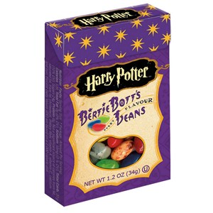
Study 2b: Methods
150 UBC students randomly assigned to “Dirt” or “Toasted marshmallow” flavor jellybean (pretested)
Everyone must wait one week to eat the jellybean (no choice! therefore no rationalization)
Jellybeans visible in the experimental room
Rated predicted experience utility
and anticipation utility
Notes:
Image source: https://www.delish.com/food/g75/fictional-tv-movie-food/

Slide 50
Studies 1 & 2: Summary
Dread is more pronounced than pleasurable anticipation
Anticipation value predicts time preference, for both gains and losses
Together, this (partly) explains the “sign effect” in intertemporal choice

Slide 51
Study 3: Controlling for loss aversion

Slide 52
Study 3: Overview
106 participants from Amazon MTurk
Dynamically identify subjectively equivalent gains and losses for each subject
Compare anticipation for these subjectively equivalent pairs

Slide 53
Accept this pair of events?
50% chance of receiving 25 dollars
AND
50% chance of paying 25 dollars
Yes Unsure No

Slide 54
Accept this pair of events?
50% chance of receiving 500 dollars
AND
50% chance of paying 25 dollars
Yes Unsure No

Slide 55
Accept this pair of events?
50% chance of receiving 49 dollars
AND
50% chance of paying 25 dollars
Yes Unsure No

Slide 56
Event Pairs
Positive | Negative
50% chance of receiving [$55] | 50% chance of paying $25
get a free, relaxing massage for 50 minutes | spend time stuck in horrible traffic for [45] minutes
watch really funny TV program for 30 minutes | watch boring, annoying commercials for [12] minutes
70% chance of receiving [$25] | do a really boring online survey for 90 minutes
a complimentary dinner at a restaurant of your choice | endure [10] mild (and harmless) electric shocks

Slide 57
Study 3: Stimulus
Please consider the following event:
[50% chance of receiving a $49]
Assuming this event would definitely happen to you and you knew it were coming, when would you prefer it to happen?
Immediately OR in one week

Slide 58
Time preferences
 | Gains | Losses
Now | 79% | 57%
In one week | 21% | 43%

Slide 59
Time preferences
 | Gains | Losses
Now | 79% | 57%
In one week | 21% | 43%

Slide 60
Study 3: Stimulus
2.a. Please imagine this event happening one week from now. Would experiencing this event be pleasurable or unpleasurable?
Pleasurable experience OR unpleasurable experience
2.b. How strongly would experiencing this event affect your feelings at that time?
not at all strongly extremely
|--------------------------------------------------------------------------|
(Wording based on McGraw et al, 2010)

Slide 61
Study 3: Stimulus
3.a. If this event were one week away, would the anticipation be psychologically pleasurable or unpleasurable? In other words, how would you feel while waiting for it?
Like the feeling of waiting OR Dislike the feeling of waiting
3.b. How strongly would anticipating this event affect your feelings while waiting for the event?
not at all strongly extremely
|--------------------------------------------------------------------------|

Slide 62
Utility for experience and anticipation

Slide 63
Study 4: Why the asymmetry?

Slide 64
Study 4: Methods
105 participants from Amazon MTurk
10 positive & 10 negative events (same as Study 2a)
Time preference
Two questions for anticipation:
…how pleasurable or happy would the anticipation be?
…how displeasurable or unhappy would the anticipation be?

Slide 67
Mixed anticipation
How often does the same person report both pleasure and displeasure in anticipation?
42% report mixed anticipation of gains
26% report mixed anticipation of losses

Slide 68
Summary
Anticipation of losses > anticipation of gains
Even when experience utility is matched
Anticipation of gains is emotionally mixed
Anticipation of losses is more unidimensional
Anticipation predicts choices
This (partly) explains the “sign effect”

Slide 69
Thank You!

