Slide 1
Elite Mentors Association
Consumer behaviour and presentation tips
Professor David J. Hardisty
May 10, 2015

Slide 2
Outline
My research
Some consumer behaviour concepts:
  Attribute Framing
  Segmentation & targeting
  Social Norms
  Make it easy
Proposal presentation tips
Ask questions any time!

Slide 3
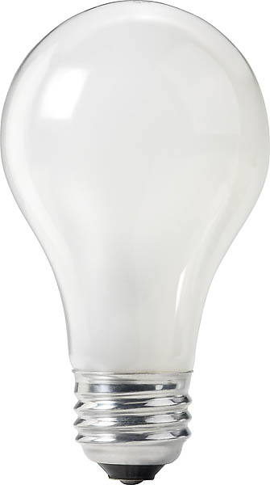
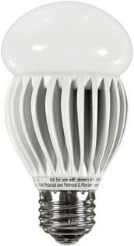
An economic mystery
Price: $0.97
Watts: 60
Lumens: 820
Price: $17.99
Watts: 13
Lumens: 800
(Saves $188 on energy)
Notes:
Image source left: https://www.fastenal.com/product/details/0723964
Image source right: https://www.amazon.ca/Magic-Lighting-A19P-30-30X-MA-Listed-Dimmable/dp/B00IEI0CWG

Slide 4
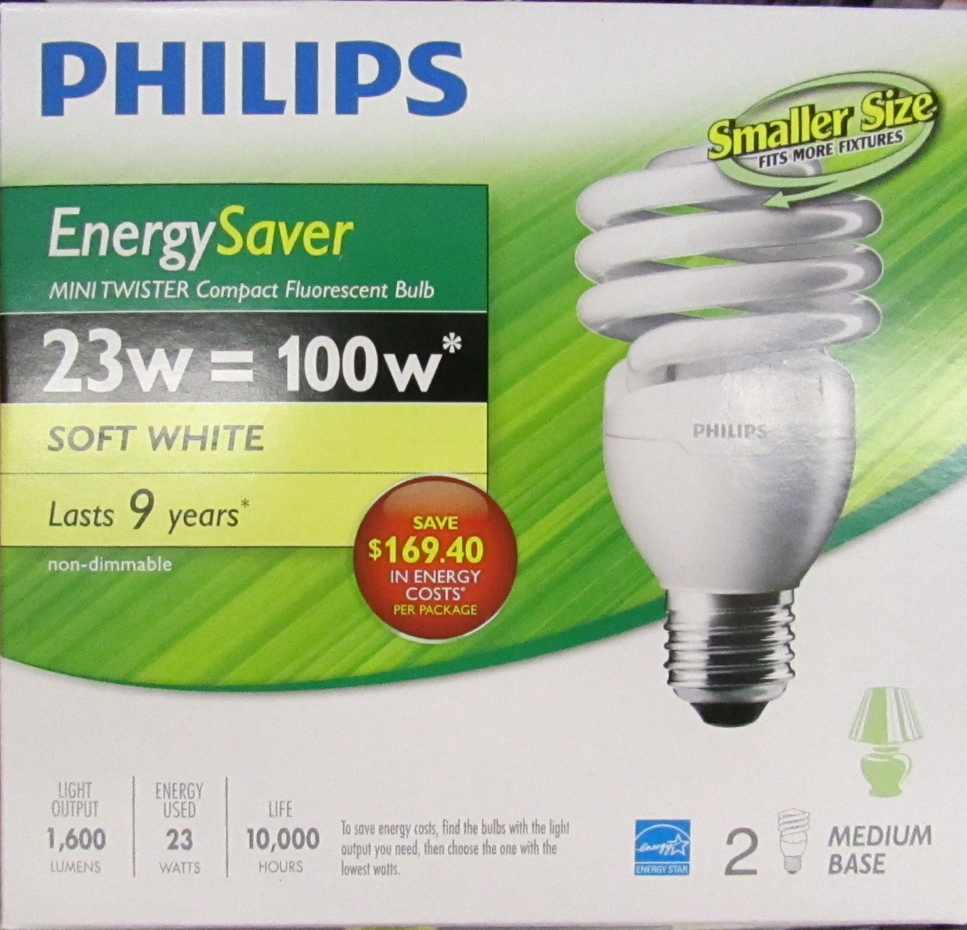
Consumers don’t care about the future?
Notes:
Image source: https://www.homedepot.ca/product/philips-13w-60w-soft-white-2700k-mini-twister-cfl-light-bulb-12-pack-/1000821862

Slide 5
Our theory
Consumers have a latent goal to reduce long-term costs
Price: $0.97
10-year energy cost: $239
Watts: 60
Lumens: 820
Price: $17.99
10-year energy cost: $52
Watts: 13
Lumens: 800
Notes:
Image source left: https://www.fastenal.com/product/details/0723964
Image source right: https://www.amazon.ca/Magic-Lighting-A19P-30-30X-MA-Listed-Dimmable/dp/B00IEI0CWG

Slide 6
Online Survey Results
Normal labels:
15% mention long-term cost or energy efficiency
30% choose the efficient bulb
10-year cost labels:
61% mention long-term cost or energy efficiency
67% choose the efficient bulb
Other survey results:
Works with other products: TVs, washing machines, etc.
Energy savings and dollar savings labels don’t do much
Asking consumers to estimate the 10-year cost of each product: equally effective

Slide 7
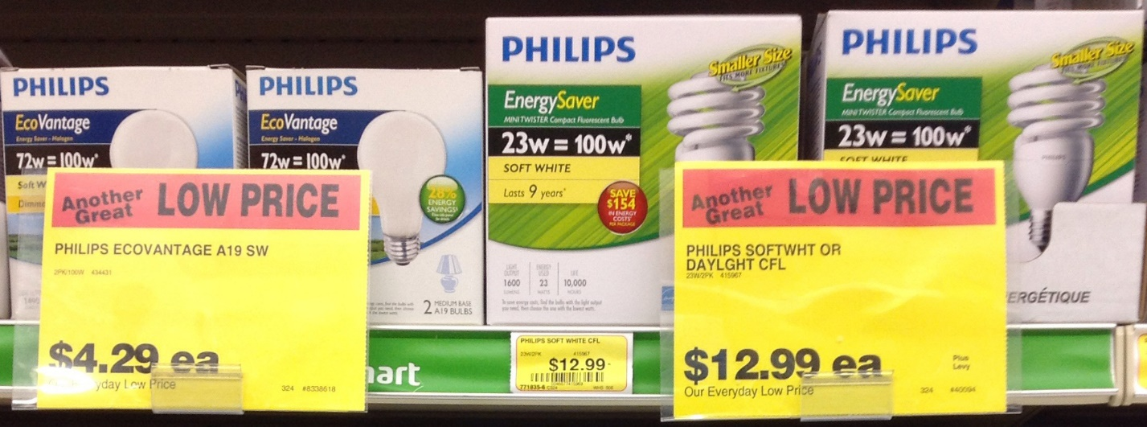
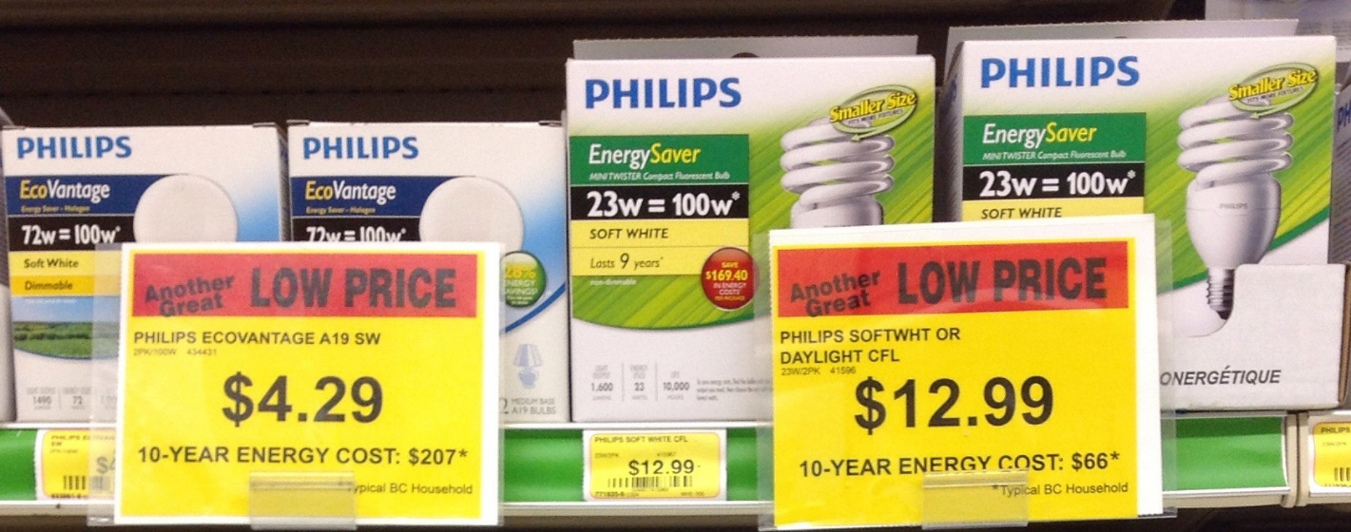
Does it work in real stores?
12%
chose efficient option
48%
chose efficient option
Notes:
Increased units sold by 47%, increased sales by 134%

Slide 8
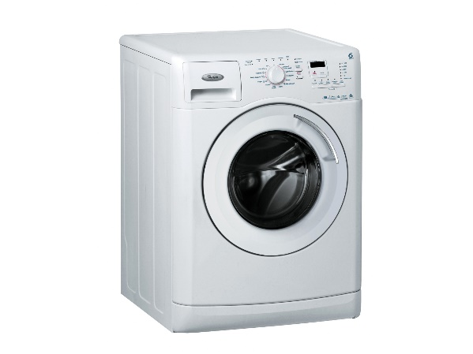
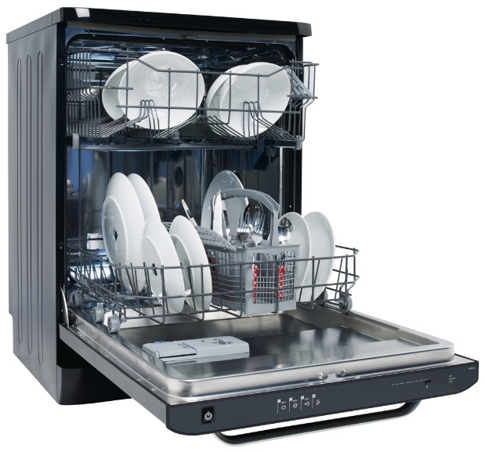
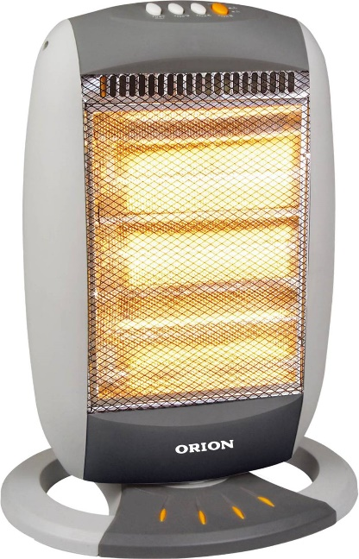

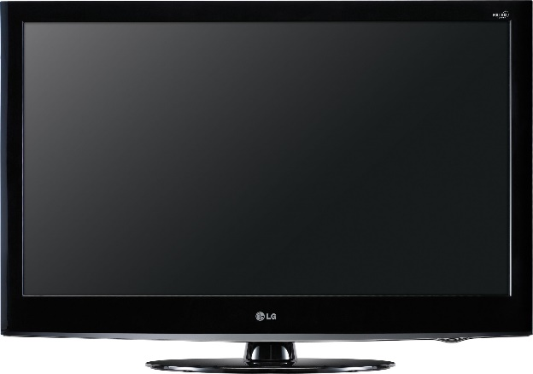
Let’s scale this up
Triple winner:
Good for the consumer
Good for the firm (sales up 134%!)
Good for the environment
Notes:
Image source:
computer - https://www.indiamart.com/proddetail/computer-system-20357403197.html
Tv - https://www.indiamart.com/proddetail/32-inch-lg-television-18470908188.html
Heater - https://www.differencebetween.info/difference-between-blower-and-heater
Dishwasher - https://www.arcappliances.co.uk/our-products/dishwashers/
Washign machine - https://www.ifixit.com/Device/Whirlpool_Washing_Machine

Slide 9
Attribute Framing

Slide 10
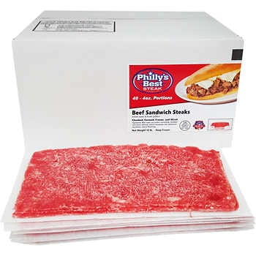

Attribute Framing
Frames and labels make a big difference
People pay more for 75% lean than 25% fat (Levin & Gaeth, 1988)
Doctors & patients prefer survival rate to mortality rate (Marteau, 1980; McNeil, Pauker, Sox & Tversky, 1982)
Women, but not men, prefer an 80% fat-free chocolate bar (Braun, Gaeth & Levin, 1997)
Carbon tax vs mandatory carbon offset?
Notes:
We thought we might see differences based on political ideology
Image source:
Beef -> https://www.costcobusinessdelivery.com/phillys-best-steak-beef-sandwich-steaks%2C-4-oz-portion%2C-10-lbs.product.100245970.html
Tax icon -> https://m.facebook.com/revrexhamont/photos/no-tax-sale-today-friday-august-10th-indulge-in-some-sweet-sales-from-10am-9pm-t/2128405174097301/

Slide 11
Attribute Framing: Methods
Proposal to increase cost of certain products believed to contribute to climate change through energy use and resulting CO₂ emissions
Price increases would fund programs to decrease CO₂ levels by funding alternative energies or carbon sequestration
Proposal described as carbon tax or carbon offset (between subjects)
Hardisty, D. J., Johnson, E. J., & Weber, E. U. (2010). A dirty word or a dirty world? Attribute framing, political affiliation, and query theory. Psychological Science, 21(1), 86-92.
Notes:
...after reading this description, participants faced a series of choices.

Slide 12
Attribute Framing: Methods
Suppose you are purchasing a round trip flight across the country, and you are debating between two tickets, one of which includes a carbon tax. You are debating between the following two tickets, which are otherwise identical. Which would you choose?
Ticket A | Ticket B
$392.70 round trip ticket includes a carbon tax | $385.00 round trip ticket
Notes:
We used real prices from the internet for the products and offsets

Slide 13
Attribute Framing: Methods
Suppose you are purchasing a round trip flight across the country, and you are debating between two tickets, one of which includes a carbon offset. You are debating between the following two tickets, which are otherwise identical. Which would you choose?
Ticket A | Ticket B
$392.70 round trip ticket includes a carbon offset | $385.00 round trip ticket
Notes:
We used real prices from the internet for the products and offsets

Slide 14
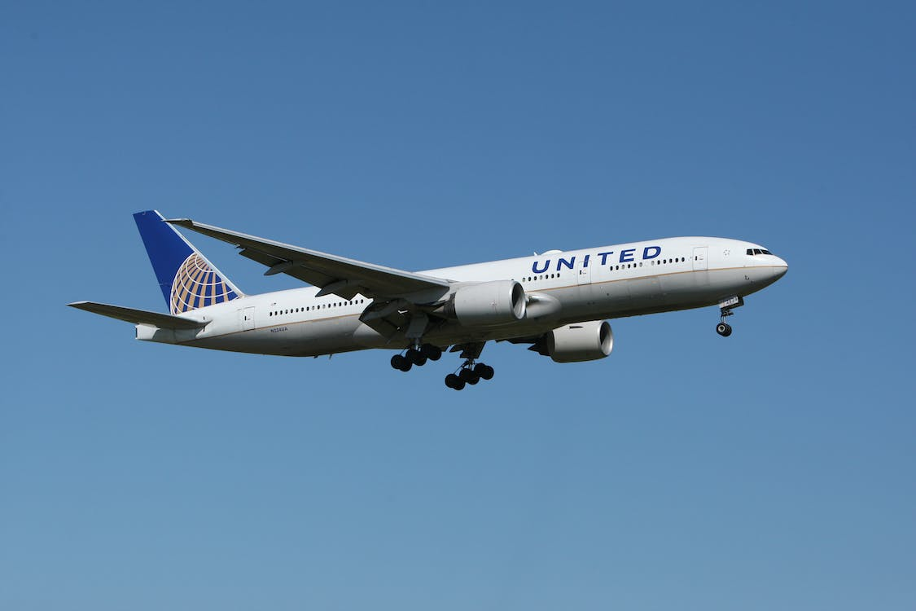
Attribute Framing: Methods
Do you think the carbon tax [offset] included in Ticket A should be made mandatory for all airline tickets sold in the country?
(-3 = Definitely Not to 3 = Definitely)
Prediction?
Notes:
Image source: https://unsplash.com/

Slide 15
Attribute Framing: Results
1
0.9
0.8
0.7
0.6
Proportion Choosing the Costlier Ticket
Offset
0.5
Tax
0.4
0.3
0.2
0.1
0
Liberal
Independent
Conservative

Slide 16
Attribute Framing: Results
3
2
1
Mean Support for Regulation
Offset
0
Tax
-1
-2
-3
Liberal
Independent
Conservative
Notes:
Same

Slide 17

Attribute Framing: Summary
Often the same attribute can be represented in two different ways
Choose your frames wisely
Frames that don’t matter to you might still matter to someone else
“15% off” or “Tax free”?
Eco-friendly
Notes:
Image source: https://www.dreamstime.com/eco-friendly-green-badge-tree-leaf-design-element-packaging-design-promotional-material-vector-eco-friendly-green-image170367185

Slide 18
Segmentation & Targeting

Slide 19
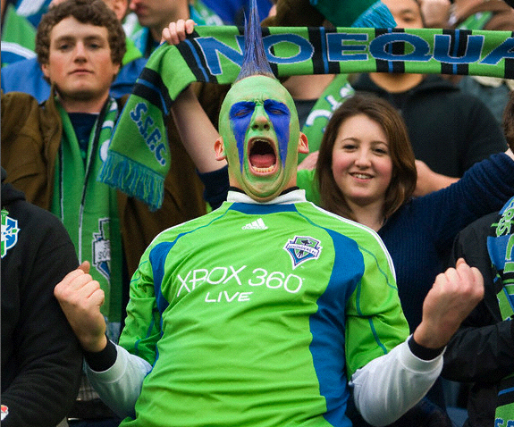
Notes:
Image source: https://www.pinterest.ca/pin/57632070201474216/

Slide 20
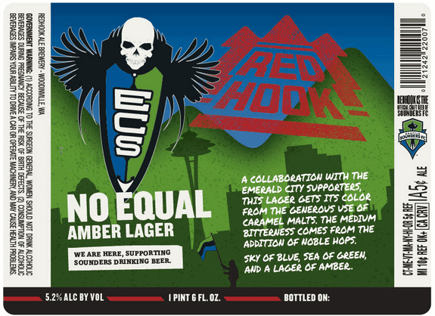
Notes:
Image source: https://thefullpint.com/beer-news/redhook-ecs-equal-blonde-collaboration-emerald-city-supporters/

Slide 21
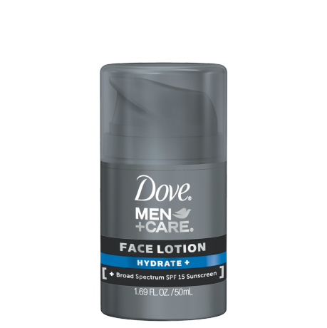
Segmentation & Targeting
Other common ways to segment?
Social class
Gender
Age
Lifestyles and values (e.g., health
conscious)
Culture/ethnicity
Early adopters vs majority
Notes:
Image source: Dove.com
https://www.dove.com/us/en/men-care/skin-care/men-care-hydrate-face-lotion.html

Slide 22
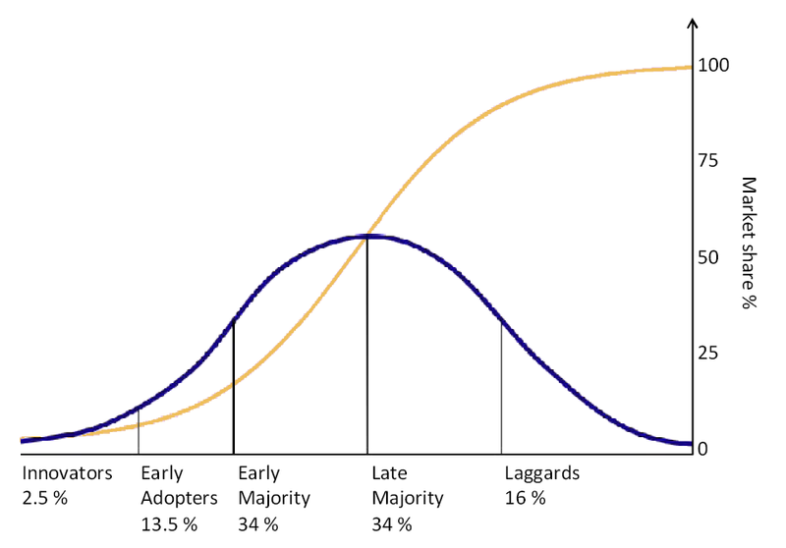
Transition to early majority? https://www.youtube.com/watch?v=xgmLgQ7YkIU

Slide 23
Social Norms

Slide 24
Social norms
What’s the best message for convince hotel guests to reuse towels?
“HELP SAVE THE ENVIRONMENT.”
35% reuse rate
“JOIN YOUR FELLOW GUESTS IN HELPING TO SAVE THE ENVIRONMENT.”
44% reuse rate
Cialdini, Robert B. "Crafting normative messages to protect the environment." Current directions in psychological science 12.4 (2003): 105-109.

Slide 25
Descriptive vs Injunctive Social Norms
Power company in California
Monthly energy bill shows how you compare to your neighbors
Predictions?

Slide 26
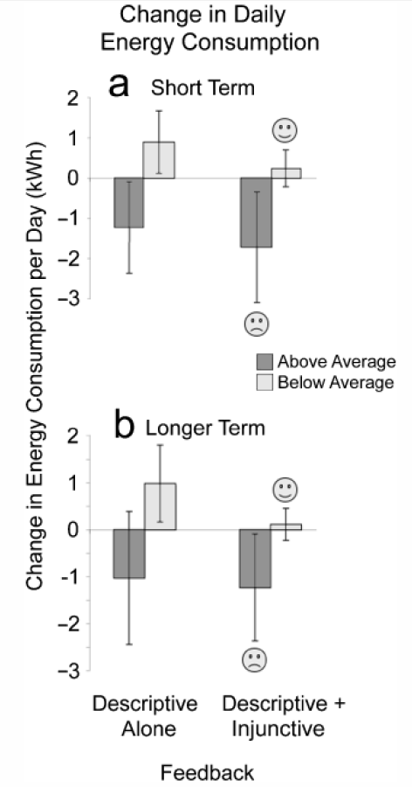

Slide 27
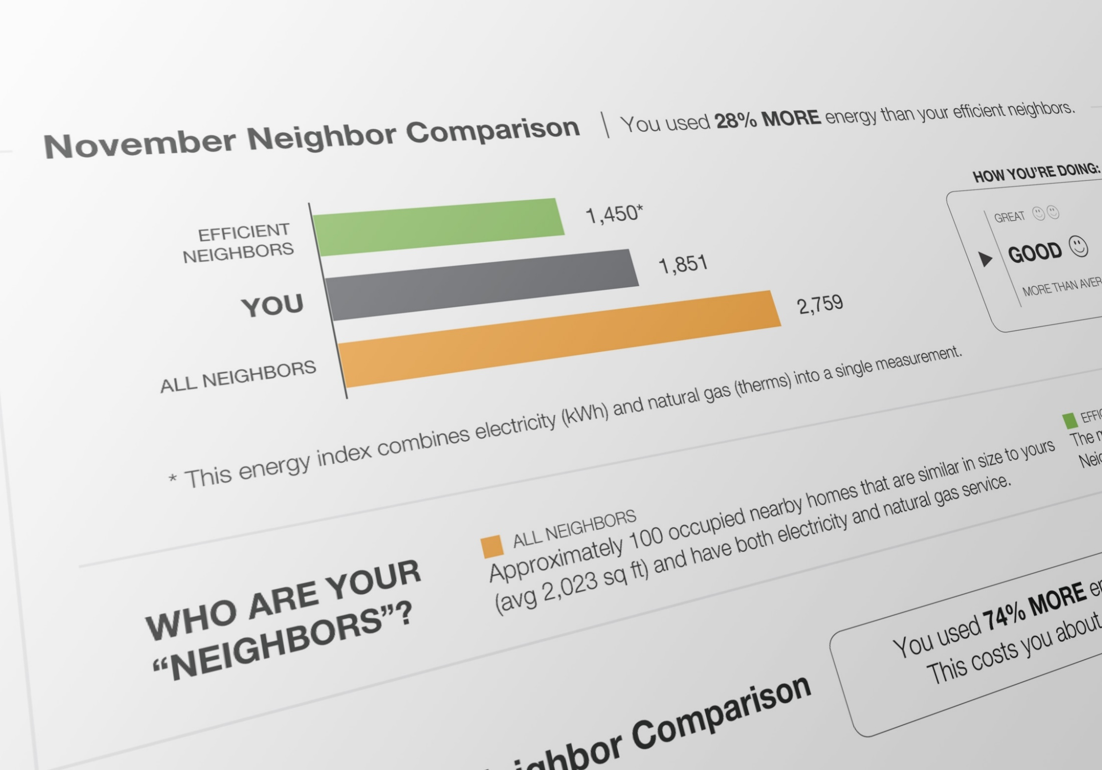

Slide 28
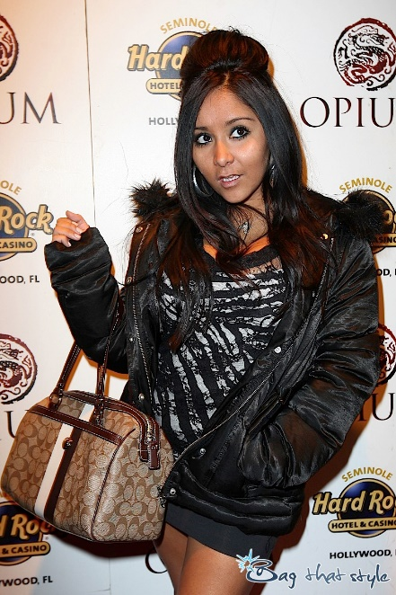
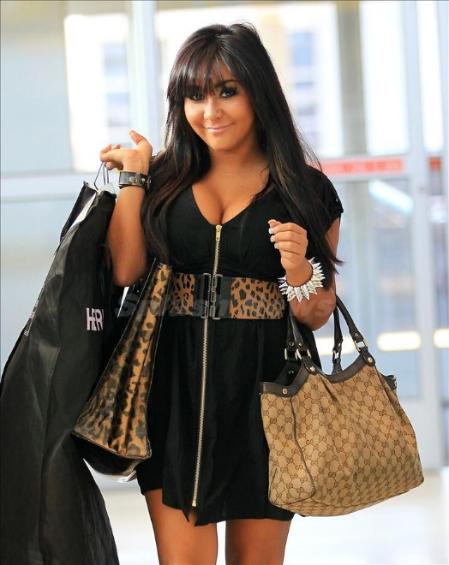
More social norm examples
Product observability (e.g., fitbit, gopro)
Crowding/lines
Out-groups
Notes:
Image source left: https://blogs.ubc.ca/calvinkwok/2010/10/01/unbranding/
Image source right: https://nypost.com/2010/09/23/snookis-fleshy-offer/

Slide 29
Make it easy

Slide 30
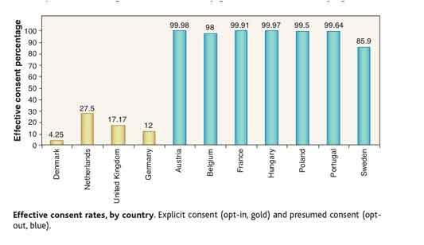
Organ Donation

Slide 31
Defaults
Why do they work?
Laziness
Social norms
Implied endorsement
Loss aversion (status quo bias)
Marketing Implications:
Choose defaults strategically: auto-renewal
“Free 30-day trial”
Johnson, E., & Goldstein, D. (2003). Do defaults save lives?. Science, 302, 1338-1339.

Slide 32
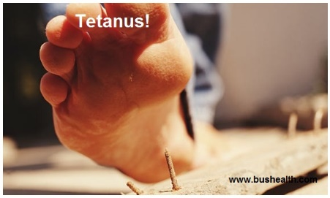
Action Plan: Methods
We want students to get tetanus vaccines. We distribute pamphlets
Fear appeal (yes or no):
- scary adjectives
- scary photos (“proved to be quite startling to the subjects”)
Action plan (yes or no):
- map of University Health Service location
- list of times when shots were available
- request to look at your schedule and choose a time
All pamphlets say shots are effective and free
Who is more likely to get a shot? Predictions?
Leventhal, H., Singer, R., & Jones, S. (1965). Effects of fear and specificity of recommendation upon attitudes and behavior. Journal of Personality and Social Psychology, 2(1), 20.
Notes:
Image source: https://www.youtube.com/watch?v=WrX_Fry9gbs

Slide 33
Action Plan: Results
High fear vs low fear
- High fear group thought shots were more important
- High fear group reported stronger intention to get shots
- High fear group were NOT more likely to get a shot
Action plan (with map) vs no plan
- No plan: 3% got a shot (1 out of 30)
- With plan: 28% got a shot (8 out of 29)
Leventhal, H., Singer, R., & Jones, S. (1965). Effects of fear and specificity of recommendation upon attitudes and behavior. Journal of Personality and Social Psychology, 2(1), 20.

Slide 34
Make it easy
Make your target action obvious and easy
Examples: https://www.facebook.com/
https://www.linkedin.com/
http://www.doctorswithoutborders.org/
Provide multiple routes to important pages or actions
Example: http://www.nytimes.com/
Business cards

Slide 35
Presentation Tips

Slide 36
Presentation Tips: Verbal
Confidence is number 1 (practice!)
Tell a story
Keep everything simple
Spend time on the important stuff

Slide 37
Presentation Tips: Written
Clear writing and organization
Images/graphics
Executive summary (abstract)
Have a friend or family member read it

Slide 38
Review
Framing
Segmentation & targeting
Social Norms
Make it easy

Slide 39
Thank You!

