Slide 1
Encouraging Energy Efficiency: Product Labels Facilitate Temporal Tradeoffs
David J. Hardisty, University of British Columbia
Yoonji Shim, University of British Columbia
Daniel Sun, University of Calgary
Dale Griffin, University of British Columbia
Wharton Decision Processes Seminar
Jan 23, 2017

Slide 2



Co-authors
Dale Griffin
Yoonji Shim
Daniel Sun

Slide 3
Thank you!
Working paper
“Trees” version
Please interrupt

Slide 4
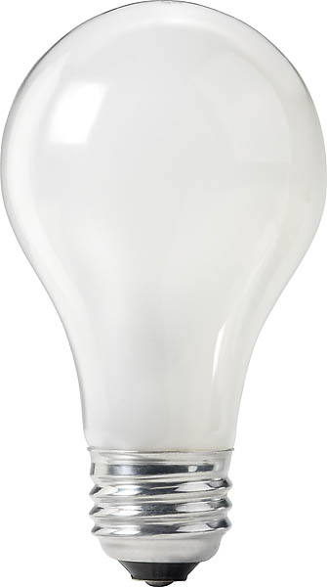
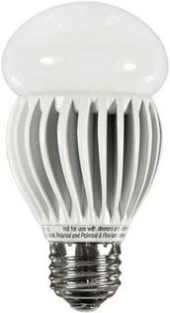
The “Energy Paradox”
Price: $0.97
Watts: 60
Lumens: 820
Price: $17.99
Watts: 13
Lumens: 800
(Saves $188 on energy over lifetime of the bulb)
Notes:
People are so “dumb” about this choice that many state governments have made inefficient light bulbs illegal. As choice architects, we don’t like this.
Image source (left): https://www.rona.ca/en/product/feit-electric-light-bulb-bright-white-a15-bulb-shape-40-watt-bp40a15-can-31925045
Image source (right): https://www.bulbconnection.com/product/4909-TCP-80101450-14W-SPRINGLIGHT-50K-14w-Spiral

Slide 5
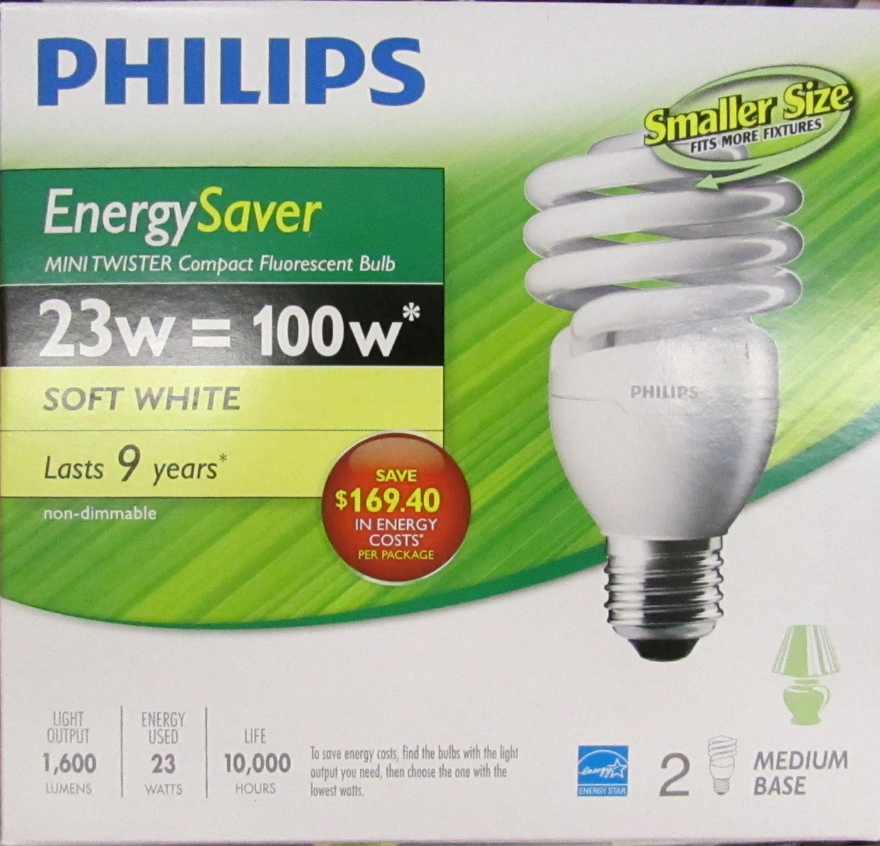
Consumer don’t know? Or don’t care?
Notes:
Image source: https://www.walmart.ca/en/ip/philips-23w-100w-mini-twister-soft-white-cfl-bulb-2-pack-soft-white/6000200197323

Slide 6
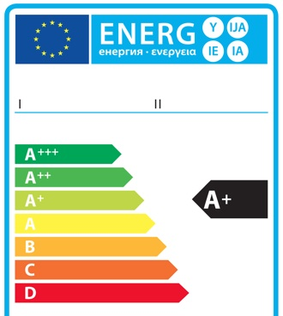
Previous Findings
People don’t know?
  Education changes knowledge, not choices (Abrahamse et. al 2005)
  Energy efficiency labeling changes attention, not choices (Kallbekken, Sælen, & Hermansen 2013; Waechter et al., 2015)
  …but operational cost labeling DOES influence choices, especially if you scale up the metric (Camilleri & Larrick, 2014; Min et. al, 2014; Larrick & Soll 2008)
People don’t care?
  People have really high discount rates (Frederick et. al, 2002)
  For real-world energy choices, too (Hausman, 1979)
  …but discount future losses less than future gains
  (Thaler, 1981; Hardisty & Weber 2009)
Notes:
Mention calorie labeling, traffic light labelling.
Image source: https://ec.europa.eu/info/energy-climate-change-environment/standards-tools-and-labels/products-labelling-rules-and-requirements/energy-label-and-ecodesign/about_en

Slide 7
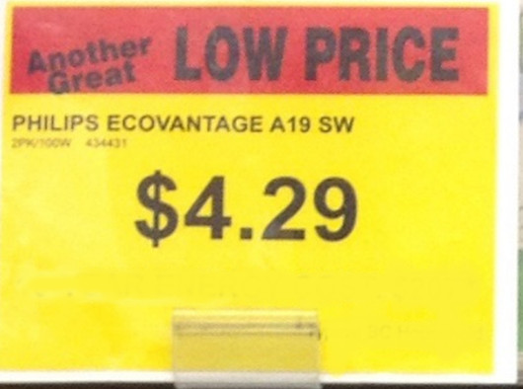
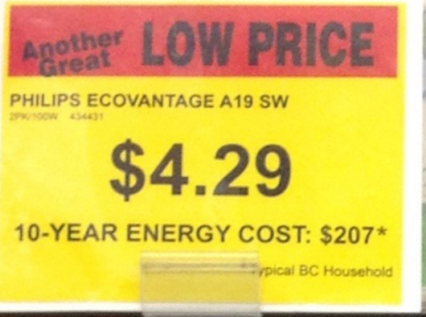
Our Nudge: 10-year energy cost
The best energy label.
Why does it work? Multiple reasons, but in particular:
People have a latent goal to minimize long term dollar costs
“10-year energy cost” labels activate this goal and makes it easy to act on

Slide 8
Outline
It works (Study 1a, 1b & 1c)
Under certain conditions (Study 2)
Even without the labels (Study 3)
Better than the alternatives (Study 4)
Why? (Study 5)

Slide 9

Study 1 methods
Price: $999.95
Estimated Electricity Use (W): 121
Standby energy consumption: 0.2w
Brand: Samsung
Size: 50”
Resolution: 1080p
Price: $749.95
Estimated Electricity Use (W): 181
Standby energy consumption: 0.4w
Brand: Samsung
Size: 50”
Resolution: 1080p
Notes:
Image source: https://www.freepnglogos.com/pics/tv

Slide 10
Study 1 methods
Price: $999.95
10-year energy cost: $600
Estimated Electricity Use (W): 121
Standby energy consumption: 0.2w
Brand: Samsung
Size: 50”
Resolution: 1080p
Price: $749.95
10-year energy cost: $1,000
Estimated Electricity Use (W): 181
Standby energy consumption: 0.4w
Brand: Samsung
Size: 50”
Resolution: 1080p
Notes:
Image source: https://www.freepnglogos.com/pics/tv

Slide 11
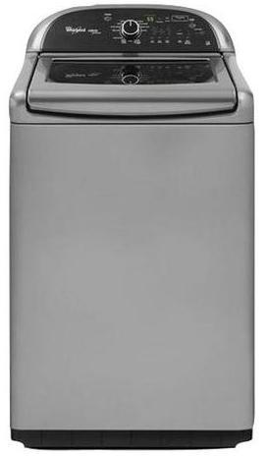
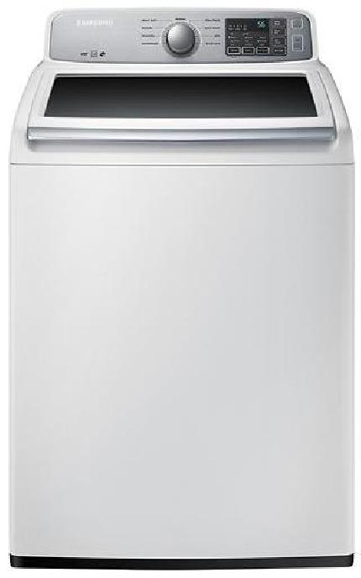
Price: $629.99
Estimated Yearly Electricity Use (kWh): 169
Model: 4.5 Cu. Ft.
9 cycle
Top Load Washer
Brand: Samsung
Price: $899.99
Estimated Yearly Electricity Use (kWh): 150
Model: 4.8 Cu. Ft.
13 cycle
Top Load Washer
Brand: Whirlpool
Notes:
Image source:
Left - https://image-us.samsung.com/SamsungUS/home/home-appliances/washers/top-load/pd/wa50m7450aw/01_Washer-TopLoader_WA50M7450AW_Front_Closed-White.jpg?$product-details-jpg$
Right - https://www.energycenterappliance.com/product/whirlpool-cabrio-platinum-top-load-washer-chrome-shadow-wtw8500bc-23606

Slide 12
Price: $629.99
10-year energy cost: $180
Estimated Yearly Electricity Use (kWh): 169
Model: 4.5 Cu. Ft.
9 cycle
Top Load Washer
Brand: Samsung
Price: $899.99
10-year energy cost: $100
Estimated Yearly Electricity Use (kWh): 150
Model: 4.8 Cu. Ft.
13 cycle
Top Load Washer
Brand: Whirlpool
Notes:
Image source:
Left - https://image-us.samsung.com/SamsungUS/home/home-appliances/washers/top-load/pd/wa50m7450aw/01_Washer-TopLoader_WA50M7450AW_Front_Closed-White.jpg?$product-details-jpg$
Right - https://www.energycenterappliance.com/product/whirlpool-cabrio-platinum-top-load-washer-chrome-shadow-wtw8500bc-23606

Slide 13
Study 1a Results: Clean

Slide 14
Study 1a Results: Real

Slide 15

Study 1b: Community Sample
Notes:
Image source: https://hseds.ca/bc-hydro-logo/

Slide 16
Study 1b Results: BC Hydro

Slide 17

Study 1c: Field Study
Notes:
Image source: London Drugs. (2022, October 14). In Wikipedia. https://en.wikipedia.org/wiki/London_Drugs

Slide 18
Study 1b: Methods
Run in 5 drug stores over 6 weeks
Two types of lightbulbs:
  72w Halogen bulb (2-pack) for $4.29
  23w CFL bulb (2-pack) for $12.99
Displayed on endcaps and aisles
Labels switched once per week, counterbalanced across stores
DV: proportion of CFLs purchased
Notes:
55

Slide 19
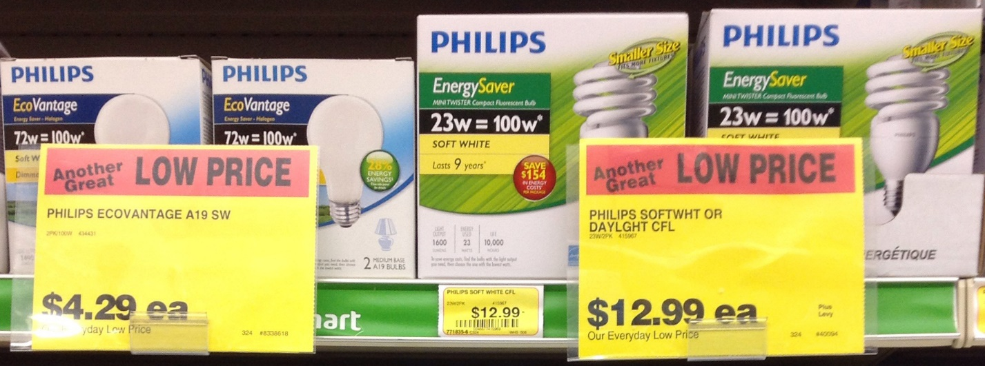
Study 1b Methods: Control Labels

Slide 20
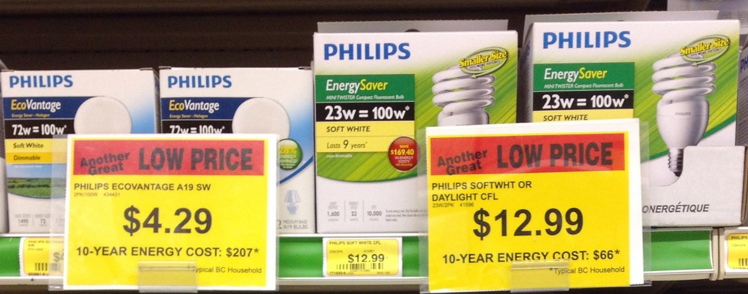
Study 1b Methods: 10-year Energy Cost Labels

Slide 21
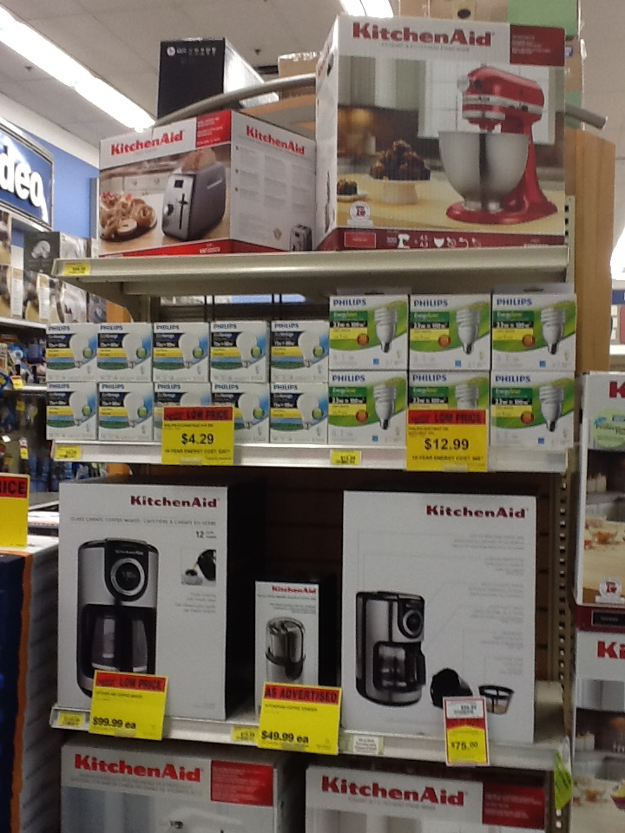

Slide 22
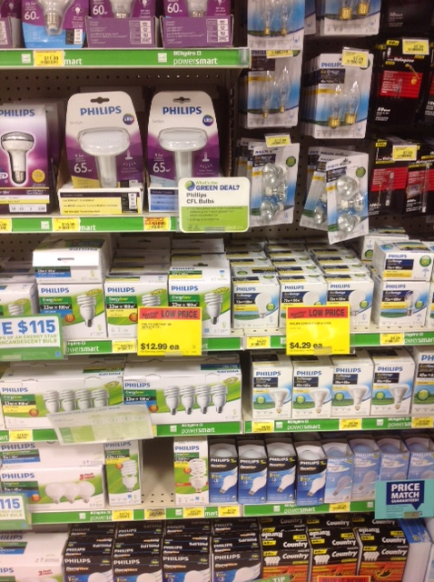

Slide 23
Study 1b: Results
12%
chose efficient option
(n = 26)
48%
chose efficient option
(n = 29)

Slide 24
Endcap vs Aisle
 | Endcap | Aisle
Control | .12 (n=26) | .38 (n=104)
10-year | .48 (n=29) | .39 (n=71)

Slide 25
Study 1 Discussion
Replicated our paradigm with real shoppers
Why doesn’t it work in the aisle?
  Unobserved choice shift?
  Habitual purchase vs Constructed preference?
  Dichotomous choice vs Multi-option choice?
    Information overload?
  Labels on some products vs Labels on all products?

Slide 26
Study 2: Dichotomous vs Multi-Option Choice

Slide 27
Study 2: Methods
MTurk, Lightbulbs (from London Drugs), 2 + 3 design (?)
2-option choice
  Control
  10-year energy cost
6-option choice
  Control
  10-year labels on target bulbs
  10-year all light bulbs
  10-year cost per bulb (rather than 10-year cost per package)
  DV: wattage chosen (lower is better)

Slide 28
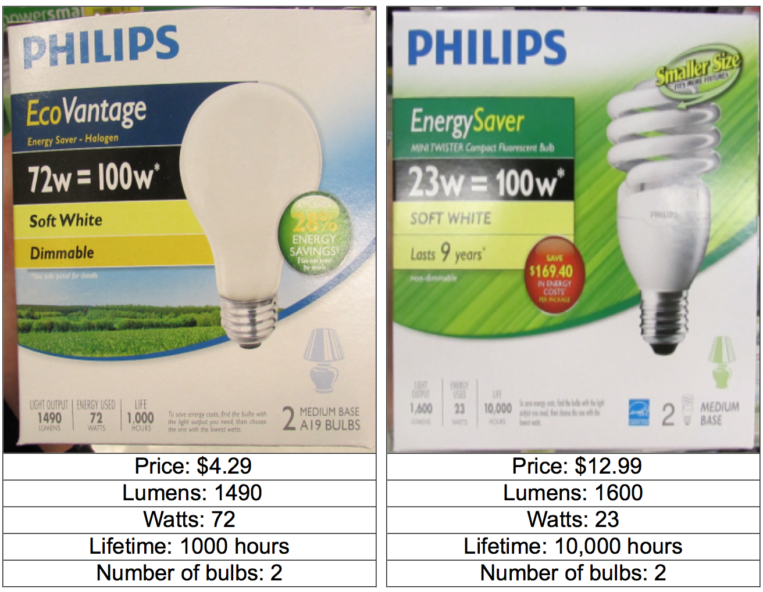
Endcap: Control

Slide 29
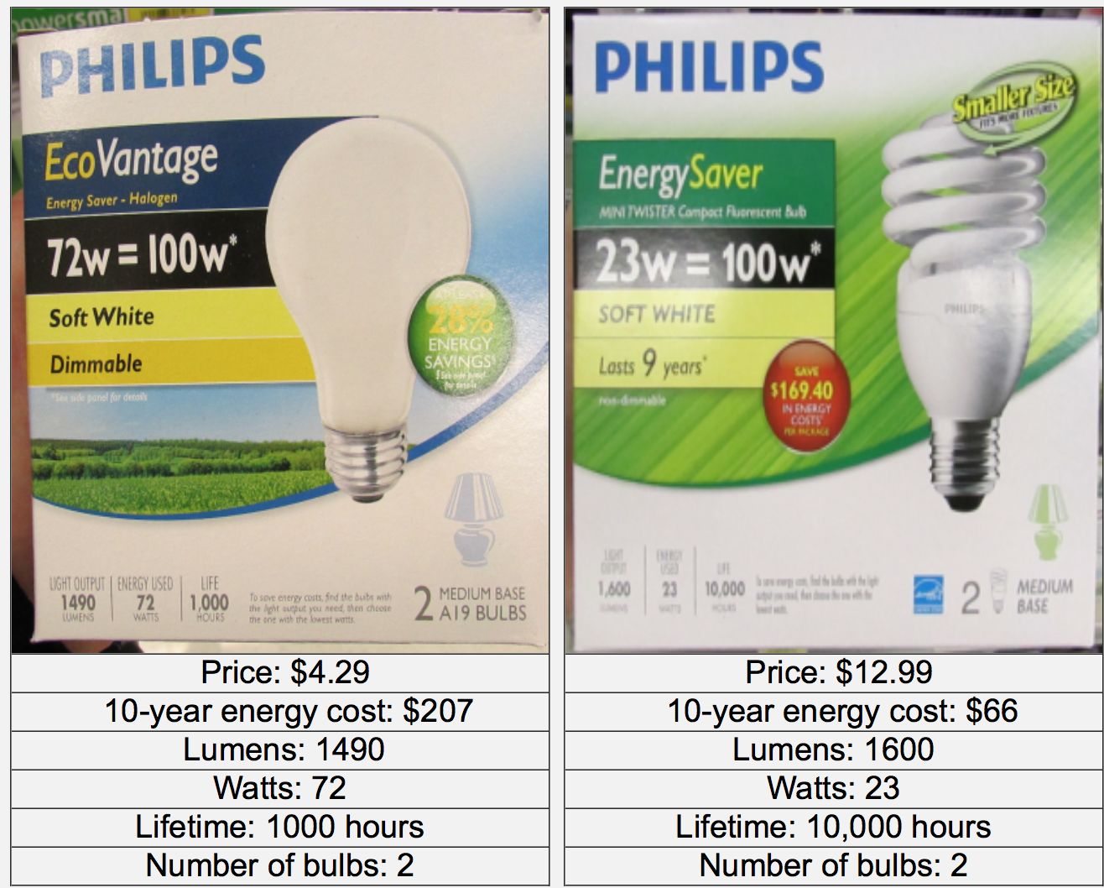
Endcap: 10-year cost

Slide 30
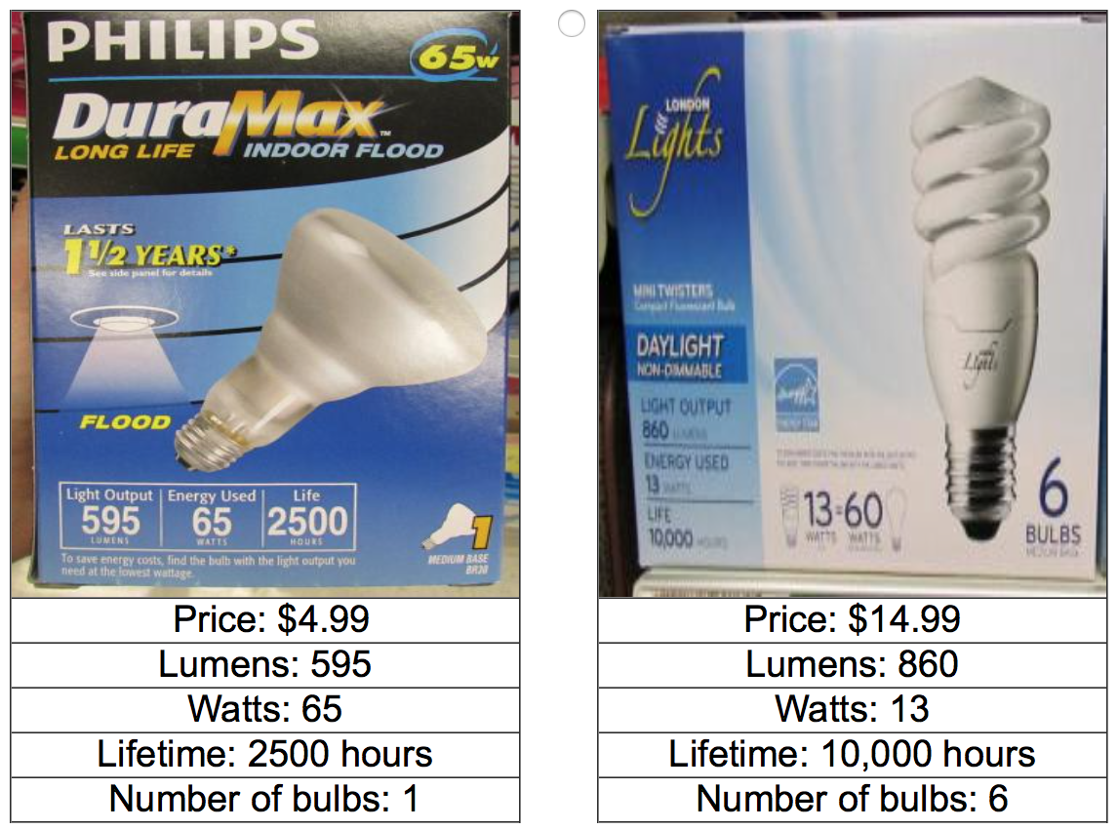
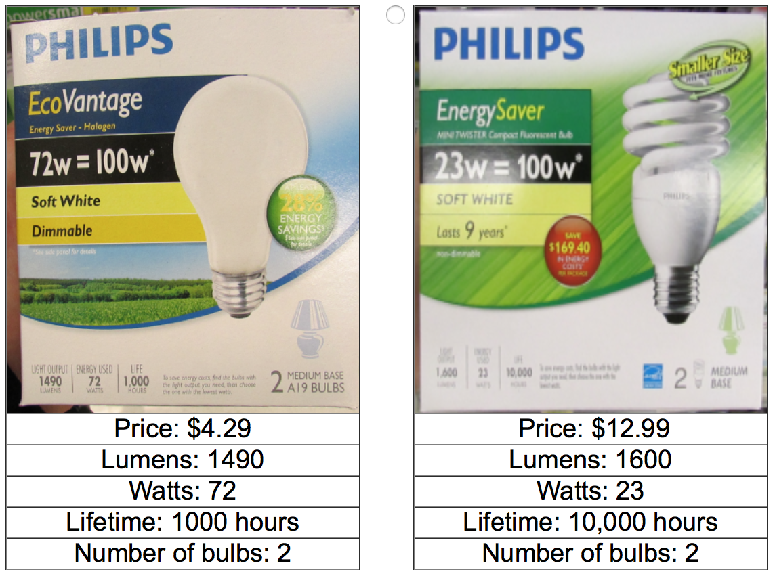
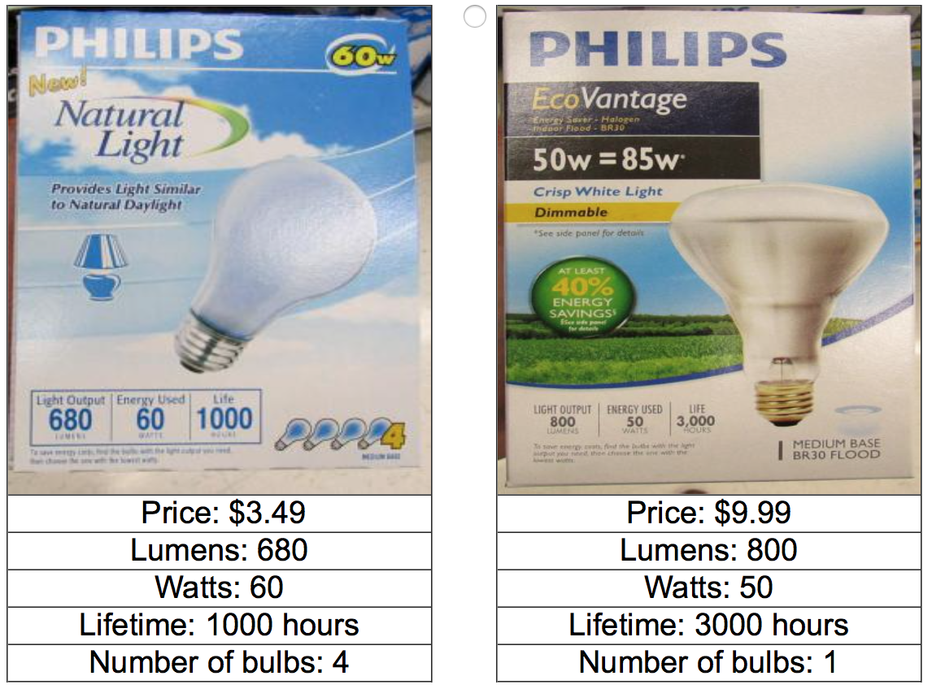
Aisle: Control

Slide 31
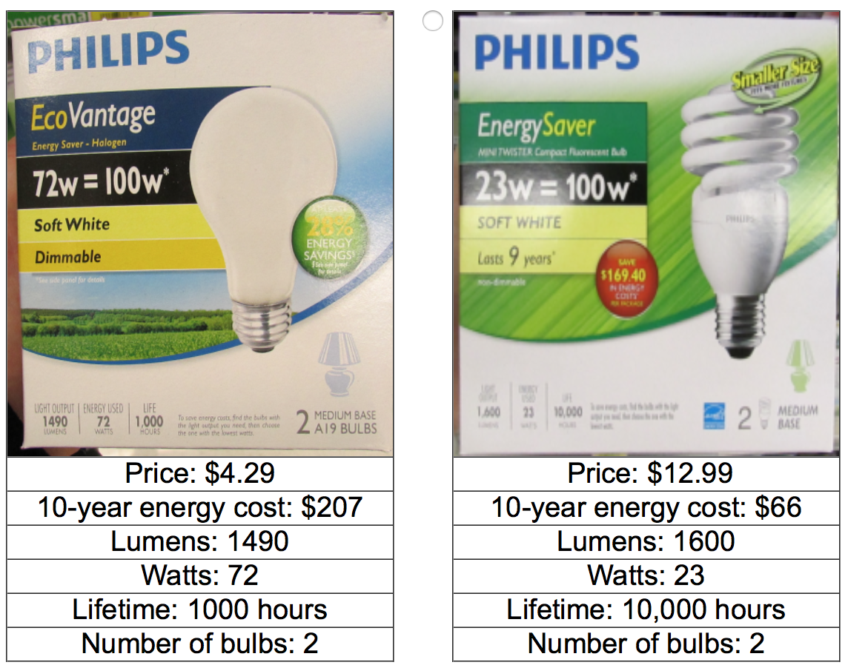
Aisle: 10-year target

Slide 32
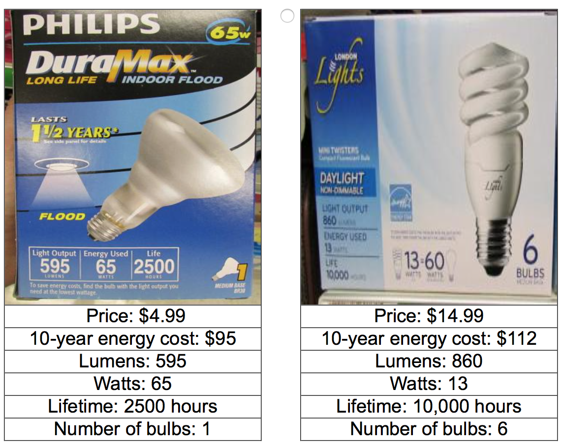
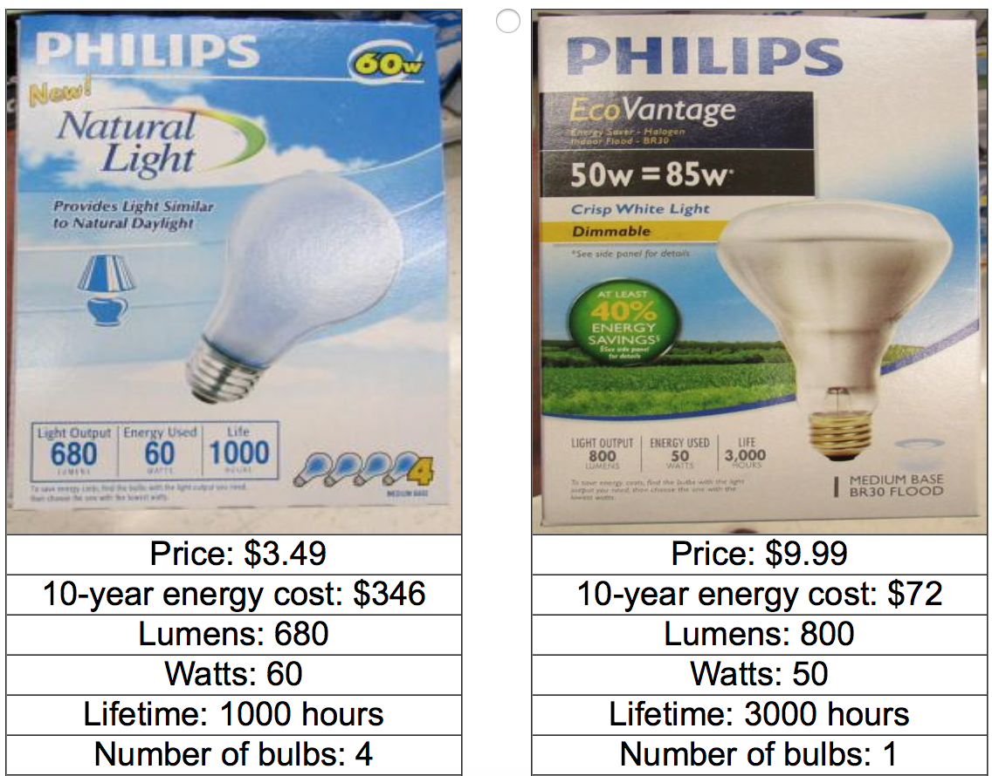
Aisle: 10-year all

Slide 34
Study 2: Discussion
10-year labels work with multi-option choice
  Only if on all (or most?) products under consideration
Hypothesized process:
Labels activate goal
Make it easy to act on goal

Slide 35
Study 3: Alternative goal activation

Slide 36
Study 3: Methods
184 MTurkers
3 conditions: control, 10-year cost, and subjective estimation.
Subjective estimation condition [before choice] :
  "How many dollars do you estimate you would spend on energy costs to use product A, over a period of 10 years?“
  $_______
  "How many dollars do you estimate you would spend on energy costs to use product B, over a period of 10 years?“
  $_______

Slide 38
Study 3 Discussion
Subjective estimation has the same effect at 10-year cost labels
Strong evidence that information provision is not a necessary condition
Is this just attribute salience? Or attribute counting?
What if we frame as:
  Dollar savings
  kWh energy cost
  % energy savings

Slide 39
Study 4: Comparison to alternative goals

Slide 40
Study 4: Methods
1,155 Mturkers
Lightbulbs only (same bulbs as field study)
1 (control) + 2 (positive vs negative) x 3 (dollars, kWh, % energy)

Slide 41
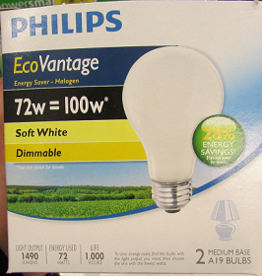
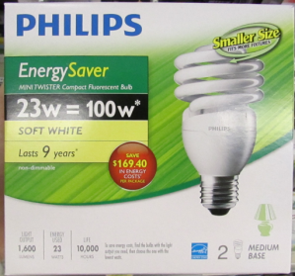
Study 4: Control
Price: $4.29
Lumens: 1490
Watts: 72
Number of bulbs: 2
Price: $12.99
Lumens: 1600
Watts: 23
Number of bulbs: 2

Slide 42
Study 4: 10-year dollar cost
Price: $4.29
10-year energy cost: $207
Lumens: 1490
Watts: 72
Number of bulbs: 2
Price: $12.99
10-year energy cost: $66
Lumens: 1600
Watts: 23
Number of bulbs: 2

Slide 43
Study 4: 10-year dollars saved
Price: $4.29
10-year energy saved: $81
Lumens: 1490
Watts: 72
Number of bulbs: 2
Price: $12.99
10-year energy saved: $222
Lumens: 1600
Watts: 23
Number of bulbs: 2

Slide 44
Study 4: 10-year energy cost
Price: $4.29
10-year energy cost: 1837 kWh
Lumens: 1490
Watts: 72
Number of bulbs: 2
Price: $12.99
10-year energy cost: 586 kWh
Lumens: 1600
Watts: 23
Number of bulbs: 2

Slide 45
Study 4: 10-year energy saved
Price: $4.29
10-year energy saved: 718 kWh
Lumens: 1490
Watts: 72
Number of bulbs: 2
Price: $12.99
10-year energy saved: 1969 kWh
Lumens: 1600
Watts: 23
Number of bulbs: 2

Slide 46
Study 4: 10-year % cost
Price: $4.29
10-year energy cost: 28% less
Lumens: 1490
Watts: 72
Number of bulbs: 2
Price: $12.99
10-year energy cost: 77% less
Lumens: 1600
Watts: 23
Number of bulbs: 2

Slide 47
Study 4: 10-year % saved
Price: $4.29
10-year energy saved: 28% more
Lumens: 1490
Watts: 72
Number of bulbs: 2
Price: $12.99
10-year energy saved: 77% more
Lumens: 1600
Watts: 23
Number of bulbs: 2

Slide 48
Study 4: Results

Slide 49
Study 4: Discussion
Goal activation is specific to dollar costs
Also an effect of attribute salience (or attribute counting)

Slide 50
Study 5: Why is the 10-year cost label effective?
Goal activation
Planning horizon
Information provision
Scaling (10-yr cost is better than 1-yr cost)
Attribute counting
Trust/legitimacy
Other?

Slide 51
Study 5: Methods
Similar to Study 1
Added 1-year cost and 5-year cost conditions
Measure goals
Planning horizon
[Then choice is made.]
Cost estimation

Slide 52
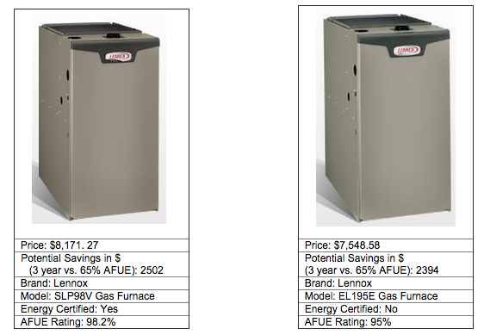
As you consider purchasing a new furnace, what product features are most important to you? Please list the three most important product features.

Slide 53
When purchasing a new furnace, roughly how far ahead do you plan?
Not at all
Up to one week
More than one week up to one month
More than one month up to one year
More than one year up to five years
More than five years up to ten years
Ten years or more

Slide 54
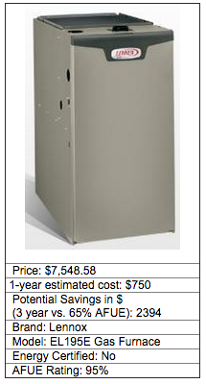
Please imagine that you purchased the furnace above. How much do you estimate your household would spend on energy to use this furnace in your home, over a period of [1 year]?
$_______

Slide 59
Study 5: Modelling
 | Bulb |  | TV |  | Furnace |  | Vacuum
 | p | r² | p | r² | p | r² | p | r²
cost estimate | .43 | .00 | .03 | .02 | .39 | .00 | .87 | .00
planning horizon | .002 | .04 | .22 | .01 | .59 | .00 | .08 | .01
goal prominence | <.001 | .11 | <.001 | .08 | <.001 | .06 | <.001 | .15
condition | .01 | .05 | .25 | .02 | .24 | .02 | .09 | .03

Slide 60
Study 2: Mediation
Long-term cost goal prominence
(β = 0.19, p < .001)
β = 0.15, p < .001
(β = 0.66, p < .001)
Energy efficient choices
10-year cost labelling
(β = 0.25, p < .001)
β = 0.15, p = .01

Slide 61
Study 5 Discussion
10-yr energy cost labeling is effective
Why?
  Activates energy cost reduction goal (biggest r²)
  Improved cost estimation is NOT an important factor for influencing choices
  Attribute scaling (10yr vs 5yr vs 1yr) is also somewhat helpful

Slide 62
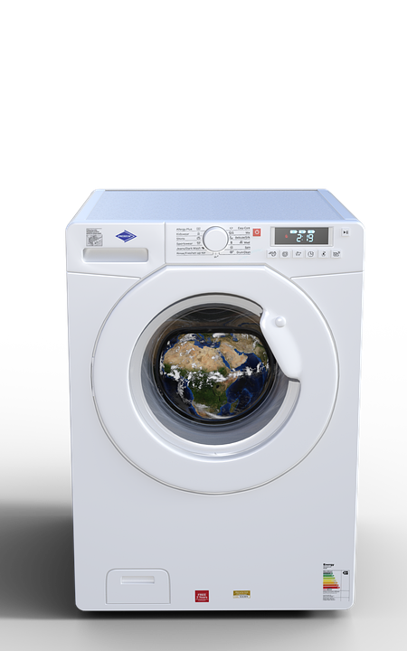

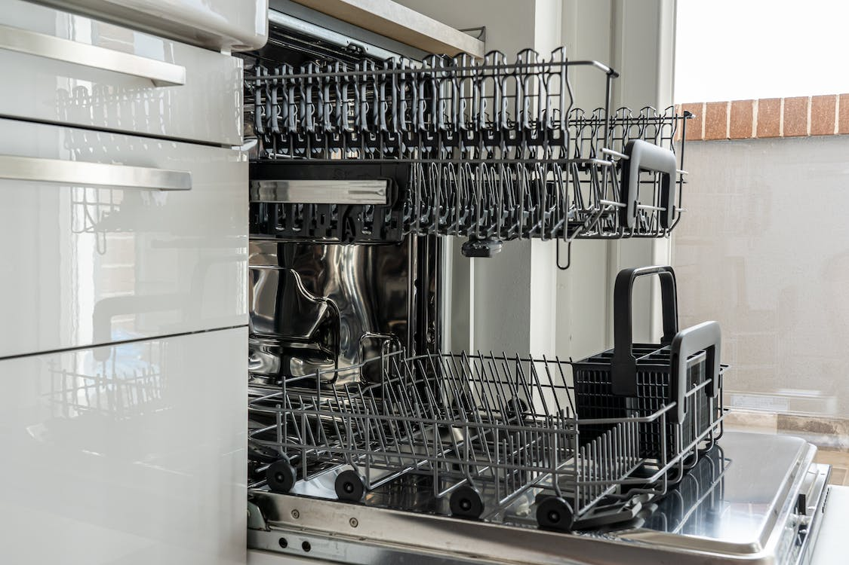
Conclusions
10-year energy cost labelling is an effective, low-cost nudge to increase energy efficient choices
Works via goal activation (in part)
Win-win-win
Easy to scale up
Notes:
Similar to unit cost labeling
Image source: https://unsplash.com/

Slide 63
Thank You!

