Slide 1


Ray Charles “Chuck” Howard, Texas A&M University a David J. Hardisty, University of British Columbia a Dale W. Griffin, University of British Columbia a Chongbo “Zack” Wang, WUSTL
Documenting and Debiasing
the
Income Prediction Bias

Slide 2
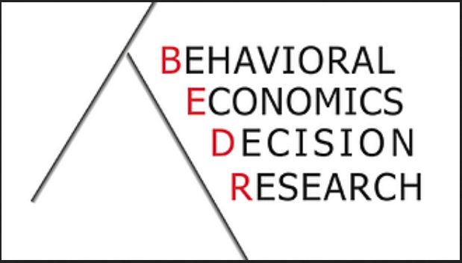
BEDR
& The Gatto Economic Research & Faculty Fund
Notes:
Thank you for having me here; it was a real honour to be invited
I’ve never presented at a BEDR seminar
I had to decide what to present, and I decided to be greedy and present a working paper, that could really use your feedback
Please jump in with questions & suggestions!

Slide 3




Authors
Chuck Howard
Dave Hardisty
Dale Griffin
Zack Wang

Slide 4

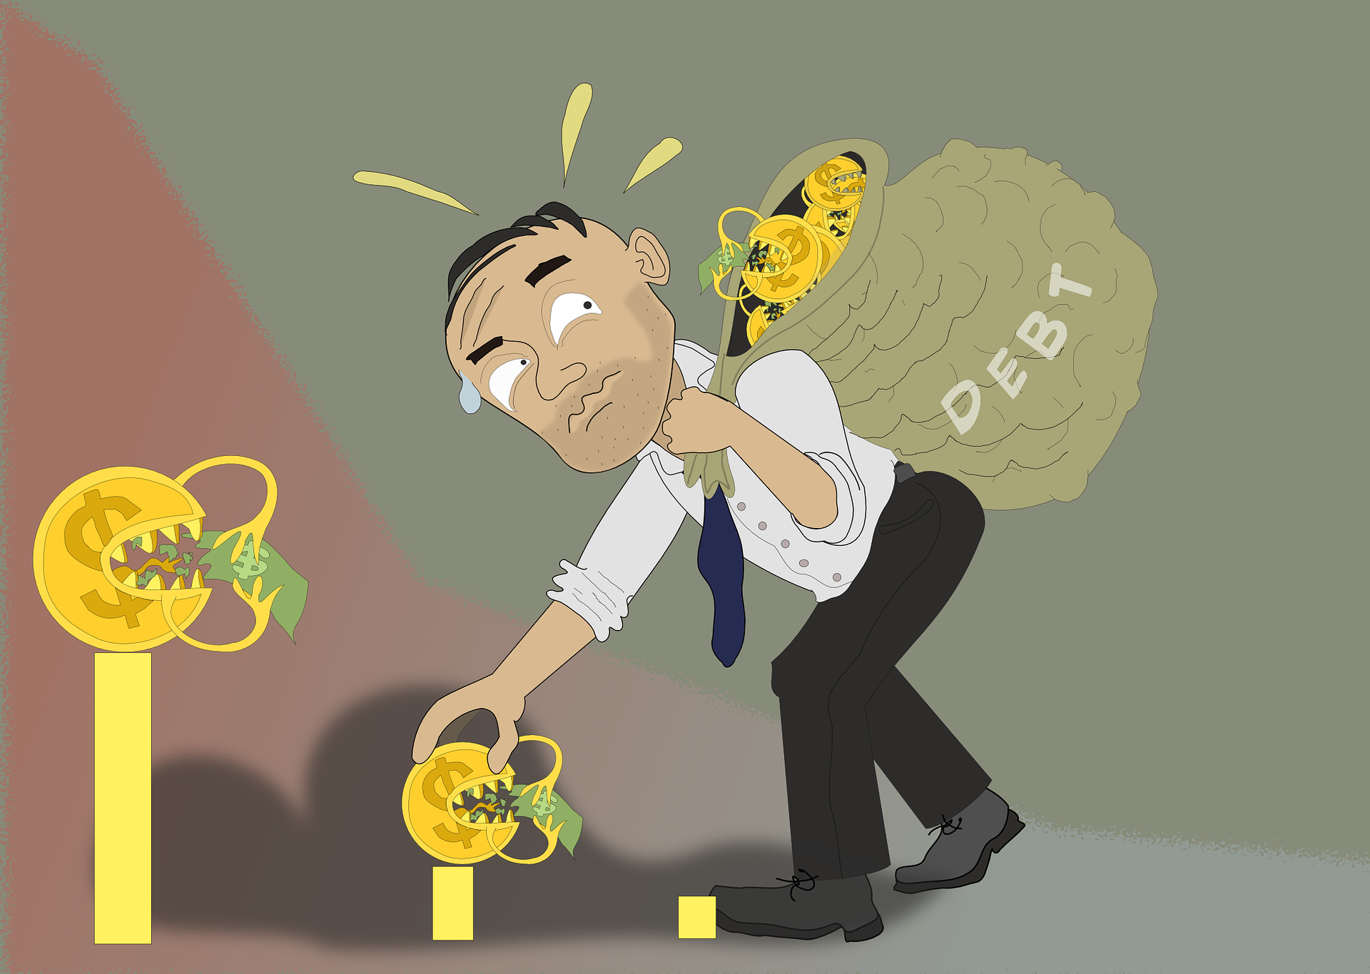
Motivation
Over 65% of US consumers predict income
(Zhang et al. 2020)
Notes:
Can/should you make the argument that savings and debt shape consumer behavior (e.g., purchases)?
“Interventions that help people accurately understand future expenses and income may thus minimize current spending and future debt.” → Hershfield et al. (2015)
Pictures from:
https://www.pexels.com/photo/man-looking-at-an-empty-wallet-7927581/
https://twitter.com/cnbctv18live/status/1285086501387161601

Slide 5
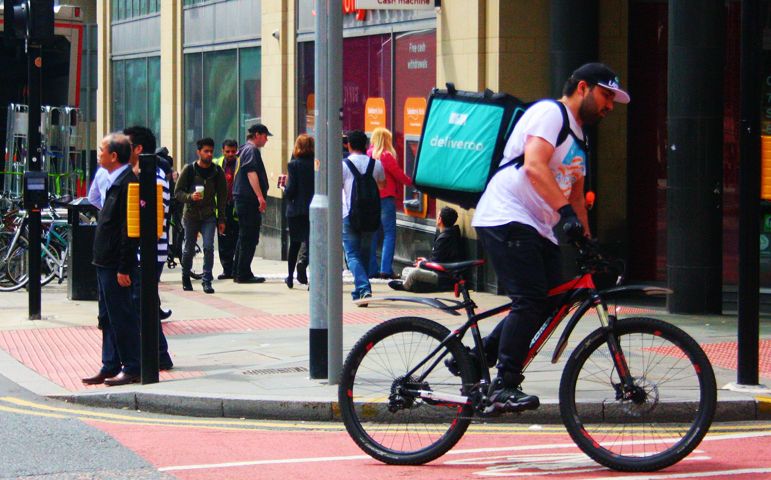
Motivation
Notes:
Gig economy employment refers to temporary, freelance work arrangements that are typically short-term, where independent contractors are hired on-demand.
For the purposes of today’s talk, we’re going to focus on gig workers for major tech platforms, such as Uber or Doordash
Picture credit: Gig worker. (2022, October 16). In Wikipedia. https://en.wikipedia.org/wiki/Gig_worker

Slide 6
Motivation
Gig work = variable income
(e.g., Shell 2022)

Slide 7

Motivation
Gig work = variable income
(e.g., Shell 2022)
Notes:
Image source: https://unsplash.com/

Slide 8

Motivation
Gig work = variable income
(e.g., Shell 2022)
Notes:
Image source: https://unsplash.com/

Slide 9
Motivation
Globally, 1.1 billion people work in the gig economy (Zgola 2021)
In the US, about one-third of the labor market works in the gig economy (McFeely and Pendell 2018)
In the US, gig income totalled over $1.3 trillion last year (Upwork 2021)
Notes:
Zgola (2021): https://www.forbes.com/sites/forbesbusinesscouncil/2021/08/12/will-the-gig-economy-become-the-new-working-class-norm/?sh=46e09497aee6
McFeely and Pendell (2018): https://www.gallup.com/workplace/240929/workplace-leaders-learn-real-gig-economy.aspx; One-third = about 55M people
Upwork (2021): https://www.upwork.com/press/releases/upwork-study-finds-59-million-americans-freelancing-amid-turbulent-labor-market
Statista (2022): https://www.forbes.com/sites/forbesbusinesscouncil/2021/08/12/will-the-gig-economy-become-the-new-working-class-norm/?sh=46e09497aee6
31% of US gig workers are full-time: https://www.pewresearch.org/internet/2021/12/08/the-state-of-gig-work-in-2021/
The article that directed me to the links above: https://fortunly.com/statistics/gig-economy-statistics/#gref

Slide 10
Research Questions
RQ1: Is there an income prediction bias?
RQ2: Why do people overpredict?
RQ3: How can we improve prediction accuracy?

Slide 11
Roadmap
Background
Theory and hypotheses for RQ1 and RQ2
Descriptive Studies 1 and 2
Theory and hypotheses for RQ3
Intervention Studies 3 & 4
Discussion
Notes:
Roadmap for rest of talk: Theory and hypotheses related to RQ’s 1 and 2, then two main effect studies, then theory and hypotheses related to RQ3, then two debiasing studies.
Preview the studies: longitudinal, real gig workers, app data, etc.

Slide 12
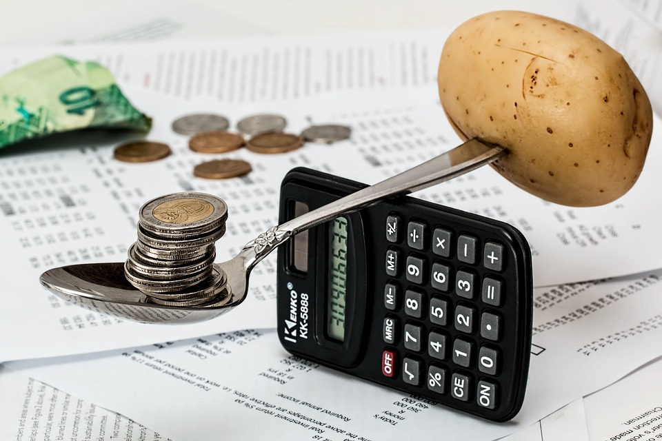
Background
Savings = Income – Expenses
Notes:
Image source: https://unsplash.com/

Slide 13
Background
Savings = Income – Expenses
Hershfield et al. 2011
Hershfield et al. 2018
Hershfield et al. 2020
Koehler et al. 2011
Shu & Payne 2015
Thaler & Benartzi 2004
Notes:
Any Sharma and Tully cites I can use on these slides? Can I make this list longer/more complete to really hammer home that there is relatively little work on income? The Koehler et al cite pertains specifically to people underpredicting how much money they will save. Remind yourself what each of these paper’s shows.
Image source: https://unsplash.com/

Slide 14
Background
Savings = Income – Expenses
Howard, Hardisty, Sussman, & Lukas 2022
Lukas and Howard 2022
Peetz & Buehler 2009, 2012, 2013
Peetz et al. 2015, 2016
Sussman & Alter 2012
Ülkümen et al. 2008
Notes:
Image source: https://unsplash.com/

Slide 15
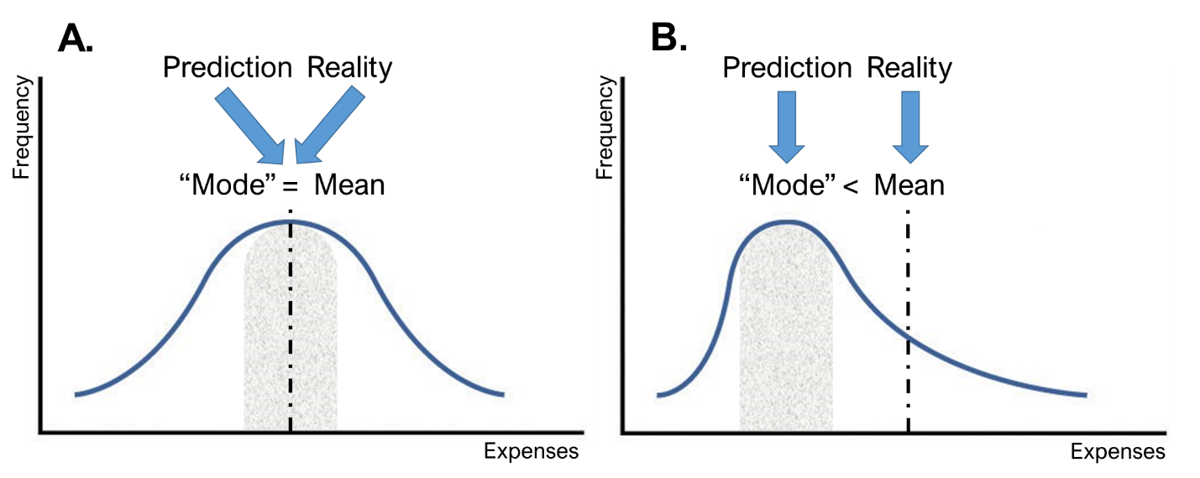
Background
Howard, Hardisty, Sussman, & Lukas (2022)
Notes:
But if you look at the work related to the income term in this equation you start to see a gap in the literature.

Slide 16
Background
Savings = Income – Expenses
Notes:
There are actually a number of structural & psychological differences between income and expenses:
Income = hours worked + hourly rate
Expenses are left bounded, but income is bounded on both sides (for most people)
Gig income is perhaps more controllable than expenses
Image source: https://unsplash.com/

Slide 17
Background
Savings = Income – Expenses
Berman et al. (2016)
De La Rosa and Tully (2022)
Zauberman and Lynch (2005)
Notes:
You will find some work on subjective predictions of things like perceived financial slack or feelings of uncertainty, but that doesn’t tell us if consumers are inputting the right number for income in this budgeting equation.
Income categorization
Subjective perceptions of wealth or uncertainty
Labor econ literature typically doesn’t measure actual accuracy, and the time horizon (e.g., 5 or 10 years) doesn’t tell us much about the psychology of budgeting for the next week or month.
Wendy and Steph (a) hold income constant, (b) measure subjective uncertainty of “having enough,”, (C) measure “prediction” retrospectively, and (d) do it all in hypothetical studies on Mturk.
What makes income different? How is it a different psychological space? Skewness.
Our studies indicate that income occupies a different psychology space than expenses or savings, which makes it an important context for theory building.
Image source: https://unsplash.com/

Slide 18
Background
Savings = Income – Expenses
Berman et al. (2016)
De La Rosa and Tully (2022)
Zauberman and Lynch (2005)
Betts (1996)
Jerrim (2015)
Webbink and Hartog (2004)
Notes:
Similarly, you will also find some work measuring students’ long-term salary expectations against industry averages, but again, that doesn’t tell us much about individual accuracy, or how effectively people forecast their income for the next week or month, as you need to do to complete this equation.
Income categorization
Subjective perceptions of wealth or uncertainty
Labor econ literature typically doesn’t measure actual accuracy, and the time horizon (e.g., 5 or 10 years) doesn’t tell us much about the psychology of budgeting for the next week or month.
Wendy and Steph (a) hold income constant, (b) measure subjective uncertainty of “having enough,”, (C) measure “prediction” retrospectively, and (d) do it all in hypothetical studies on Mturk.
What makes income different? How is it a different psychological space? Skewness.
Our studies indicate that income occupies a different psychology space than expenses or savings, which makes it an important context for theory building.
Image source: https://unsplash.com/
You will find some more recent work on subjective predictions of things like perceived wealth or uncertainty, but that doesn’t tell us if consumers are inputting the right number for income in this budgeting equation.

Slide 19
Is there an income prediction bias?
The case for accuracy:
Income targeting (Camerer et al. 1997)
Encouraged by some apps (Sheiber 2017)
Students have fairly accurate salary expectations (Webbink and Hartog 2004)
Apps provide real-time feedback on earnings

Slide 20
Is there an income prediction bias?
The case for bias:
Predictions tend to be optimistic
Expense prediction bias (e.g., Howard et al. 2022; Ülkümen et al. 2008)
Slack (e.g., Zauberman and Lynch 2005)
Planning Fallacy (e.g., Buehler et al.1994; Kahneman and Tversky 1977)

Slide 21
Is there an income prediction bias?
H1: Consumers who work in the gig economy display an income prediction bias in which they over-predict future gig income.

Slide 22



Why do people overpredict?
# of hours
$ per hour
Notes:
A bias like this, if it exists, is almost certainly multiply determined. We focus specifically on determining if the bias is caused by overpredicting the # of hours I can work and/or the amount per hour.
Icons source: https://www.freeimages.com/

Slide 23
Why do people overpredict?
# of hours
People neglect factors that will prevent them from working on specific tasks (e.g., Buehler et al. 1994, 2010; Kahneman and Tversky 1977; Kruger and Evans 2004)
Notes:
There are an unlimited number of things that may pop up and stop you from working – the “unknown unknowns”

Slide 24
Why do people overpredict?
$ per hour
Reservation wages set a floor, which is tied to expected wages (Brown and Taylor 2013)
Market competition sets ceiling
Notes:
If you accept the assumption that lower variability makes things easier to predict, that leads to the prediction that hourly wage estimates may be reasonably accurate.

Slide 25
Why do people overpredict?
H2: People tend to overpredict their gig hours more than their hourly wage.

Slide 26

Study 1: The App Study
Purpose
Examine the magnitude, prevalence, and persistence of the bias for weekly and monthly predictions
Method
Conducted in partnership with KABU
Predict gig income for the next week and next month
Wave 1: n = 49, M_{age} = 41.8, 95.1% men
Wave 2: n = 38, M_{age} = 42.5, 94.3% men
Notes:
Clarify that we asked people about all apps in Studies 2a and 2b
Preregistered icon citation: University of Melbourne (https://library.unimelb.edu.au/open-scholarship/preregistering_research)

Slide 27
Study 1: The App Study
Please take some time to estimate the total amount of money you will earn working for KABU in the next week.
How much money do you estimate you will earn (in total) working for KABU in the next week?
Notes:
Key points to highlight here are (a) this study lets us measure the bias more accurately, (b) it shows whether the bias exists for monthly predictions as well as weekly predictions, and (c) it lets us determine if the bias persists over time.
Note: The dates I’ve included are approximations to use as a simple illustration.
This study was preregistered on aspredicted.org

Slide 28
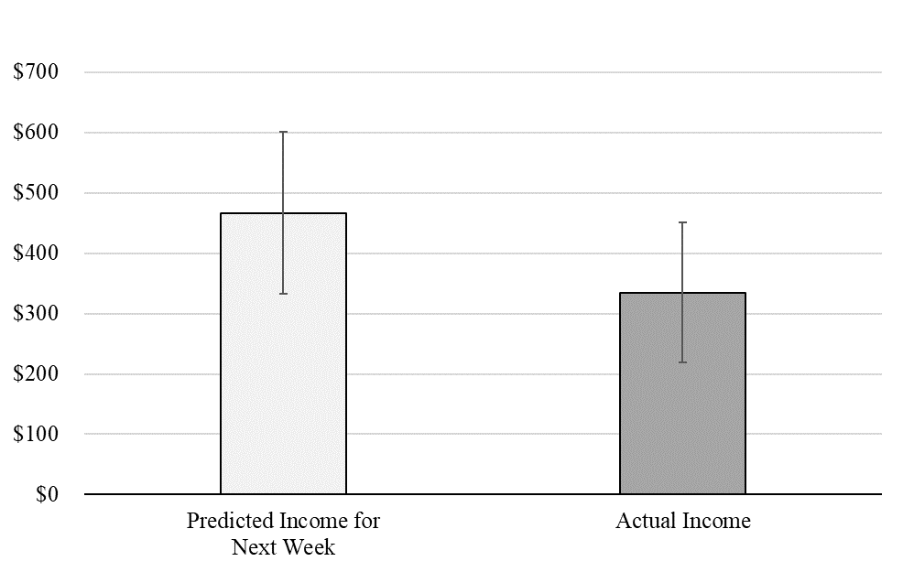
February Results
Week
Bias = $132.07 (28.3%)
(p < .001)
Notes:
r(47) = .87, p < .001
In the first survey, participants over-predicted their weekly income by an average of $132.07 or 28.3%, as revealed by a paired-samples t-test (M_{predicted_income} = $466.94, SD = 468.71; M_{actual_income} = $334.87, SD = 403.56; t(48) = 4.01, p < .001, d = .57). Moreover, the bias was prevalent: 75.5% of participants overpredicted to at least some extent, and 53.1% of participants over-predicted by $100 or more.
In the first survey, participants over-predicted their monthly income by an average of $347.43 or 20.1%, as revealed by a paired-samples t-test (M_{predicted_income} = $1724.52, SD = 1828.31; M_{actual_income} = $1377.09, SD = 1722.71; t(47) = 2.96, p = .005, d = .43). The bias was once again prevalent: 66.7% of participants over-predicted to at least some extent, and 50.0% of participants over-predicted by $300 or more.

Slide 29
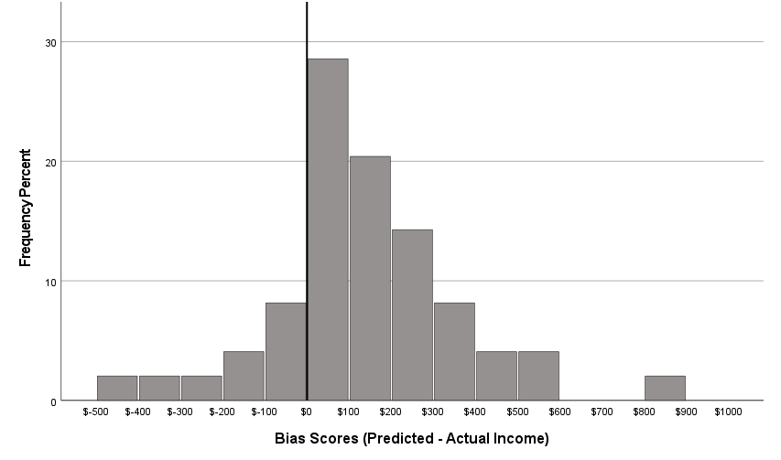
February Results
18.4%
81.6%

Slide 30
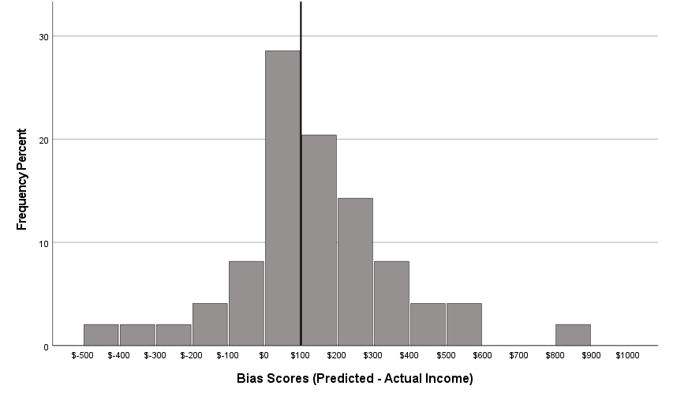
February Results
Median = $100.00 (p < .001)

Slide 31
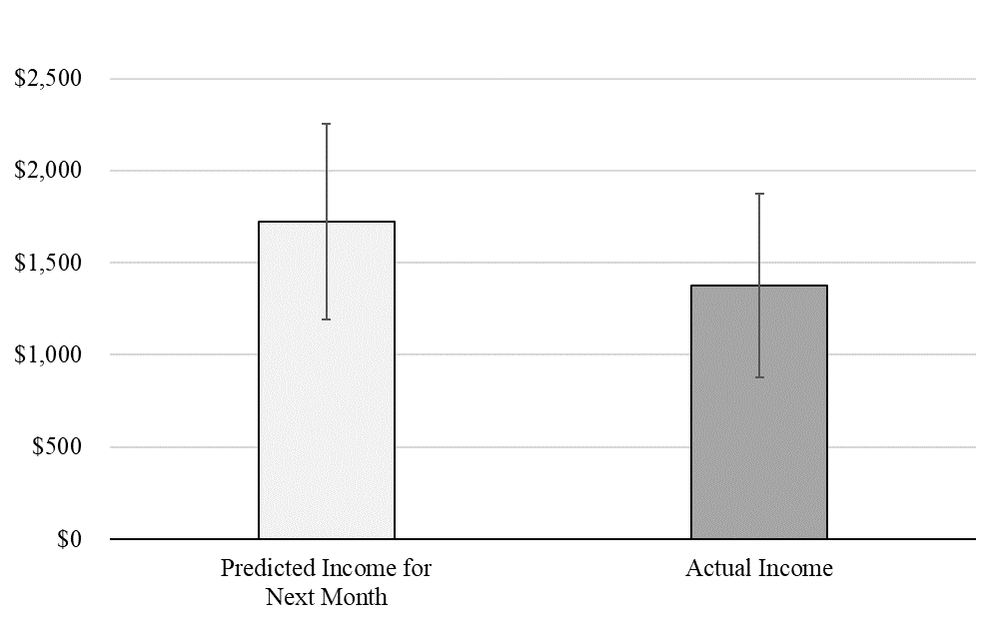
February Results
Month
Bias = $347.43 (20.1%)
(p = .005)
Notes:
r(47) = .90, p < .001
In the first survey, participants over-predicted their weekly income by an average of $132.07 or 28.3%, as revealed by a paired-samples t-test (M_{predicted_income} = $466.94, SD = 468.71; M_{actual_income} = $334.87, SD = 403.56; t(48) = 4.01, p < .001, d = .57). Moreover, the bias was prevalent: 75.5% of participants overpredicted to at least some extent, and 53.1% of participants over-predicted by $100 or more.
In the first survey, participants over-predicted their monthly income by an average of $347.43 or 20.1%, as revealed by a paired-samples t-test (M_{predicted_income} = $1724.52, SD = 1828.31; M_{actual_income} = $1377.09, SD = 1722.71; t(47) = 2.96, p = .005, d = .43). The bias was once again prevalent: 66.7% of participants over-predicted to at least some extent, and 50.0% of participants over-predicted by $300 or more.

Slide 32
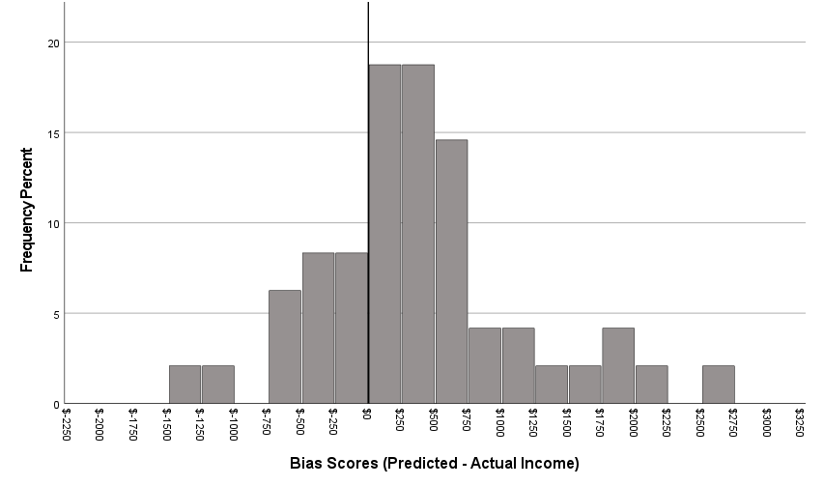
February Results
27.1%
72.9%

Slide 33

February Results
Median = $301.00 (p = .005)

Slide 34
March Results
Week
Bias = $118.82 (22.1%)
(p = .034)
Notes:
r(36) = .80, p < .001
In the first survey, participants over-predicted their weekly income by an average of $132.07 or 28.3%, as revealed by a paired-samples t-test (M_{predicted_income} = $466.94, SD = 468.71; M_{actual_income} = $334.87, SD = 403.56; t(48) = 4.01, p < .001, d = .57). Moreover, the bias was prevalent: 75.5% of participants overpredicted to at least some extent, and 53.1% of participants over-predicted by $100 or more.
In the first survey, participants over-predicted their monthly income by an average of $347.43 or 20.1%, as revealed by a paired-samples t-test (M_{predicted_income} = $1724.52, SD = 1828.31; M_{actual_income} = $1377.09, SD = 1722.71; t(47) = 2.96, p = .005, d = .43). The bias was once again prevalent: 66.7% of participants over-predicted to at least some extent, and 50.0% of participants over-predicted by $300 or more.

Slide 35
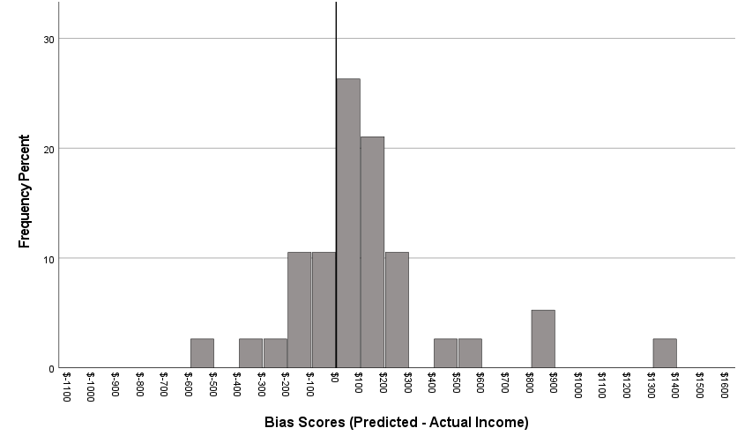
March Results
28.9%
71.1%

Slide 36

March Results
Median = $65.42 (p = .030)

Slide 37
March Results
Month
Bias = $610.57 (27.8%)
(p = .003)
Notes:
r(36) = .83, p < .001
In the first survey, participants over-predicted their weekly income by an average of $132.07 or 28.3%, as revealed by a paired-samples t-test (M_{predicted_income} = $466.94, SD = 468.71; M_{actual_income} = $334.87, SD = 403.56; t(48) = 4.01, p < .001, d = .57). Moreover, the bias was prevalent: 75.5% of participants overpredicted to at least some extent, and 53.1% of participants over-predicted by $100 or more.
In the first survey, participants over-predicted their monthly income by an average of $347.43 or 20.1%, as revealed by a paired-samples t-test (M_{predicted_income} = $1724.52, SD = 1828.31; M_{actual_income} = $1377.09, SD = 1722.71; t(47) = 2.96, p = .005, d = .43). The bias was once again prevalent: 66.7% of participants over-predicted to at least some extent, and 50.0% of participants over-predicted by $300 or more.

Slide 38
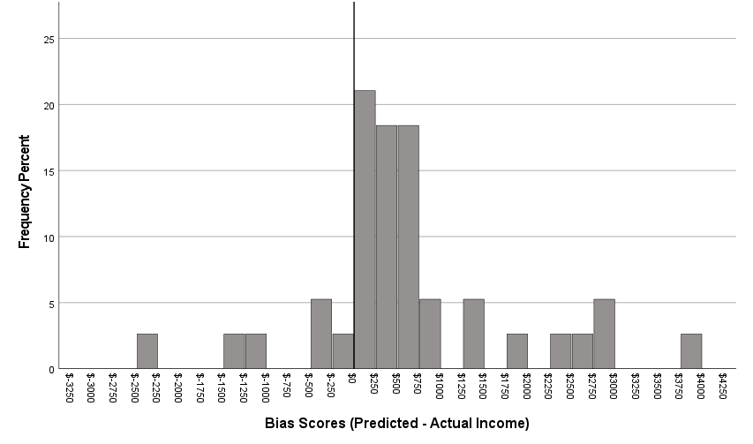
March Results
15.8%
84.2%

Slide 39
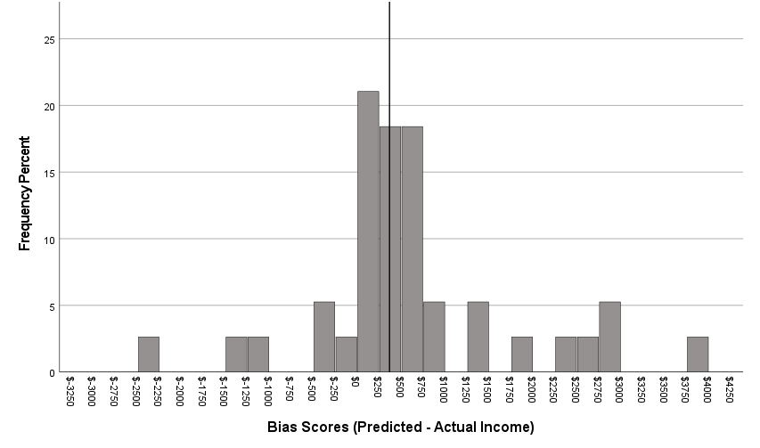
March Results
Median = $366.16 (p < .001)

Slide 40
Income Correlations
Correlation between predicted and actual income
Notes:
Week1 and Week2 bias scores are correlated (r = .47, p = .002). Month1 and Month2 bias scores are correlated (r = .59, p < .001). The week1 and month1 scores are correlated, as are the week2 and month2 scores. This indicates that people do not try to compensate for underearning?

Slide 41
Bias Score Correlations
Correlation between bias scores
Notes:
Week1 and Week2 bias scores are correlated (r = .47, p = .002). Month1 and Month2 bias scores are correlated (r = .59, p < .001). The week1 and month1 scores are correlated, as are the week2 and month2 scores. This indicates that people do not try to compensate for underearning?

Slide 42
Bias Score Correlations
Correlation between bias scores
Notes:
Week1 and Week2 bias scores are correlated (r = .47, p = .002). Month1 and Month2 bias scores are correlated (r = .59, p < .001). The week1 and month1 scores are correlated, as are the week2 and month2 scores. This indicates that people do not try to compensate for underearning?

Slide 43
Bias Score Correlations
Correlation between bias scores
Notes:
Week1 and Week2 bias scores are correlated (r = .47, p = .002). Month1 and Month2 bias scores are correlated (r = .59, p < .001). The week1 and month1 scores are correlated, as are the week2 and month2 scores. This indicates that people do not try to compensate for underearning?

Slide 44
Individual Difference Correlations
Correlation between individual differences and bias scores
Notes:
The p-value for .28 is p = .077

Slide 45
Individual Difference Correlations
Correlation between individual differences and bias scores
Notes:
The p-value for .28 is p = .077

Slide 46
Individual Difference Correlations
Correlation between individual differences and bias scores
Notes:
The p-value for .28 is p = .077

Slide 47
Individual Difference Correlations
Correlation between individual differences and bias scores
Notes:
The p-value for .28 is p = .077

Slide 48
Individual Difference Correlations
Correlation between individual differences and bias scores
Notes:
The p-value for .28 is p = .077

Slide 49
Individual Difference Regressions
ActInc = α + β₀PrdInc + β₁Perc + β₂PrdInc*Perc
Notes:
Week1 and Week2 bias scores are correlated (r = .47, p = .002). Month1 and Month2 bias scores are correlated (r = .59, p < .001). The week1 and month1 scores are correlated, as are the week2 and month2 scores. This indicates that people do not try to compensate for underearning?

Slide 50
Individual Difference Regressions
ActInc = α + β₀PrdInc + β₁Perc + β₂PrdInc*Perc
Notes:
Week1 and Week2 bias scores are correlated (r = .47, p = .002). Month1 and Month2 bias scores are correlated (r = .59, p < .001). The week1 and month1 scores are correlated, as are the week2 and month2 scores. This indicates that people do not try to compensate for underearning?

Slide 51
Individual Difference Regressions
ActInc = α + β₀PrdInc + β₁Perc + β₂PrdInc*Perc
Notes:
Week1 and Week2 bias scores are correlated (r = .47, p = .002). Month1 and Month2 bias scores are correlated (r = .59, p < .001). The week1 and month1 scores are correlated, as are the week2 and month2 scores. This indicates that people do not try to compensate for underearning?

Slide 52
Individual Difference Regressions
ActInc = α + β₀PrdInc + β₁Perc + β₂PrdInc*Perc
Notes:
Week1 and Week2 bias scores are correlated (r = .47, p = .002). Month1 and Month2 bias scores are correlated (r = .59, p < .001). The week1 and month1 scores are correlated, as are the week2 and month2 scores. This indicates that people do not try to compensate for underearning?

Slide 53
Regression Results
ActInc = α + β₀PrdInc + β₁Perc + β₂PrdInc*Perc
Notes:
Week1 and Week2 bias scores are correlated (r = .47, p = .002). Month1 and Month2 bias scores are correlated (r = .59, p < .001). The week1 and month1 scores are correlated, as are the week2 and month2 scores. This indicates that people do not try to compensate for underearning?

Slide 54
Regression Results
ActInc = α + β₀PrdInc + β₁Expr + β₂PrdInc*Expr
Notes:
Week1 and Week2 bias scores are correlated (r = .47, p = .002). Month1 and Month2 bias scores are correlated (r = .59, p < .001). The week1 and month1 scores are correlated, as are the week2 and month2 scores. This indicates that people do not try to compensate for underearning?

Slide 55
Regression Results
ActInc = α + β₀PrdInc + β₁Expr + β₂PrdInc*Expr
Notes:
Week1 and Week2 bias scores are correlated (r = .47, p = .002). Month1 and Month2 bias scores are correlated (r = .59, p < .001). The week1 and month1 scores are correlated, as are the week2 and month2 scores. This indicates that people do not try to compensate for underearning?

Slide 56
Study 1 Discussion
The bias is large, even though predicted income and actual income earned are strongly correlated
The bias is prevalent, with a strong majority overpredicting
The bias persistent, with overprediction in one time period associated with overprediction in other time periods
The association between predicted income and actual income earned is not moderated by gig experience or percentage of total income earned from the gig
Notes:
Experience is not correlated with income predictions

Slide 57
Study 1 Discussion
The bias is large, prevalent, and persistent
Limitations:
Can’t observe hours (or hourly wage)
Population is small
Notes:
Experience is not correlated with income predictions

Slide 58
Study 2: The Diary Study
Purpose
Test H1 and H2
Test robustness across gig sector & across different recruitment channels
Notes:
To explore our first research question, we began by running a trio of financial diary studies. A secondary purpose of these studies was to figure out the best way to recruit gig workers to participate in our studies, so we sampled from three different gigs, through three different channels.
In Study 1 we recruited Uber drivers by making an organic (i.e., non-paid) reddit post on r/uberdrivers/, which is “The Uber Driver’s Subreddit”
In Study 2 we recruited online workers through Amazon Mechanical Turk
In Study 3 we recruited food delivery app workers through paid advertisements on relevant subreddits
The structure of these studies was the same: We first asked people to predict their gig income for the next week, then one week later we had them report how much they actual earned.

Slide 59
Study 2: The Diary Study
Participants
***Participants who completed both surveys did not differ significantly from participants who only completed
the first survey on any observable measure (p’s > .12).
BTW: Make sure you get approval from mods before posting a survey link!
Notes:
To explore our first research question, we began by running a trio of financial diary studies. A secondary purpose of these studies was to figure out the best way to recruit gig workers to participate in our studies, so we sampled from three different gigs, through three different channels.
In Study 2A we recruited Uber drivers by making an organic (i.e., non-paid) reddit post on r/uberdrivers/, which is “The Uber Driver’s Subreddit”
In Study 2B we recruited online workers through Amazon Mechanical Turk
The structure of these studies was the same: We first asked people to predict their gig income for the next week, then one week later we had them report how much they actual earned.

Slide 60
Study 2: The Diary Study
Method
Predict income, hours, and hourly wage for the next week
Report income and hours for the past week
Notes:
To explore our first research question, we began by running a trio of financial diary studies. A secondary purpose of these studies was to figure out the best way to recruit gig workers to participate in our studies, so we sampled from three different gigs, through three different channels.
In Study 1 we recruited Uber drivers by making an organic (i.e., non-paid) reddit post on r/uberdrivers/, which is “The Uber Driver’s Subreddit”
In Study 2 we recruited online workers through Amazon Mechanical Turk
In Study 3 we recruited food delivery app workers through paid advertisements on relevant subreddits
The structure of these studies was the same: We first asked people to predict their gig income for the next week, then one week later we had them report how much they actual earned.

Slide 61
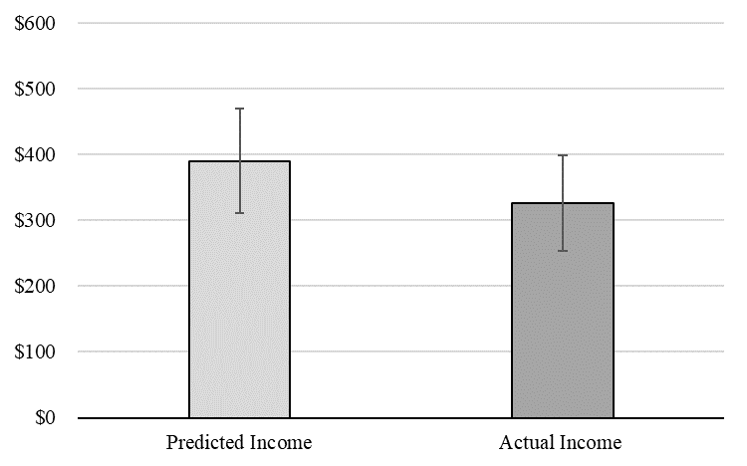
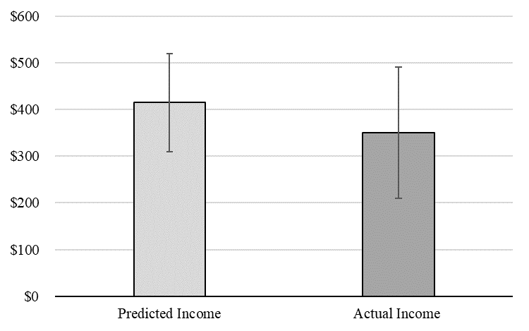
Income Results
Delivery Drivers
Bias = 19.9%
(p = .014)
Rideshare Drivers
Bias = 18.2%
(p = .053)
Notes:
$63.52, $63.90

Slide 62
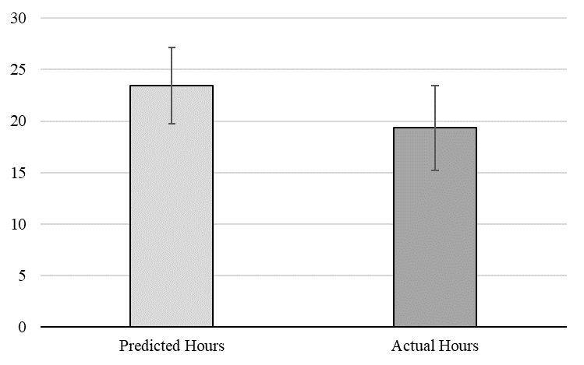

Hours Results
Delivery Drivers
Bias = 21.2%
(p = .001)
Rideshare Drivers
Bias = 31.2%
(p < .001)
Notes:
About 5 hours for the Uber drivers and 4 hours for the Mturkers and food delivery app drivers.

Slide 63
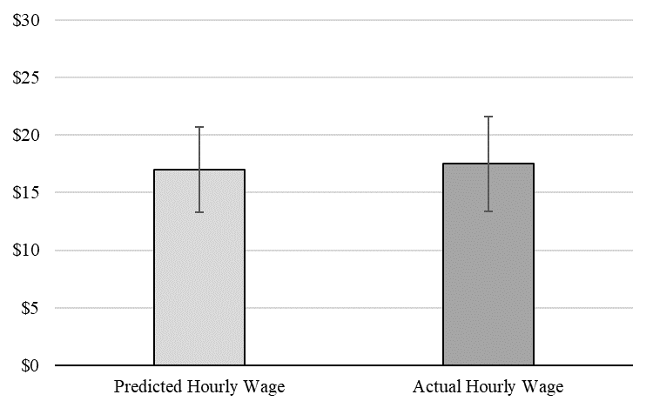
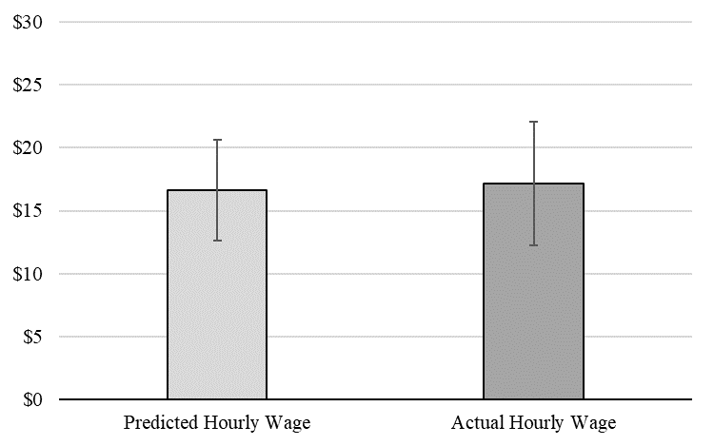
Hourly Wage Results
Delivery Drivers
Bias = −$0.52
(p = .56)
Rideshare Drivers
Bias = −$0.50
(p = .70)

Slide 64
Correlation Results
Correlation between bias scores

Slide 65
Study 2 Discussion
Replicates the bias
Shows people overpredict their hours but not their hourly wage, and that the former is correlated with income overprediction

Slide 66
How can we debias income predictions?
Intervention #1: Taking an “outside view”
Prediction accuracy can be improved by incorporating relevant past outcomes (e.g., Buehler et al. 1994; Kahneman & Tversky 1979)
H3: Prompting people to consider their average past earnings before predicting their future earnings reduces the income prediction bias
Notes:
We test two interventions in this paper, both of which are based on the idea that prediction biases occur because people do not consider the full distribution of possible outcomes.

Slide 67
How can we debias income predictions?
Intervention #2: An “atypical” intervention (Howard et al. 2022)
Perhaps gig workers have negatively skewed income (assumption)
Predictions are based on typical past outcomes
Typical = mode
If outcomes are negatively skewed with mode > mean, then people will over-predict

Slide 68
How can we debias income predictions?
Intervention #2: An “atypical” intervention (Howard et al. 2022)
H4: Prompting people to consider reasons why their schedule will be different than usual reduces the income prediction bias.

Slide 69
Study 3: The Debiasing Study
Sample
662 food delivery app drivers (M_{age} = 30.0, 35.0% female)
Recruitment channel = paid ads in relevant subreddits
Notes:
Preregistered icon citation: University of Melbourne (https://library.unimelb.edu.au/open-scholarship/preregistering_research)

Slide 70
Study 3: The Debiasing Study
Method
Start of the week:
Which food delivery apps do you currently work for? Please select all that apply.
Predict gig income for next week in 1 of 3 conditions:
Control
Outside view (e.g., Buehler, Griffin, and Ross 1994)
“Atypical” condition (Howard et al. 2022)

Slide 71
Study 3: The Debiasing Study
Outside view condition
Please take some time to estimate the total amount of money you have earned working for food delivery apps over the past four weeks.
How much money do you estimate you have earned (in total) working for food delivery apps over the past four weeks?
$

Slide 72
Study 3: The Debiasing Study
Outside view condition
Over the past 4 weeks you estimate you have earned $X per week working for food delivery apps. Considering that experience, how much money do you estimate you will earn working for food delivery apps in the next week?
$

Slide 73
Study 3 Results
Atypical condition
Please take some time to consider reasons why the number of hours you work for food delivery apps in the next week might be different than usual.
Please list 2 reasons why the number of hours you work for food delivery apps in the next week might be different than usual.

Slide 74
Study 3 Results
Atypical condition
Keeping in mind your answer to the previous question, how much money do you estimate you will earn (in total) working for food delivery apps in the next week?
$

Slide 75
Study 3: The Debiasing Study
Method
End of the week:
Report actual income earned

Slide 76
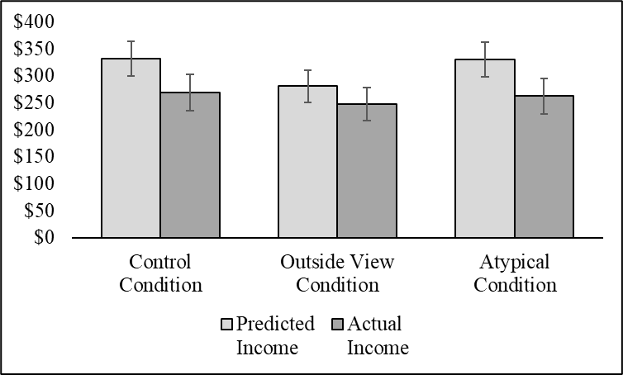
Study 3 Results
23.2%***
13.4%**
25.7%***
*p < .05, **p < .01, ***p < .001
Notes:
How many people overpredicted in each condition? What was correlational accuracy like?
Control: 66.2% overpredicted, median = $50, p < .001. r = .78.
Outside: 60.2% overpredicted, median = $27, p < .001. r = .79.
Atypical: 68.2% overpredicted, median = $53, p < .001. r = .75.

Slide 77
Study 3 Results
23.2%***
13.4%**
25.7%***
*p < .05, **p < .01, ***p < .001

Slide 78
Study 3 Results
23.2%***
13.4%**
25.7%***
Interaction: F(1, 659) = 3.02, p = .050
*p < .05, **p < .01, ***p < .001
Notes:
The is a little more than 40% smaller in the outside view condition versus control.

Slide 79
Study 3 Results
p = .024
p = .028
Interaction: F(1, 659) = 3.02, p = .050

Slide 80
Study 3 Results
p = .35
p = .52
Interaction: F(1, 659) = 3.02, p = .050

Slide 81
Study 3 Discussion
Replicates Studies 1 and 2
Outside view intervention reduces the bias
Atypical intervention strikes out
Discussion

Slide 82
Study 4: Hours or Hourly Wage?
Purpose
Interventions targeting expected hours versus hourly wage.
Sample
450 food delivery app drivers (M_{age} = 32.2, 27.9% female)
Recruitment channel = paid ads in relevant subreddits
Notes:
Preregistered icon citation: University of Melbourne (https://library.unimelb.edu.au/open-scholarship/preregistering_research)

Slide 83
Study 4: Hours or Hourly Wage?
Method
Cross-sectional design
Four conditions:
Control
Outside view for income
Outside view for hours
Outside view for hourly wage

Slide 84
Study 4: Hours or Hourly Wage?
Outside view for hours
Please take some time to estimate the total number of hours you have worked for food delivery apps over the past four weeks.
How many hours do you estimate you have worked (in total) for food delivery apps over the past four weeks?

Slide 85
Study 4: Hours or Hourly Wage?
Outside view for hours
Over the past 4 weeks you estimate you have worked X hours per week for food delivery apps.
Considering that experience, how much money do you estimate you will earn working for food delivery apps in the next week?

Slide 86
Study 4: Hours or Hourly Wage?
Outside view for hourly wage
Please take some time to estimate your hourly wage while working for food delivery apps over the past four weeks.
How much money per hour do you estimate you earned working for food delivery apps over the past four weeks?

Slide 87
Study 4: Hours or Hourly Wage?
Outside view for hourly wage
Over the past 4 weeks you estimate you have earned X per hour working for food delivery apps.
Considering that experience, how much money do you estimate you will earn in total working for food delivery apps in the next week?

Slide 88
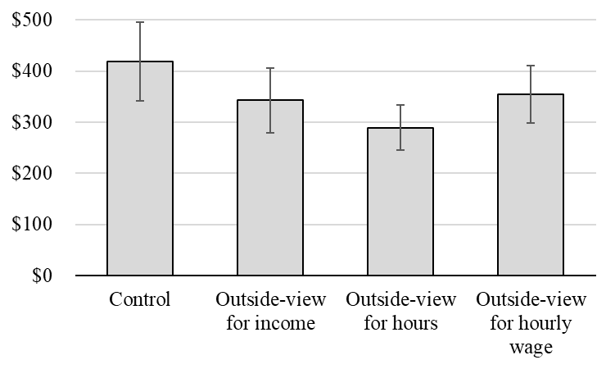
Study 4: Hours or Hourly Wage?

Slide 89
Study 4: Hours or Hourly Wage?
p = .082

Slide 90
Study 4: Hours or Hourly Wage?
p = .004

Slide 91
Study 4: Hours or Hourly Wage?
p = .15
Notes:
Expected hourly wage was about $16 and expected hours was about 24 hours.

Slide 92
Summary
RQ1: Is there an income prediction bias?
Yes, participants in our studies display an income prediction bias in which they significantly over-predict their gig income.
Notes:
Roadmap for rest of talk: Theory and hypotheses related to RQ’s 1 and 2, then four main effect studies, then theory and hypotheses related to RQ3, then two debiasing studies.
Preview the studies: longitudinal, real gig workers, app data, etc.

Slide 93
Summary
RQ2: Why do people overpredict?
People overpredict their gig hours but not their hourly wage
Notes:
Roadmap for rest of talk: Theory and hypotheses related to RQ’s 1 and 2, then four main effect studies, then theory and hypotheses related to RQ3, then two debiasing studies.
Preview the studies: longitudinal, real gig workers, app data, etc.

Slide 94
Summary
RQ3: How can we debias predictions?
Accuracy can be improved by taking an outside view, but not by considering atypical outcomes.
Notes:
Roadmap for rest of talk: Theory and hypotheses related to RQ’s 1 and 2, then four main effect studies, then theory and hypotheses related to RQ3, then two debiasing studies.
Preview the studies: longitudinal, real gig workers, app data, etc.

Slide 95
Discussion
The atypical intervention works really well for expense predictions (Howard et al. 2022)
The failure of the atypical intervention for income predictions suggests that income is structurally and/or psychologically different than expenses
Notes:
30% of participants listed reasons why their income would be higher, vs 49% who listed reasons why their income be lower and 21% who gave an ambiguous answer.

Slide 96
Discussion Questions
Incentive-compatible predictions?
Individual difference predictors?
Downstream consequences?
Notes:
Although working in the gig economy offers people perks like flexible hours, it also makes it hard to predict income, which may have negative consequences for consumers’ financial well-being.

Slide 97
Next Steps
What are the downstream consequences of the bias?
Is overprediction ever beneficial?
The psychology of predicting income vs expenses
Notes:
How and why do income and expenses occupy a different psychological space

Slide 98
THANK YOU!
david.hardisty@sauder.ubc.ca

Slide 99
Some other stuff I’m working on now
Validity trade-offs in Digital Quasi-Experiments
Goal gradient in charitable donation
Competence curse in charitable donation
Restricted promotions (“$2 off when you spend $5 or more”)
Precommitment in stochastic prisoners dilemmas
Mixed-outcome intertemporal choice (-$5 now and +$15 in one month)
Behavioural Insights field studies (sustainability, biodiversity, compliance)
Notes:
Although working in the gig economy offers people perks like flexible hours, it also makes it hard to predict income, which may have negative consequences for consumers’ financial well-being.

