Slide 1
The Cost of Paying More
David J. Hardisty
Marketing & Behavioural Science
Notes:
Edward van Dam, Terry Pelletier, Rob Felix, Brandt Louie, Bob Helsley, Martina Valkovicova, Susan Yurkovich

Slide 2
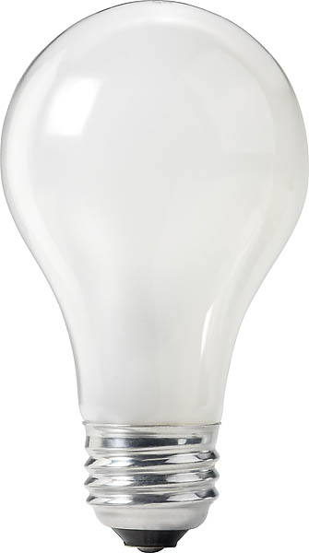
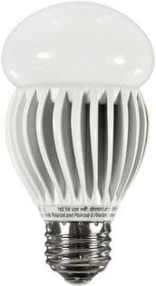
An economic mystery
The Cost of Paying More
David J. Hardisty
Price: $0.97
Watts: 60
Lumens: 820
Price: $17.99
Watts: 13
Lumens: 800
(Saves $188 on energy)
Notes:
Image source left: https://www.fastenal.com/product/details/0723964
Image source right: https://www.amazon.ca/Magic-Lighting-A19P-30-30X-MA-Listed-Dimmable/dp/B00IEI0CWG

Slide 3
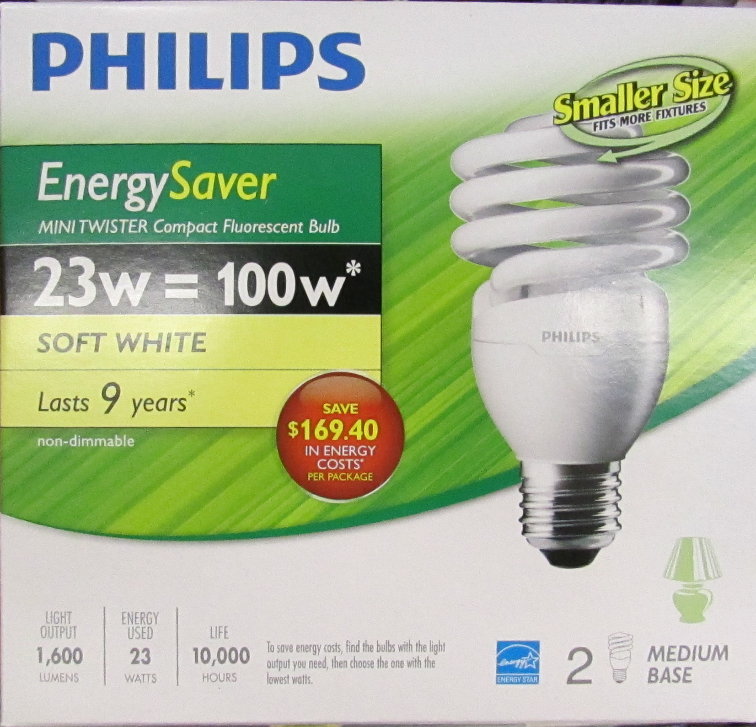
Consumers don’t care about the future?
The Cost of Paying More
David J. Hardisty
Notes:
Image source: https://www.homedepot.ca/product/philips-13w-60w-soft-white-2700k-mini-twister-cfl-light-bulb-12-pack-/1000821862

Slide 4
Our theory
The Cost of Paying More
David J. Hardisty
Consumers have a latent goal to reduce long-term costs
Price: $0.97
10-year energy cost: $239
Watts: 60
Lumens: 820
Price: $17.99
10-year energy cost: $52
Watts: 13
Lumens: 800
Notes:
Image source left: https://www.fastenal.com/product/details/0723964
Image source right: https://www.amazon.ca/Magic-Lighting-A19P-30-30X-MA-Listed-Dimmable/dp/B00IEI0CWG

Slide 5
Online Survey Results
The Cost of Paying More
David J. Hardisty
Normal labels:
15% mention long-term cost or energy efficiency
30% choose the efficient bulb
10-year cost labels:
61% mention long-term cost or energy efficiency
67% choose the efficient bulb
Other survey results:
Works with other products: TVs, washing machines, etc.
Energy savings and dollar savings labels don’t do much
Asking consumers to estimate the 10-year cost of each product: equally effective

Slide 6
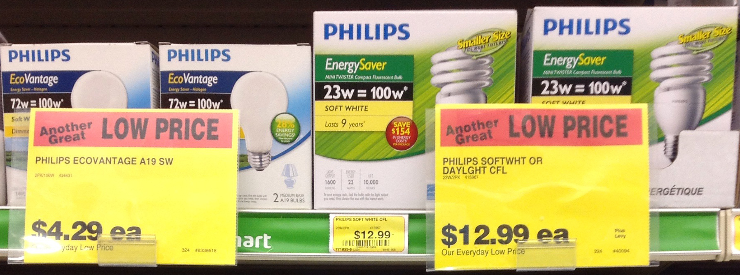
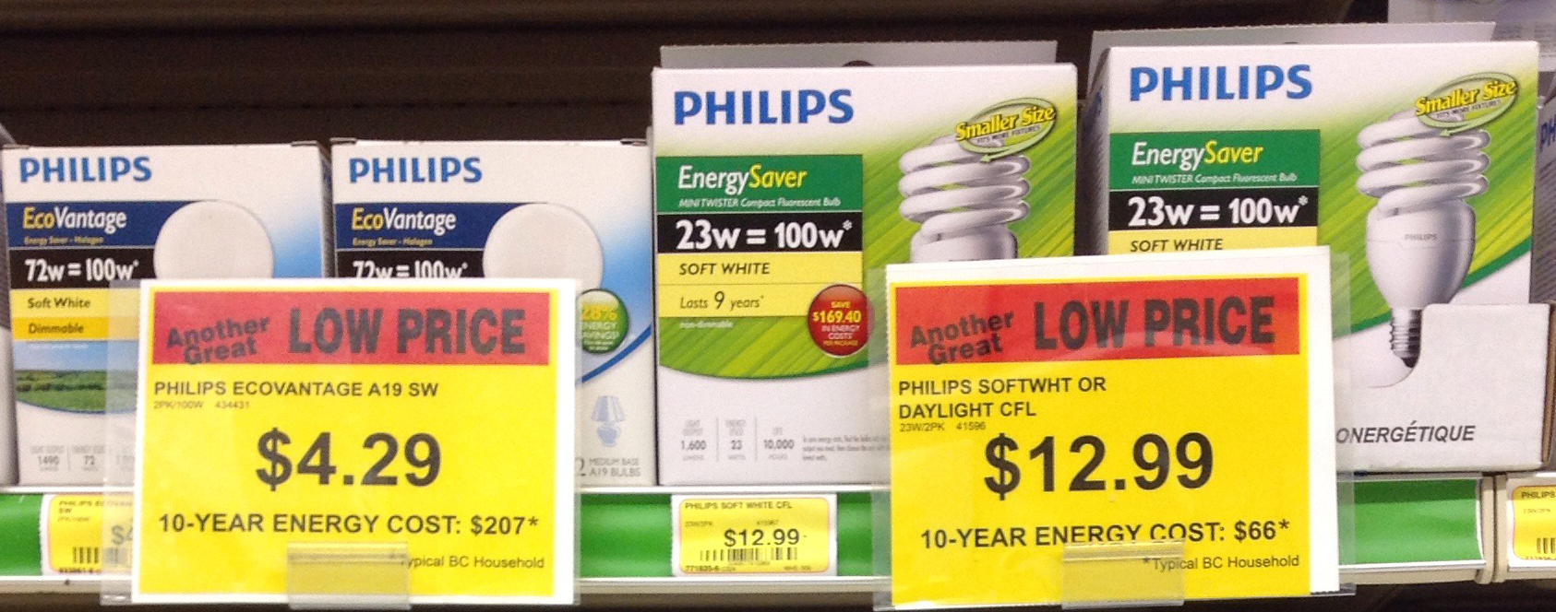
Does it work in real stores?
The Cost of Paying More
David J. Hardisty
12%
chose efficient option
48%
chose efficient option
Notes:
Increased units sold by 47%, increased sales by 134%

Slide 7
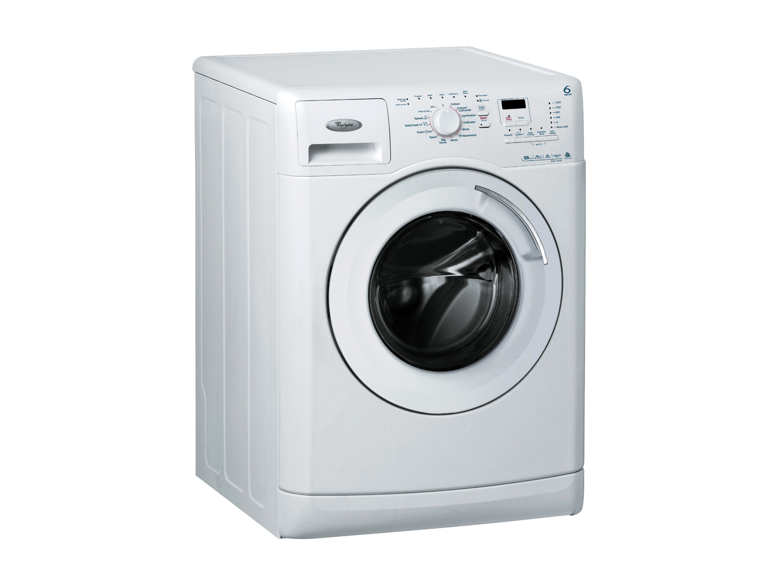
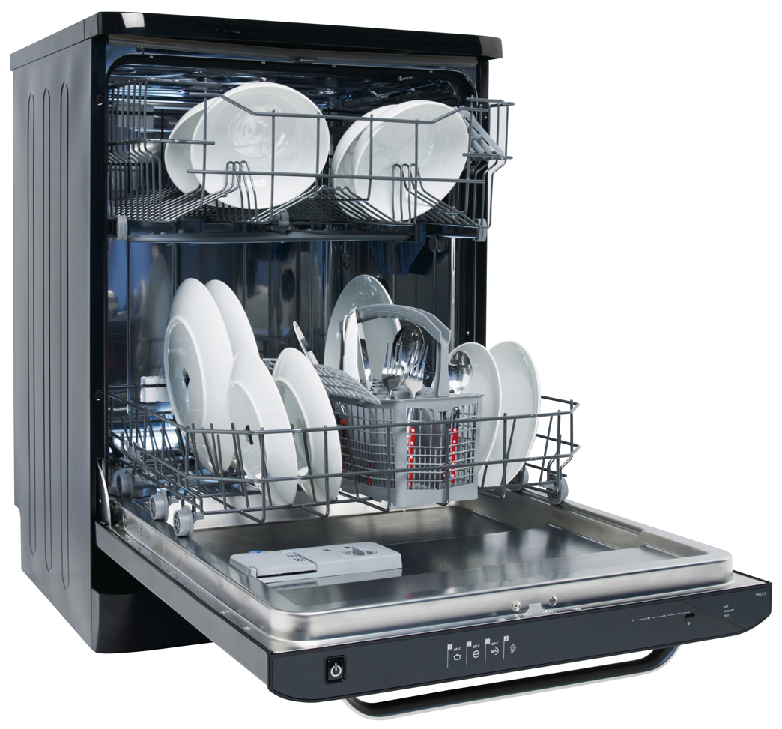
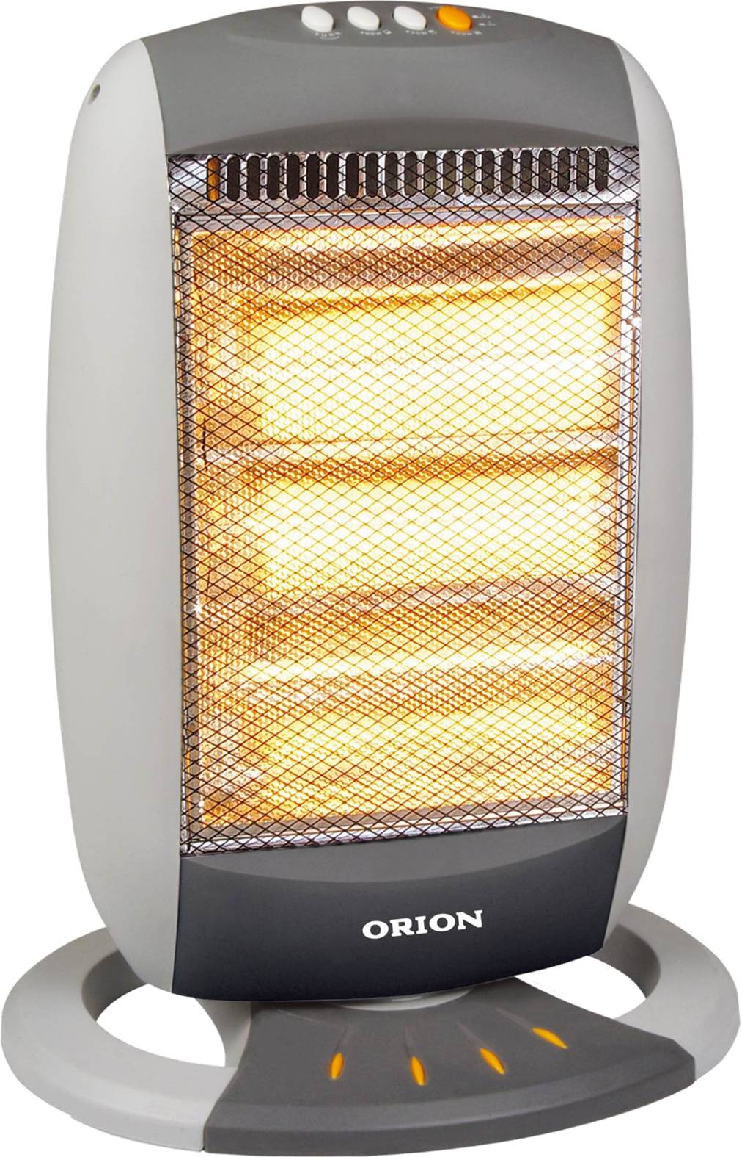


Let’s scale this up
The Cost of Paying More
David J. Hardisty
Triple winner:
Good for the consumer
Good for the firm (sales up 134%!)
Good for the environment
Notes:
Image source:
computer - https://www.indiamart.com/proddetail/computer-system-20357403197.html
Tv - https://www.indiamart.com/proddetail/32-inch-lg-television-18470908188.html
Heater - https://www.differencebetween.info/difference-between-blower-and-heater
Dishwasher - https://www.arcappliances.co.uk/our-products/dishwashers/
Washign machine - https://www.ifixit.com/Device/Whirlpool_Washing_Machine

Slide 8

Let’s work together
The Cost of Paying More
David J. Hardisty
Notes:
Image source: https://unsplash.com/

Slide 9
Thank You

