Slide 1
Future Entrepreneurs and Leaders Program
Consumer decision making and public policy nudges
David J. Hardisty
May 10, 2014

Slide 2
Hello!
About me
About you
Please ask questions and interrupt
Let’s take a break half way through

Slide 3
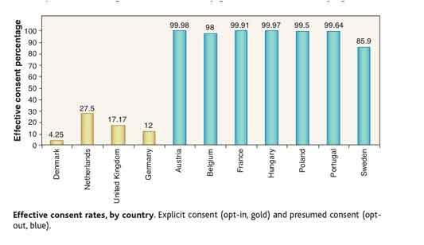
Organ Donation

Slide 4
Nudges
Maintain freedom of choice, while “nudging” people in the right direction
“Libertarian paternalism”
Decision architecture
Carefully chosen defaults are an example of a nudge
Public policy tool (also useful in the private sector)

Slide 5
Defaults
Why do they work?
Laziness
Implied endorsement
Status quo bias (loss aversion)
What defaults do you think we should set, or change, in Canada?
How about a default application to a local community college?
Johnson, E., & Goldstein, D. (2003). Do defaults save lives?. Science, 302, 1338-1339.

Slide 6
Outline
Nudging consumers towards:
Healthier eating
Public Health and Environmental Decision Making
Decisions about the future (e.g., saving for retirement)

Slide 7
Healthier eating

Slide 8
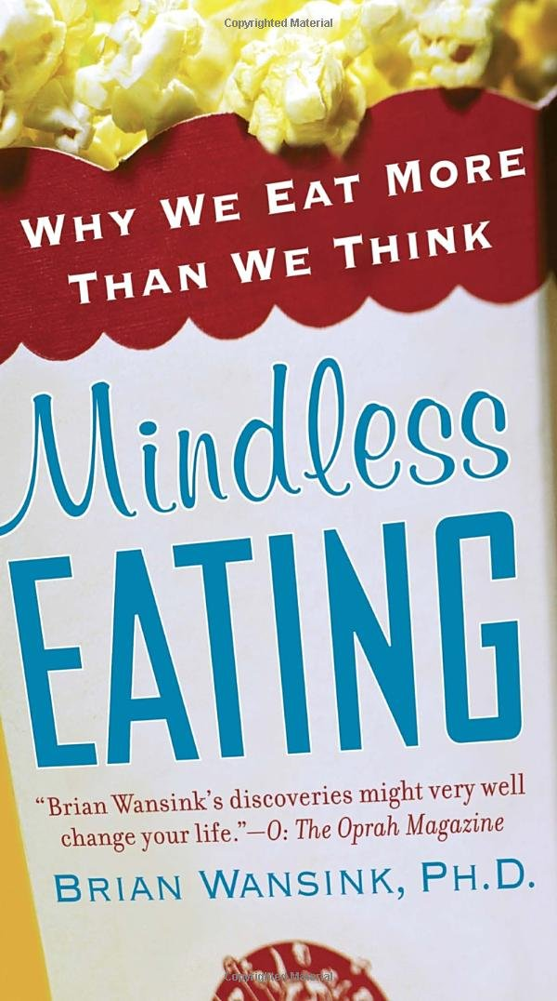
Mindless eating
How many food related decisions do you make each day?
Answer: on average, over 200
Example: Which breakfast cereal to have? How much to pour? Have another bowl? Add sugar? Skim milk or 2%? How much milk?
Wansink, Brian. Mindless eating: Why we eat more than we think. Random House Digital, Inc., 2007.

Slide 9
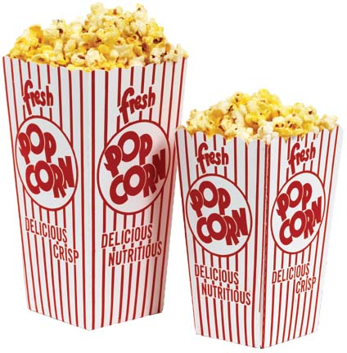
Portion size
Movie-goers were given free popcorn
Buckets were medium (120g) or large (240g)
Popcorn was fresh or stale (14 days old)
How much do you think people ate?
Notes:
Image source: https://www.indiamart.com/proddetail/paper-corn-tub-11344712073.html

Slide 10
Popcorn liking
 | Medium Container | Large Container
Fresh Popcorn | 7.5 | 6.8
Stale Popcorn | 3.5 | 2.1
Table shows average of answers to two questions:
“This popcorn tasted good”
“This popcorn was of high quality”
Means were measured on a 9-point scale (1 = strongly disagree; 9 = strongly agree)
Wansink, Brian, and Junyong Kim. "Bad popcorn in big buckets: portion size can influence intake as much as taste." Journal of nutrition education and behavior 37.5 (2005): 242-245.

Slide 11
Popcorn consumption
 | Medium Container | Large Container
Fresh Popcorn | 58.9 | 85.6
Stale Popcorn | 38.0 | 50.8
Table shows average amount of popcorn consumed in grams.
Wansink, Brian, and Junyong Kim. "Bad popcorn in big buckets: portion size can influence intake as much as taste." Journal of nutrition education and behavior 37.5 (2005): 242-245.

Slide 12
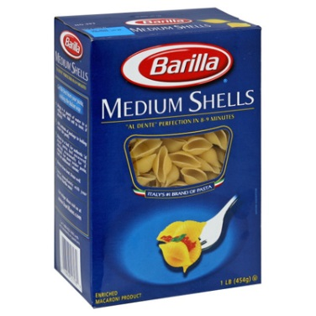
Food container size
Does the container size (as opposed to the portion size) matter? In other words, does it matter how big the box is?
Doubling the size of a container of meal-related food (such as a box of pasta) brings an 18% to 25% increase in consumption (Rolls, Engell, & Birch, 2000; Fisher, Rolls, and Birch 2001)
For snack food, doubling the container increases consumption 30% to 45% (Wansink, 1996)
Example: Adults at a Super Bowl party served themselves 53% more Chex-mix when presented with 4-liter serving bowls instead of 2-liter serving bowls (Wansink & Cheney, 2005)
Why? The bigger containers subtly suggest it is “normal” to take more.
Notes:
Image source: https://www.walmart.ca/en/ip/Barilla-1-lb-Medium-Shells-Pasta-12-Case/PRD6TYRXX8E4TS9

Slide 13
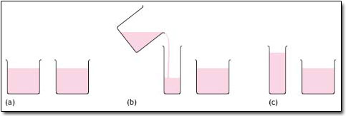
Visual Biases: Eyes vs. Stomach
Raghubir, P., & Krishna, A. (1999). Vital dimensions in volume perception: Can the eye fool the stomach?. Journal of Marketing Research, 313-326.
Notes:
Taller glasses look like more volume, makes us take smaller portions. Bar tenders fall victim to this as well – they will pour more into a small, wide glass than a narrow, tall glass.

Slide 14
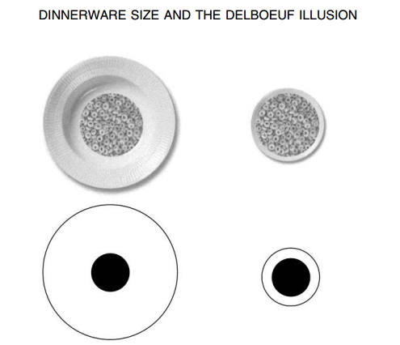
Van Ittersum, K., & Wansink, B. (2011). Plate size and color suggestibility: The Delboeuf Illusion’s bias on serving and eating behavior. Journal of Consumer Research, Forthcoming.
Notes:
Typically with larger dinnerware, consumers serve more than the target serving size.
Typically with smaller dinnerware, consumers serve less than the target serving size.

Slide 15

Cue for satiation: what’s left?
People who were served soup from “bottomless,” refillable soup bowls ate 73% more soup
Those served from the bottomless bowls did not rate themselves any more full
Psychologically, our stomachs have 3 states:
- I’m really hungry
- I’m completely stuffed
- I could eat more
Wansink B, Painter JE, North J. Bottomless bowls: why visual cues of portion
size may influence intake. Obesity Rsch. 2005;13:93-100.
Notes:
Image credit: https://unsplash.com/photos/bG5rhvRH0JM

Slide 16
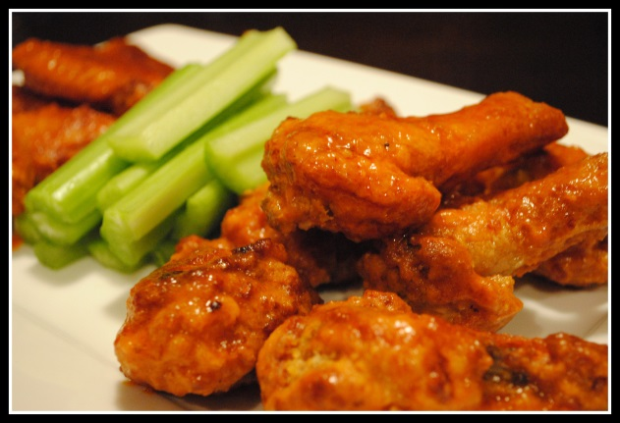
Chicken Wings:
Another satiation cue example
People ate chicken wings, and tables were either bussed (cleaned) or not
Those who ate at non-bussed tables ate about 4 wings, and remembered eating 4 wings
Those who ate at bussed tables ate about 6 wings, but only remembered eating 4 wings
Notes:
Image source: https://www.facebook.com/BoardwalkBros/

Slide 17
Group dynamics
The larger the group you are in, the more you eat
Eating with another person, you eat 35% more than eating alone
Eat with 7 other people, you’ll eat 90% more
Normally we wait for the last person to finish, and the longer you linger, the more you eat
Social modeling effect: you see others eating an appetizer and you’ll eat it too

Slide 18
Convenience
Free Hershey’s Kisses provided to secretaries every day for a month, in dishes either:
- on secretary’s desk
- 6 feet away from secretary’s desk
On the desk: ate 9 per day
6 feet away: ate 4 per day
Difference of 125 calories per day (translates into weight gain of 5.7 kg, 12.5 lbs over the course of a year)
The good news: it works with baby carrots, too

Slide 19
Other contextual food factors
We eat more when there is more variety (e.g. more colors of M&Ms)
We eat more in front of the TV

Slide 20
Food Nudges:
Review and Application
How could you reorganize a highschool cafeteria to nudge students towards healthier options?
How could you reorganize your kitchen to nudge yourself?
http://www.youtube.com/watch?v=hXxi-u0UvjE

Slide 21
Public Health and
Environmental Decision Making

Slide 22
Questionnaire – Disease
Tropical disease expected to kill 600 people in Vancouver. Two alternative programs have been proposed.

Slide 23
Questionnaire – Disease
Tropical disease expected to kill 600 people in Vancouver. Two alternative programs have been proposed.
  200 will be saved.
  1/3 probability that 600 will be saved and 2/3 probability that no one will be saved.

Slide 24
Questionnaire – Disease
Tropical disease expected to kill 600 people in Vancouver. Two alternative programs have been proposed.
  400 people will die.
  1/3 probability that no one will die and 2/3 probability that 600 people will die.

Slide 25
Questionnaire – Disease
Tropical disease expected to kill 600 people in Vancouver. Two alternative programs have been proposed.
Form A:
  200 will be saved.
  1/3 probability that 600 will be saved and 2/3 probability that no one will be saved.
Form B:
  400 people will die.
  1/3 probability that no one will die and 2/3 probability that 600 people will die.

Slide 26
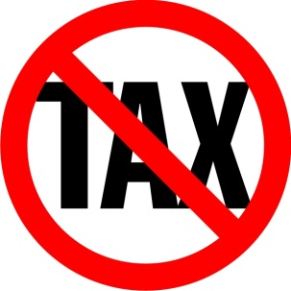
Attribute Framing
Frames and labels make a big difference
People pay more for 75% lean than 25% fat (Levin & Gaeth, 1988)
Doctors & patients prefer survival rate to mortality rate (Marteau, 1980; McNeil, Pauker, Sox & Tversky, 1982)
Women, but not men, prefer an 80% fat-free chocolate bar (Braun, Gaeth & Levin, 1997)
Carbon tax vs mandatory carbon offset?
Notes:
We thought we might see differences based on political ideology
Image source: https://m.facebook.com/revrexhamont/photos/no-tax-sale-today-friday-august-10th-indulge-in-some-sweet-sales-from-10am-9pm-t/2128405174097301/

Slide 27
Attribute Framing: Methods
Proposal to increase cost of certain products believed to contribute to climate change through energy use and resulting CO₂ emissions
Price increases would fund programs to decrease CO₂ levels by funding alternative energies or carbon sequestration
Proposal described as carbon tax or carbon offset (between subjects)
Hardisty, D. J., Johnson, E. J., & Weber, E. U. (2010). A dirty word or a dirty world? Attribute framing, political affiliation, and query theory. Psychological Science, 21(1), 86-92.
Notes:
...after reading this description, participants faced a series of choices.

Slide 28
Attribute Framing: Methods
Suppose you are purchasing a round trip flight from Los Angeles to New York city, and you are debating between two tickets, one of which includes a carbon tax. You are debating between the following two tickets, which are otherwise identical. Which would you choose?
Ticket A | Ticket B
$392.70 round trip ticket includes a carbon tax | $385.00 round trip ticket
Notes:
We used real prices from the internet for the products and offsets

Slide 29
Attribute Framing: Methods
Suppose you are purchasing a round trip flight from Los Angeles to New York city, and you are debating between two tickets, one of which includes a carbon offset. You are debating between the following two tickets, which are otherwise identical. Which would you choose?
Ticket A | Ticket B
$392.70 round trip ticket includes a carbon offset | $385.00 round trip ticket
Notes:
We used real prices from the internet for the products and offsets

Slide 30
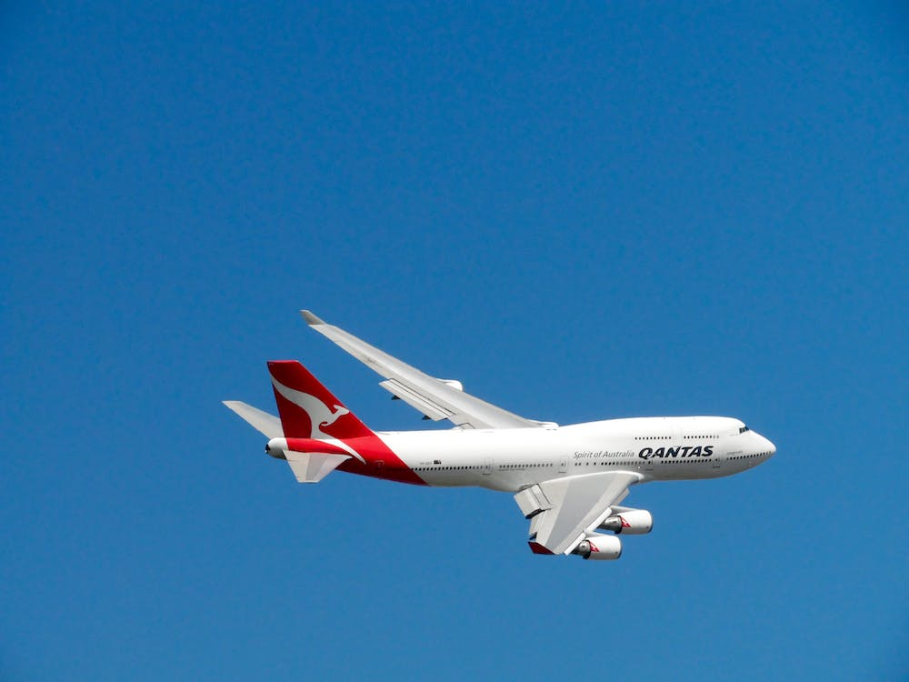
Attribute Framing: Methods
Do you think the carbon tax [offset] included in Ticket A should be made mandatory for all airline tickets sold in the US? (-3 = Definitely Not to 3 = Definitely)
Predictions?

Slide 31
Attribute Framing: Results
1
0.9
0.8
0.7
0.6
Proportion Choosing the Costlier Ticket
Offset
0.5
Tax
0.4
0.3
0.2
0.1
0
Democrat
Independent
Republican

Slide 32
Attribute Framing: Results
3
2
1
Mean Support for Regulation
Offset
0
Tax
-1
-2
-3
Democrat
Independent
Republican
Notes:
Same

Slide 33
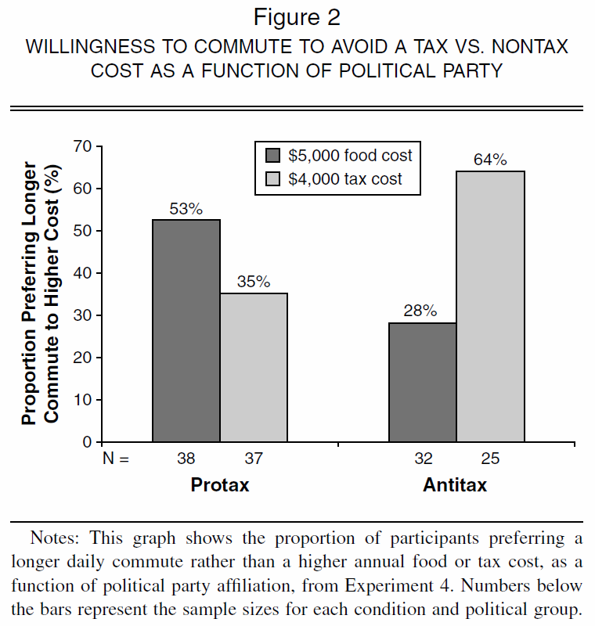
Attribute Framing: Replication
Sussman, A. B., & Olivola, C. Y. (2011). Axe the tax: taxes are disliked more than equivalent costs. Journal of Marketing Research, 48(SPL), S91-S101.

Slide 34
Attribute Framing: Summary
Often the same attribute can be represented in two different ways
Choose your frames wisely
Frames that don’t matter to you might still matter to someone else

Slide 35
Social norms
What’s the best message for convince hotel guests to reuse towels?
“HELP SAVE THE ENVIRONMENT.”
35% reuse rate
“JOIN YOUR FELLOW GUESTS IN HELPING TO SAVE THE ENVIRONMENT.”
44% reuse rate
Cialdini, Robert B. "Crafting normative messages to protect the environment." Current directions in psychological science 12.4 (2003): 105-109.

Slide 36
Descriptive vs Injunctive Social Norms
Power company in California
Monthly energy bill shows how you compare to your neighbors
Predictions?

Slide 37
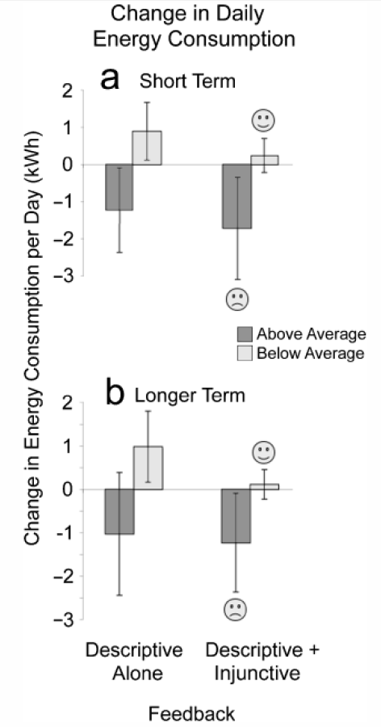

Slide 38
Local Warming
How convinced are you that global warming is happening? (1=“not at all”, 5=“completely”)
How concerned are you about global warming? (1=“not at all”, 5=“a great deal”)
18 minute distractor task
Is today warmer or cooler than usual for this time of year?
U.S. and Australian participants
Li, Y., Johnson, E. J., & Zaval, L. (2011). Local warming daily temperature change influences belief in global warming. Psychological Science, 22(4), 454-459.

Slide 39
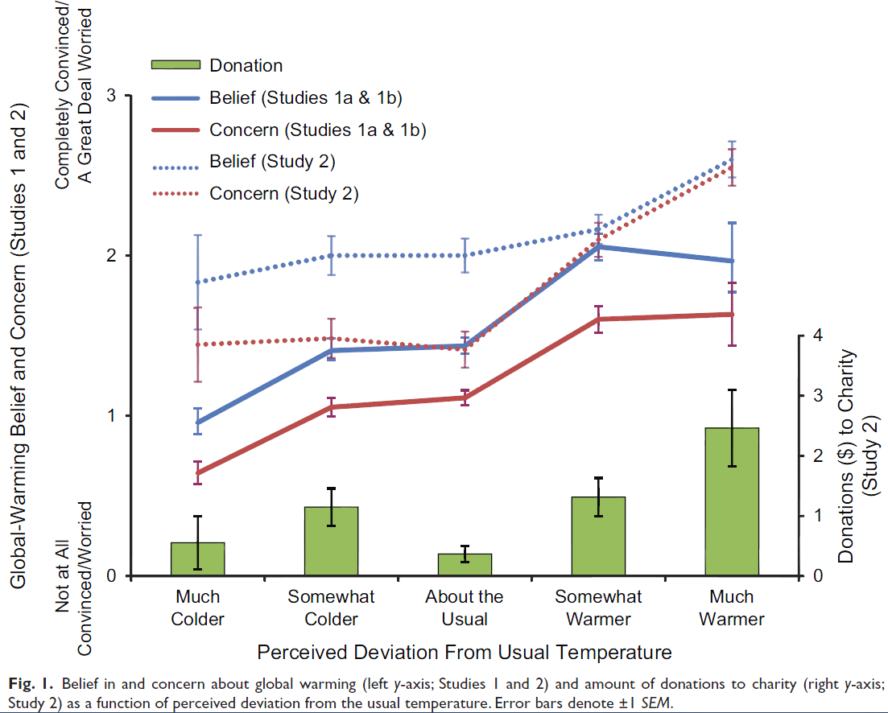
Li, Y., Johnson, E. J., & Zaval, L. (2011). Local warming daily temperature change influences belief in global warming. Psychological Science, 22(4), 454-459.

Slide 40
Action Plan: Methods
We want students to get tetanus vaccines. We distribute pamphlets
Fear appeal (yes or no):
- scary adjectives
- scary photos (“proved to be quite startling to the subjects”)
Action plan (yes or no):
- map of University Health Service location
- list of times when shots were available
- request to look at your schedule and choose a time
All pamphlets say shots are effective and free
Who is more likely to get a shot? Predictions?
Leventhal, H., Singer, R., & Jones, S. (1965). Effects of fear and specificity of recommendation upon attitudes and behavior. Journal of Personality and Social Psychology, 2(1), 20.

Slide 41
Action Plan: Results
High fear vs low fear
- High fear group thought shots were more important
- High fear group reported stronger intention to get shots
- High fear group were NOT more likely to get a shot
Action plan (with map) vs no plan
- No plan: 3% got a shot (1 out of 30)
- With plan: 28% got a shot (8 out of 29)
Leventhal, H., Singer, R., & Jones, S. (1965). Effects of fear and specificity of recommendation upon attitudes and behavior. Journal of Personality and Social Psychology, 2(1), 20.

Slide 42
Decisions about the future

Slide 43
Temporal Discounting
The farther something is in the future, the less we care about it
Good things -> now
Bad things -> later
Would you rather receive $100 today, or $101 next year?
It is rational to discount future costs and benefits by the market interest rate (~6%), following an exponential formula (V=Ae^{-kD})

Slide 44
Normative Model:
Exponential Discounting
1.2
1
0.8
Present Value of 1 Util
0.6
0.4
0.2
0
0
5
10
15
20
25
30
35
40
45
50
Delay (in years)

Slide 45
Rational Reasons to
Discount the Future
Uncertainty about the world
Uncertainty about your future self (could die tomorrow)
Opportunity cost (e.g., investment)
Increasing future wealth (give to the “poor” present)
Pure time preference (which avoids the “infinite investment” problem)

Slide 46
Experiment
Half the class, please close your eyes!

Slide 47
Experiment
A) Receive $67 dollars today
B) Receive $68 next week

Slide 48
Experiment
A) Receive $67 in 52 weeks
B) Receive $68 in 53 weeks

Slide 49
Experiment
A) Receive $67 dollars today
B) Receive $68 next week
A) Receive $67 in 52 weeks
B) Receive $68 in 53 weeks

Slide 50
Descriptive Model
Humans, pigeons, and rats all discount hyperbolically (Mazur 1987)
Very high discount rates (often over 30% or even 300%)
Preference reversals and inconsistencies
V=A/(1+kD)
Value
Notes:
This model doesn’t distinguish between gains and losses. This is surprising, given that a Nobel Prize was awarded for Prospect Theory, which differentiates gains and losses in intertemporal choice.
Why hasn’t more attention been paid to losses versus gains in intertemporal choice? One possibility is because there hasn’t been a process account or process data to explain the difference.
Today, I am going to show you that the difference between gains and losses is robust across domains, and then demonstrate why this difference happens.

Slide 51
Exponential vs. Hyperbolic Discounting
1.2
1
0.8
Exponential
Present Value of 1 Util
0.6
Hyperbolic
0.4
0.2
0
0
5
10
15
20
25
30
35
40
45
50
Delay (in years)

Slide 52
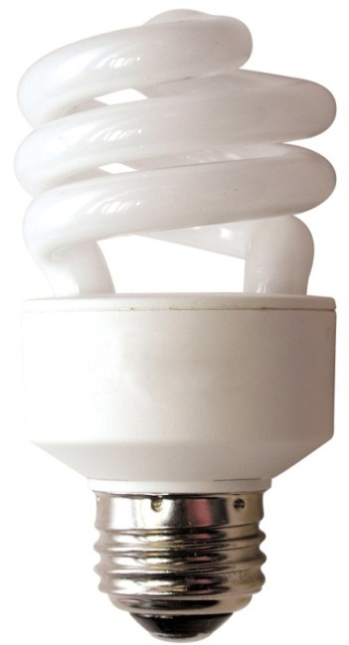
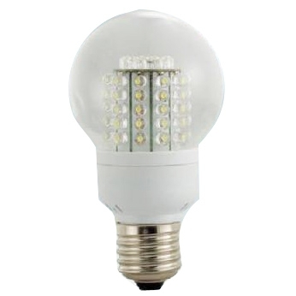
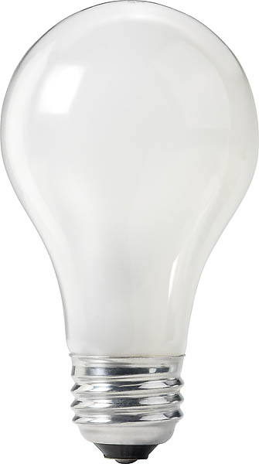
Discounting: Implications
Immediate cost vs. 10-year cost
60 watt incandescent
14 watt CFL
9 watt LED
$0.87 now
$3.29 now
$17.50 now
$443 later
$109 later
$61 later
52
(Hardisty, Orlove, Krantz, Small, & Milch, 2012)
Notes:
Consumers are constantly making intertemporal tradeoffs, and they don't always make good choices. Here's one example... In fact, the incandescent bulb is so much worse that it is being outlawed in California and across the country. This is unfortunately heavy handed, and may have unintended consequences…
(be sure to cover uncertainty, resource slack, domain)
Image source (left): https://www.rona.ca/en/product/feit-electric-light-bulb-bright-white-a15-bulb-shape-40-watt-bp40a15-can-31925045
Image source (middle): https://www.bulbconnection.com/product/4909-TCP-80101450-14W-SPRINGLIGHT-50K-14w-Spiral
Image source (right): https://stair-lighting.com/led-e27-c-16_20.html

Slide 53
Resource Slack (Zauberman 2005)
“Think about your activities today and your available spare time. Now consider your likely activities and available spare time for the same day of the week a month from now. On which day do you expect to have more spare time?”
“Think about your expenses today and your available spare money. Now consider your likely expenses and available spare money for the same day of the week a month from now. On which day do you expect to have more financial reserves?”
Zauberman, G., & Lynch Jr, J. G. (2005). Resource slack and propensity to discount delayed investments of time versus money. Journal of Experimental Psychology: General, 134(1), 23.

Slide 54
Resource Slack (Zauberman 2005)
1 = much more time [money] available today
10 = much more time [money] available next month
For both time (M = 8.2, SD = 2.9) and money (M = 7.0, SD = 2.9), respondents believed that the resource would be more available in a month than today.
“Yes... damn!” effect
Resource slack predicted discount rates, as well as hyperbolic discounting
Zauberman, G., & Lynch Jr, J. G. (2005). Resource slack and propensity to discount delayed investments of time versus money. Journal of Experimental Psychology: General, 134(1), 23.

Slide 55
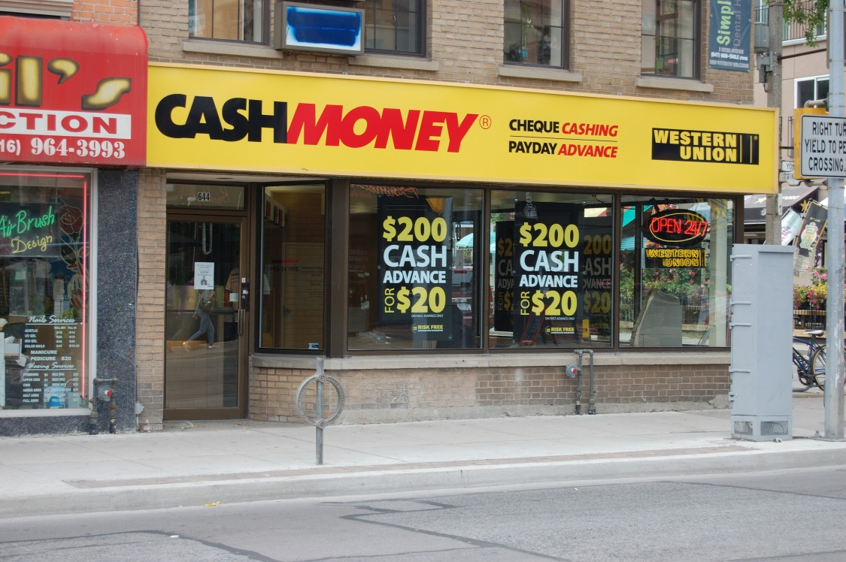
Resource Slack: Implications
Consumers are more likely to agree to donate time or money in the future than today
May contribute to debt problems
Notes:
Image source: https://www.blackenterprise.com/millennials-resorting-to-payday-loans-to-help-make-ends-meet/

Slide 56
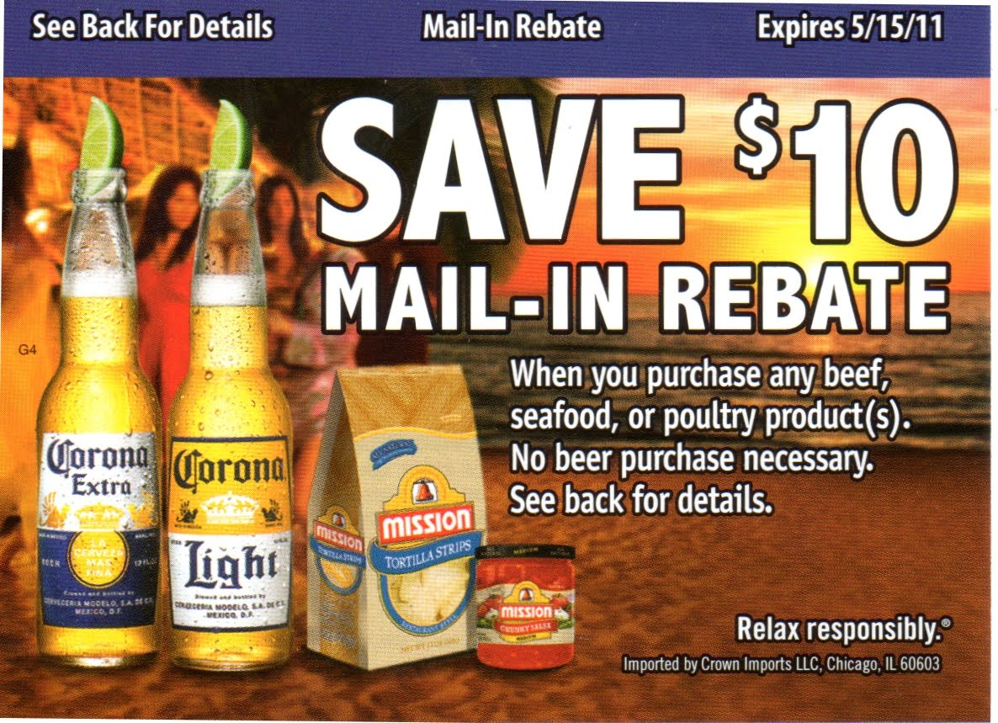
Rebates
(Tim Silk)
Consumers only send in the rebate ~50% of the time
Longer redemption period -> less redemption
Notes:
Mail in rebate

Slide 57
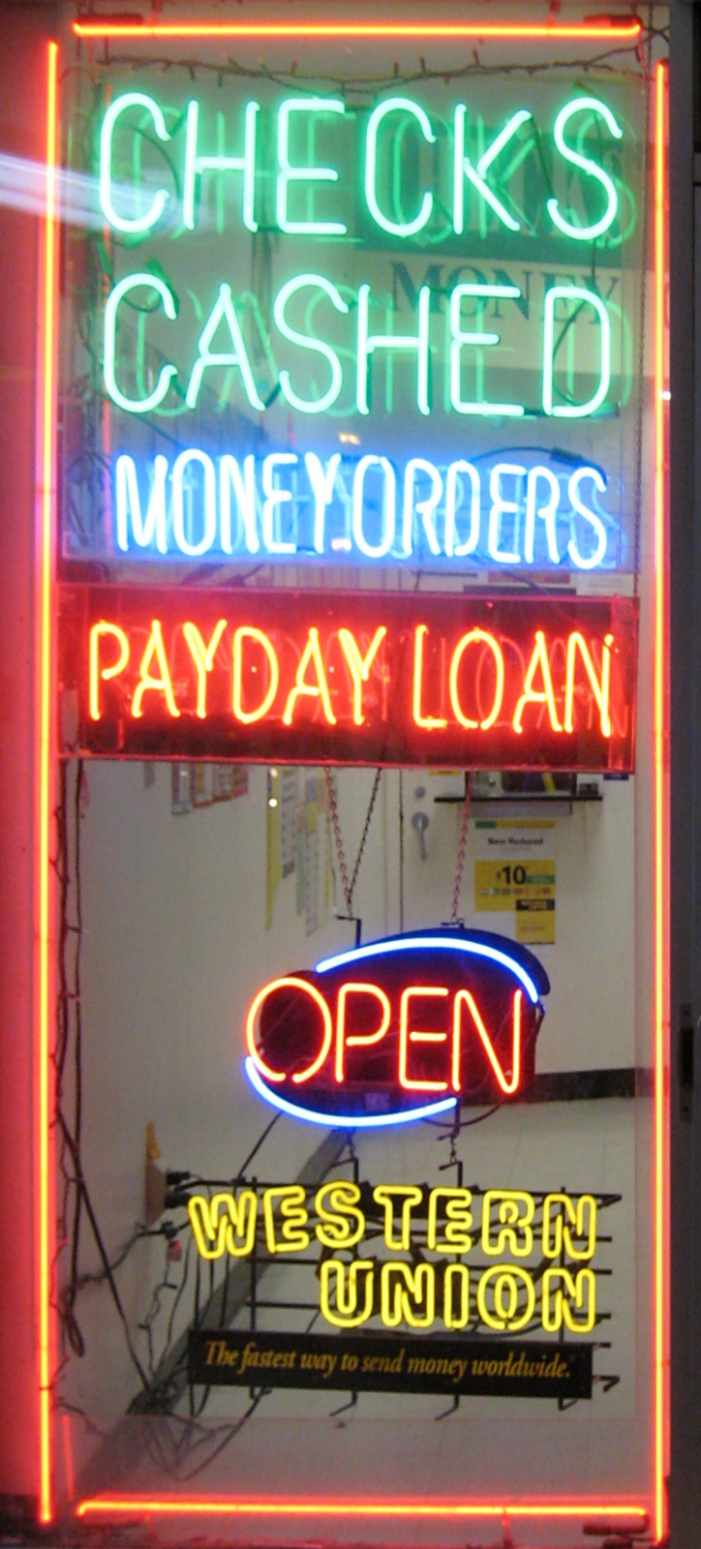
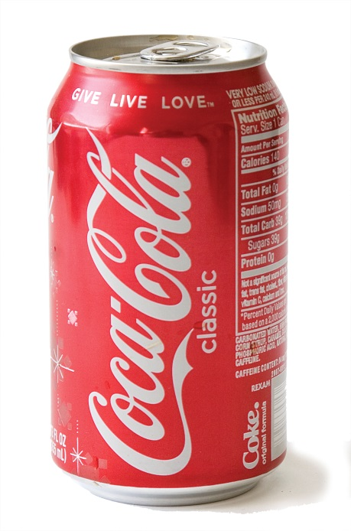

Public Policy Implications
Do consumers need to be protected from themselves?
Notes:
Image source
(coke): https://quatr.us/tag/soup-cans
(Mcdonald’s): https://firstwefeast.com/eat/2013/07/the-secret-behind-mcdonalds-canadas-success-transparency
(Payday loan): By Gregory F. Maxwell &lt;gmaxwell@gmail.com&gt; PGP:0xB0413BFA - By Uploader, GFDL 1.2, https://commons.wikimedia.org/w/index.php?curid=1664818

Slide 58
Regulations?
Only immediate rebates
Advance ordering of school lunches
Cell-phone contracts

Slide 59
Regulate Yourself?
Three short papers due over the course of the semester, plus one final project
No choice deadlines (evenly spaced) vs self-imposed deadlines
Short paper grades: 89 vs 86
Final assignment grades: 86 vs 77
Ariely, D., & Wertenbroch, K. (2002). Procrastination, deadlines, and performance: Self-control by precommitment. Psychological Science, 13(3), 219-224.

Slide 60
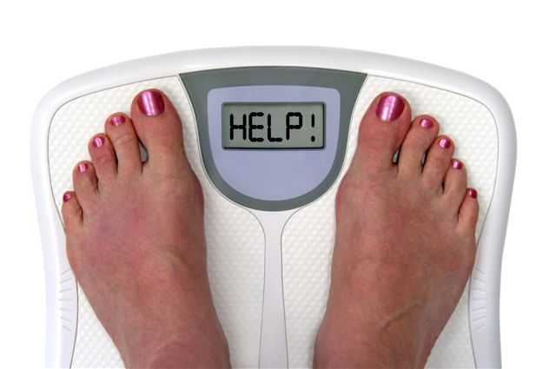
Commitment Devices
3 things required:
Clearly defined goal
Meaningful losses at stake
A referee
Have you used one?
See stickk.com
Notes:
Image source: https://www.freeart.com/art/prints/exercise/all/

Slide 61
Consumer Demand for
Commitment Devices
Consumers chose between liquid vs Illiquid savings accounts (22% interest)
Illiquid account conditions:
10% early withdrawal penalty: 39%
20% early withdrawal penalty: 45%
No early withdrawals: 56%
10% early withdrawal penalty and 21% interest: 28%
Beshears, J., Choi, J. J., Laibson, D., Madrian, B., & Sakong, J. (2011). Self control and liquidity: How to design a commitment contract. RAND Corporation Publications Department Working Papers.

Slide 62

Delay of Gratification:
Individual Differences
Mischel’s “marshmallow” study:
4-year chose between 1 candy now or 2 candies “later”
How long could they wait?
This predicted future:
Academic and social competence
Coping ability, SAT scores
BMI
Mischel, W., Shoda, Y., & Rodriguez, M. I. (1989). Delay of gratification in children. Science, 244(4907), 933-938.
Notes:
Image source: https://nalakagunawardene.com/2010/01/03/why-do-we-still-go-to-the-movies-in-the-21st-century/

Slide 63
Self-Control: Replication (2011)
Self-control of 1,000 children rated at ages 3-11, controlling for family background
Those with better self control later had (at age 32):
Better physical health
Less substance dependence
Higher SES and income
Less criminal convictions
Less single-parent child-rearing
Moffitt, T. E., Arseneault, L., Belsky, D., Dickson, N., Hancox, R. J., Harrington, H., ... & Caspi, A. (2011). A gradient of childhood self-control predicts health, wealth, and public safety. Proceedings of the National Academy of Sciences, 108(7), 2693-2698.

Slide 64
Save More Tomorrow (SMarT)
Lag between sign-up and start-up (hyperbolic discounting, money slack, CLT)
First contribution with first paycheck after a raise (loss aversion, money slack)
Contributions increase with each raise up to a pre-set maximum (procrastination/inertia/status-quo bias)
Default in, opt out (laziness, implicit endorsement, loss aversion, time slack)
Thaler, R. H., & Benartzi, S. (2004). Save More Tomorrow™: Using behavioral economics to increase employee saving. Journal of political Economy, 112(S1), S164-S187.

Slide 65
Save More Tomorrow (SMarT)
Baseline: 6.2% savings
Financial consultant: 8.8%
SMarT: 13.6%
If adopted by 15 large companies, could lead to $125 billion annual increase in savings
Thaler, R. H., & Benartzi, S. (2004). Save More Tomorrow™: Using behavioral economics to increase employee saving. Journal of political Economy, 112(S1), S164-S187.

Slide 66
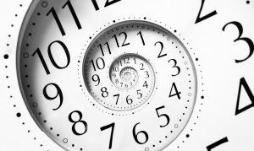
Planning Fallacy
People underestimate their own completion times (but not others’)
People focus on plan-based future scenarios
People attribute past delays to transitory factors
Buehler, R., Griffin, D., & Ross, M. (1994). Exploring the" planning fallacy": Why people underestimate their task completion times. Journal of personality and social psychology, 67(3), 366.
Notes:
Image source: https://www.thefloatspa.co.uk/what-is-the-best-time-to-float/

Slide 67
Planning Fallacy
Solutions:
Compare to previous similar projects
Get others to estimate for you
Take a third person view when imagining yourself doing the task
Commitment devices
Buehler, R., Griffin, D., & Ross, M. (1994). Exploring the" planning fallacy": Why people underestimate their task completion times. Journal of personality and social psychology, 67(3), 366.

Slide 68
Budgeting Fallacy
People spend more than they predict they will
Savings goals influence predictions, but not actual spending
Peetz, J., & Buehler, R. (2009). Is there a budget fallacy? The role of savings goals in the prediction of personal spending. Personality and Social Psychology Bulletin, 35(12), 1579-1591.

Slide 69

Sequences
People prefer improving sequences
(e.g., income, vacation package)
This is opposite of what discounting models would predict
Loewenstein, G. F., & Prelec, D. (1993). Preferences for sequences of outcomes. Psychological review, 100(1), 91.

Slide 70
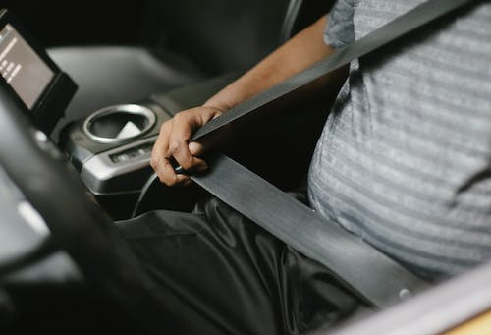
Choice Bracketing
When making multiple choices:
Broad bracketing means assessing the consequences of all of them taken together
Narrow bracketing means making each choice in isolation
Often people make more prudent choices when using broad bracketing
Example: deciding whether to wear a seat-belt “this one time” vs “every time”

Slide 71
Broad bracketing
Low-income people buy more lottery tickets when buying one at a time than when deciding once how many to purchase (Haisley 2008)
Broad bracketing can be helpful for impulse control (e.g., alcoholics anonymous)
(Ainslie, 2005)

Slide 72
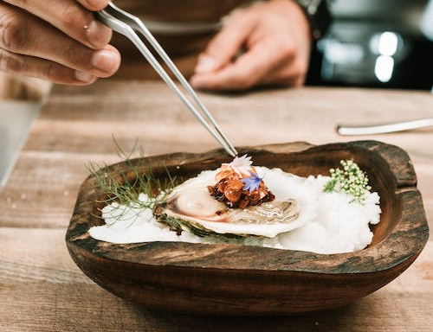
Broad bracketing creates sequences (Loewenstein & Prelec 1993)
Narrow: Fine French meal in one month or two? Most prefer sooner.
Broad: Eat French meal in one month and at home in two months, or eat at home in one month and French meal in two?
Choice bracketing shifts discount rates from positive to negative

Slide 73
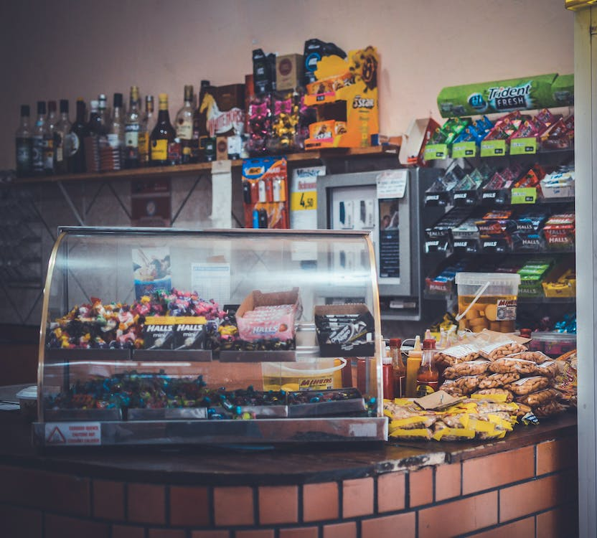
The “diversification bias”
Choosing 3 snacks (1 per week) in advance, 64% chose a different snack for each week; choosing 1 snack each week, 9% chose a different snack each week (Simonson 1990)
The more yogurt consumers buy at once, the more rare flavors they buy (Simonson & Winer 1992)
Also shown with children and Halloween candy (Read & Loewenstein 1995) and audio tracks

Slide 74
Review
How can we nudge consumers to:
Eat healthier?
Be more sustainable?
Improve public health?
Save more for retirement?

Slide 75
Thank You!

