Slide 1

Temporal Discounting of Losses
David Hardisty dhardisty@stanford.edu UBC Presentation
Notes:
Today I’m going to tell you about a few papers from my dissertation. Please feel free to jump in and ask questions at any point.
I’m really interested in intertemporal choice. How do we decide what to have now, and what to put off until later? Every moment of our lives, we are making intertemporal decisions. Do I want to do work now, or watch The Daily Show and put off work until later? There’s been a lot of research on intertemporal choice, but almost all of it has focused on gains. Meanwhile, many of the real life choices we are interested in involve future losses. For example, credit card debt, obesity, and climate change all involve future losses. Is there a difference between gains and losses? YES THERE IS.

Slide 2
Research Overview
Temporal
Discounting
of Losses
Product
Attribute
Framing
Social
Dilemmas

Slide 3
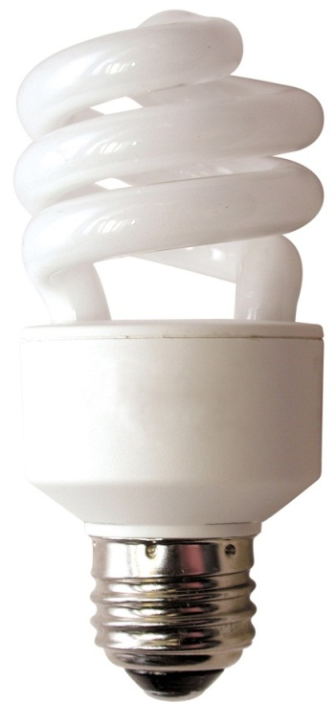
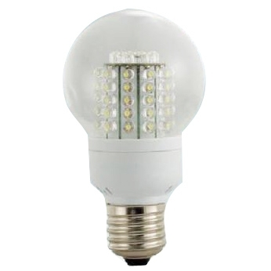
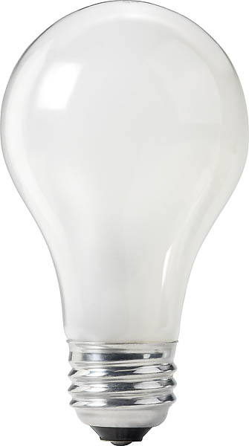
60 watt incandescent
14 watt CFL
9 watt LED
$0.87 now, $443 later
$3.29 now, $109 later
$17.50 now, $61 later
3
Hardisty, Orlove, Krantz, Small, & Milch, 2012
Notes:
Consumers are constantly making intertemporal tradeoffs, and they don't always make good choices. Here's one example...
Image source (left): https://www.rona.ca/en/product/feit-electric-light-bulb-bright-white-a15-bulb-shape-40-watt-bp40a15-can-31925045
Image source (middle): https://www.bulbconnection.com/product/4909-TCP-80101450-14W-SPRINGLIGHT-50K-14w-Spiral
Image source (right): https://stair-lighting.com/led-e27-c-16_20.html

Slide 4
Factors Affecting Time Preference
Uncertainty (Bixter & Luhmann, 2012; Takahashi et al, 2007)
Interest on investment (Franklin, 1748)
Resource slack (Zauberman & Lynch, 2005)
Anticipation (Loewenstein 1987)
Social goals (Krantz & Kunreuther, 2007)
Domain (Bohm and Pfister 2005; Chapman, 1996)

Slide 5
Discounting: definition
The higher the discount rate, the more consumers want gains now and losses later
Humans, pigeons, and rats all discount hyperbolically (Mazur 1987)
V=A/(1+kD)
Value
Notes:
This model doesn’t distinguish between gains and losses. This is surprising, given that a Nobel Prize was awarded for Prospect Theory, which differentiates gains and losses in intertemporal choice.
Why hasn’t more attention been paid to losses versus gains in intertemporal choice? One possibility is because there hasn’t been a process account or process data to explain the difference.
Today, I am going to show you that the difference between gains and losses is robust across domains, and then demonstrate why this difference happens.

Slide 6
The Discounting Bandwagon

Slide 7
“the biggest uncertainty of all in the economics of climate change is the uncertainty about which interest rate to use for discounting” (Weitzman 2007)
Notes:
furthermore, there’s the question of whether to use different discount rates for different domains.

Slide 8
Are discount rates lower for environmental outcomes?
Previous research suggests yes
(Gattig & Hendrickx, 2007; Bohm & Pfister, 2005)
Notes:
(while controlling for confounding factors)

Slide 9
Experimental Overview
3 Studies
477 US residents, recruited & run online
Hypothetical monetary, environmental & health scenarios
DV: discount rate
(Hardisty & Weber 2009)

Slide 10
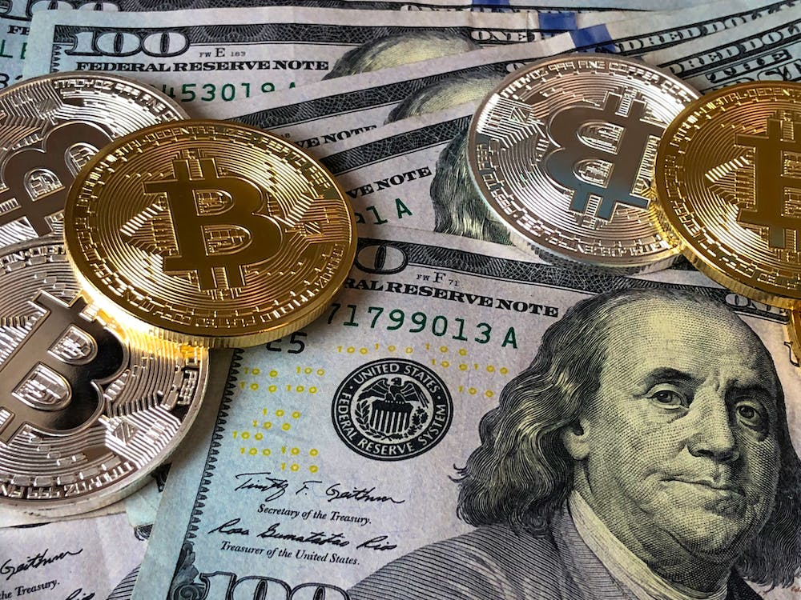
Monetary Gain Scenario
Imagine you just won a lottery, worth $250, which will be paid to you immediately. However, the lottery commission is giving you the option of receiving a different amount, paid to you one year from now.
(Hardisty & Weber 2009)
Notes:
Image source: https://unsplash.com/

Slide 11
Indifference Point Elicitation
Please choose which option you prefer in each pair:
[ ] Win $250 immediately | [ ] Win $410 one year from now.
[ ] Win $250 immediately | [ ] Win $390 one year from now.
[ ] Win $250 immediately | [ ] Win $370 one year from now.
... | ...
Please fill in the number that would make you indifferent between the following two options:
A. Win $250 immediately.
B. Win $ one year from now.
(Hardisty & Weber 2009)

Slide 12
Indifference Point Elicitation
Please choose which option you prefer in each pair:
[ ] Win $250 immediately | [x] Win $410 one year from now.
[ ] Win $250 immediately | [x] Win $390 one year from now.
[x] Win $250 immediately | [ ] Win $370 one year from now.
... | ...
Please fill in the number that would make you indifferent between the following two options:
A. Win $250 immediately.
B. Win $ 380 one year from now.
(Hardisty & Weber 2009)

Slide 13
Discount Rate Computation
[ ] Win $250 immediately | [x] Win $410 one year from now.
[ ] Win $250 immediately | [x] Win $390 one year from now.
[x] Win $250 immediately | [ ] Win $370 one year from now.
... | ...
V = A/(1+kD)
250 = 380/(1+k*1)
k = .52
(Hardisty & Weber 2009)

Slide 14
Monetary Loss Scenario
Imagine you just got a parking fine for $250, which you must pay immediately. However, the city court is giving you the option of paying a different amount instead, one year from now.
(Hardisty & Weber 2009)
Notes:
Image source: https://unsplash.com/

Slide 15
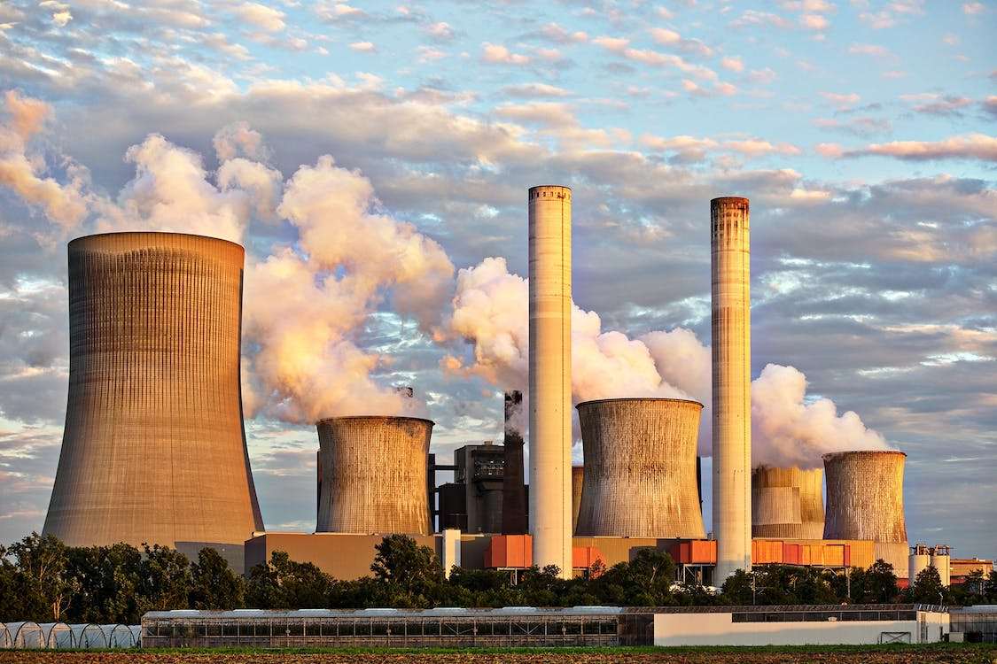
Air Quality Scenarios
Imagine the current air quality in your area is moderate
Temporary emissions regulation test will immediately improve [worsen] air quality for 3 weeks
Alternately, the test may be carried out one year from now, for a different length of time
We are interested in your
preference, as someone who
will be personally affected by
it, between the two options of
improved air now or in the
future
(Hardisty & Weber 2009)
Notes:
Image source: https://unsplash.com/

Slide 16
Indifference Point Elicitation
Please choose which option you prefer in each pair:
[ ] Improved air quality immediately, for 21 days. | [ ] Improved air quality one year from now, for 37 days.
[ ] Improved air quality immediately, for 21 days. | [ ] Improved air quality one year from now, for 35 days.
[ ] Improved air quality immediately, for 21 days. | [ ] Improved air quality one year from now, for 33 days.
... | ...
Please fill in the number that would make you indifferent between the following two options:
A. Improved air quality immediately, for 21 days.
B. Improved air quality one year from now, for ____ days.
(Hardisty & Weber 2009)

Slide 17
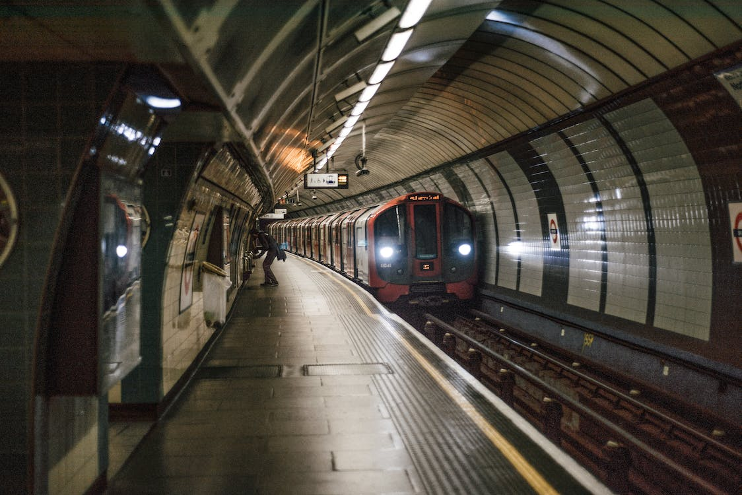
Mass Transit Scenario
(Hardisty & Weber 2009)
Notes:
Image source: https://unsplash.com/

Slide 18
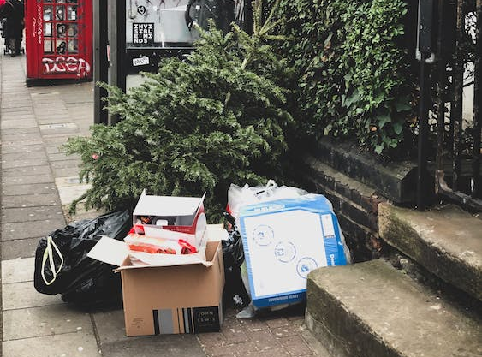
Garbage Scenario
(Hardisty & Weber 2009)
Notes:
Image source: https://unsplash.com/

Slide 19
Study 1: Discussion
No domain differences
Difficult to interpret null results
Environmental outcomes measured in days, not equivalent to monetary outcomes
(Hardisty & Weber 2009)

Slide 20
Study 1: Results
(Hardisty & Weber 2009)

Slide 21
Study 2: Objectives
Replicate study 1, using a different measure of air quality & an experienced population
Compare with discounting of health outcomes
(Hardisty & Weber 2009)

Slide 22
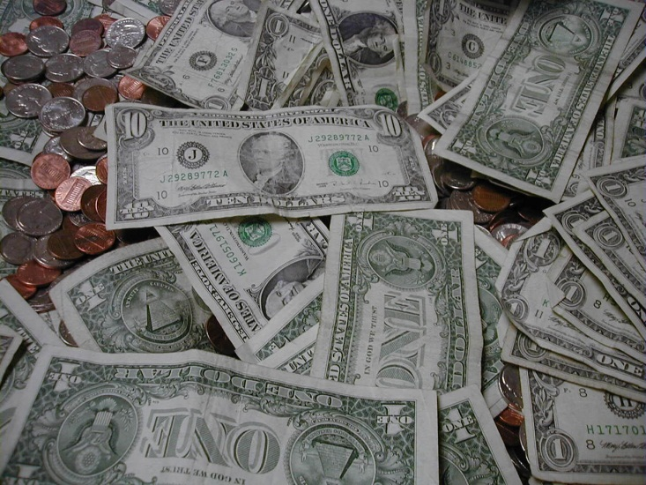
Monetary Scenarios
Gain and loss, same as study 1
(Hardisty & Weber 2009)
Notes:
Image source: https://unsplash.com/

Slide 23
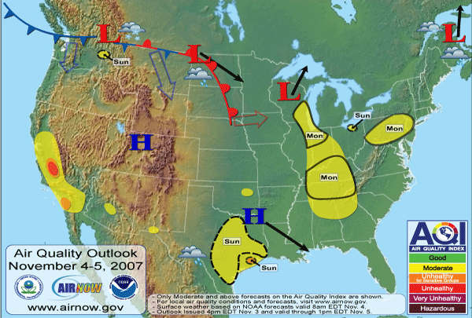
Environmental Scenarios: the AQI
(Hardisty & Weber 2009)
Notes:
Image source: www.airnow.gov

Slide 24


Understanding the AQI
What is the AQI?
The AQI is an index for reporting daily air quality that tells you how clean or polluted your air is... etc
Good
Moderate
Unhealthy for Sensitive Groups
Unhealthy
Very Unhealthy
Hazardous
(Hardisty & Weber 2009)

Slide 25


Health Scenarios
Used stimuli developed by Chapman (1996)
Imagine you are currently in poor [good] health
You can choose between two treatments [disorders] which will restore you to [cause you to lose your] full health for a limited amount of time (~12 weeks)
One would take effect immediately, the other one year from now
(Hardisty & Weber 2009)
Notes:
Image source: https://unsplash.com/

Slide 26
Study 2: Results
(Hardisty & Weber 2009)
Notes:
I’ve run around 20 studies of discounting, and they all show a striking effect: losses are discounted much less than gains. First, let me walk you through the study that got me started on this. This was an online study, with Elke Weber. Participants made a series of choices….
Remarkably, some participants actually showed negative discounting of losses. For example…
Previous studies of environmental discounting screwed this up....
In addition to this behavioral evidence of differences between gains and losses, we also have neural evidence

Slide 27
Study 2: Discount Correlations
 | $ + | $ - | Air + | Air - | Health + | Health -
$ +
$ - | -.04
Air + | .39*** | -.03
Air - | -.01 | .09 | .11
Health + | .39*** | -.15 | .39*** | .04
Health - | -.14 | .269** | -.13 | .03 | -.07
** = p < .01, *** = p < .001
Notes:
Explain empty cells

Slide 28
Study 2: Discount Correlations
 | $ + | $ - | Air + | Air - | Health + | Health -
$ +
$ - | -.04
Air + | .39*** | -.03
Air - | -.01 | .09 | .11
Health + | .39*** | -.15 | .39*** | .04
Health - | -.14 | .269** | -.13 | .03 | -.07
** = p < .01, *** = p < .001
Notes:
Explain empty cells

Slide 29
Study 2: Discount Correlations
 | $ + | $ - | Air + | Air - | Health + | Health -
$ +
$ - | -.04
Air + | .39*** | -.03
Air - | -.01 | .09 | .11
Health + | .39*** | -.15 | .39*** | .04
Health - | -.14 | .269** | -.13 | .03 | -.07
** = p < .01, *** = p < .001
Notes:
Explain empty cells

Slide 30
Study 2: Discount Correlations
 | $ + | $ - | Air + | Air - | Health + | Health -
$ +
$ - | -.04
Air + | .39*** | -.03
Air - | -.01 | .09 | .11
Health + | .39*** | -.15 | .39*** | .04
Health - | -.14 | .269** | -.13 | .03 | -.07
** = p < .01, *** = p < .001
Notes:
Explain empty cells

Slide 31
Study 3: Results

Slide 32
Study 3: Discount Correlations
 | $ + | $ - | Air + | Air -
$ +
$ - | .08
Air + | .21* | -.03
Air - | .09 | .42* | .17*
** = p < .01, *** = p < .001
Notes:
Explain empty cells

Slide 33
Paper 1: Discussion
Environmental outcomes discounted similarly to monetary outcomes (when equalizing as many factors as possible)
Sign more important than domain

Slide 34
Why?

Slide 35
Outline
Anticipation
Loss aversion
Magnitude
Uncertainty

Slide 36
Anticipation

Slide 37
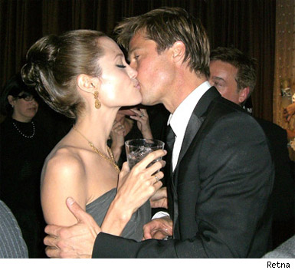
Kiss from a movie star: today or next week?
(Loewenstein, 1987)
Discounting
Anticipation
Notes:
Image source: https://people.com/celebrity/angelina-jolie-brad-pitt-married-top-10-pda-moments/

Slide 38
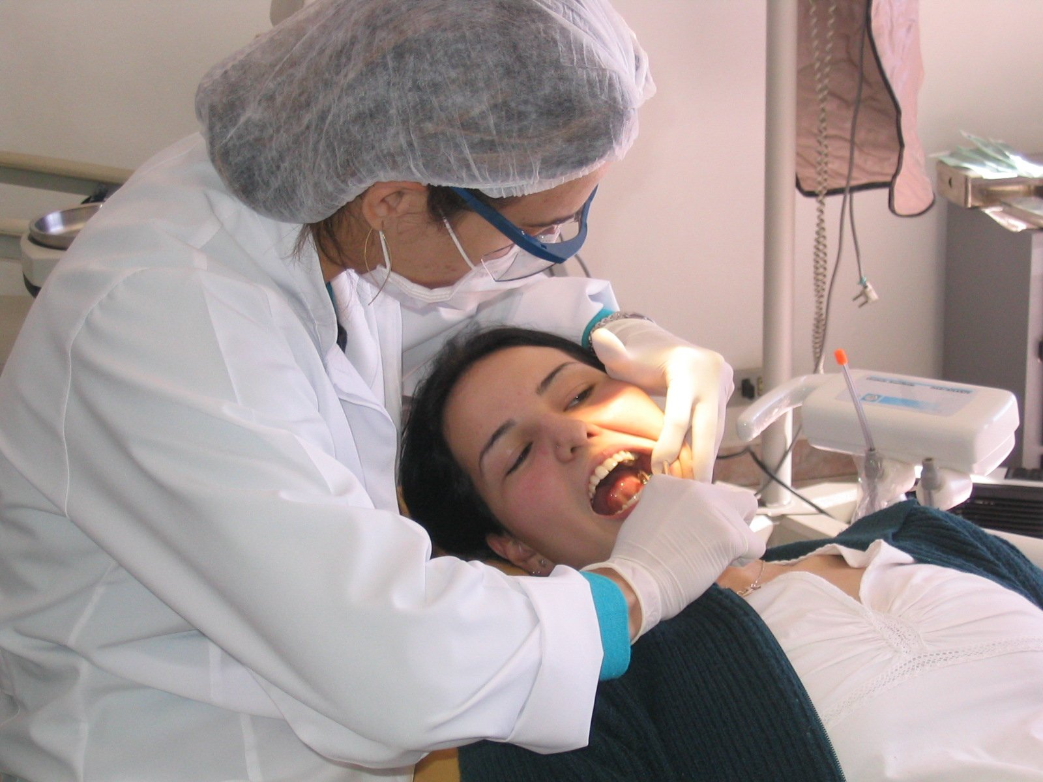
Scheduling a dental procedure
Discounting
Anticipation
Notes:
Image source: https://unsplash.com/

Slide 39
Pilot research: savoring?
Savoring: Only 6 out of 103 students would pay more for a kiss next week than one today
Dread: 20 out of 56 students preferred eating 9 worms today rather than 8 next week (see also Harris, 2010 & Berns et al 2006)
Does dread loom larger?
Notes:
Students who liked eating worms were screened out. In this sample, at any rate, we failed to replicate Loewenstein’s finding; meal worms isn’t the best control for kissing movie stars

Slide 40
Anticipation: Methods
Imagine receiving [losing] $50.
When would you prefer this to happen?
If this event were one week away, how psychologically pleasurable or unpleasurable would the anticipation be? In other words, how would you feel while waiting for it?
Hardisty, Frederick, & Weber (in revision)
Notes:
We asked this question for 20 different events, 10 positive and 10 negative, including financial, health, and social events, and several “classics” from the literature, such as Loewenstein’s “kiss from a movie star” effect.
Incidentally, we ran two replications of Loewenstein’s kiss from a movie star paradigm, and failed to replicate it both times.
We wanted to see whether anticipation was asymmetric, and whether it predicted time preference.
So, what did we find for time preference?

Slide 41
Results: Time preference
 | Now | Indifferent | Later
Positive Events | 62% | 31% | 7%
Negative Events | 41% | 22% | 37%
Total N=5,420 events (20 events for each of 169 participants)
Notes:
What about anticipation?

Slide 42
Results: Anticipation
Notes:
The distribution for positive events crosses over zero…
Moreover, we found that these ratings of anticipation predicted time preference. This relationship was significant for all 20 events; average standardized beta = -.3. That’s weak, and reinforces the fact that anticipation is just one of many factors that drives time preference.
So, we’ve shown that dread looms larger than savoring, and that anticipation predicts time preferences…
Taken together, this explains the “sign effect”. But is this just loss aversion?

Slide 43
Loss Aversion

Slide 44
Controlling for loss aversion
Would you accept this pair of events?
50% chance to receive [$25]
AND
50% chance to lose $25
Yes Unsure No
Notes:
We also investigated non-monetary outcomes, such as a 50 minute pleasurable massage and being stuck in horrible traffic for 50 minutes.
So, with the outcomes matched, what did we find for time preference?

Slide 45
Results: Time preference
 | Now | Later
Positive Events | 80% | 20%
Negative Events | 57% | 43%
Total N=5,420 events (20 events for each of 169 participants)
Notes:
What did we find for anticipation?

Slide 46
Results: Utility
Notes:
It’s not that losses are stronger, it’s that the anticipation of losses is qualitatively different from the anticipation of gains.

Slide 47
Anticipation: What do we call it?
 | Pleasurable Anticipation | Aversive Anticipation
Positive Event | Savoring | Impatience
Negative Event | ??? | Dread
Notes:
This is just anecdotal evidence, and we wanted to study it more systematically…

Slide 48
Breaking down anticipation

Slide 49
Summary
People choose immediate gains more than they choose to postpone losses
Why? Dread looms larger than savoring. (Even when controlling for loss aversion.)
Why?
Future gains -> savoring and deprivation
Future losses -> dread but not “enjoying the moment”
Notes:
Any further questions before I move on to talking about some other projects?

Slide 50
Magnitude

Slide 51
Sign X Magnitude
(Hardisty, Appelt, & Weber 2012)

Slide 52
Uncertainty

Slide 56
Other Discounting Projects
Methods of measuring discounting (Hardisty, Thompson, Krantz, & Weber, revise & resubmit)
Losses reverse the magnitude effect in discounting (Hardisty, Appelt, & Weber, 2012)
Losses reverse the direction effect in discounting (Appelt, Hardisty, & Weber, 2011)
Uncertainty and time preference for gains and losses (Hardisty & Pfeffer, under review)
Policy applications (Hardisty, Orlove, Krantz, Small, & Milch, 2012)

Slide 57
Disco brain
Gain > Loss
Loss > Gain
(Hardisty, Wimmer, Weber, & Shohamy; in prep)
Notes:
Left: Gain > Loss at p<.01 showing activation in the vmPFC
Right: Loss > Gain at p<.05 showing activation in the amygdala and habenula
Why does this happen?
Perhaps, one reason why there are differences in time preference is because there are differences in anticipation value.

Slide 58
Sign X Direction

Slide 59
Other Projects
Product Attribute Framing (Hardisty, Johnson, & Weber, 2010; Hardisty & Wheeler, in preparation)
Time horizons in social dilemmas (Arora, Peterson, Krantz, Hardisty & Reddy, 2012; Hardisty, Kunreuther, Krantz, & Arora, under review)

Slide 60
A dirty word, or a dirty world?
Hardisty, Johnson, & Weber (2010). A dirty word or a dirty world? Attribute framing, political affiliation, and query theory. Psychological Science, 21, 86-92.
Notes:
I’m also working on an attribute representation project with Christian Wheeler...

Slide 61
Thank You!

Slide 62
Additional Slides

Slide 63
Study 1: Discount Correlations
 | $ + | $ - | Air + | Air - | Transit + | Garbage -
$ +
$ - | -.20
Air + | .68** | -.19
Air - | .23 | .38* | .25
Transit + | .41* | -.13
Garbage - | .46** | .41* |  |  | .15
** = p < .01, *** = p < .001
Notes:
Explain empty cells

Slide 64
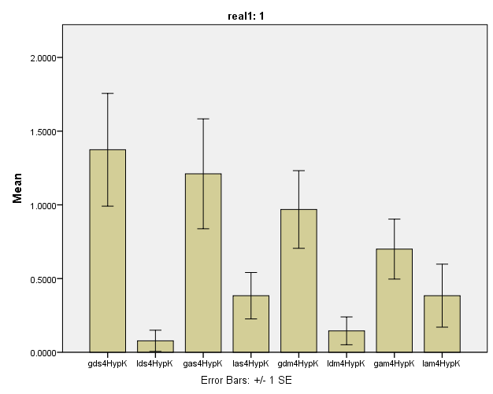
Discount rates for real gains and losses

Slide 65
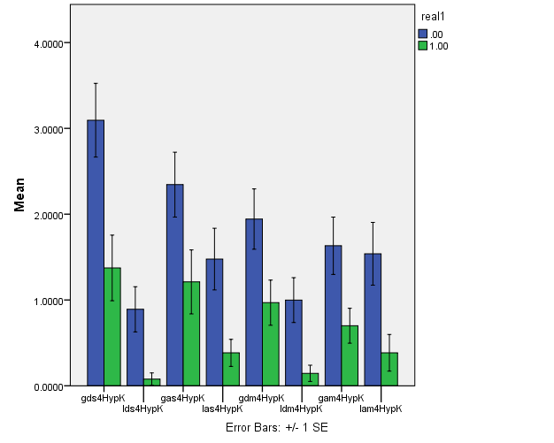
Comparison of real and hypothetical gains and losses

Slide 66
event | a | e | Corr(a,e) | c | beta (a) | beta (e)
a free 5-day vacation to the destination of your choice | 28 | 75 | .27** | .19 | -.40** | .00
eating a nice meal out at a restaurant | 28 | 59 | .42** | .29 | -.31** | .15
a kiss from the movie star of your choice | 22 | 46 | .38** | .32 | -.17* | .34**
receiving a good grade or performance review | 21 | 68 | .33** | .68 | -.22** | -.01
getting a gift in the mail from a family member | 21 | 64 | .43** | .49 | -.35** | .15
spending time with your best friend | 21 | 67 | .24** | .44 | -.21** | .14
watching your favorite TV show or reading a good book for an hour | 13 | 52 | .39** | .57 | -.27** | .18*
receiving a $50 check | 13 | 66 | .25** | .78 | -.17* | .04
improved energy and health for 10 days | 9 | 67 | .24** | .69 | -.31** | .12
winning the lottery | 6 | 83 | .20* | .79 | -.31** | .15*
doing difficult home cleaning and renovation for 5 days | -19 | -13 | .51** | .02 | -.36** | .32**
filling out paperwork and waiting around for an hour at the local Department of Motor Vehicles (DMV) | -26 | -35 | .43** | .11 | -.30** | .26**
paying a $50 fine | -27 | -39 | .39** | .02 | -.28** | .16
giving a stressful 60 minute improvised speech | -45 | -37 | .45** | -.10 | -.20* | .26**
being sick for 10 days | -47 | -65 | .28** | -.15 | -.32** | .22**
a painful dental procedure | -53 | -63 | .37** | .18 | -.44** | .39**
receiving a bad grade or performance review | -55 | -65 | .43** | .15 | -.38** | .31**
a confrontation with your co-worker or family member | -57 | -60 | .55** | .18 | -.35** | .32**
getting twenty painful (but harmless) electric shocks in a research experiment | -58 | -66 | .41** | .13 | -.36** | .33**
having one of your legs amputated | -63 | -86 | .31** | -.56 | -.24** | .33**

Slide 67
Typical Event Pair
Event | Anticipation | Experience | Choice (1=prefer now) | Regression Beta
receiving a good grade or performance review | 21 | 68 | .68 | -.22**
receiving a bad grade or performance review | -55 | -65 | .15 | -.38**

