Slide 1
The Victory Effect:
Is First-Place Seeking Stronger than
Last-Place Aversion?
Steven Shechter
David J. Hardisty*
UBC Sauder
*Presenting author
Funding from the Social Sciences and Humanities Research Council (SSRHC) of Canada
Notes:
Images from unsplash.com

Slide 2
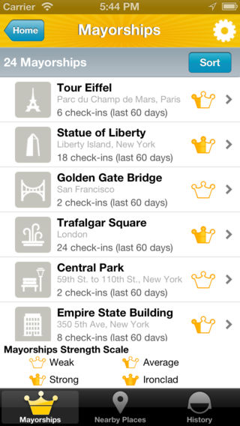
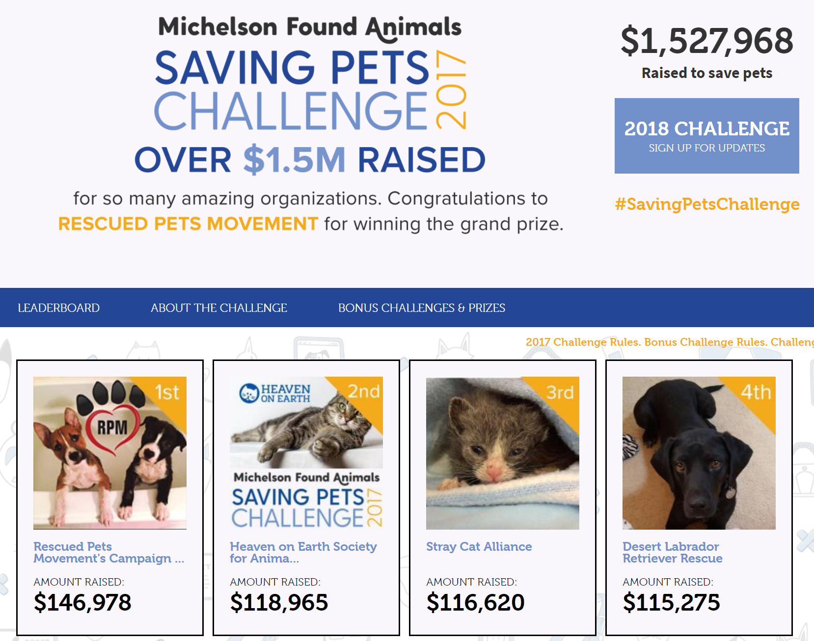
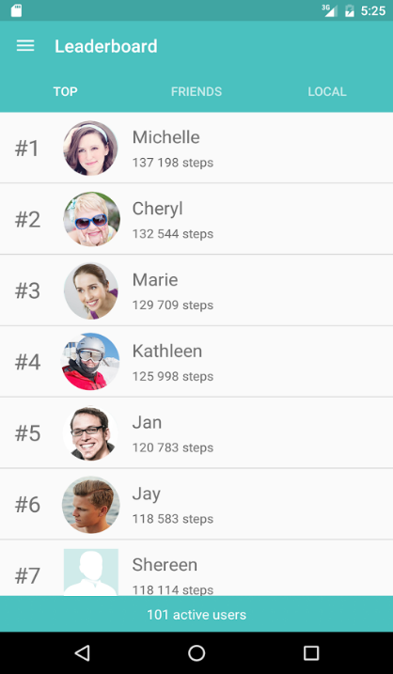

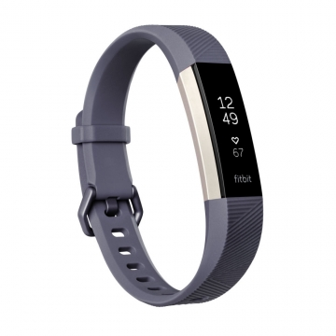
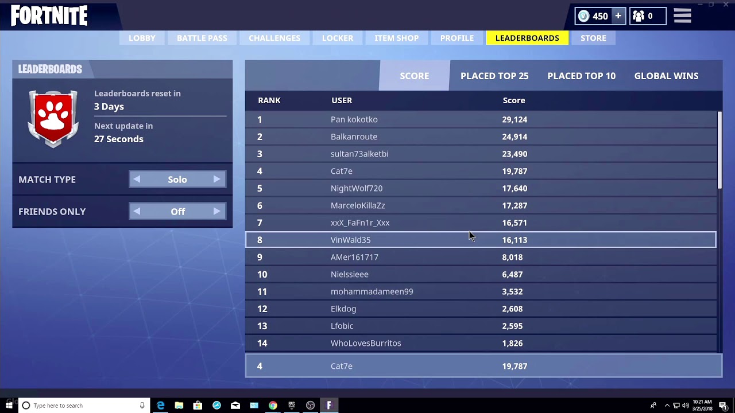
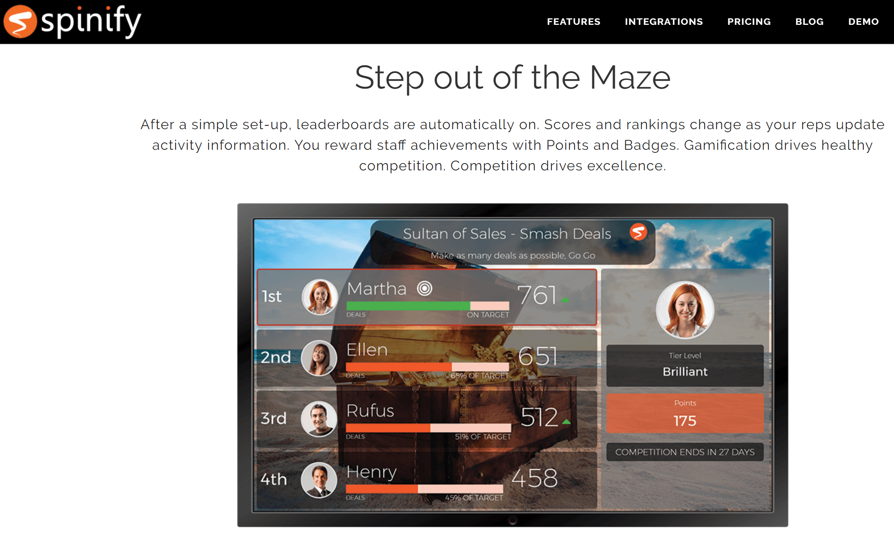
Gamification

Slide 3
Related literature
Empirical studies
  Strong motivating effect of PGA prize money on golf performance (Ehrenberg and Bognanno, 1990)
  Rank feedback improves employee productivity (Blanes i Vidal and Nossol, 2011)
  Larger competition group sizes reduces performance in software development contests (Boudreau at al., 2011)
Behavioral studies
  Gender similarities in a non-competitive task, but differences when competing against each other (Gneezy, Niederle, and Rustichini, 2003)
  Men embrace competition vs. women shy away from it (Niederle and Vesterlund, 2007)

Slide 4
Related literature
Behavioral studies
  Social comparisons shown during a step-count experiment led to more steps taken in remainder of experiment, relative to controls that only saw their own step counts (Chapman et al., 2016)
  Last-place aversion (Kuziemko et al., 2013)
    Individuals randomly assigned to groups of 6
    Each individual randomly endowed with one of 6 amounts of money
      $1.75, $2.00, $2.25 … , $3.00
    Asked to choose:
      Win $0.13 with 100% chance
      Win $0.50 with 75% chance and lose $1.00 with 25% chance
    Main finding: individuals with $1.75 chose gamble significantly higher proportion of time than other amounts.
    Did not find support for first-place seeking behavior

Slide 5
What’s new in our study
We examine utility (Study 1) and performance (Study 2) as a function of specific rank outcomes in a competition
We focus on intrinsic motivation of rank
  No prizes awarded
  Anonymous display of rank

Slide 6
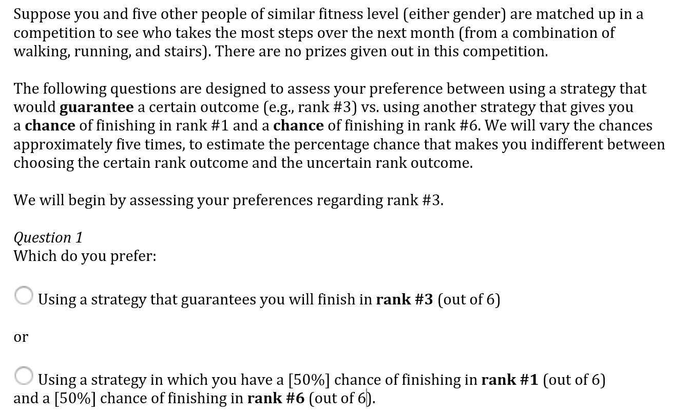
Study 1: Utility as a function of rank

Slide 7
Study 1 hypotheses
Hypothesis 1: Individuals care about rank in contests without prizes. Specifically, their utility curves are decreasing in rank.
Hypothesis 2:
  a) Individuals are risk-seeking when in second place
  b) Individuals are risk-averse when in second-to-last place.
Hypothesis 3: Individuals experience a greater decrease in utility from first to second place, compared to the decrease in utility from second-to-last to last place.

Slide 8
Study 1 overview
Study label | Subject pool | Number of contestants per group | Sample size | % male | Avg age | Avg male comp | Avg female comp
1a. | MTurk | 6 | 1001 | 50 | 36 | 5.0 | 4.5
1b. | MTurk | 6 | 1960 | 52 | 35 | 5.0 | 4.4
1c. | UBC undergrads | 10 | 423 | 36 | 21 | 5.7 | 5.2

Slide 9
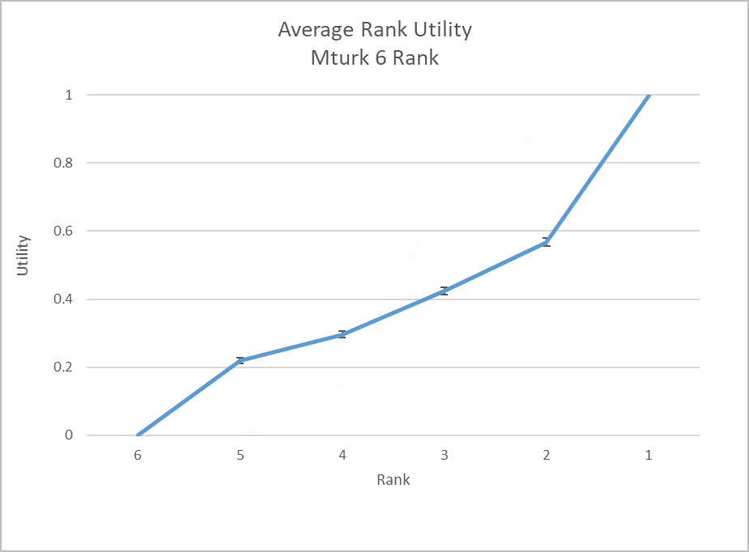
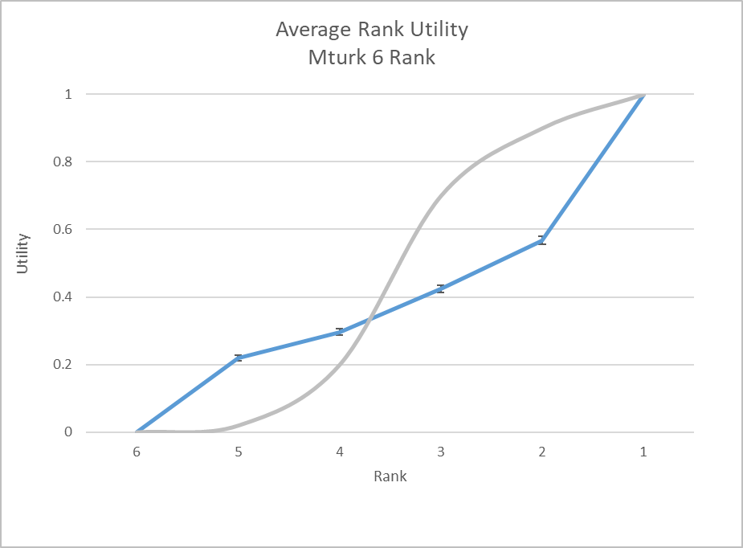
Average utility vs. rank, MTurk 6
-
+

Slide 10
Average utility vs. rank, UBC 10

Slide 11
Utility by rank and gender, MTurk 6

Slide 12
Utility by rank and gender, UBC 10

Slide 13
Summary of results at individual level
Proportions
Study | Utility Second > Utility Second-to-Last | Risk-seeking at Second (RSS) | Risk-averse at Second-to-Last (RASTL) | Both | Drop from First > Drop to Last
1a | 87% | 79% | 72% | 57% | 68%
1b | 91% | 79% | 68% | 56% | 70%
Magnitudes (average and 95% CI)
Study | Utility Second – Utility Second-to-Last | Prop RSS – Prop RASTL | Drop from First – Drop to Last
1a | .35 (.34, .36) | .07 (.04,.10) | .21 (.20,.23)
1b | .45 (.42, .48) | .12 (.06,.17) | .23(.19,.26)

Slide 14
Study 2: Performance as a function of rank
Two competitions run in the lab
  Study 2a: Stepping competition
  Study 2b: Puzzle competition
Two rounds, separated by 1 week
  Step as much as you can in each 5-min round
  Output measure: Round 2 – Round 1 score
Treatment group: Shown anonymized leaderboard (rank, # steps) prior to Round 2
Control group: Not in a group competition. Just shown their own Round 1 # of steps prior to Round 2

Slide 15
Study 2 hypothesis
Hypothesis 4:
  a) Individuals near first and last place after one round will demonstrate greater improvement in the second round, relative to other ranks.
  b) Furthermore, the performance gains of those near first place will be greater than the performance gains of those near last place.

Slide 16
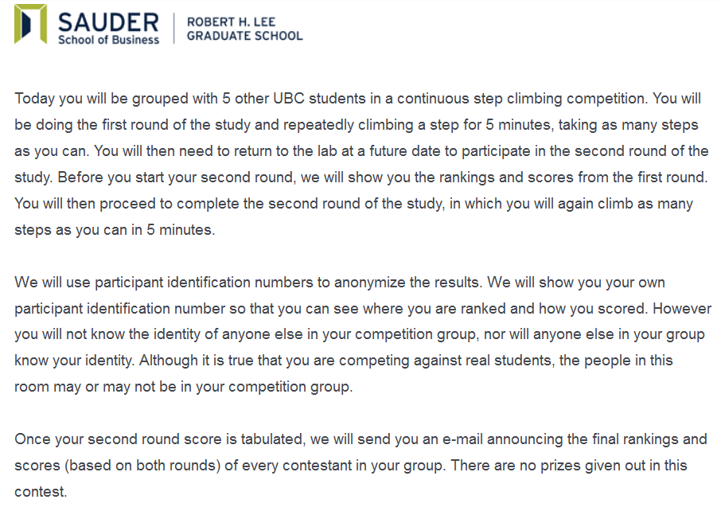
Study 2: Step instructions (treatment group)

Slide 17
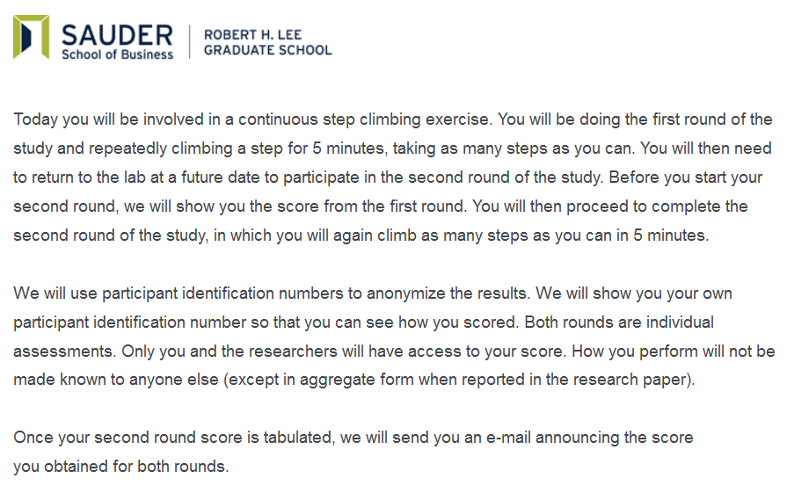
Study 2: Step instructions (control group)

Slide 18
Study 2 overview
Study | Contestants per group | Contest type | Condition | n | % female | Avg age | Avg male comp | Avg female comp
2 | 6 | Step | Treatment | 231 | 64% | 20 | 5.6 | 4.8
2 | 6 | Step | Control | 162 | 52% | 20 | 5.6 | 5.1

Slide 19
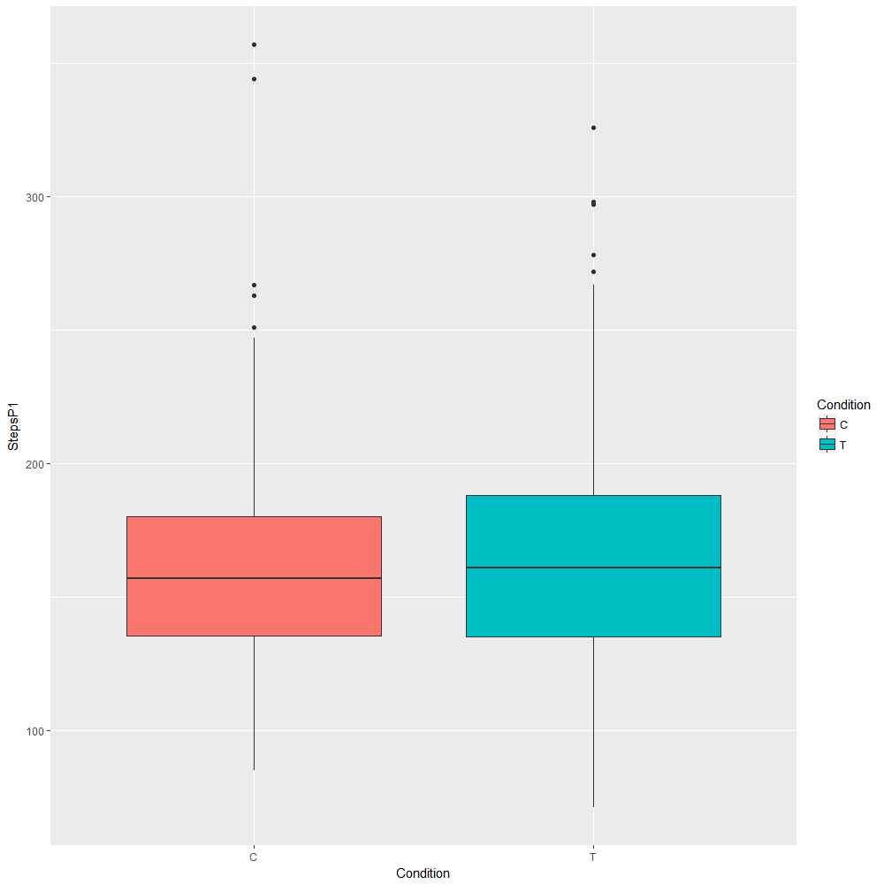
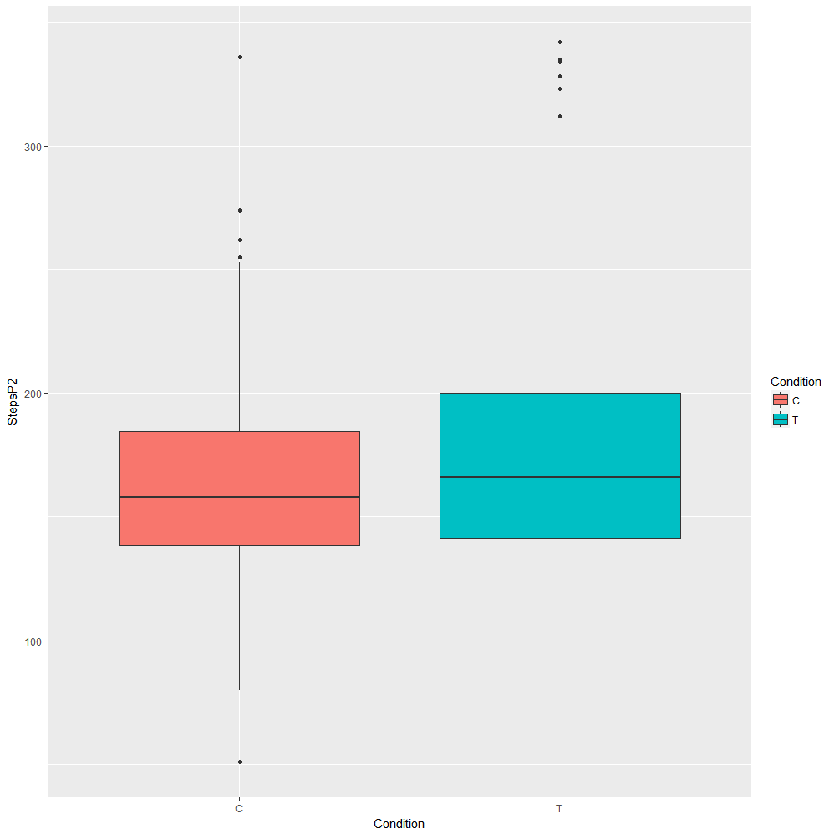
Step study aggregate results
Round 1 steps
Round 2 steps

Slide 20
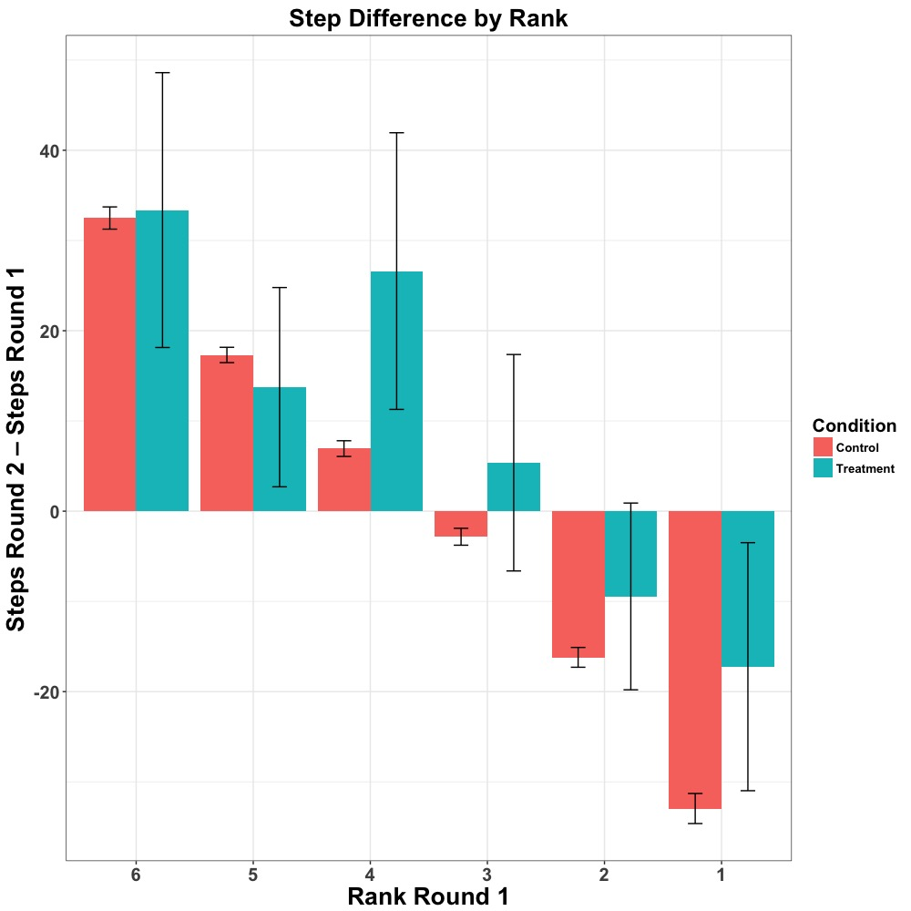
Step study diff. scores as a function of R1 rank
.96
.58
.02
.14
.25
.02

Slide 21
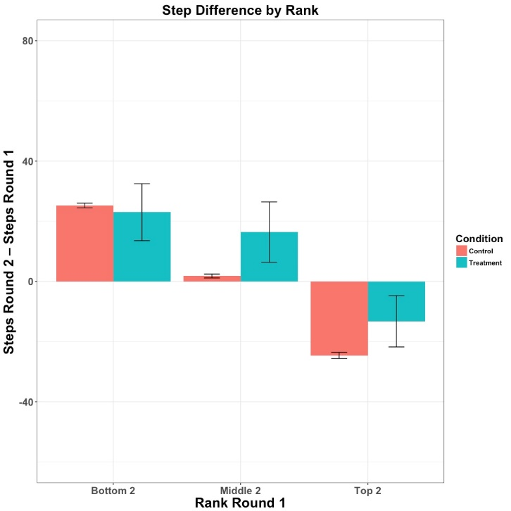
Step study diff. scores as a function of R1 rank
p = 0.65
p < .01
p = .01

Slide 22
Alternative explanation: Competitiveness level?
Does “how competitive” one is drive both Round 1 rank and step differential?
 | Round 1 Rank | Round 2 – Round 1 steps
Competitiveness level | 0.21 | 0.08
Correlations for treatment group

Slide 23
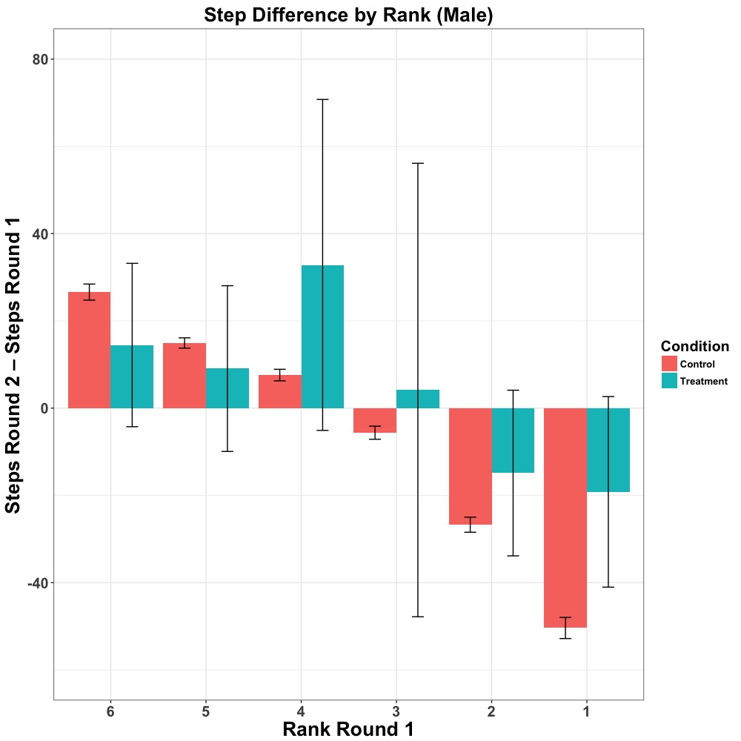
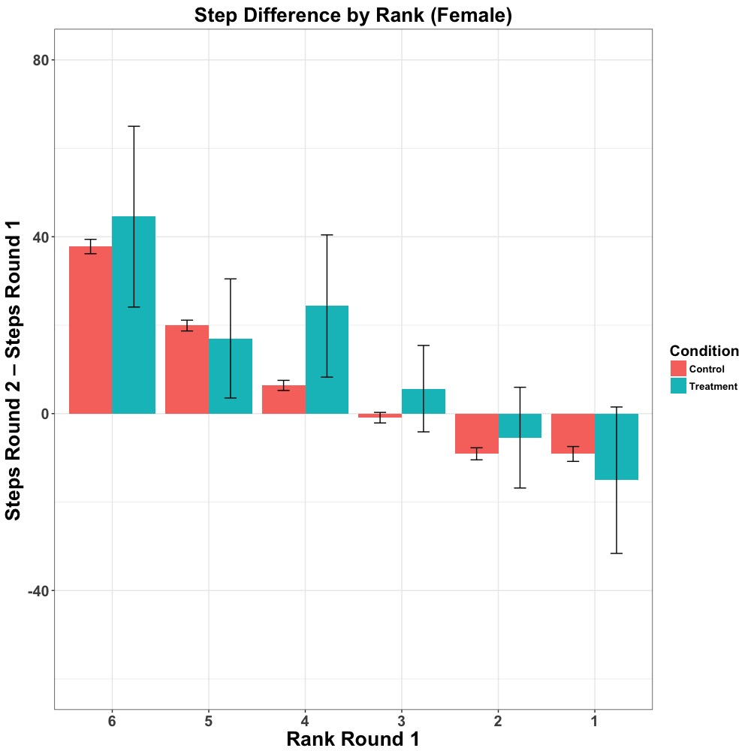
Step study results by gender

Slide 24
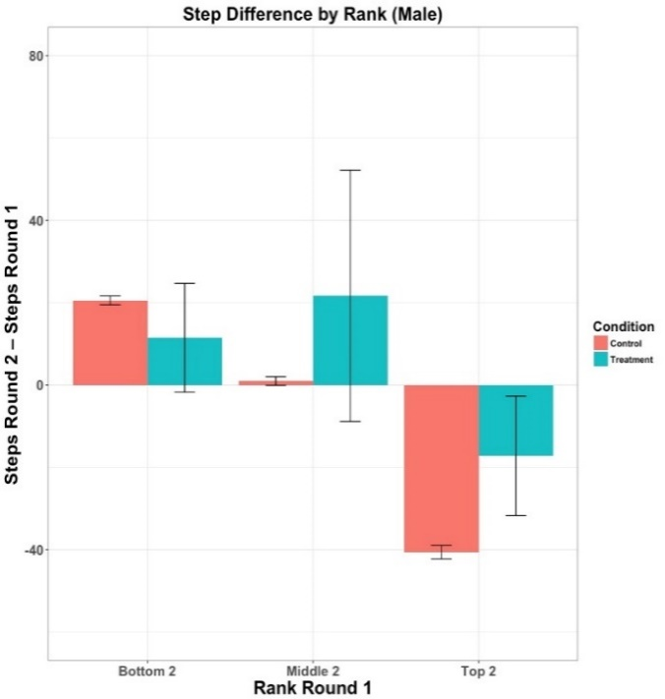
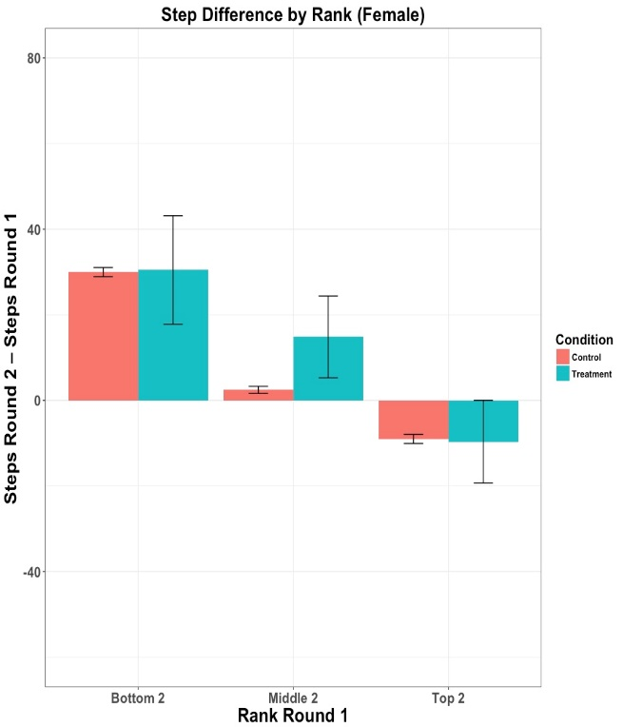
Step study results by gender
p = .20
p = .94
p = .19
p = .01
p < .01
p = .90

Slide 25
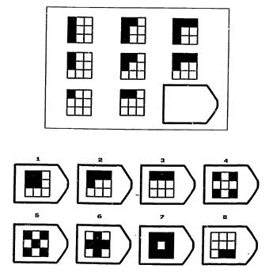
Study 2b
Measured performance on a measure of intelligence (Raven’s Progressive Matrixes) at T1 and T2
Replicated Study 2a, but weaker effects

Slide 26
Summary
People intrinsically care about ranks
Risk-seeking for first place, risk averse to avoid last place
First-place seeking is stronger than last place aversion
Slightly stronger rank effects for males than females

Slide 27
Further research questions
How does distance behind/ahead affect performance change?
How do groups competing against each other react to rank feedback?
Would using real names on leaderboards bring about last-place aversion?

Slide 28
Thank you!

