Slide 1
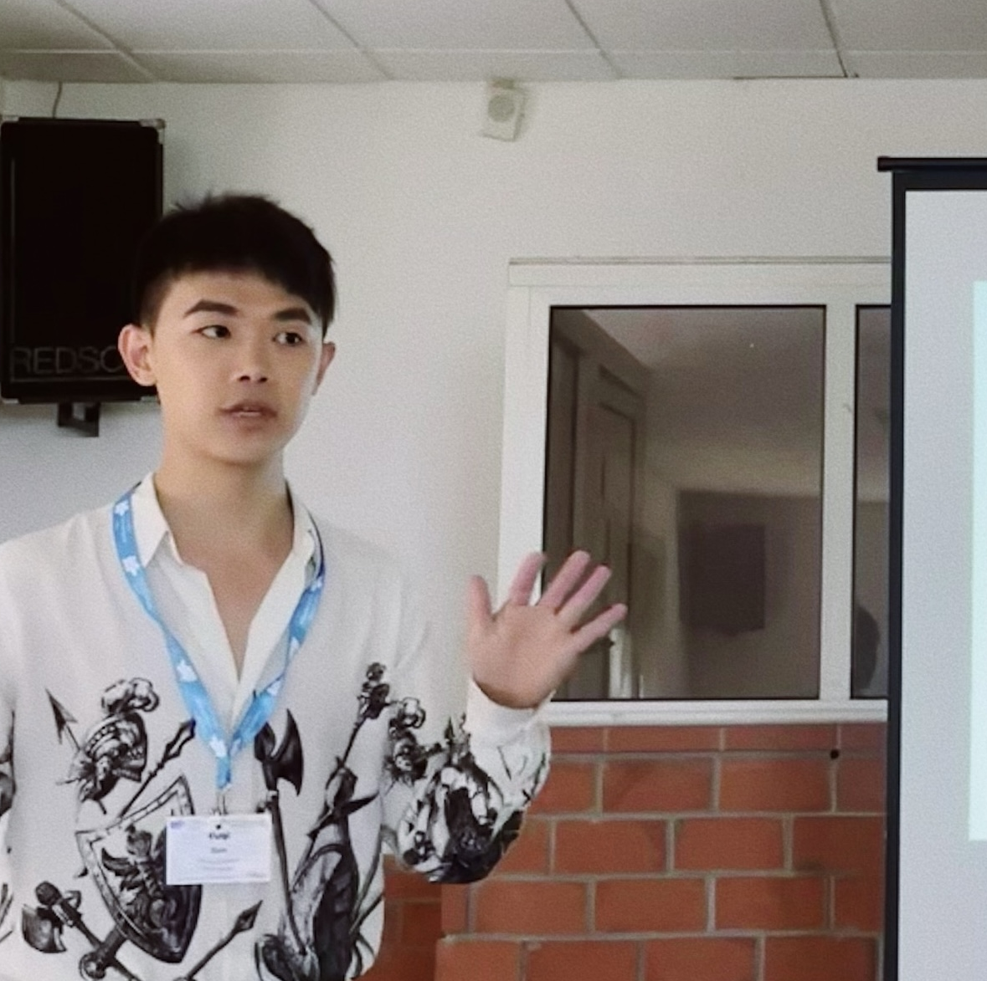


Colour it green: How and Why Green PRODUCT Choices Affect Preferences for Delivery Speed
Presentation at polyu
April 2026
Yuqi Guo, Tilburg University
Jen Park, The University of British Columbia
David J. Hardisty, The University of British Columbia
Notes:
New title!
Maybe: go fast or go green
Maybe about the process?
Activating sustainability considerations?
Don’t say it is about self-perception, it is not just self-perception...
Being green again is not even coming to my mind? When consistency and when licensing… implementation intention?
An explanation of the effect?
Small companies -> benefit from being green
A company who cant afford shipping
Price-sensitivity: ruled out by conjoint study.
Online groceries: and back to Qualtrics to ask the question…

Slide 2
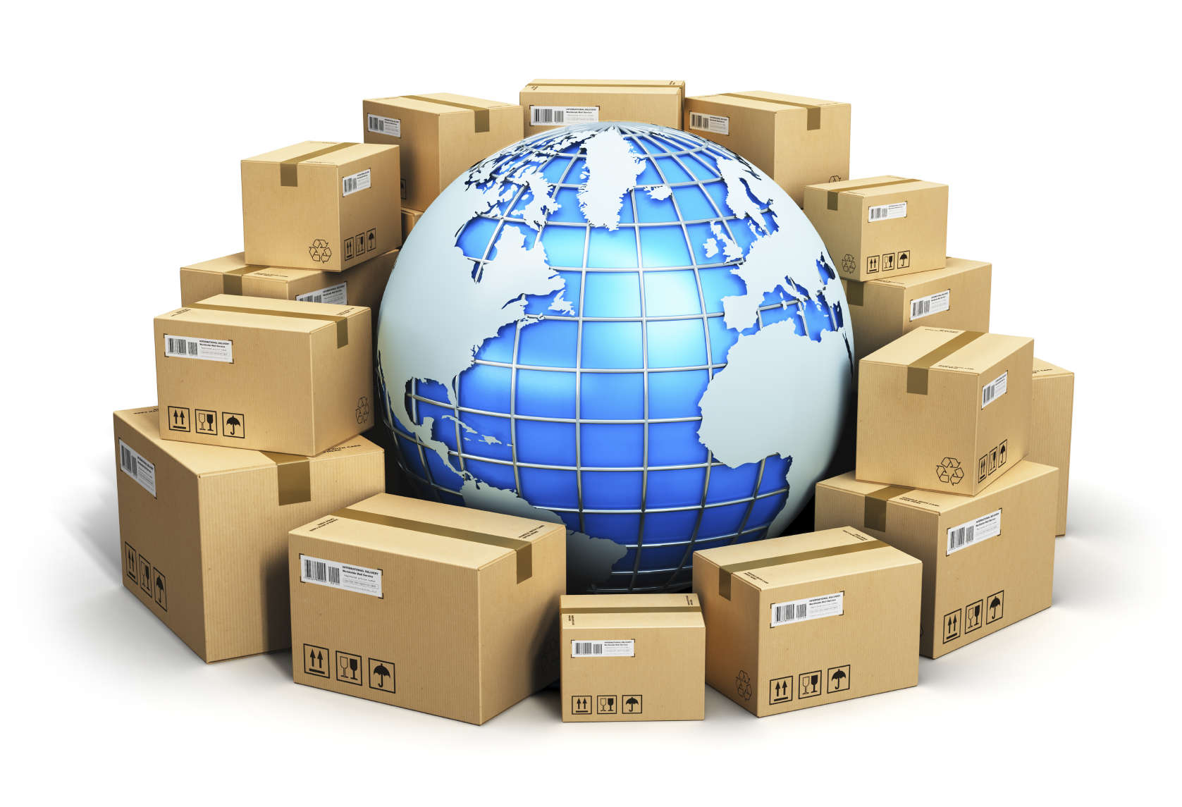
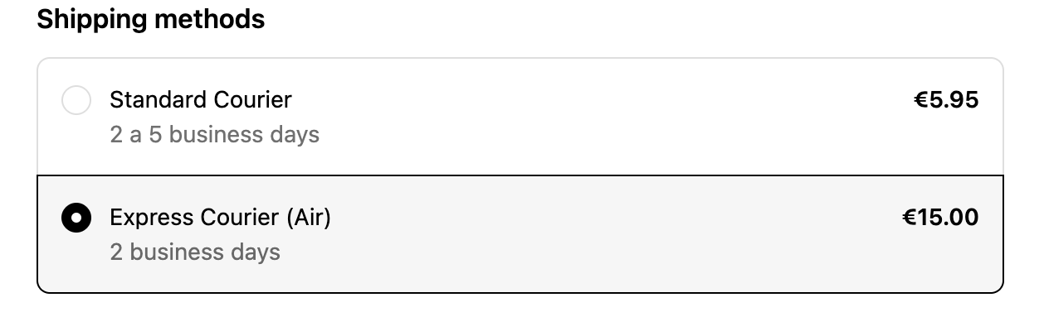
338 billion packages, one question: how fast?
Introduction
Most online checkouts ask:
“How fast do you want it?”
338B packages
shipped globally in 2022
Captialoneshopping 2024
Notes:
I probably don’t have to tell you that online shopping is getting more and more prevalent. But lets see some statistics. In 2022 alone, there were 338 billion packages shipped worldwide.
Another decision that is almost as common as choosing a product is choosing how fast you want a product to arrive. Do you want it to arrive faster, or are you ok to wait a little bit.

Slide 3
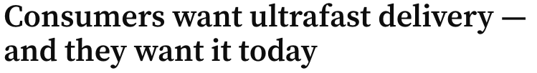
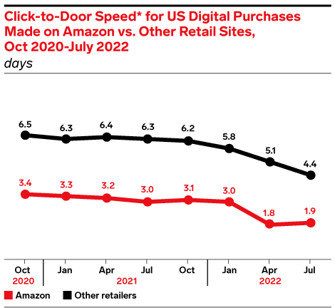
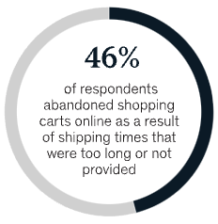
The rise of ultrafast delivery
Introduction
Faster delivery comes at many costs
McKinsey & Company 2021; Insider intelligence 2022; SupplyChainDive 2023
Notes:
another trend in the online shopping industry is that consumers really want ultrafast delivery.
In fact, in a survey, 46% of consumers say that they will abandon the cart if the shipping times are too long or not provided.
Probably as a response to these rising expectations, retailers are trying to reducing the delivery time, both for amazon and other smaller retailers.
but as we can all imagine, faster delivery comes at many costs.
https://www.mckinsey.com/industries/retail/our-insights/retails-need-for-speed-unlocking-value-in-omnichannel-delivery
https://www.supplychaindive.com/spons/consumers-want-ultrafast-delivery-and-they-want-it-today/646011/
Our analysis suggests that in most countries, same-day accounts for less than 5 percent of the courier, express, and parcel (CEP) market.
https://ecommercedb.com/insights/ecommerce-delivery-expectations-2023-speed-beats-price/4635

Slide 4
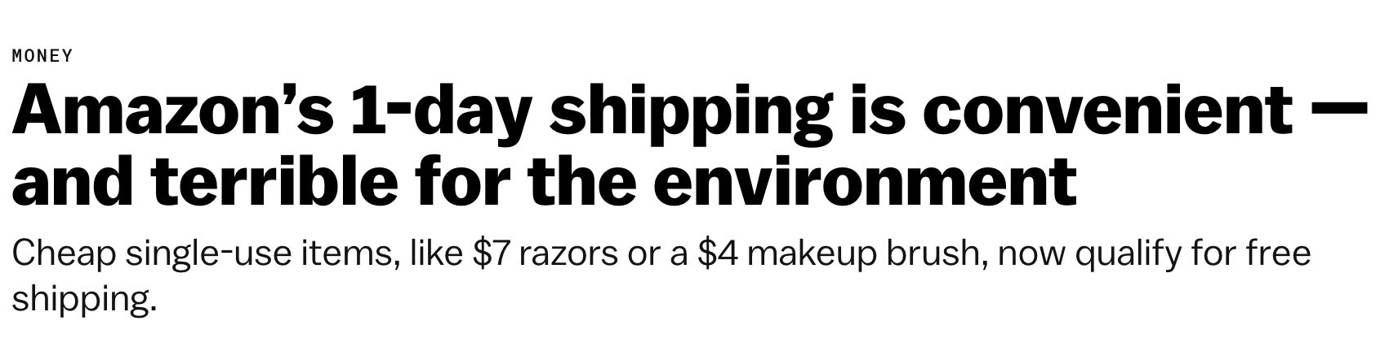
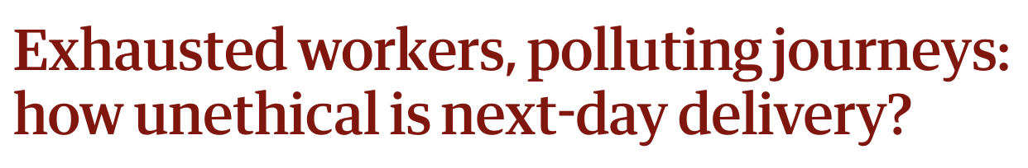

The environmental cost of faster delivery
Introduction
Up to 35 times more CO₂
🟢 Extending delivery from same-day to 4-day delivery:
↓ 39% CO₂ emissions on average
↓ up to 56% in some cases
Why should businesses also care about it?
CNN 2019; Munoz-Villamizar et al. 2022, 2024; Quinton 2021; The Guardian 2022; Vox 2019
Notes:
Let's first talk about the environmental costs. a lot of media outlets are already picking up on this. and they are saying things like: amazon's 1-day delivery is convenient but terrible for the environment.
Just to give you an example, a recent research found if we can extend the delivery time from same-day to four-days. we can reduce 39% of carbon emssisons on average.
in some cases, it can be as dramatic as 56%.
however, you might ask, but why should business also care about this?
well, because there are also financial costs.
next-day delivery can create up to 35 times more carbon dioxide than slower shipping options (CNN 2019)
🚚 Fast shipping increases “last mile” delivery
📦 It reduces efficiency: fewer packages per trip, more trips overall
Recent studies indicate that extending the delivery window to four days instead of opting for same-day delivery led to an average decrease of 39% in CO2 emissions (Munoz-Villamizar et al. 2024), with some cases showing a reduction as high as 56% (Munoz-Villamizar et al., 2022).
In a nutshell, the new analysis suggests that extending the shipping period allows the companies to use the most efficient and environmentally friendly ways of delivering the goods. Options such as next-day delivery forces companies to send out trucks which aren’t at full capacity,
Jaller said in most cases, the faster we want our packages delivered, the more impact our orders have on the environment. Fast shipping increases what’s called “last mile” travel, getting a package delivered that last mile to your doorstep. He said shipping loses efficiency when you cannot combine as many orders as possible on the same truck. Jaller compared it to mass transit.
Research indicates that fast shipping substantially increases CO2 emissions due to challenges
in consolidating cargo, resulting in a 15% increase in total CO2 emissions and a 68% surge
in costs (Munoz-Villamizar et al. 2021).
The demand for last-mile delivery is projected to rise
by 78% by 2030, leading to a predicted increase of over 30% in emissions in major cities globally
(Deloison et al. 2020).
Last-mile operations not only have a significant impact on the growth of
carbon emissions, but they also make up approximately 41% of the total supply chain costs (Jacobs
et al. 2019).

Slide 5
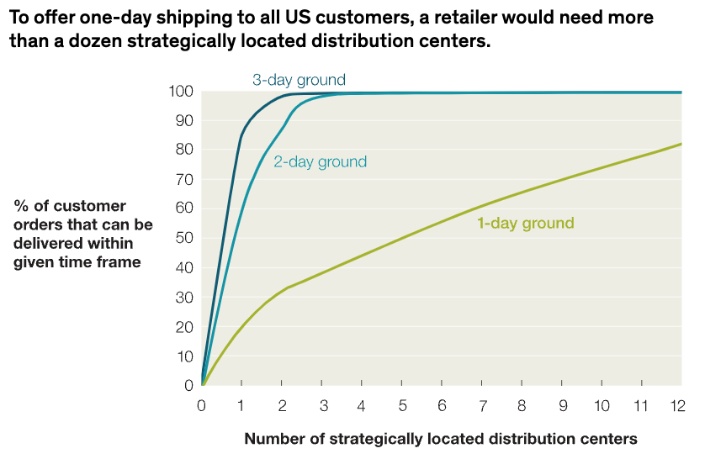
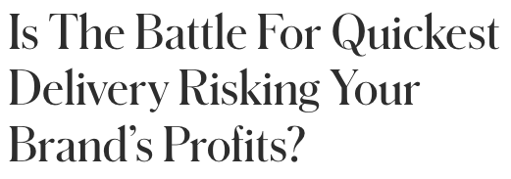
Is faster delivery the best practice?
The many costs of faster delivery
Next- or same-day parcel delivery can cost retailers more than $15 per package
1 center
5 centers
“We can be in that three to five day click-to-deliver timeline,” said Laura Ritchey, COO at e-commerce fulfillment provider Radial. “It gets really expensive to go faster than that.”
Forbes 2023; McKinsey & Company 2013, 2021; SupplyChainDive 2023
Notes:
In fact, next or same day delivery can cost retailers more than $15 per package.
One of the many reasons that it costs so much is because they need to build many distribution centers. As you can see from this graph, as an illustration, to make sure 50% of orders can be delivered within 1 day, you will need to build approximately 5 distribution centersc. but you will only need 1 center to reach 3 day delivery. And of course, additional centers require initial investments and ongoing operational costs.
As we can all imagine, such short delivery time is probably extremely costly. In fact, for smaller retailers, … can cost more than $15.
One of the many reasons that it costs so much is because they need to build many distribution centers. As you can see from this graph, as an illustration, to make sure 50% of orders can be delivered within 1 day, you will need to build approximately 5 distribution centers. but you will only need 1 center to reach 2 or 3 day delivery. And of course, additional centers require investment and additional costs.
Additionally, multiple distribution centers mean that inventory will be more segregated, which will entail higher risk. An expert from a logistic techonology company basically suggests that…
And this, ofc, will be additional costs for companies.
But perhaps more importantly, this is simply not feasible for smaller firms.
Building at-scale distribution centers is a costly pursuit. Few retailers are large enough to build same-day networks
Among others, e-commerce businesses have made substantial investments in distribution centers over the years to reduce delivery times (A.T. Kearney, 2016).
Retailers have been pushing for years to better compete with the delivery speeds offered by Amazon’s massive warehouse network
https://www.supplychaindive.com/news/faster-last-mile-delivery-speeds-project44/652165/
https://www.supplychaindive.com/spons/consumers-want-ultrafast-delivery-and-they-want-it-today/646011/
Our analysis suggests that in most countries, same-day accounts for less than 5 percent of the courier, express, and parcel (CEP) market.
https://ecommercedb.com/insights/ecommerce-delivery-expectations-2023-speed-beats-price/4635

Slide 6
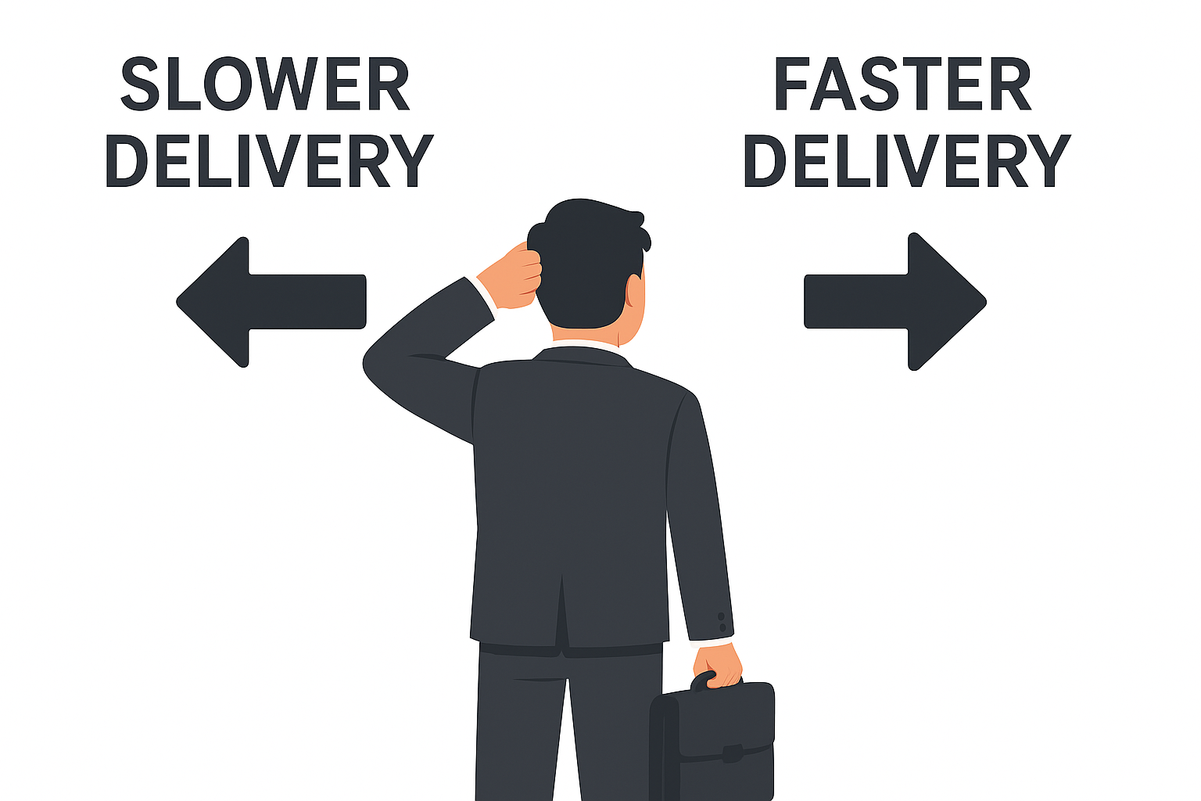
When are people more likely to choose slower delivery?
A demand-side approach
How can we encourage slower delivery choices?
Fewer orders
Huge environmental and financial costs
Smaller companies simply cannot afford to keep up
Very limited research on delivery speed decisions (for exceptions, see Kelting, Robinson, and Wood 2024; Velazquez Martinez et al. 2024)
Notes:
alright.
so this is a dilemma that many companies are facing. on the one hand, if they opt for slower delivery, they will get fewer orders.
on the other hand, if they go for faster delivery, it comes with huge environmental and financial costs. and more importantly, smaller companies simply cant afford to keep up.
so a natural question that we are asking in this research is: how can we encourage slower delivery choices?
and surprisingly, if we look at the literature, only very limited research has looked at the delivery speed decisions.
Increasing prevalence of green attributes
In 2023, more than 1.4 million products with the Climate Pledge Friendly certificate on Amazon, a 157% increase from 2022
Nearly 1.2 billion certified items sold, a 42% increase from 2022
So far I have shown you that: delivery time matters.
Delivery time matters to consumers. If you have a slow delivery time, you might not even be in the consideration set. This is a particular challenge for smaller businesses who struggle to reduce delivery time due to a multitude of reasons as I showed you before.
Since the race to faster delivery time is aimed at meeting consumer expectations, because they are getting increasingly impatient, we want to take a more consumer lens to address this challenge.
Slow delivery time = no orders; -> a challenge for smaller businesses that might struggle to increase delivery time.
Since the race to faster delivery time is aimed at meeting consumer expectations, because they are getting increasingly impatient, we want to take a more consumer lens to address this challenge.
In particular, we look at how attribute type (sustainable vs. conventional) affects consumer patience and whether sustainable attributes can increase consumer patience.
Maybe more something about the practical relevance of these attributes. These attributes are also becoming more and more prevalent.
For instance, In 2023, more than 1.4 million products with the Climate Pledge Friendly certificate on Amazon, a 157% increase from 2022
Nearly 1.2 billion certified items sold, a 42% increase from 2022

Slide 7
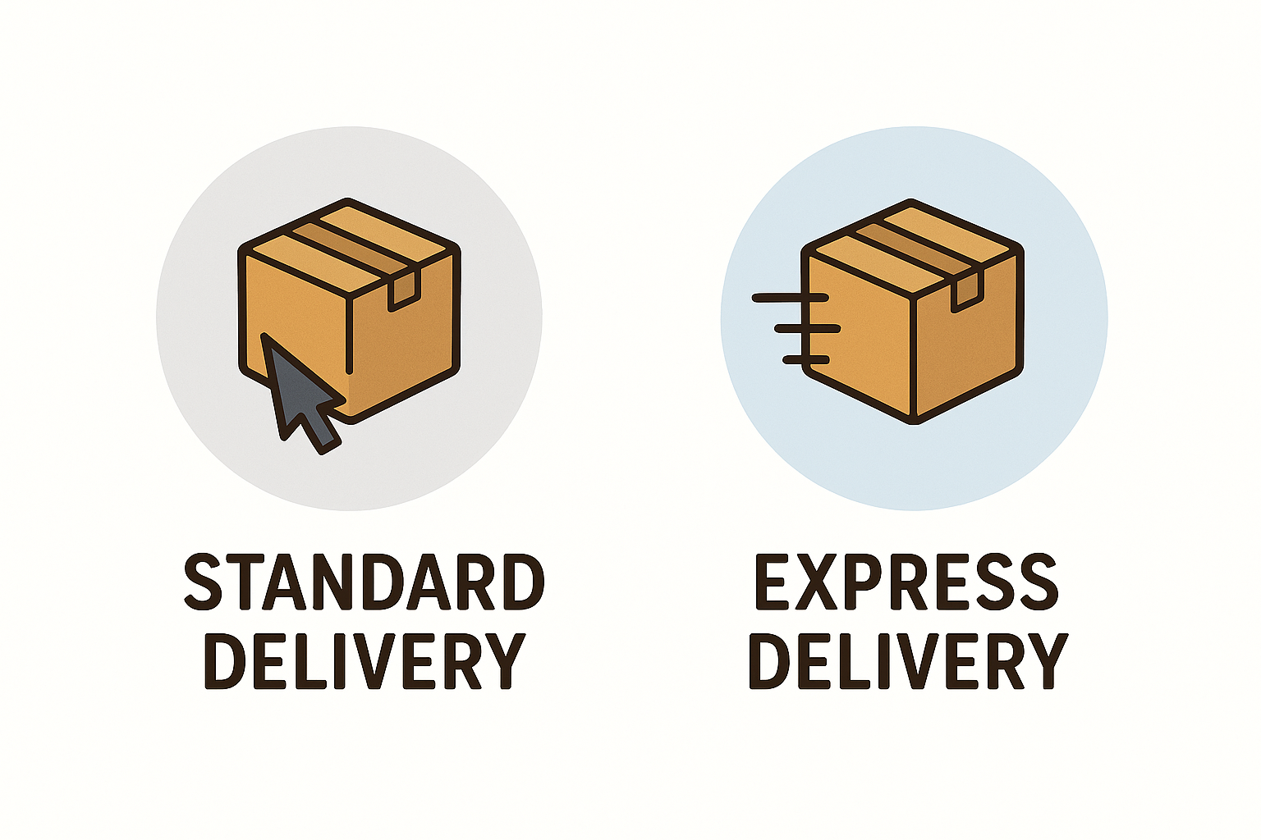

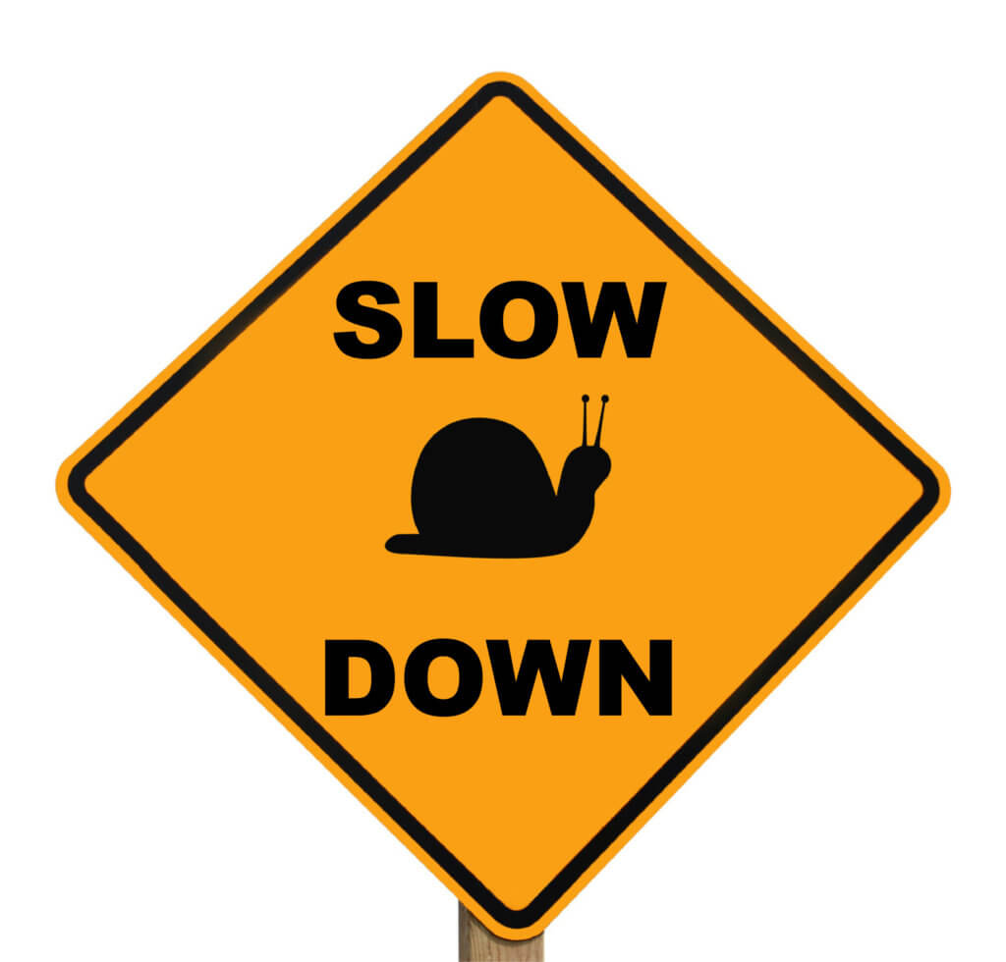

A novel pathway through green consumption
Introduction
Buying a green (vs. conventional) product
H1: Buying a green product increases preferences for slower delivery
Effron 2012; Monin and Miller 2001; Mullen and Monin 2016
Notes:
in this project, we offer a novel pathway through green consumption.
Specifically, we show that buying a green product reduces preferences for faster delivery.
So, what we are studying here is essentially a sequential moral behavior paradigm. So, does moral behavior 1 (buying a green product) lead to higher uptake of moral behavior 2 (delivery speed choice)?

Slide 8
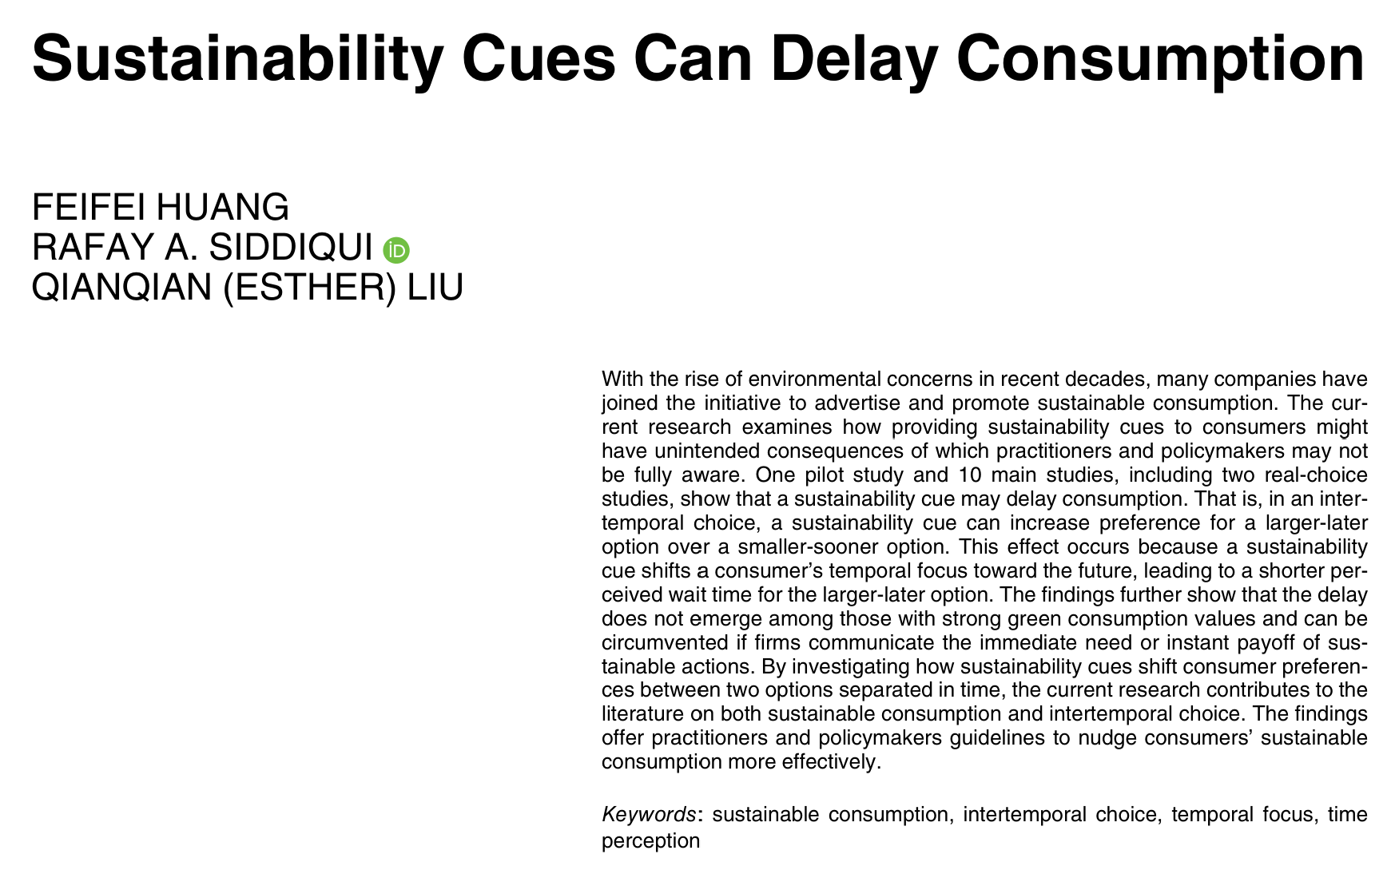
Great minds think alike!
Introduction
Huang, F., Siddiqui, R. A., & Liu, Q. (in press). Sustainability Cues Can Delay Consumption. Journal of Consumer Research, ucaf050.

Slide 9
A sequential moral behavior paradigm (SMB)
Introduction
moral behavior 1
moral behavior 2
Does moral behavior 1 lead to higher uptake of moral behavior 2?
Effron 2012; Monin and Miller 2001; Mullen and Monin 2016
Notes:
in this project, we offer a novel pathway through green consumption.
Specifically, we show that buying a green product reduces preferences for faster delivery.
So, what we are studying here is essentially a sequential moral behavior paradigm. So, does moral behavior 1 (buying a green product) lead to higher uptake of moral behavior 2 (delivery speed choice)?

Slide 10
A sequential moral behavior paradigm (SMB)
Introduction
Prior research (see these articles for reviews: Ferguson et al. 2024; Maki et al. 2019; Truelove et al. 2014) has largely attributed moral consistency effects to self perception theory (Bem 1967):
  People look to their behavior to infer their self-concept (Bem 1972) and strive to maintain consistency across behaviors and beliefs (Festinger and Carlsmith 1959).
  “I made a sustainable choice, therefore I am the kind of person who cares about sustainability.”
  ”Since I am a sustainable person, I might as well choose a more sustainable delivery option.”
Assumption of self perception account:
The subsequent behavior (e.g., delivery choice) must be readily construed as moral; without this, it cannot provide a meaningful basis for self-inference or behavioral consistency.

Slide 11
A sequential moral behavior paradigm (SMB)
Introduction
moral (?) behavior 2
Except…Do people naturally think of delivery speed as a moral decision?

Slide 12
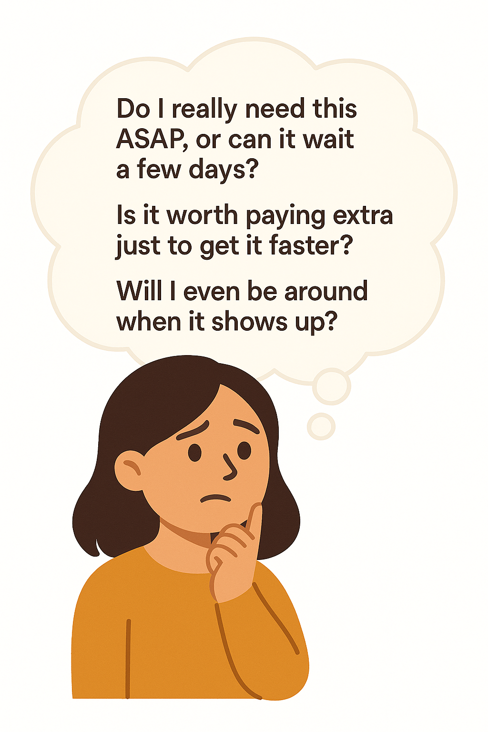
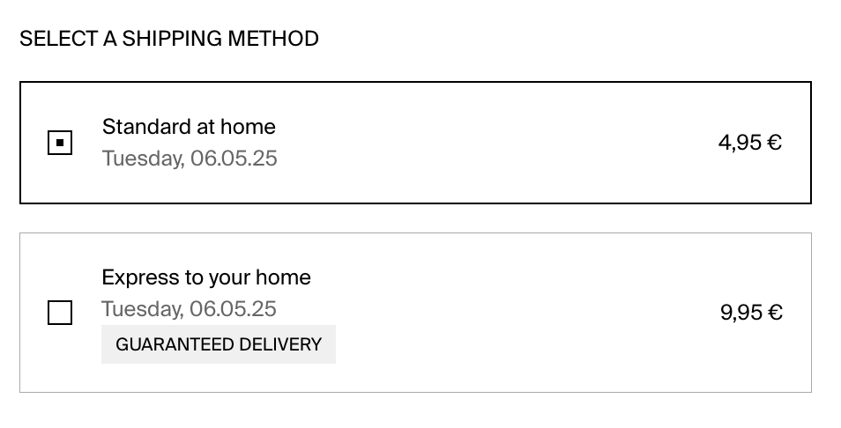
Typical considerations when choosing shipping option
Buying a conventional product online…
Pilot study: 0 participants mentioned environmental considerations when explaining their delivery choice
Delivery choice is not readily viewed as moral
Wednesday, June 25
Monday, June 23
Notes:
Lets think about the typical considerations that we have when choosing shipping options.
We are probably thinking about do I need this ASAP? Is it worth it to pay extra to get it sooner?
In our pilot study, 0 people mentioned environmental considerations when explaining their delivery choice for a conventional product.
This suggests that delivery speed decision is not readily construed as moral.

Slide 13
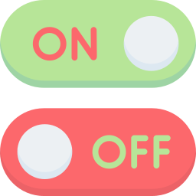
How green purchase activates the consideration
Buying a green product…
More sustainable choice
Wednesday, June 25
Monday, June 23
Less sustainable choice
Buying a green product
Activation of environmental consideration
Consider the environmental impact of different shipping options
A non-sustainability decision gains a sustainability dimension (moralization)
People become more willing to choose the slower option
Hedberg and Higgins 2011; Kahneman and Frederick 2002
Notes:
So, in essence, what we are proposing here is that, when people are buying a green product, it activates environmental consideration like a psychological switch. Because of this, a non-sustainability decision gains a sustainability dimension.
They will realize that: well actually, delivery speed choices might also have an environmental impact. and they will be more willing to choose the slower option because they assume that the slower option is more sustainable.

Slide 14

Empirical package
Overview
THE ROLE OF PRODUCT TYPE
RULE OUT IMPATIENCE
SELF-PERCEPTION VS. ACTIVATION
1: With vs. without choice agency
2A: Implications for product choice in a choice-based conjoint
2B: Consequential choice in a self-developed webshop
3: Process by mediation
4: Moderation by framing the faster delivery
5: Moderation by activating environmental consideration
6A: Same product, delivery delivery options (1)
6B: Same product, delivery delivery options (2)
WA1: Main effect replication
WA2: Additional mediation study
Pilot study: thought listing
Data files, syntax files, and study preregistrations are available at https://osf.io/szk8p/?view_only=962262a064f7410f9b768e1c0d3d0e97
Notes:
We investigate this across a series of 9 studies, all of these studies are preregistered.

Slide 15
Study 1: With vs. without choice agency
Overview
400 Prolific US participants
2 (product type: green vs. conventional) x 2 (choice agency: choice vs. assigned) between-subjects design
Demonstrate the basic effect that green product choice leads to preference for slower delivery
Examine whether this effect depends on choice agency (consistent with self-perception theory)
Provide process evidence for the moralization account

Slide 16
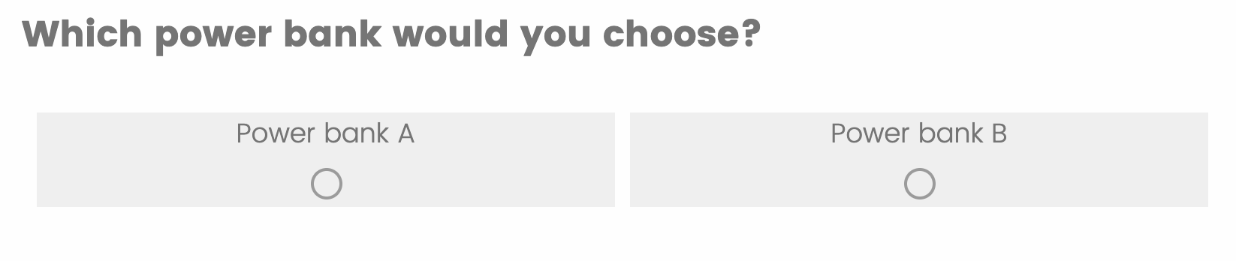
Study 1: With vs. without choice agency
Choice agency manipulation
Imagine that you participated in a consumer research study. As a thank-you for participating, you will receive a power bank as a reward.
Choice condition
Assigned condition
You can choose between the two options below. Please review the information about each product and select the one you would prefer to get.
In this study, participants are randomly assigned to one of two products (i.e., the assignment is not based on personal choice).
You have been assigned to the following product: Power Bank A.

Slide 17
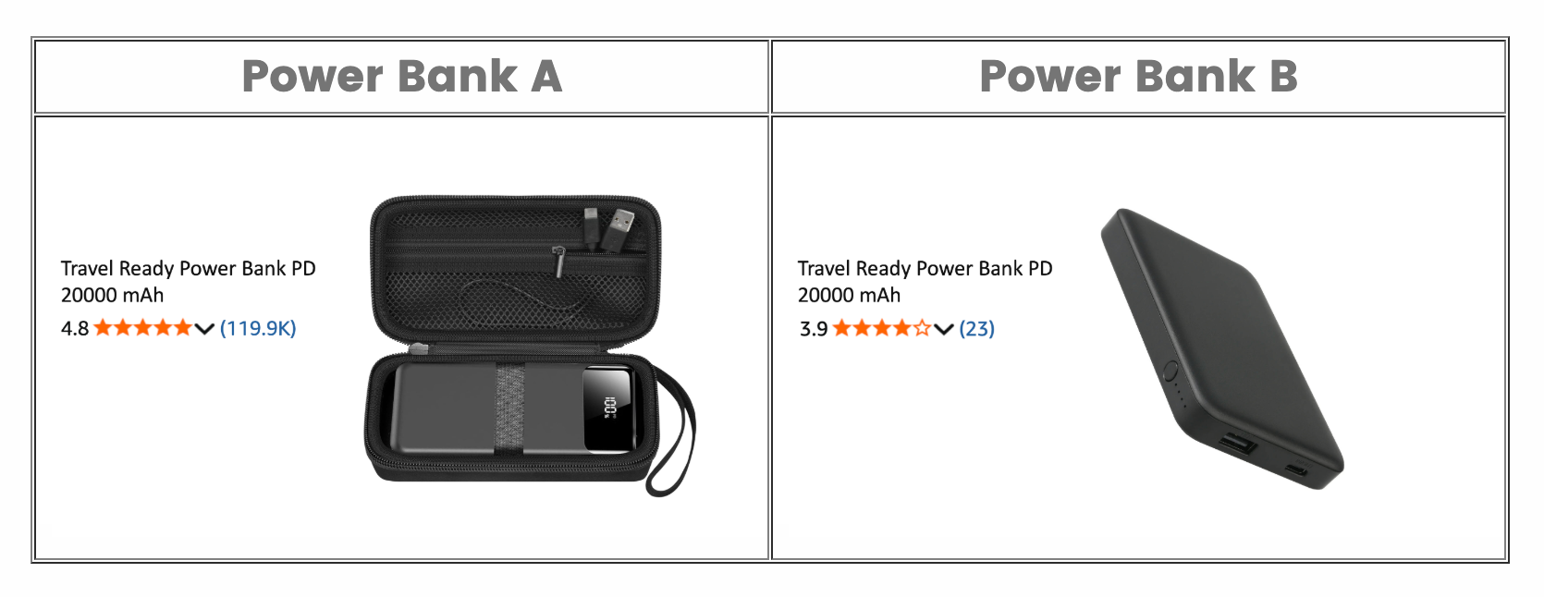
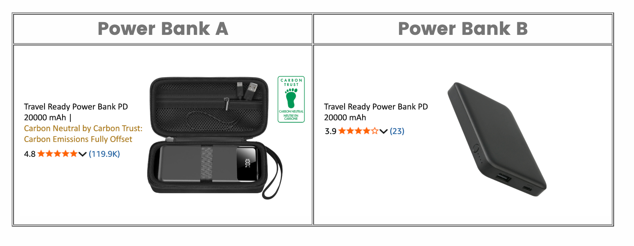
Study 1: With vs. without choice agency
Product type manipulation
Conventional condition
Green condition
Power bank A dominates power bank B (more reviews, higher ratings)
97.8% participants chose power bank A in the choice condition
Manipulate product type by adding an additional green attribute (carbon neutral)

Slide 18
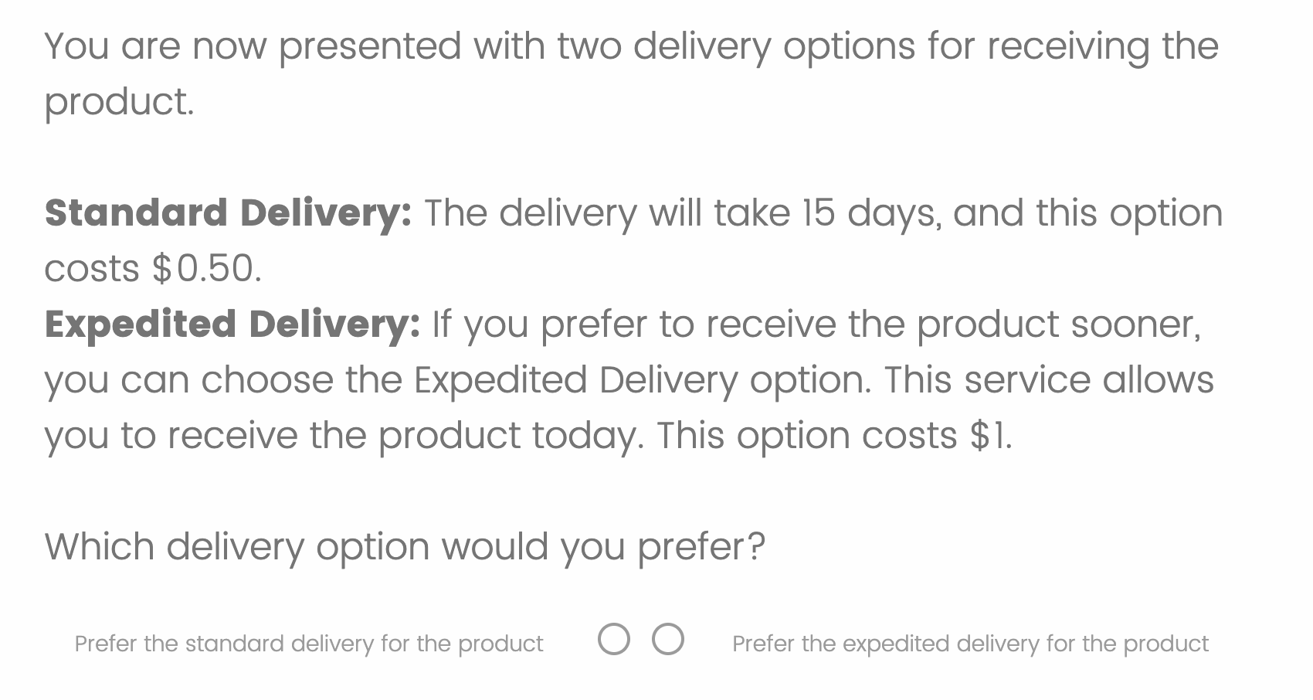
Study 1: With vs. without choice agency
DV measure
Delivery Choice DV
Standard shipping ($0.50, 15 days)
Expedited shipping
($1, same day)

Slide 19
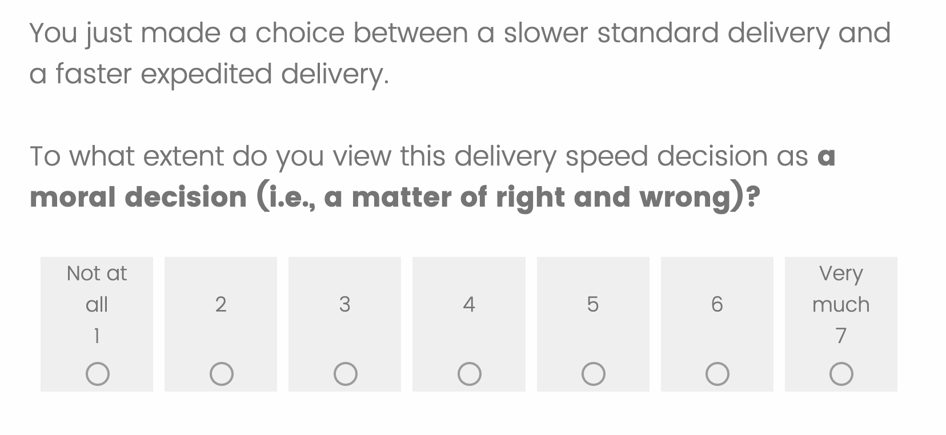
Study 1: With vs. without choice agency
Moralization (mediator) measure
Moralization (mediator) measure
Based on Feinberg et al. 2019

Slide 20
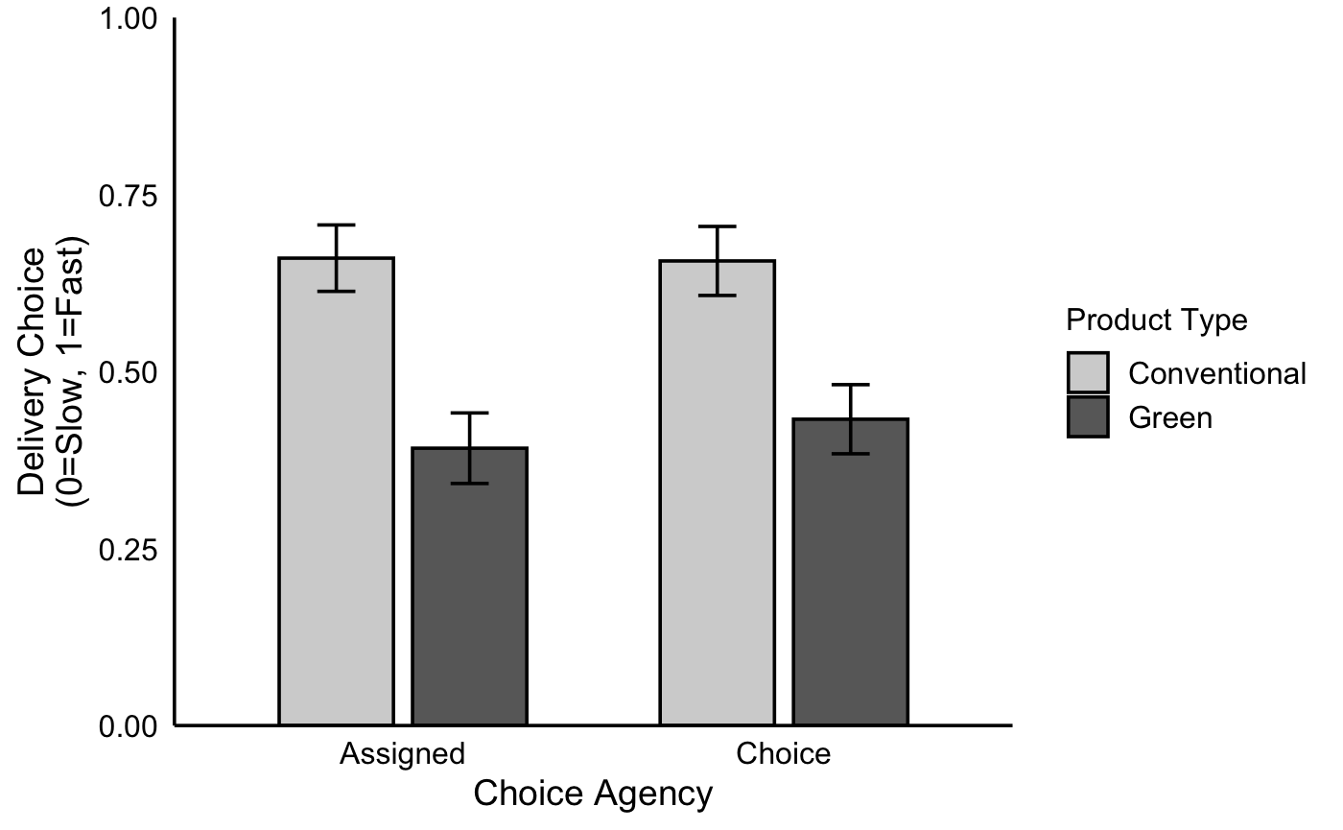
Study 1: With vs. without choice agency
Results
The effect of green products on delivery preferences does NOT depend on choice agency
Main effect of product type:
z = -3.753, p < .001
Main effect of choice agency:
z = -.059, p = .953
Interaction:
z = .450, p = .652

Slide 21
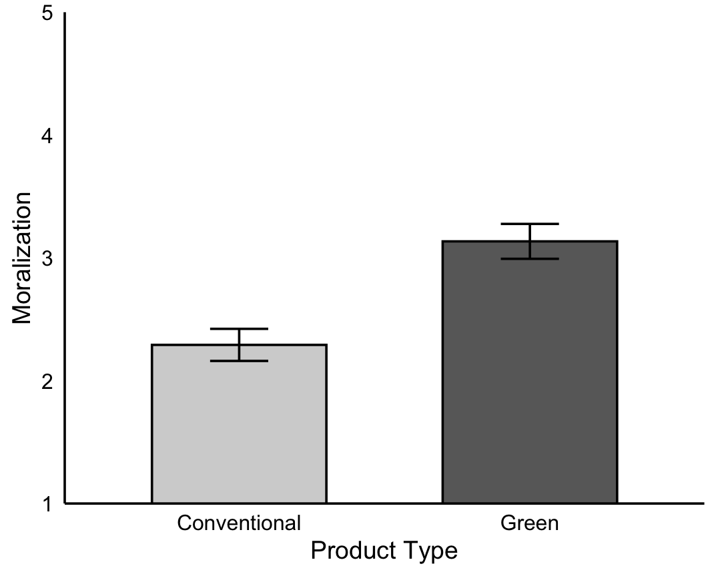
Study 1: With vs. without choice agency
Results
Participants in the green condition moralized the delivery choice more
We collapsed across the choice agency conditions for the mediation analysis.
Significant mediation through moralization (95% CI [-.06, -.01], p = .006)

Slide 22
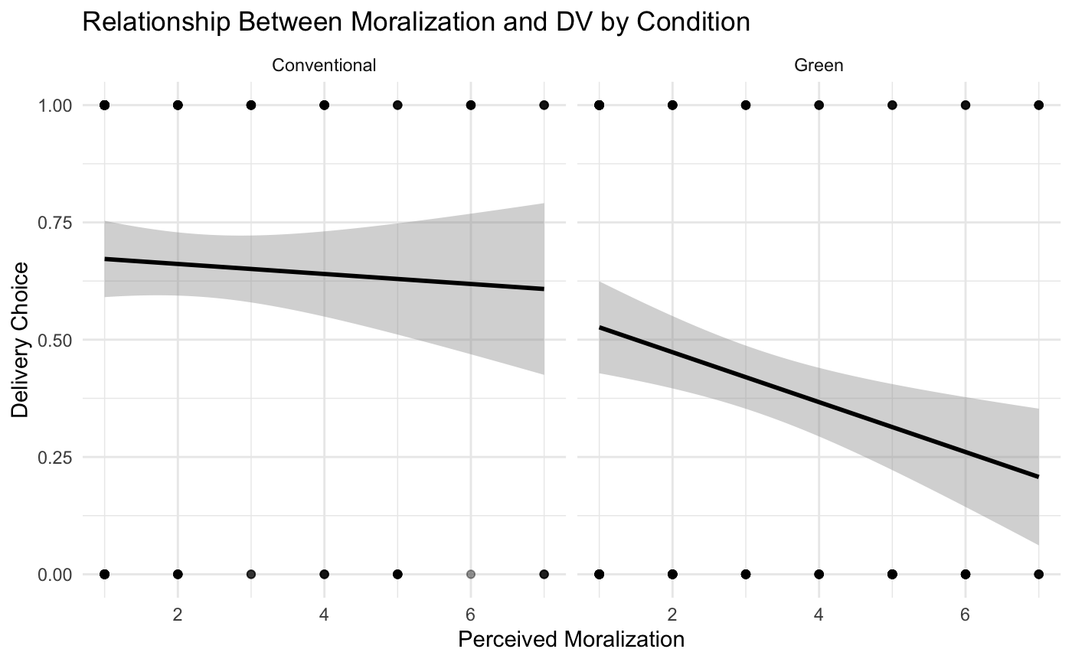
Study 1: With vs. without choice agency
Results
Conventional condition
Green condition
Moralization does not predict delivery choice for conventional products (p = .56).
For green products, however, greater moralization predicts a lower likelihood of choosing faster delivery (p = .002).
Receiving a green product can moralize delivery choice
r = -.041, p = .56
r = -0.217, p = .002

Slide 23
Study 1: Take-aways
Discussion
Receiving a green (vs. conventional) product decreases the choice share of faster delivery
This effect does not depend on whether the product was self-chosen or assigned
This effect is partially driven by increased moralization of the delivery decision

Slide 24
Study 2A: Utility of delivery time in choice-based conjoint
Overview
289 Cloud Research Connect US participants
2 cell (product type: green vs. conventional) between-subjects design
Choice implications in a choice-based conjoint experiment
Grounded in the fact that shipping time influences purchase decisions
Notes:
We used a choice-based conjoint to understand how choosing among green products versus conventional products affect the weight people place on delivery speed.
This study followed a 2-cell between-subjects design: people either choose among green prdoucts or conventional products.

Slide 25
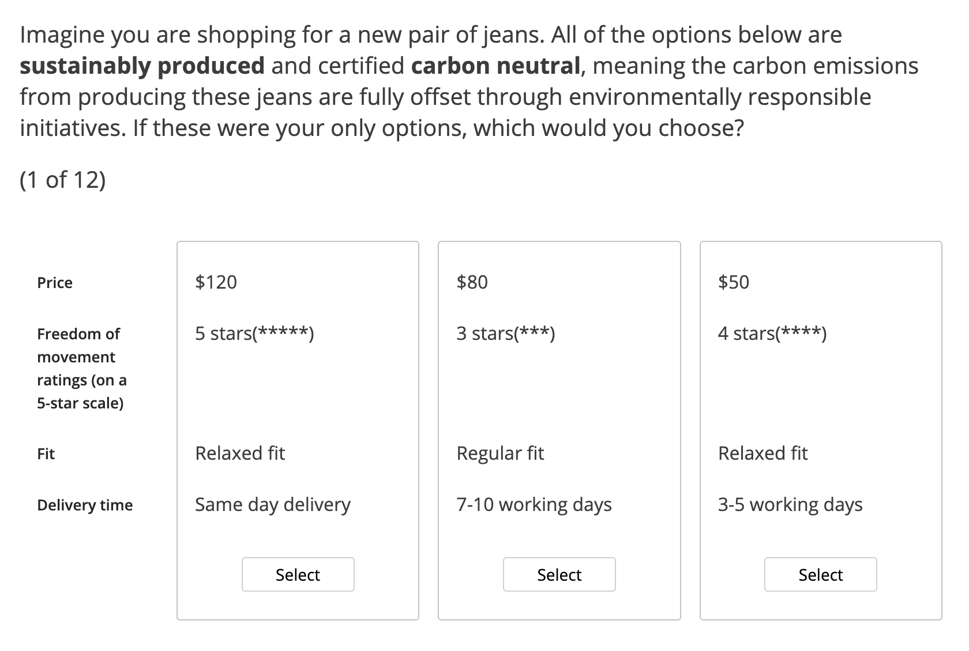
Study 2A: Utility of delivery time in choice-based conjoint
Design
Conventional condition
Green condition
12 choices in total
Our DV = individual part-worth utilities
Hierarchical bayes methods from sawtooth
Notes:
So in the conventional condition, people choose among 3 jeans differing in price, freedom of movement ratings, fit, and, most importantly, delivery time.
In the green condition, everything else is the same, but we tell people that these jeans are sustainabily produced.
They repeat these choices 12 times in total, and our dependent measure is the individual part-worth utilities of each attribute.

Slide 26
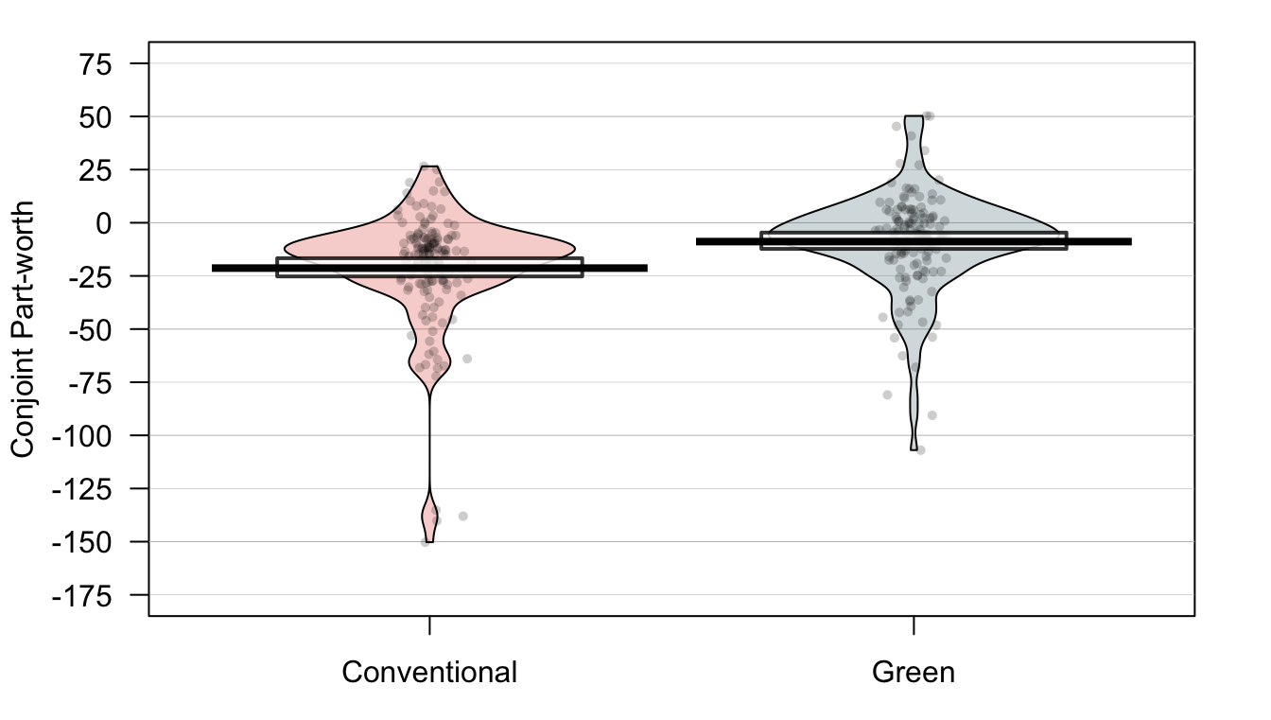
Study 2A: Utility of delivery time in choice-based conjoint
Results
Conjoint part-worth of delivery time is less negative in the green condition
 | Conventional | Green
Zero-centered utilities | M (SD) | M (SD) | t-Stat. | p-Value
Delivery time | -21.32 (27.68) | -8.86 (23.45) | -4.14 | < .001
Price | -78.80 (48.42) | -85.48 (50.56) | 1.15 | 0.252
Freedom of movement | 65.56 (44.86) | 75.06 (41.53) | -1.87 | 0.063
Regular fit | 0.50 (37.54) | -0.35 (30.28) | 0.21 | 0.833
-8.86
-21.32
t(283.15) = -4.14, p < .001
Welch Two Sample t-test results
Notes:
Now lets look at the results.
Here we see that the conjoint part-worth utilities are less negative in the green condition than in the conventional condition. meaning that they are more likely to choose a product with longer delivery time if the product is green.
Welch Two Sample t-test results: It adjusts the degrees of freedom using the Welch–Satterthwaite equation, making it more robust when variances are unequal.
• Condition 0 (Conventional):
• Mean Total Utility: -35.05
• Standard Deviation: 83.36
• Condition 1 (Green):
• Mean Total Utility: -18.94
• Standard Deviation: 83.64
Independent Samples t-Test:
• t-Statistic: -1.64
• p-Value: 0.102

Slide 27
Study 2A: Utility of delivery time in choice-based conjoint
Discussion
Longer delivery time has a less negative influence on decisions among green (vs. conventional) products
Green products are penalized less for offering slower delivery
WHAT about choosing between delivery options?
Notes:
Now in this study, we looked at the weight of delivery time in product choice. You might be wondering, ok what about when people already bought the product, and they have to choose the delivery method?

Slide 28
Study 2B: Delivery choice in a realistic online shop
Overview
397 Prolific US participants
2 cell (product type: green vs. conventional) between-subjects design
Making decisions in a realistic online store that we developed
A common (binary) choice between slower standard delivery and faster ($$) express delivery
Ostensibly consequential choice
Notes:
Well this is what we are doing in the next study.
So in this next study, we want to study delivery choice in a very realistic online shopping environment.
To do this, we actually developed two online stores where people can freely browse and choose their products.

Slide 29
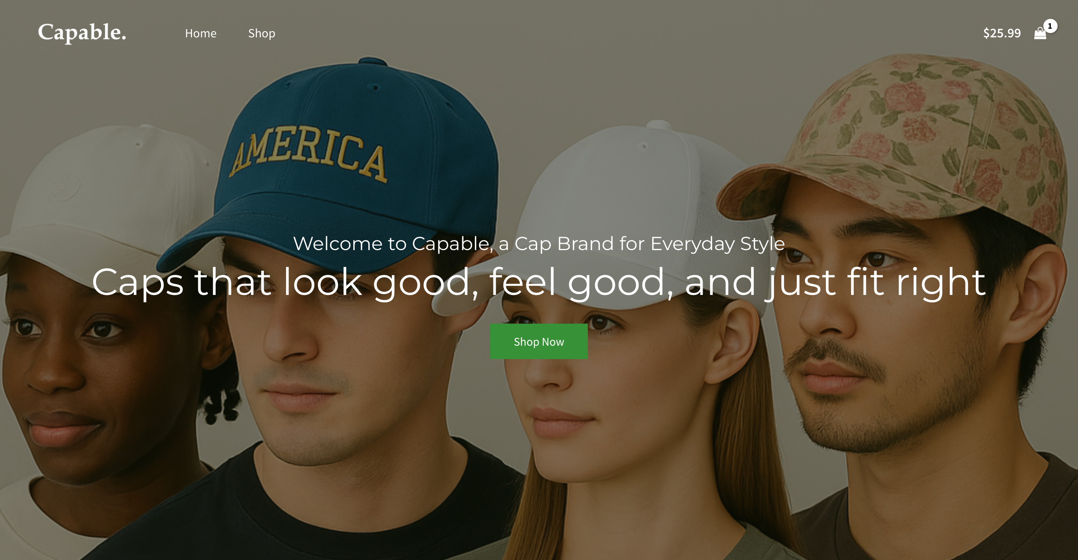
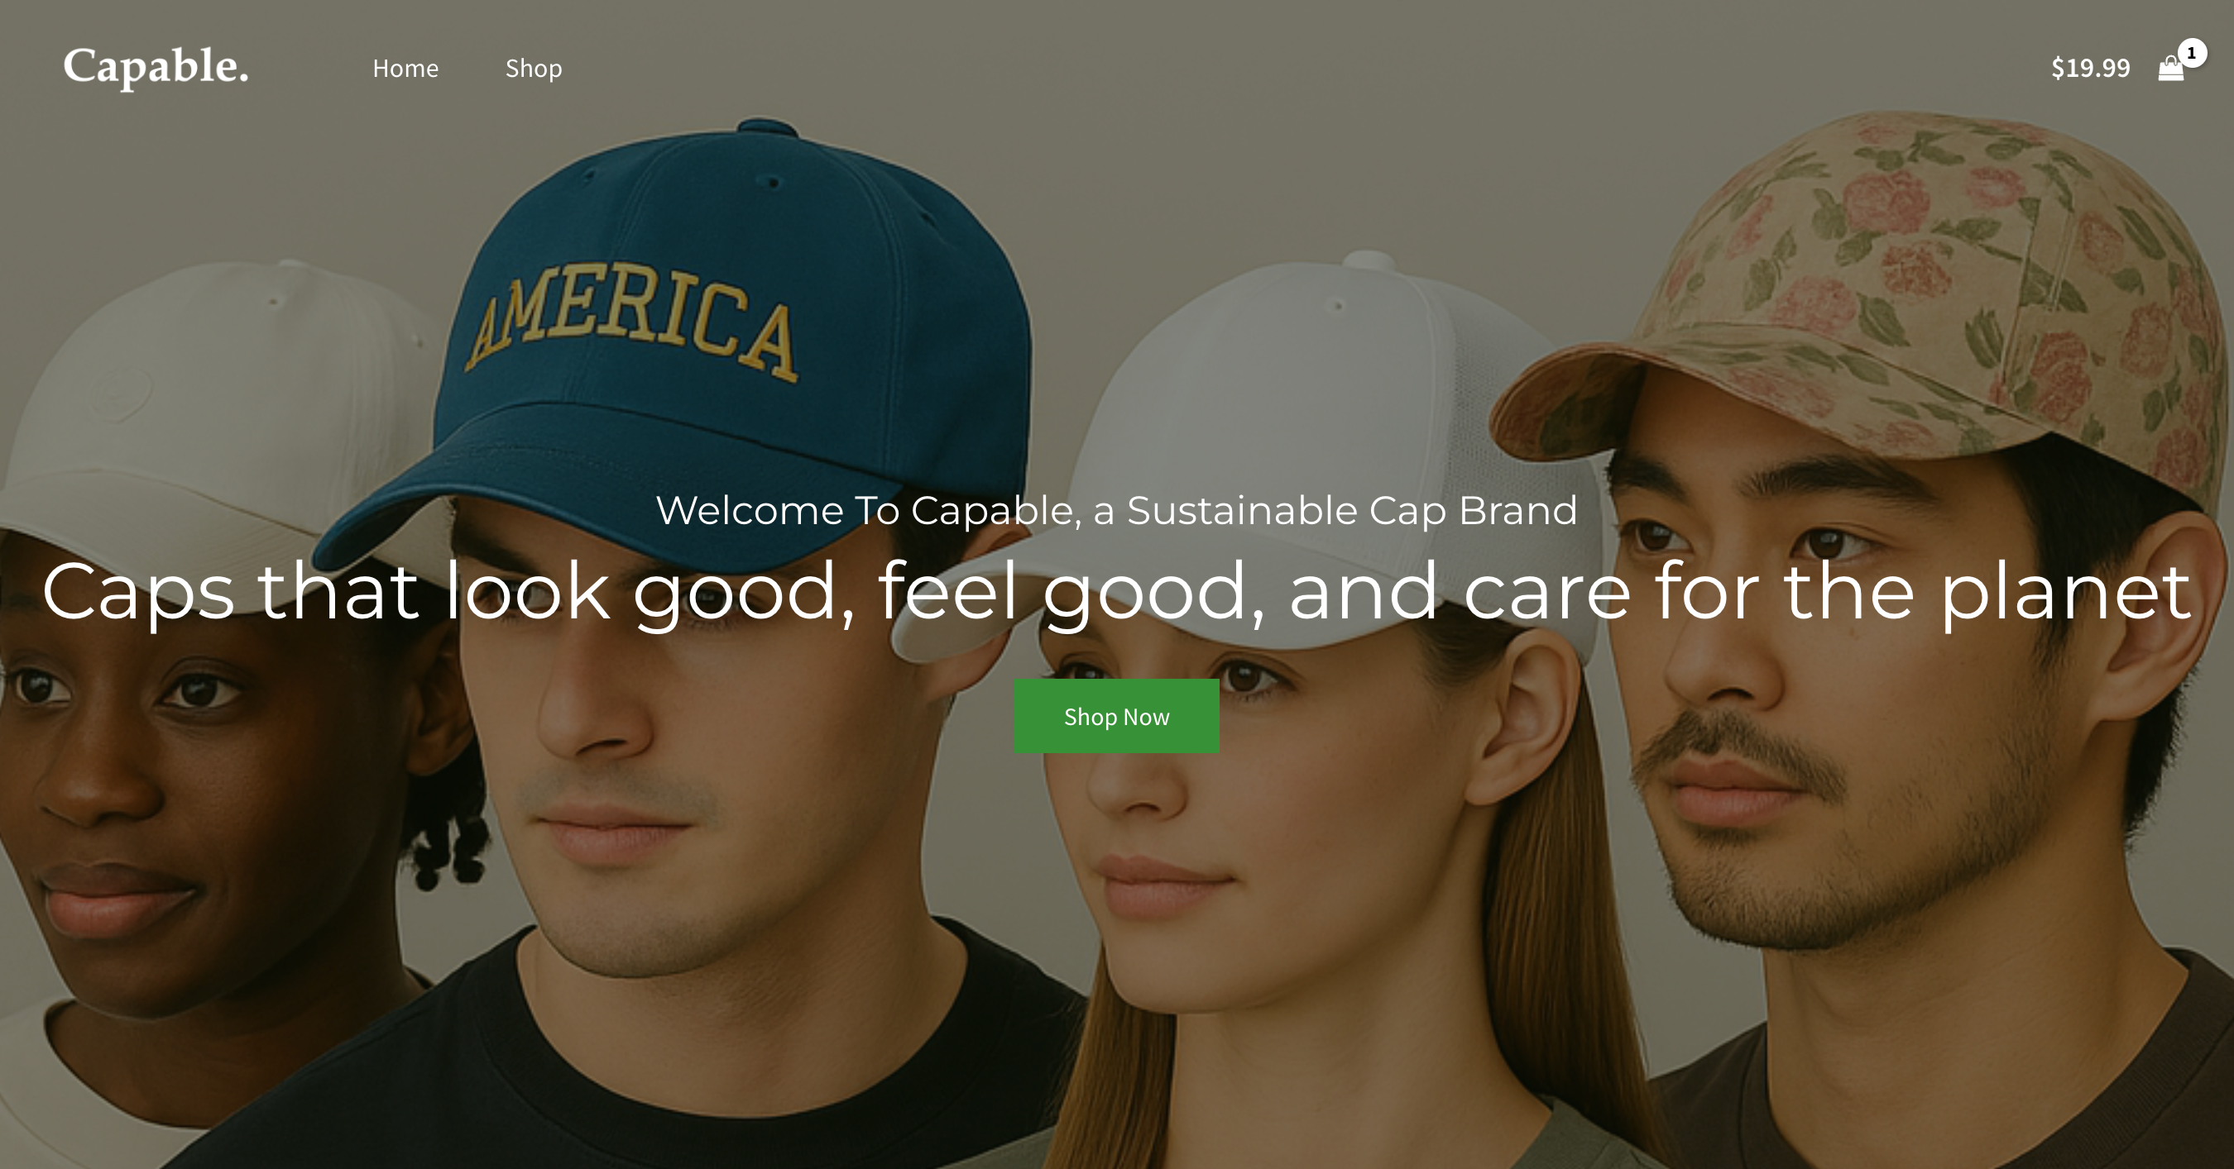
2 Webstores: landing page
Design
Conventional condition
Green condition
Notes:
Here, we developed two versions of stores, for the conventional condition and green condition. participants were randomly assigned to visit one of the online stores, and they see landing pages, brand story, and consumer reviews. So we are really try to simulate a realistic experience.

Slide 30
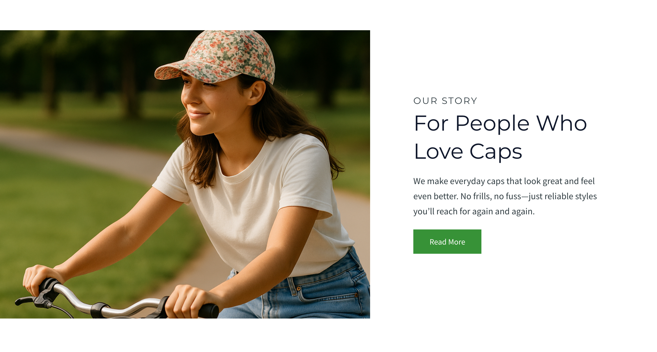
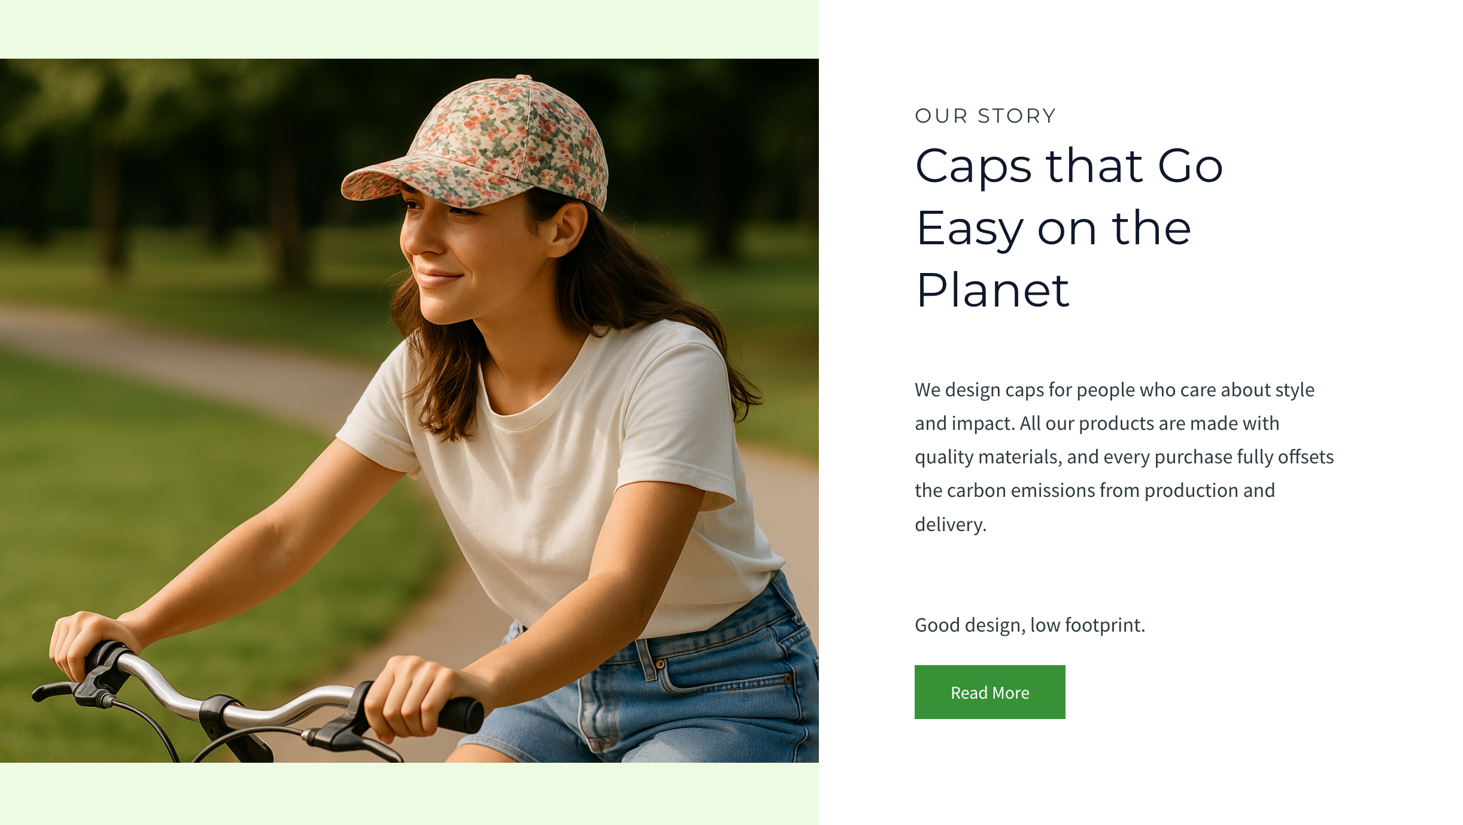
2 Webstores: landing page
Design
Conventional condition
Green condition

Slide 31
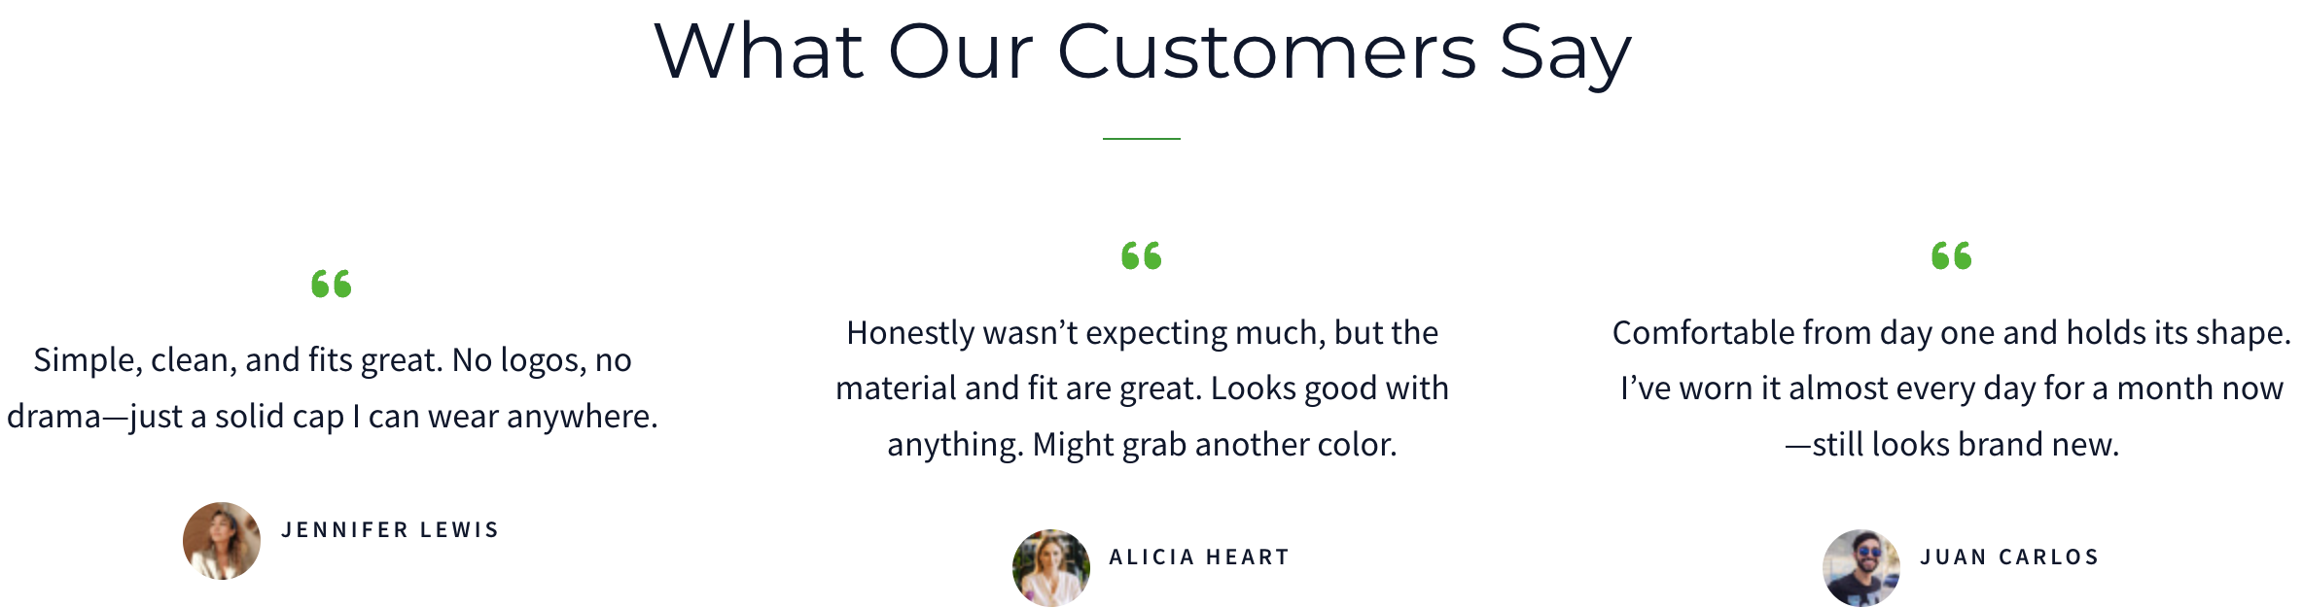
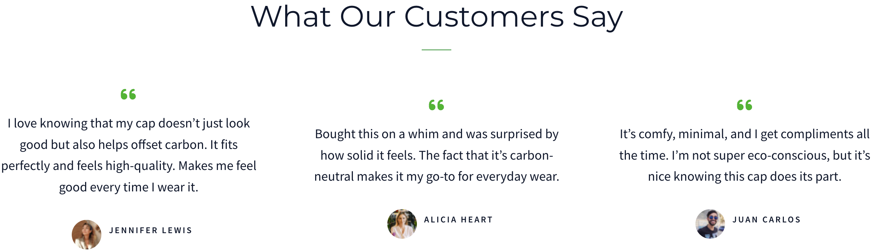
2 Webstores: landing page
Design
Conventional condition
Green condition

Slide 32
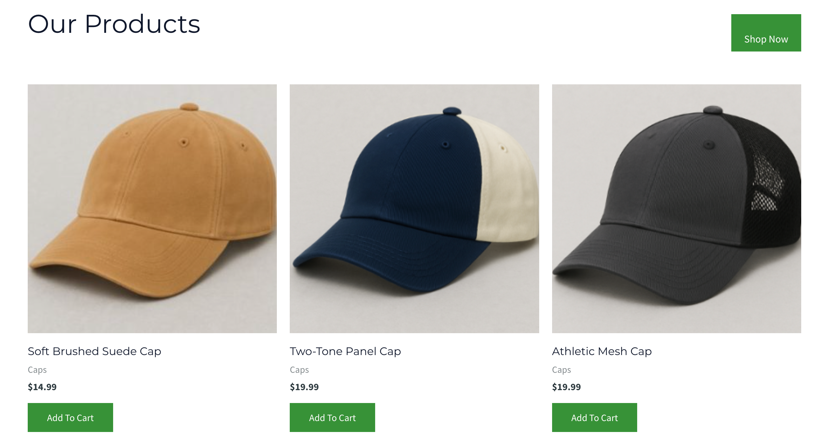
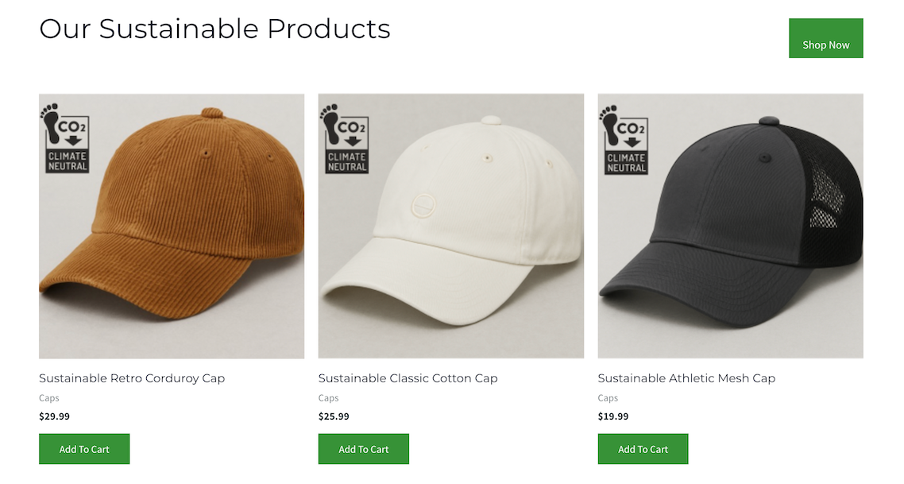
2 Webstores: shop page, 5 caps in total
Design
Conventional condition
Green condition

Slide 33
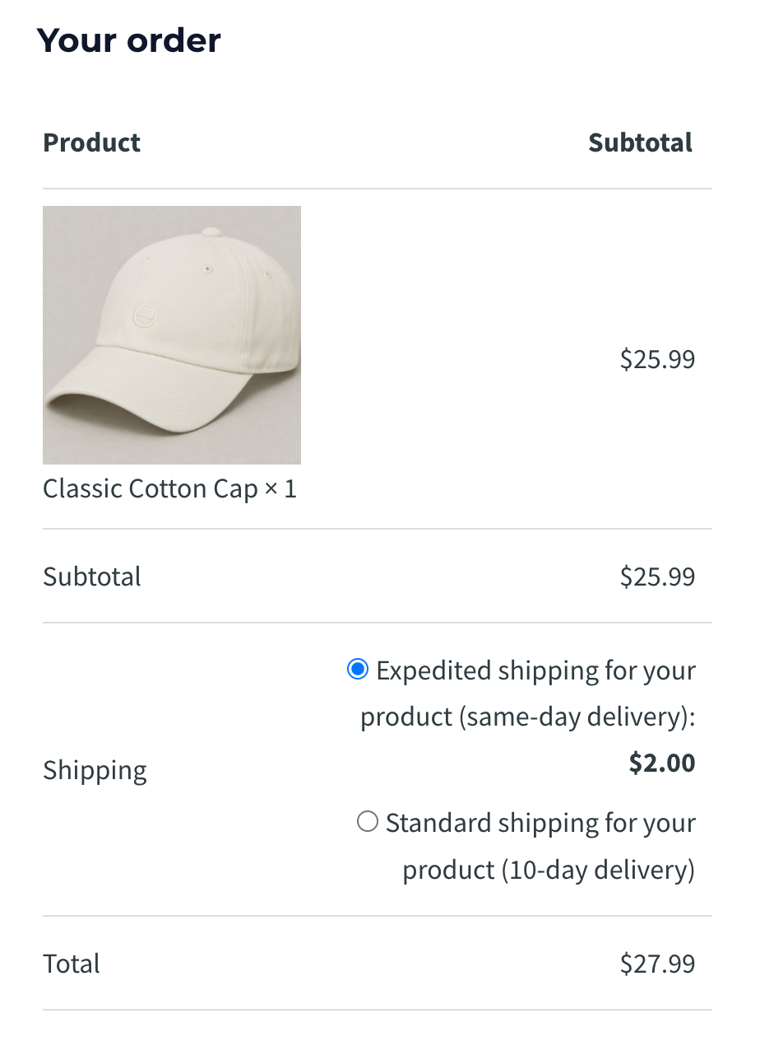
2 Webstores: checkout page and DV measure
Design
Expedited shipping
($2, same day)
Standard shipping (free, 10 days)
Coded as 1
Coded as 0

Slide 34
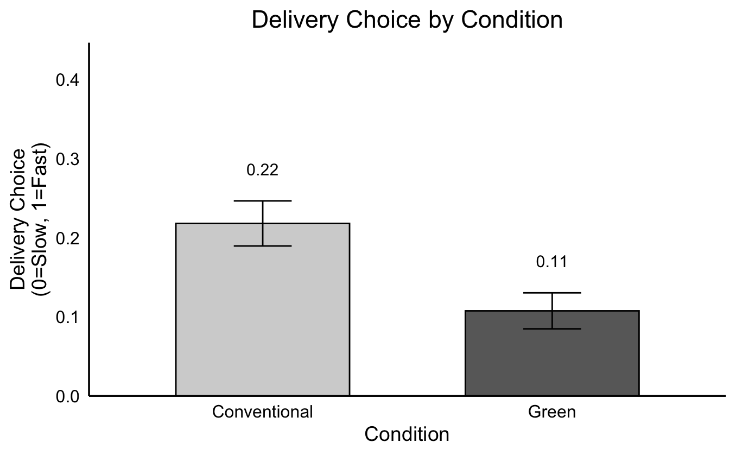
Study 2B: Delivery choice in a realistic online shop
Results
11% fewer people chose the faster delivery option in the green product condition
**p = .004
A 51% decrease in relative terms

Slide 35
Study 2B: Take-aways
Discussion
Consumers are less likely to choose the faster shipping option when buying a green product
This effect holds in a realistic shopping environment
What about process evidence?
Notes:
We actually have quite a few process studies where we also treid to rule out alternative explanations, but today I want to show you a process study that I think is closest to our mechanism.

Slide 36
Study 3: Process by mediation
Overview
201 Prolific US participants, 189 after preregistered exclusion
2 cell (product type: green vs. conventional) between-subjects design
Measure activation account vis-à-vis feeling of impatience
Notes:
how fast shipping promises drive top of funnel purchase decisions

Slide 37
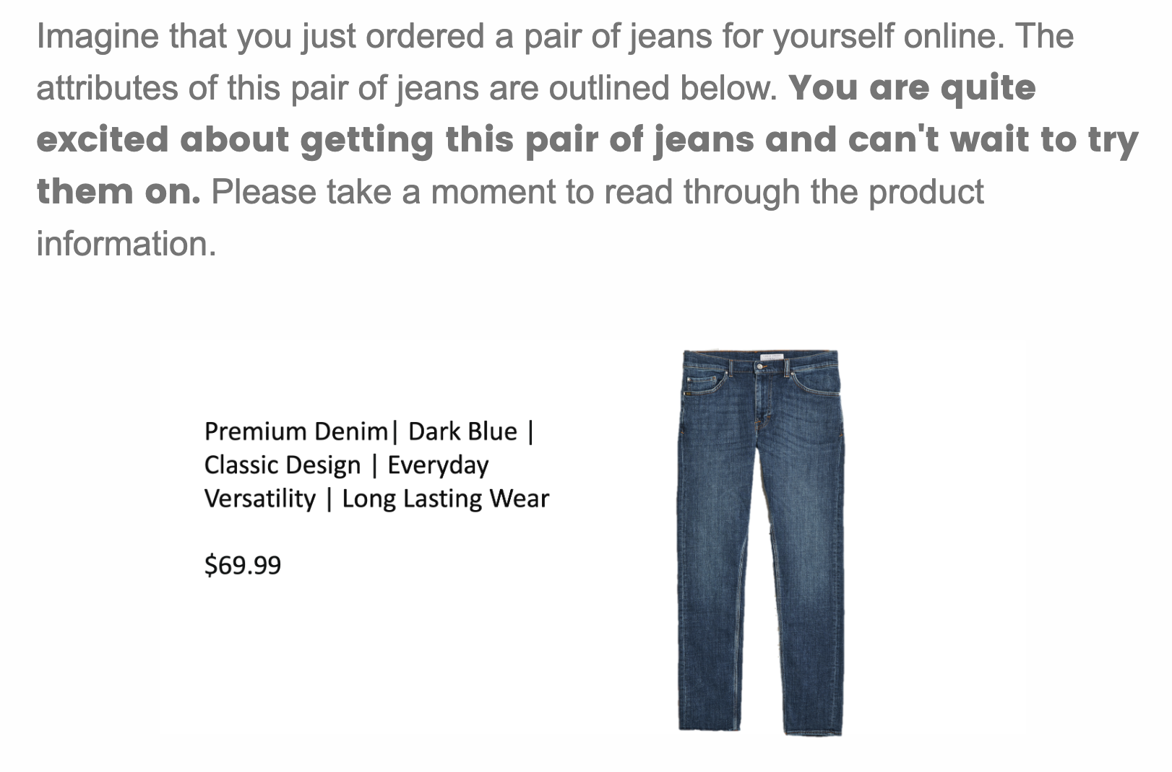
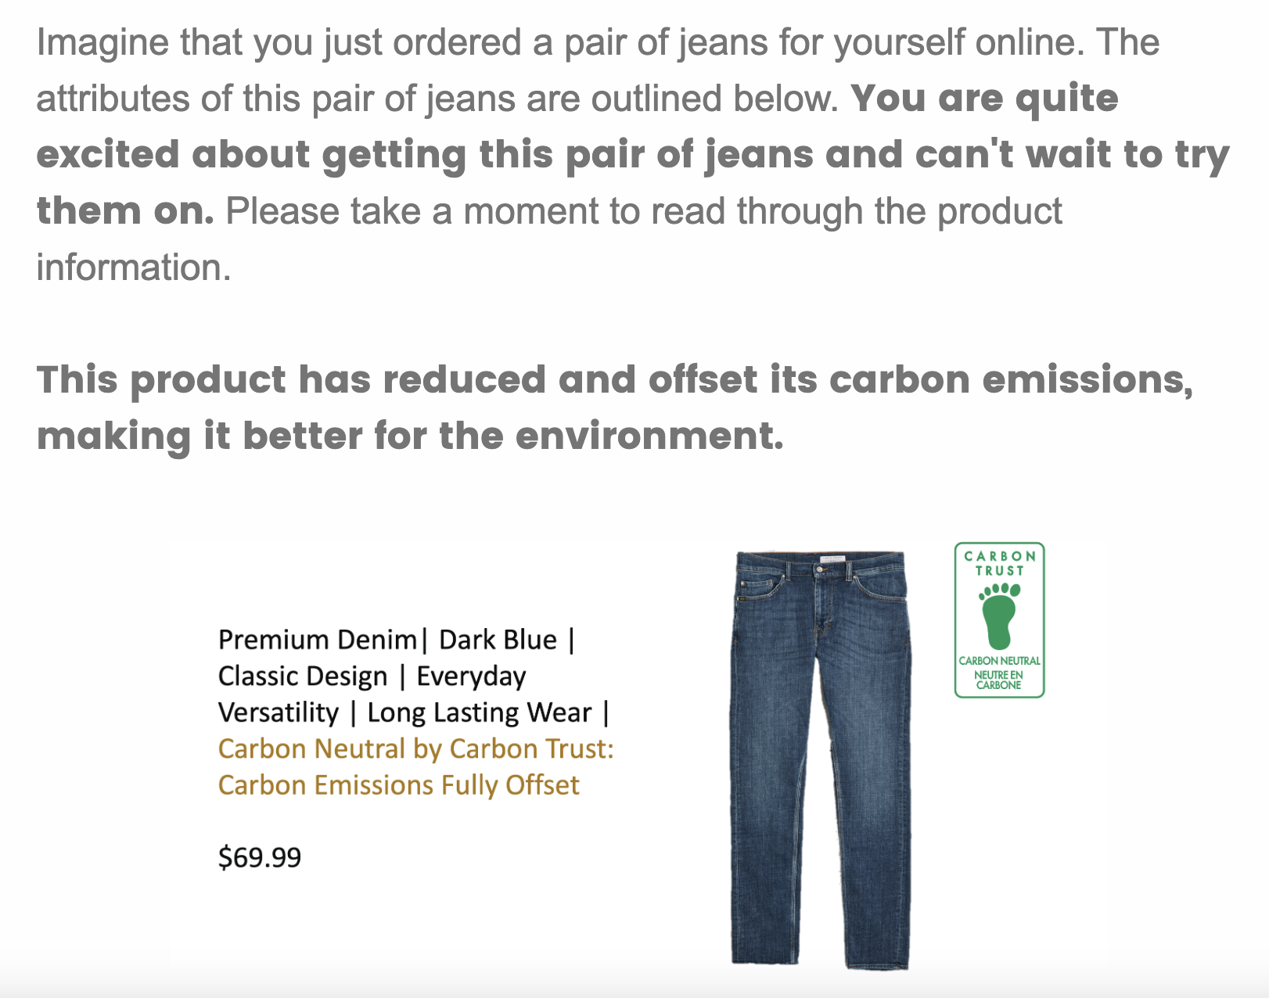
Study 3: Process by mediation
Design
Conventional condition
Green condition

Slide 38
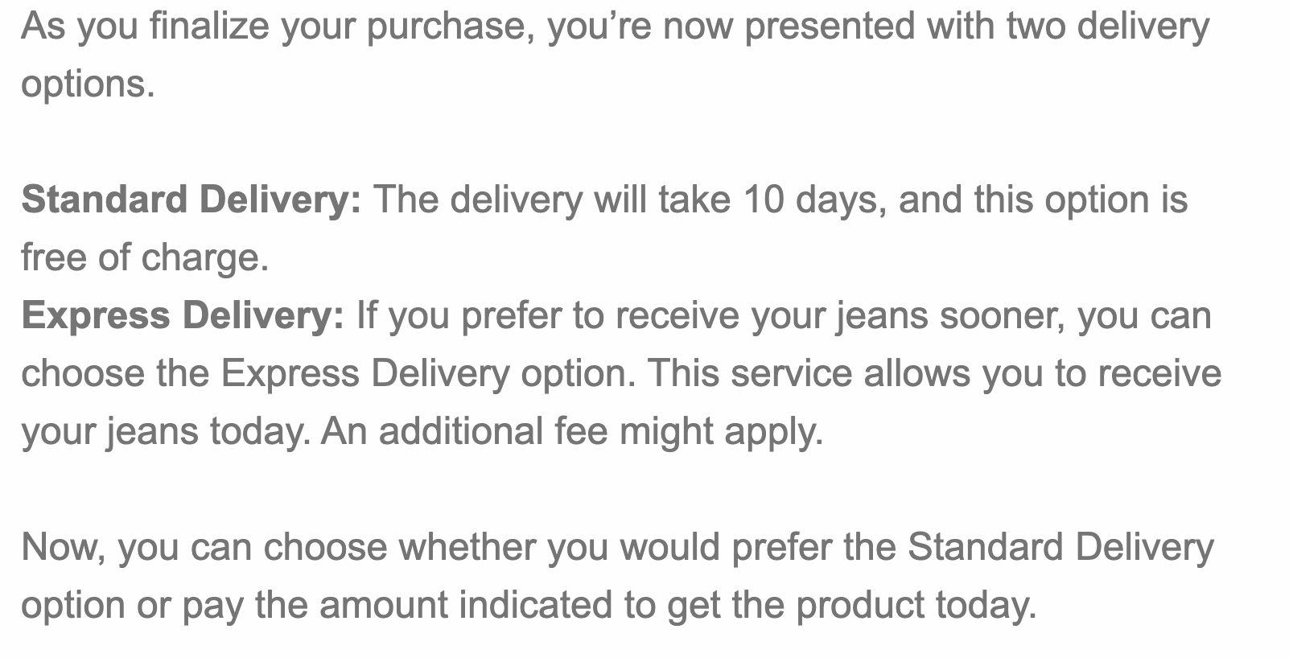
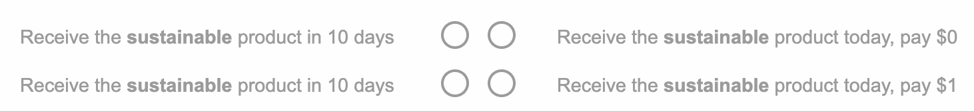
Study 3: Process by mediation
Design
11 pairs of choices from $0 to $10

Slide 39
Study 3: Process by mediation
Measures
Activation of environmental consideration:
To what extent did you consider the environmental impact of different delivery options when choosing between them? (1 = Not at all, 7 = Very much)
Impatience: From Kumar, Killingsworth, and Gilovich (2014)
Is waiting for this product more unpleasant or pleasant? (-4 = extremely unpleasant, 4 = extremely pleasant)
Would you describe the nature of your anticipation as more like impatience or more like excitement? (-4 = Much more like impatience, 4 = Much more like excitement)

Slide 40
Study 3: Process by mediation
Results
*p = .019
***p < .001
p = .651
Mediation through accessibility (95% CI [-.63, -.10])
But not impatience (95% CI [-.12, .25])

Slide 41
Study 3: Take-aways
Discussion
Buying a green product activated environmental consideration, reducing the likelihood of choosing faster shipping options
This study also provides evidence against the impatience reduction account
Process by moderation evidence?

Slide 42
Study 4: Moderation by framing
Overview
401 Connect US participants, 382 after preregistered exclusion
2 (product type: green vs. conventional) x 2 (framing of faster delivery: control vs. framed-as-greener) between-subjects design
Framing the faster delivery as more environmentally friendly
Provide evidence for and against each theoretical account
Examine how credibility-laden but unverified sustainability claims can influence downstream environmental decisions
Notes:
how fast shipping promises drive top of funnel purchase decisions

Slide 43
Potential results
Two competing accounts
Impatience Reduction
Activation/moralization
If buying a green product reduced impatience, it should remain stable regardless of how the shipping option is framed
Only a main effect of product type
The framing activates environmental consideration for both conventional and green conditions
An attenuation

Slide 44
Study 4: Moderation by framing
Product type manipulation
Conventional condition
Green condition

Slide 45
Study 4: Moderation by framing
Framed as greener manipulation
Is Faster Shipping Actually Greener?
By Leslie Albrecht | Business & Sustainability News
In the race for faster shipping, Amazon has made a claim: same-day delivery might actually be better for the environment. Despite widespread concerns about the carbon footprint of ultra-fast shipping, CEO Jeff Bezos argues that faster delivery speeds can actually reduce emissions by relying on local fulfillment centers rather than long-haul transportation.
“It actually turns out that as you increase the speed of delivery, you have less carbon. That is counterintuitive,” Amazon founder and CEO Jeff Bezos said when he announced the company's environmental goals. That’s because one-day and same-day deliveries can’t be made with air transportation, Bezos explained, so the inventory comes from warehouses that are “very close” to customers.
“A result of building those fulfillment centers very close to the customer, you’re actually transporting the products in a very efficient way, a very short distance,” he said.
(1) Make people consider the environmental impact of different delivery options (activation)
(2) Believe that faster delivery is more sustainable
Based on the real interview with Jeff Bezos
Notes:
We need a different manipulation:
Can we make this more believable?
Add a manipulation check?
Make it look like an actual newspaper article?
Buying on Amazon…
On this particular context…
Because of amazon’s logistics
In other contexts, maybe slower is greener; but in the amazon context…
Do you believe amazon faster shipping is actually more sustainable

Slide 46
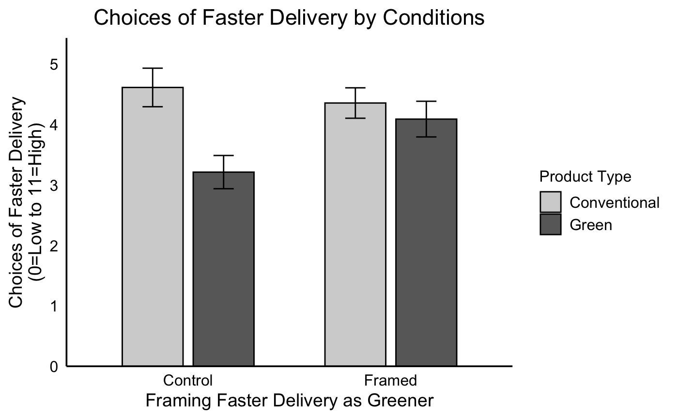
Study 4: Moderation by framing
Results
Framing faster delivery as greener using the article intervention attenuates the effect, consistent with the activation account
***p < .001
p = .505
F(1, 378) = 3.91, p = .0487
Notes:
Maybe the p value is too close to 0.05
We see a main effect of product type (F(1, 378) = 7.96, p = 0.005)
Also an insignificant main effect of framing (F(1, 378) = 1.10, p = 0.296)
Importantly, we see the predicted interaction (F(1, 378) = 3.91, p = 0.0487), see the graph below. Note that this effect is JUST significant, as you can see from the p value. Before we exclude inconsistent responses, the p value is actually marginal (p = 0.074), but the exclusion is preregistered.

Slide 47

Results
Two competing accounts
Impatience Reduction
Activation/moralization
If buying a green product reduced impatience, it should remain stable regardless of how the shipping option is framed
Only a main effect of product type
The framing activates environmental consideration for both conventional and green conditions
An attenuation

Slide 48
Study 4: Take-aways
Discussion
Framing faster delivery as greener using the article intervention attenuates the effect, consistent with the activation account
These results are inconsistent with the impatience reduction account
evidence against the self-perception account?

Slide 49
Study 5: Moderation by a reminder nudge
Overview
401 Connect US participants, 381 after preregistered exclusion
2 (product type: green vs. conventional) x 2 (environmental consideration: control vs. activated) between-subjects design
Provide process by moderation evidence for the activation account
Notes:
This study followed a 2x2 between-subjects design. So apart from manipulating product type, we also manipulated the activation of environmental consideration.

Slide 50
Potential results
Self-perception vs. Activation
Self-perception
Activation/moralization
Environmental consideration activated
The reminder should not affect delivery choices for conventional conditions as the initial moral act is absent
Only a main effect of product type
The reminder will activate environmental consideration including for those in the conventional condition
An attenuation

Slide 51
Study 5: Moderation by a reminder nudge
Product type manipulation
Conventional condition
Green condition
Notes:
To manipulate product type, we asked people to imagine that they just bought a pair of jeans. And they see the attributes of the jeans. In the green condition, we add another green attribute, which is carbon neutral.

Slide 52
Study 5: Moderation by a reminder nudge
Environmental consideration manipulation
Control condition
Activated condition
On the next page, you will make decisions about delivery options. As you do so, please also consider the environmental impact of different delivery options, as some may be more sustainable than others.
No reminder
Notes:
Now, for environmental consideration. In the activated condition, before peopke make the delivery choice decision, we remind them to also consider the environmental impact of different delivery options.
Note that here we deliberately did not specify which delivery is greener so people can rely on their own judgement.

Slide 53
Study 5: Moderation by a reminder nudge
Design
Standard delivery (free, 10 days)
Express delivery
($X, same day)
11 pairs of choices from $0 to $10
Notes:
They then proceed to the delivery choice task. So they can choose from a standard delivery which is free but takes 10 days. Or express delivery and pay $X but receive the product within the same day.
They made 11 pairs of choice wehre the price of express delivery varies from $0 to $10.

Slide 54
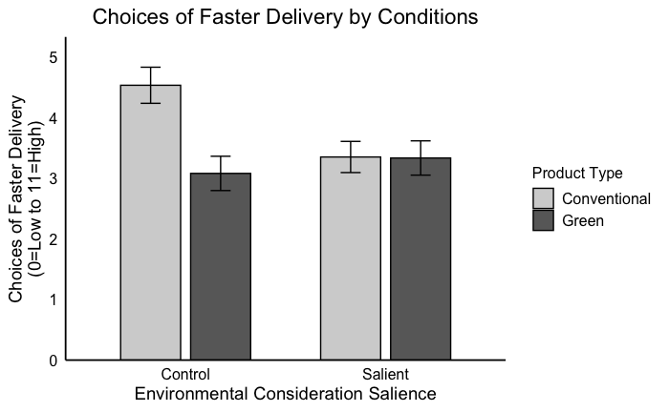
Study 5: Moderation by a reminder nudge
Results
Reminding people to consider the environmental impact attenuates the effect, consistent with the activation account
***p < .001
p = .967
F(1, 377) = 6.58, p = .011
Notes:
Now if we look at the results.
First, when environmental consideration is not activated, we replicated our previous findings.

Slide 55
Study 5: Moderation by a reminder nudge
Results
Reminding people to consider the environmental impact attenuates the effect, consistent with the activation account
***p < .001
p = .967
The reminder is as effective as buying a green product
The reminder has no additional effect when environmental consideration is already activated (e.g., buying a green product)
Consumers assume the slower delivery to be greener
F(1, 377) = 6.58, p = .011
Notes:
However, when there is a reminder that activates environmental consideration. The difference is attenuated.
There are a few things worth mentioning.
The reminder is as effective as buying a green product.
The reminder has no additional effect when the consideration is already activated. This is consistency with our theorizing that environmental consideration is like a psychological switch, so it is either switched on or off. Reminding people through multiple means does not have an additive effect.
Since we actually didn’t tell people which option is greener, this study also shows that consuemrs generally have this lay belief that slower delivery option is greener. In another study, we show that you can actually reverse this effect if you can make people believe that the faster delivery is greener.

Slide 56
Potential results
Self-perception vs. Activation
Self-perception
Activation
The reminder should not affect delivery choices for conventional conditions as the initial moral act is absent
Only a main effect of product type
The reminder will activate environmental consideration including for people in the conventional condition
An attenuation

Slide 57
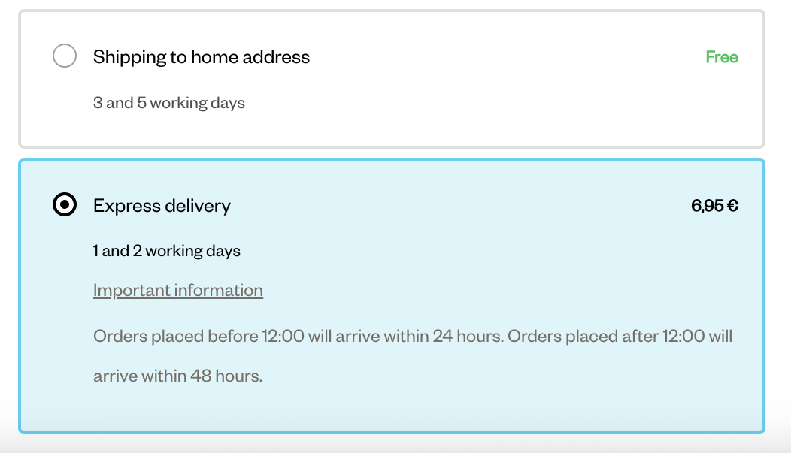

Studies 6A-B: Same product, but different delivery
A causal chain approach
When the slower delivery is indeed greener and labelled as such, it should also activate environmental consideration
Notes:
Better if they choose the delayed option reference point
Green fluency

Slide 58
Study 6A: Same product, but different delivery
Overview
201 prolific participants
2 cell (delivery type: eco-friendly vs. flexible) between-subjects design
The same product, but different delivery
Rules out that it is just about having an additional benefit (flexible)
Asking people to imagine that they bought something sustainable might prime them to be long-term focused or think of themselves as a sustainable person
Asking people to make the sustainable choice, instead of asking them to imagine

Slide 59
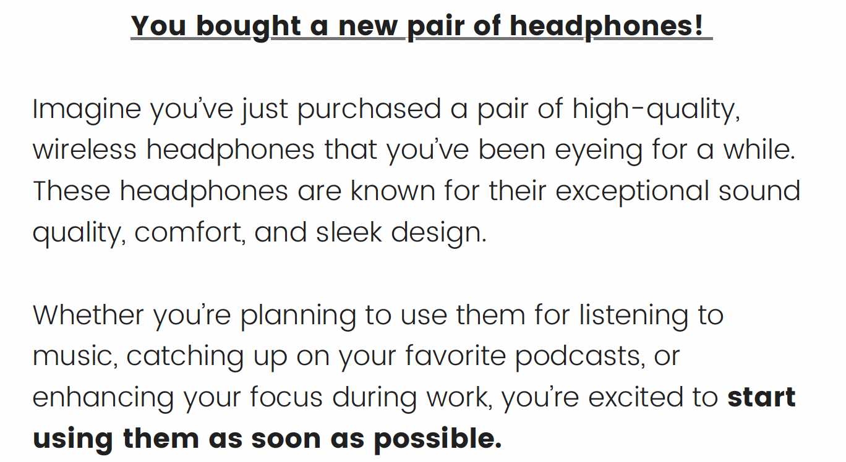
Study 6A: Same product, but different delivery
Design
Notes:
Objective price-quality association = 0,458172384

Slide 60
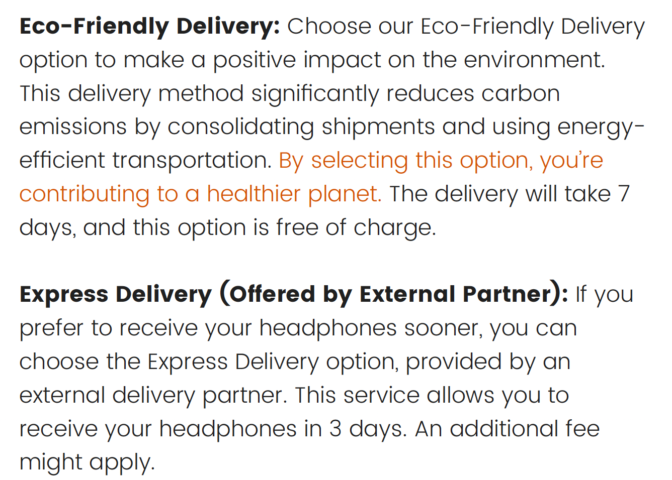
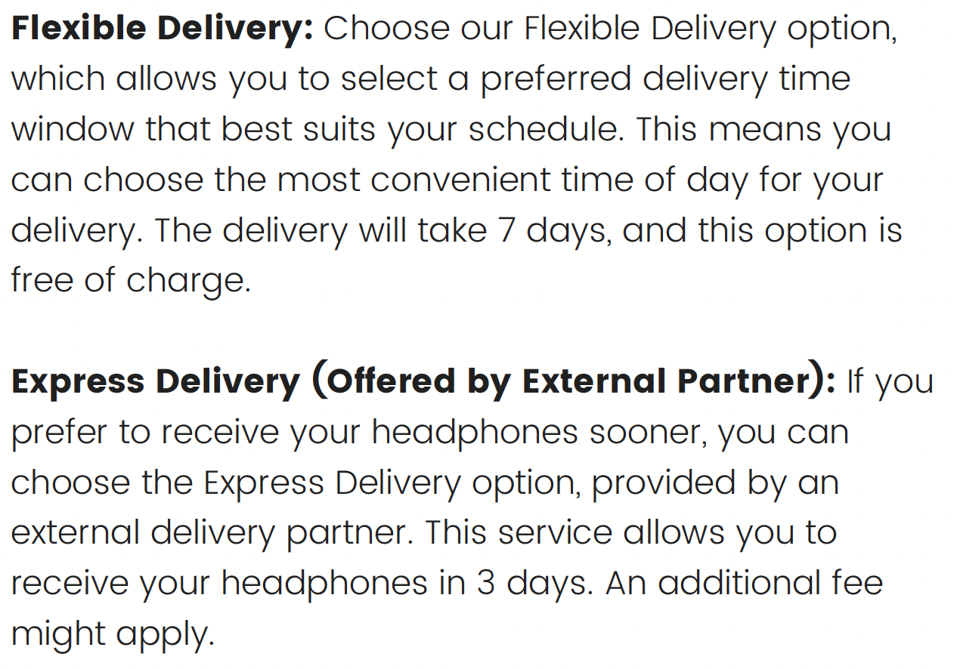
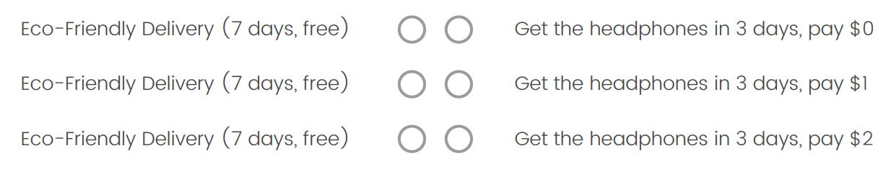
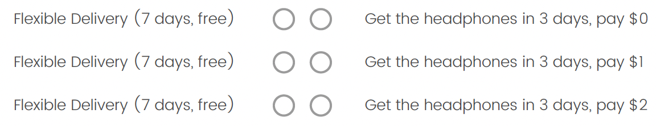
Study 6A: Same product, but different delivery
Design
Notes:
Maybe people value different things differently
Better measure of relative attractiveness
Pretest: within-subjects
Make people choose one or the other.
Consumers show some excitement about the idea of same-day delivery, but seem to be more enthusiastic about precise delivery tracking; overall, to the consumer, reliability could be more important than delivery speed.

Slide 61
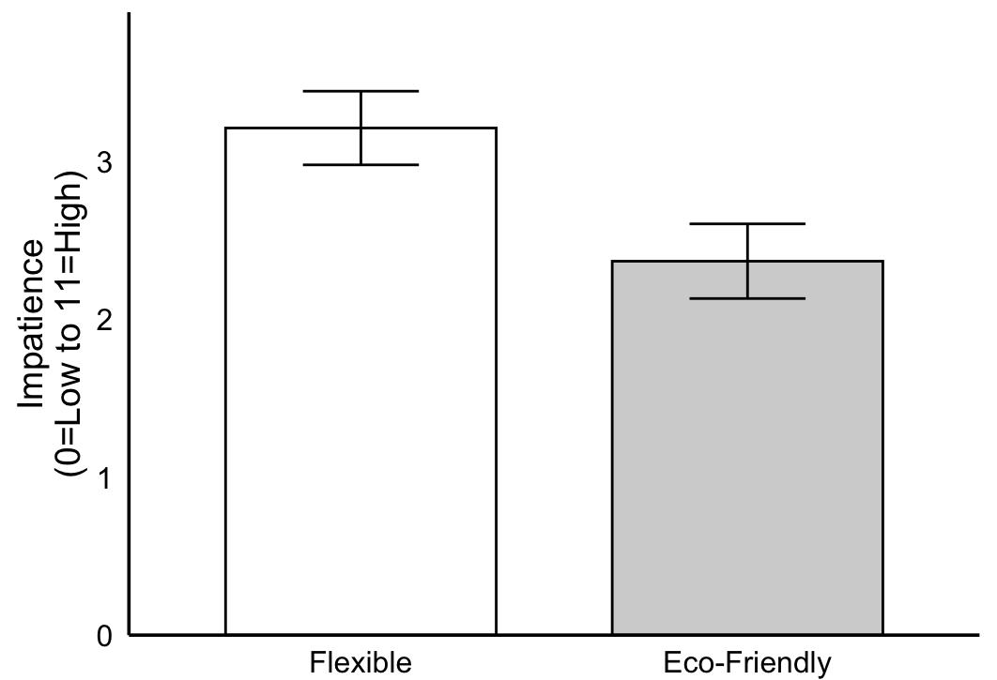
Study 6A: Same product, but different delivery
Results
Sum of Faster delivery choices by condition
Option attractiveness does not differ by condition (p = .208)
Exclude inconsistent: F(1, 191) = 6.44, p = .012
Full sample: F(1, 199) = 6.41, p = .012

Slide 62

Study 6A: Same product, but different delivery
Results
Exclude inconsistent: F(1, 191) = 6.44, p = .012

Slide 63
Study 6A: Same product, but different delivery
Results
Control for delivery attractiveness
Source | Type III Sum of Squares | df | Mean Square | F | Sig. | Partial Eta Squared | Observed Power
Intercept | 291.157 | 1 | 291.157 | 57.254 | <.001 | 0.232 | 1
Attractiveness* | 50.356 | 1 | 50.356 | 9.902 | 0.002 | 0.05 | 0.879
Condition | 26.889 | 1 | 26.889 | 5.288 | 0.023 | 0.027 | 0.629
Error | 966.209 | 190 | 5.085
Total | 2545 | 193
*attractiveness of standard delivery method is negatively correlated with impatience
Notes:
The more people like the option, the more likely they are to choose the standard option. So in essence, this capture people’s general attitude towards eco vs. Flexible delivery; or maybe sustainability vs. Flexbility in general.

Slide 64
Study 6B: Same product, but different delivery
Overview
300 prolific participants
2 cell (standard delivery type: eco-friendly vs. enhanced support) between-subjects design
The same product, but different delivery
Rules out that it is just about having an additional benefit (enhanced support)
Causal chain approach: hold the product type constant, manipulate the activation

Slide 65

Study 6B: Same product, but different delivery
Design

Slide 66


Study 6B: Same product, but different delivery
Design
Environmental consideration activated
Enhanced Support (Eco-Friendly) Delivery (7 days, Free)
Get the headphones today, pay $X
11 pairs of choices, X from $0 to $20
Notes:
For instance, if the package is broken, or if the product is broken, you do want to talk to a customer service and that is relevant even if you receive the product the same day.
Also make sure to use more parallel wording, and make the key text red.

Slide 67

Study 6B: Same product, but different delivery
Results
Choices of faster delivery by condition
Exclude inconsistent: F(1, 269) = 8.37, p = .004
Full sample: F(1, 298) = 8.83, p = .003

Slide 68
Studies 6A-B: Take-aways
Discussion
Making the environmental cost of different delivery options salient—by offering a slower delivery option that is environmentally friendly—reduced preference for faster delivery
Even when the product itself was not green

Slide 69
When are people more likely to choose slower delivery?
Discussion
When buying a green product (S1-5)
When the environmental consideration is activated by other means:
  A simple reminder nudge (S5)
  Explicitly label slower option as greener (S6A-B)
The consequences of green consumption (e.g., Mazar and Zhong 2010)
A new lens to moral consistency effect in SMB (e.g., Mullen and Monin 2016)
Theoretical
69
Notes:
To wrap up, in this project, we ask: when are people more likely to choose slower delivery?
we found that people are more likely to do so when…

Slide 70




The hidden sustainability dimension
Discussion
Environmental impact is not top of mind
But they do have environmental impact
|Meat consumption|
|Repair|
|Laundry decision|
|Gen AI usage|
Notes:
This effect might generalize to a larger body of sustainable behaviors that share the same characteristics

Slide 71
Thank you!
Questions or comments?
Yuqi Guo
Tilburg University
Jen Park
UBC
David Hardisty
UBC

