Slide 1

Does Prospect Theory Hold in Intertemporal Choice?
The interaction of time and risk in preferences for gains and losses
David J. Hardisty & Jeff Pfeffer
SJDM presentation
November 17th, 2012
Notes:
Images from unsplash.com

Slide 2
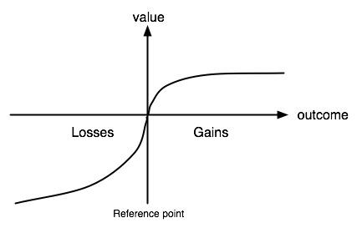
Prospect Theory

Slide 3
Uncertain Future Gains
The future is unavoidably uncertain
People are risk averse for gains (Kahneman & Tversky, 1979)
Risk aversion leads people to prefer immediate gains over future gains (Patak & Reynolds, 2007; Takahashi, Ikeda, & Hasegawa, 2007)
Examples: bonds, social security
Notes:
The relationship between uncertainty and time preference for gains is well established… one example

Slide 4
Uncertain Future Losses
People are risk seeking for losses (Kahneman & Tversky, 1979)
Yet, people sometimes choose immediate losses over future losses (Thaler, 1981; Hardisty & Weber, 2009)
Examples: insurance, pre-paid phones
Notes:
The relationship between uncertainty and time preferences for losses is a little less…. Certain. There are two types of uncertainty about future losses. One is uncertainty about whether you will have to pay. Another is uncertainty about whether you will be able to pay.

Slide 5
How does uncertainty affect time preferences for losses?

Slide 6
Previous Research
Shelly, 1994; Ahlbrecht & Weber, 1997
Riskier losses sometimes discounted less
MBAs only, 45 or 15 min training periods

Slide 7
Outline
Study 1: Future uncertainty
Study 2: Immediate uncertainty
Study 3: Immediate and future uncertainty
Individual difference correlates
Notes:
We have a revise & resubmit on this, but will run at least one more study, and we are currently designing it, so I would really appreciate any suggestions you have

Slide 8
Participants
Total N=328
Mix of Mturk and SSI (only 20% of SSI responses were usable!)
National U.S. sample, average age = 38

Slide 9
Study 1: Hypotheses
Future uncertainty -> preference for immediate gains
Effect of future uncertainty on losses?
- Prospect theory -> preference for future losses
- Previous research -> mixed story

Slide 10
Study 1 Overview
Gain vs Loss
Future “certainty” vs uncertainty
(Probability vs Variability)
(Medium vs Large Magnitude)
(Order)

Slide 11
Study 1: Gain Scenario
Please imagine you face a set of choices about receiving $100 from investments immediately, or another amount in one year.

Slide 12
Study 1: Medium Gain Choices
Receive $100 immediately or receive $90 in one year?
Receive $100 immediately or receive $100 in one year?
…
Receive $100 immediately or receive $200 in one year?

Slide 13
Study 1: Large Gain Choices
Receive $10,000 immediately or receive $9,000 in one year?
Receive $10,000 immediately or receive $10,000 in one year?
…
Receive $10,000 immediately or receive $20,000 in one year?

Slide 14
Study 1: Probabilistic Gain
Receive $100 immediately or 50% chance of receiving $180 in one year?
Receive $100 immediately or 50% chance of receiving $200 in one year?
…
Receive $100 immediately or 50% chance of receiving $400 in one year?

Slide 15
Study 1: Variable Gain
Receive $100 immediately or receive $45 to $135 in one year?
Receive $100 immediately or receive $50 to $150 in one year?
…
Receive $100 immediately or receive $100 to $300 in one year?

Slide 16
Study 1: Losses
Please imagine you face a set of choices about paying a $100 bill immediately, or another amount in one year.
Control: Pay $100 immediately or pay $150 in one year?
Probabilistic: Pay $100 immediately or 50% chance of paying $300 in one year?
Variable: Pay $100 immediately or pay $75 to $225 in one year?

Slide 17
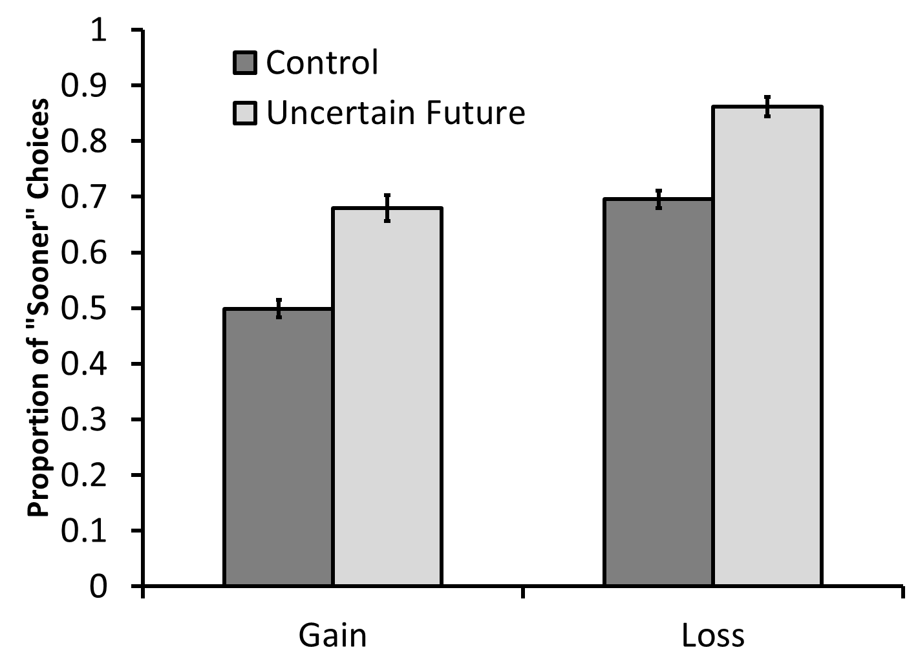
Study 1: Results

Slide 18
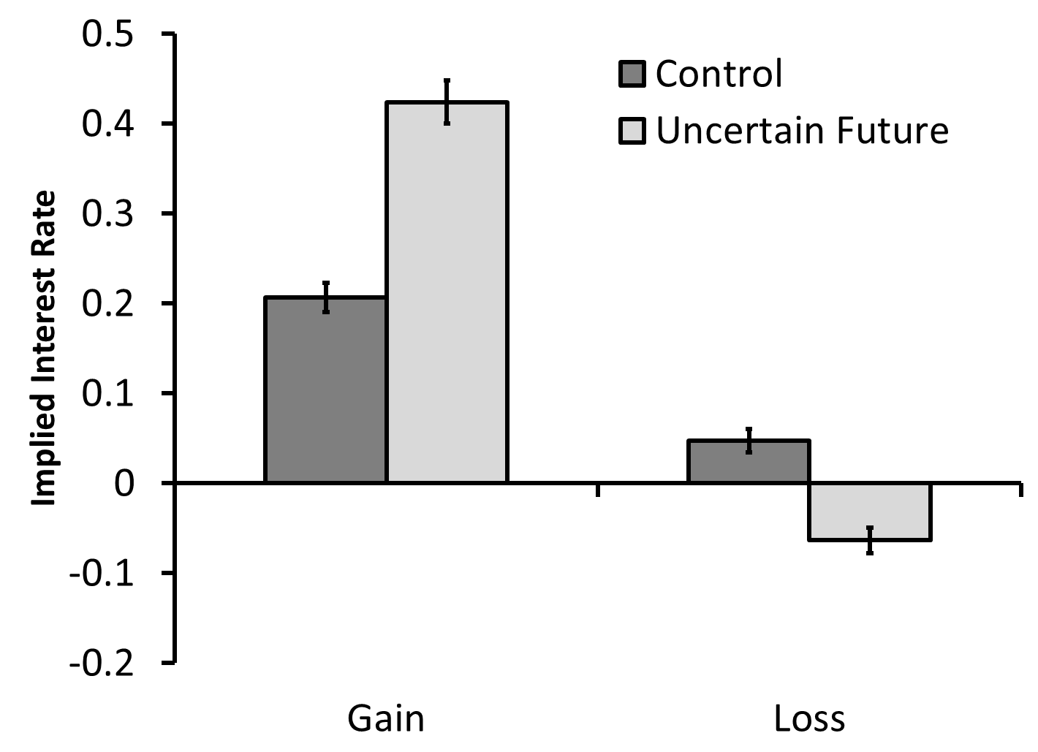
Study 1: Results

Slide 19
Study 1: Summary
Participants were risk averse for future gains and future losses
Weird study or weird participants?
What about immediate uncertainty?

Slide 20
Study 2: Overview
Prospect theory questions (all immediate outcomes)
Immediate uncertainty vs future “certainty”
Hypothesis 1: Prospect theory preferences when all outcomes are immediate
Hypothesis 2: Risk aversion when making intertemporal choices

Slide 21
Study 2: Prospect Theory Methods
50% chance of receiving $200, or receive $100 for sure?
50% chance of receiving $20,000, or receive $10,000 for sure?
50% chance of paying $200, or pay $100 for sure?
50% chance of paying $20,000, or pay $10,000 for sure?

Slide 22
Prospect Theory: Results

Slide 23
Study 2: Intertemporal Choice Methods
Control:
Receive $100 immediately or $150 in one year?
Immediate uncertainty:
50% chance of receiving $200 immediately
or receive $150 for sure in one year?

Slide 24
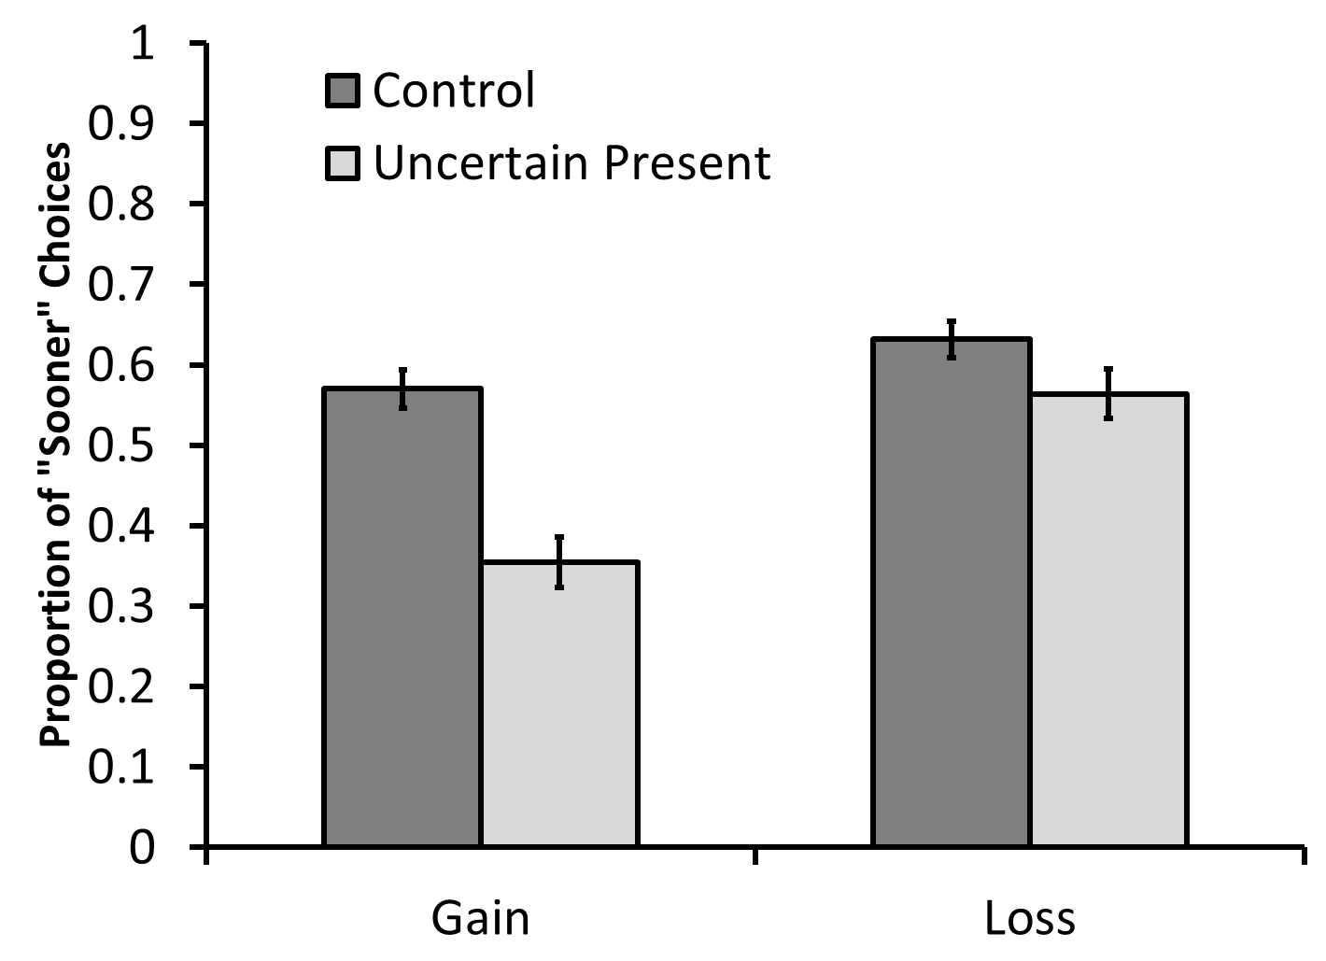
Study 2: Results

Slide 25
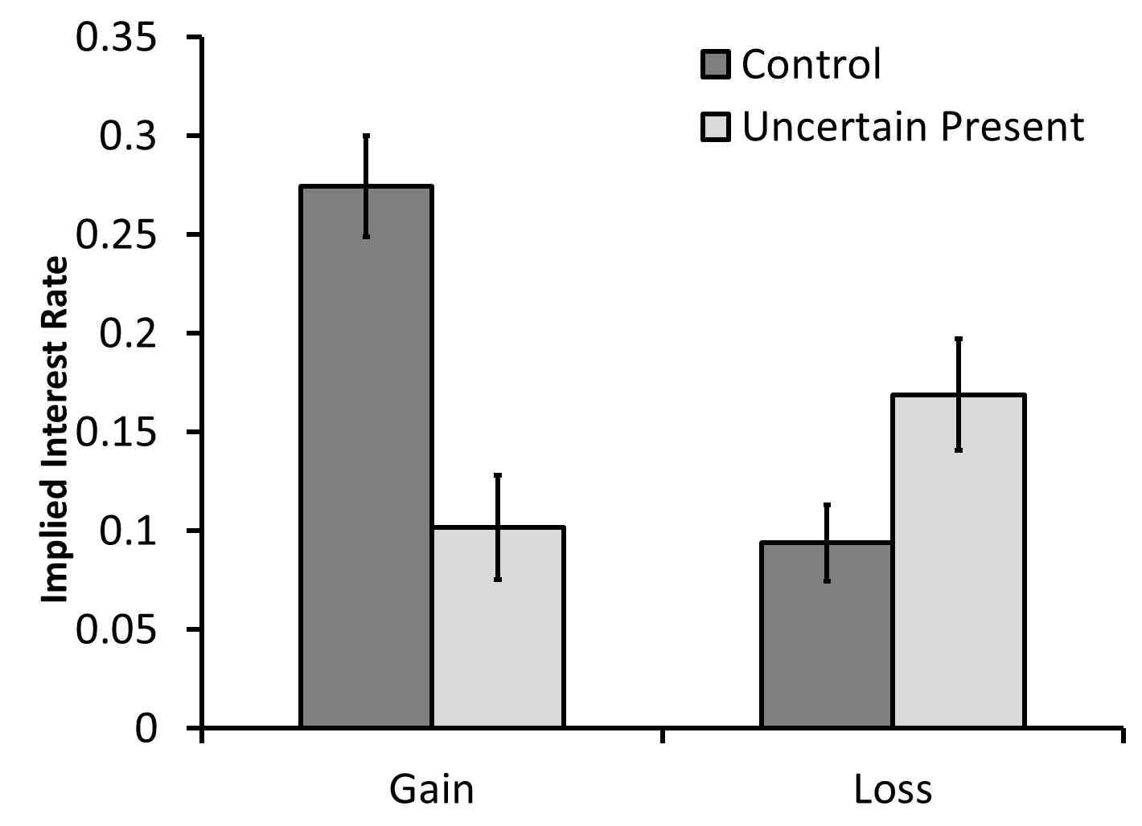
Study 2: Results

Slide 26
Study 2: Summary
When making intertemporal choices, participants showed risk aversion for gains and losses
What happens when both the immediate and future outcomes are uncertain?

Slide 27
Study 3: Intertemporal Choice Methods
Control:
Receive $100 immediately or $150 in one year?
Immediate and future uncertainty:
50% chance of receiving $200 immediately
or 50% chance of receiving $300 in one year?

Slide 28
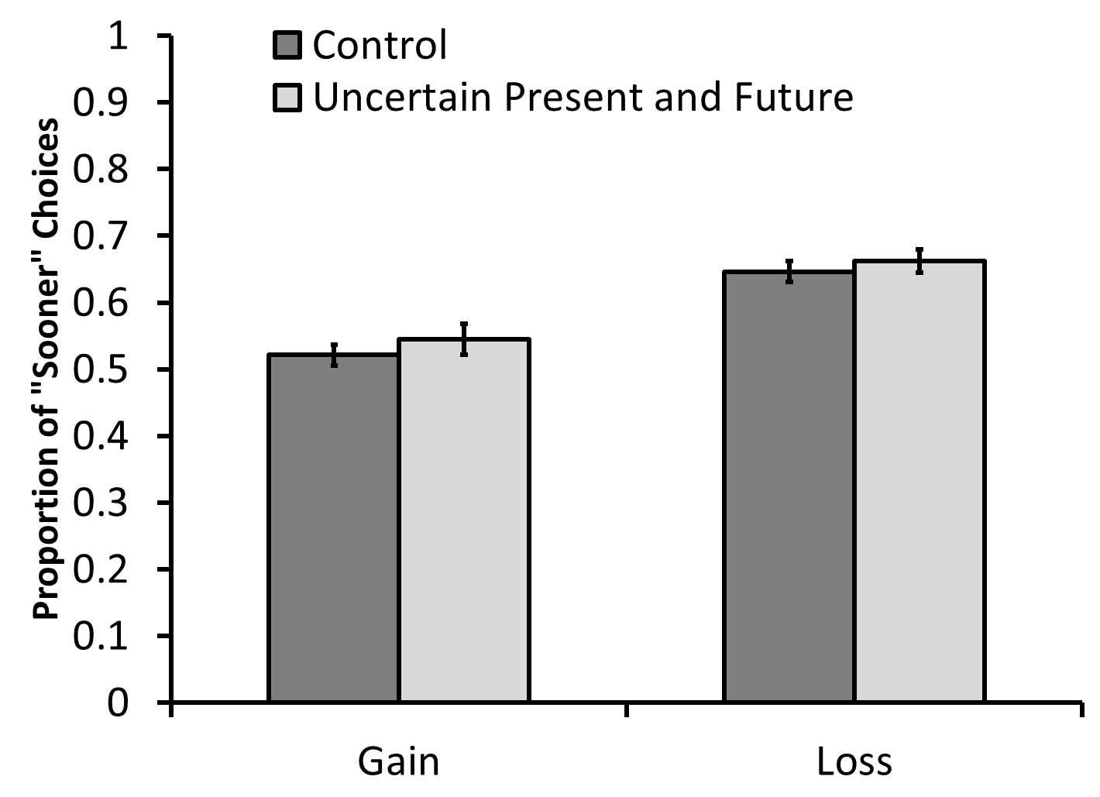
Study 3: Results

Slide 29
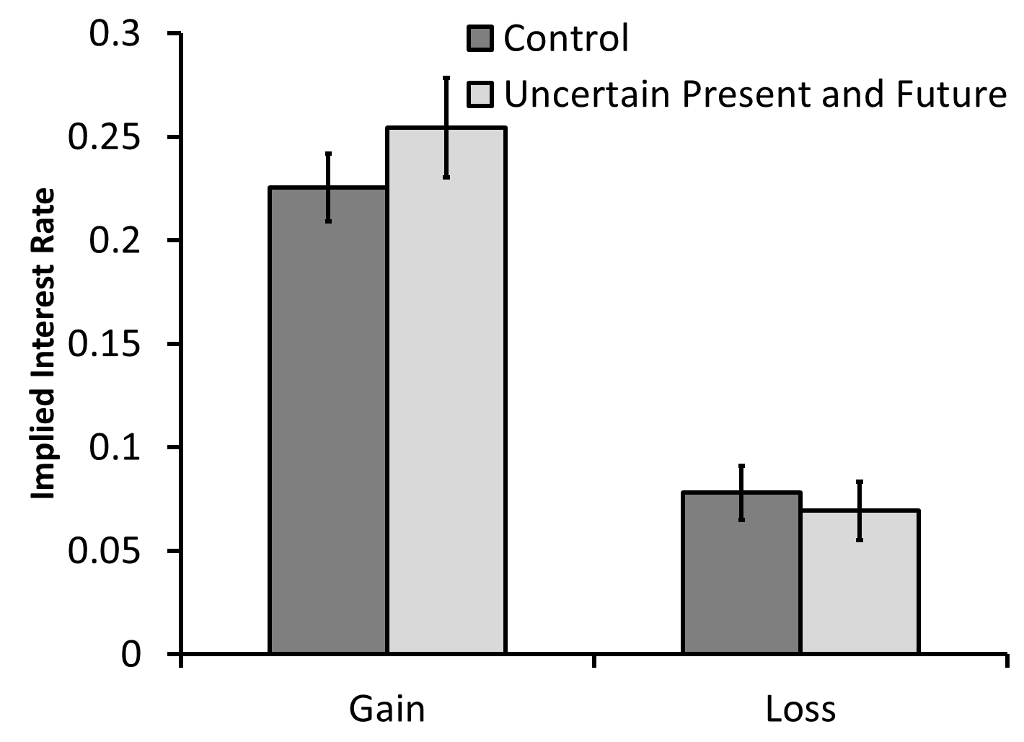
Study 3: Results

Slide 30
Individual differences
 | discounting of gains | discounting of losses
young company | .00 | .16*
employed part time | .11* | .14*
Financial resources | -.38** | -.23**
income | -.13* | -.03
feel secure | -.20* | -.22*
smoking | .16** | .02
Notes:
These are correlations

Slide 31
Overall Summary
In intertemporal contexts, participants are risk averse for gains and losses (in contrast to prospect theory predictions)
When immediate and future outcomes are equally uncertain, time preference are unaffected

Slide 32
Why are people risk averse in intertemporal contexts?
Planning?
Anxiety?

Slide 33
Future Directions
Replications and robustness (particularly MBAs vs general population)
Better process explanation & data

Slide 34
Implications & Applications
Implicit uncertainty may be one factor driving the “sign effect” in intertemporal choice
To delay SS claims, increase future certainty
Adjustable rate credit card payments

Slide 35
Thank You!

Slide 36
Additional Slides

Slide 37
Study 1: Discount Rates

Slide 38
Study 2: Discount Rates

Slide 39
Study 3: Discount Rates

