Slide 1

"Once? No. Twenty times? Sure!" Uncertainty and precommitment in repeated choice
David J. Hardisty, Amir Sepehri, Poonam Arora
UBC Sauder , Western Ivey, Manhattan College
Funding support from NSF and SSHRC
Bocconi Marketing Seminar
Feb, 2020

Slide 2



Slide 3
Background
Currently in major revision
  Now two different papers!
Today’s version:
  with warts!
  no file drawer
  get ready for a lot of data
Suggestions and criticisms, please!
  Especially on the “decision process”
Notes:
My goal is not to impress or to amuse, but to share the empirical truth and work together on understanding it.

Slide 4
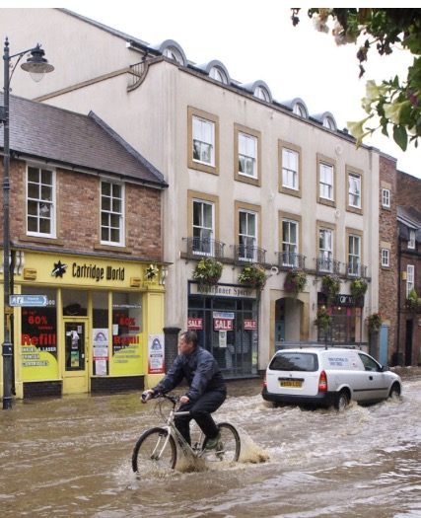


Decision Making with Rare Events
Poor decision making with low probability events:
  Data backup
  Extreme weather events (e.g., earthquake, flood)
  Nighttime visibility
Notes:
Image left and middle source: https://unsplash.com/
Flood image from: https://upload.wikimedia.org/wikipedia/commons/3/36/Urban_flood_cropped.jpg CC BY-SA 2.0

Slide 5
Research Motivation
Normally, greater delay is associated with increased uncertainty
example: $10 promised today or in 20 years
However, with repeated low probability events, increasing time horizon may increase subjective probability
Examples (choice bracketing):
  Chance of a fire today or over 20 years?
  Wear your seatbelt just once or every time? (Slovic, Fischhoff, & Lichtenstein, 1978)

Slide 6
Precommitment as a Remedy?
People sometimes precommit to invest in protection for several years in advance at a time
examples:
  Binding commitments: long-term insurance contracts
  Non-binding commitments: safety decisions (seat-belt, helmet, etc)
  Social dilemmas: CO² reductions

Slide 7
Why Precommitment?
Choice Bracketing
Slovic, Fischhoff, & Lichtenstein, 1978
Scale Design as a Choice Architecture Tool
Camilleri & Larrick, 2014
Description vs. Experience of Risk
Intertemporal Uncertainty Avoidance
Hertwig, Barron, Weber, & Erev, 2004
Hardisty & Pfeffer, 2017
Integrating losses
Kahneman & Tversky, 1979
Precommitment

Slide 8
Working Model
Time horizon
+
Subjective probability
(of large loss)
+
+
Precommitment
+
Preference for safer option
Most plausible
Not supported by any self-report measures
Not supported by some behavioral measures

Slide 9
Study 1
Question: Do individuals invest more in the safe option when they precommit their choices?

Slide 10
Instructions (pg 1)
Imagine you are an investor in Indonesia and you have a risky venture that earns 8,500 Rp per year. However, there is a small chance that you will suffer a loss of 40,000 Rp in a given year. You have the option to pay 1,400 Rp for a safety measure each year to protect against the possible loss. You will be fully protected if you invest in protection. The loss has an equal chance of happening each year, regardless of whether it occurred in the previous year.

Slide 11
Choice
INVEST | - You definitely lose 1,400 Rp, and have a 0% chance of the large loss occurring.
NOT INVEST | - You have a 4% chance of losing 40,000 Rp and a 96% chance of losing 0 Rp.
Notes:
Here’s the payoff matrix participants saw.

Slide 12
Choices
Repeated Condition:
Will you invest in protection this year?
INVEST | NOT INVEST
Precommitted condition:
Will you invest in protection in year 1?
INVEST | NOT INVEST
~~~~~~~~~~~~~~~~~~~~~~~~~~~~~~~~~~~~~~~~~~~~~~~~~~~~~~~~~~~~~~~~~~~~~~
Will you invest in protection in year 2?
INVEST | NOT INVEST
~~~~~~~~~~~~~~~~~~~~~~~~~~~~~~~~~~~~~~~~~~~~~~~~~~~~~~~~~~~~~~~~~~~~~~
[...]
Will you invest in protection in year 20?
INVEST | NOT INVEST

Slide 13
Feedback
Year 1 Results
Your choice: INVEST
The random number was: 88
This Means
The large loss: did not occur
Result: You lost 1,400 Rp.

Slide 14
Feedback
Year 2 Results
Your choice: NOT INVEST
The random number was: 3
This Means
The large loss: occurred
Result: You lost 40,000 Rp.

Slide 15
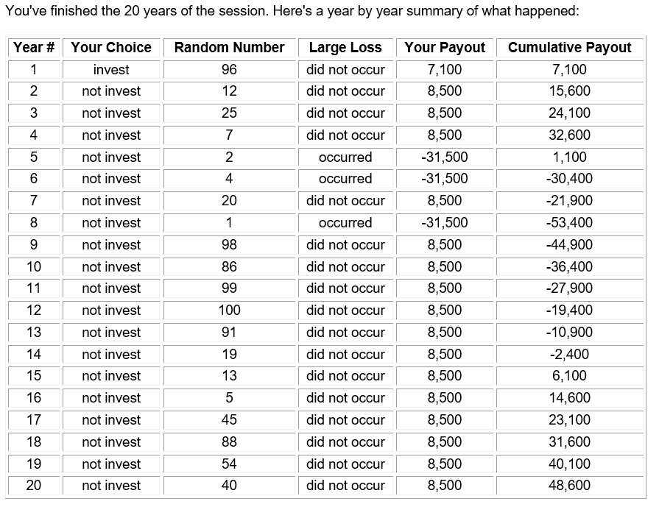

Slide 16
Design Details
Comprehension test
Participants (N=60 students) played 4 blocks of 20 rounds (“years”)
1 block paid out for real money
Between subjects: repeated vs precommited choice

Slide 17
Solo: repeated vs precommited
1
0.9
0.8
0.7
0.6
Investment Proportion
0.5
Repeated
0.4
Precommitted
0.3
0.2
0.1
0
Block 1
Block 2
Block 3
Block 4
Notes:
We tried to find process evidence through explicit measures by asking participants about the aggregate probability of the big loss across 20 rounds, or the extent to which they were worried that the big loss will happen over the 20 rounds. We did not find any effect. However, the review team were quite sympathetic to that fact and we make our case by providing process evidence through moderation.
We argue that precommitment works through increasing the decision making time-horizon which in turn increases the subjective likelihood of the big loss happening. In the next two studies, we experimentally manipulate a) the actual probability of the big loss, and b) the decision-making time horizon focus.

Slide 18
Self-report Data
Across studies, self-report:
“the likelihood that a loss would occur at least once in 20 rounds” (___%)
Risk perception (1-7 scale)
Risk concern (1-7 scale)
Time horizon (___ rounds)
All null results!

Slide 19
Study 2
Question: How does a change in the actual probabilities of the large loss affect precommitment?
Notes:
In Study 2, we try to find support for our subjective probability account by experimentally changing the probabilities of the big loss. If precommitment works through increasing the subjective probability of the big loss, then when the actual probability of the big loss is increased, precommitment effect should be diluted.

Slide 20
Study 2: Theory
If precommitment works by increasing subjective probability, then…
…explicit increases in probability (with EV constant) should have the same effect (and should wipe out the effect of precommitment)

Slide 21
Study 2
Modified Solo game, N=421 MTurkers
  Slightly modified version with mining in the Known region (certain loss of 1,400 Rp) or the Unknown region (4% chance of a 40,000 Rp. loss)
Repeated vs Precommitted
Probability of the big loss (4% vs. 20% vs. 50%)
  Expected value held constant
Notes:
We used the same solo game design here and increased the probability of the big loss by condition.

Slide 22
Study 2: Choice
KNOWN | - You definitely lose 1,400 Rp, and have a 0% chance of the large loss occurring.
UNKNOWN | - You have a 4% chance of losing 40,000 Rp and a 96% chance of losing 0 Rp.
Notes:
Here’s the payoff matrix participants saw.

Slide 23
Study 2: Choice
KNOWN | - You definitely lose 1,400 Rp, and have a 0% chance of the large loss occurring.
UNKNOWN | - You have a 20% chance of losing 8,000 Rp and a 80% chance of losing 0 Rp.
Notes:
Here’s the payoff matrix participants saw.

Slide 24
Study 2: Choice
KNOWN | - You definitely lose 1,400 Rp, and have a 0% chance of the large loss occurring.
UNKNOWN | - You have a 50% chance of losing 3,200 Rp and a 50% chance of losing 0 Rp.
Notes:
Here’s the payoff matrix participants saw.

Slide 25
Study 2: Results
Notes:
We replicate the effect of precommitment in our original solo game which was the 4% conditions. The pattern of results in the 20% and 50% conditions supports our subjective probability account. As the probability of the big loss increases, the effect of precommitment becomes weaker in the 20% condition, and becomes non-significant in the 50% condition.

Slide 26
Conclusion
Precommitment effect becomes weaker and eventually non-significant as the probability of big loss increases.
Why? Because when the probability is already high, there is little room for precommitment to increase the subjective likelihood of the big loss.

Slide 27
Study 3
Question: How does a change in the Decision-Making time horizon affect precommitment?
Notes:
In this study, we experimentally manipulate the decision-making time horizon focus. This will provide further process evidence.

Slide 28
Study 3: Theory
If precommitment increases time horizon, then…
…experimentally increasing the time horizon should have the same effect
…and should wipe out the effect of precommitment
Also, we test whether precommitment leads to smarter choices or safer choices
  What if the risky option yields higher EV?

Slide 29
Study 3
N=567 MTurkers
Repeated vs Precommitted
Time horizon manipulation (vs no-instruction control):
  Think about all the 20 rounds of the game. What is the best strategy?
  How many rounds out of 20 you think you should invest?
Expected Value Advantage (Risky vs. Safe)
  Known region: Fixed pay of 1400
  Unknown region: 4% chance of paying 40,000 Rp. vs. 30,000 Rp.

Slide 30
Results:
Notes:
Here are the results. You can see the means of all the 8 cells. However, since we did not have a three-way interaction, I will talk about the two interesting two-by-two interactions we found.

Slide 31
Study 3: Results

Slide 32
Conclusion
Urging participants to think about “all” 20 rounds of the game:
  Increased the choice of safe option in the repeated condition.
  Did not have any effect in the precommitment condition.
Further supports our “increase in time-horizon” account.
Notes:
The aggregate focus manipulation did not have any effect on the precommitment condition, because precommitment had already increased the time-horizon in participants in that condition.

Slide 33
Study 4
Question: Is pre-commitment binding?
Notes:
Pre-commitment is not always feasible in real-world. People may precommit their choices but would want the liberty to change their choices later. Therefore, a non-binding precommitment condition may be an interesting situation to explore.
Also,

Slide 34
Study 4: Theory
If precommitment increases time horizon, then…
…non-binding precommitment should have the same effect

Slide 35
Study 4
N=210 MTurkers
Repeated vs Precommitted vs. non-binding precommitted
Key difference: Ability to change precommitted choices after each round
Notes:
We used the same solo game with three conditions. The repeated and precommited conditions were similar to previous studies. In the non-binding precommitment condition, participants precommitmed their choices for 20 rounds, but after each round was played, they were redirected to the choice page and could change their choices for the remaining rounds.

Slide 36
Study 4: Results
Notes:
The non-binding precommitment condition is as effective as the original precommitment. Even though this condition was essentially similar to the repeated condition in that participants could change their choices after each round, the mere fact that they precommit their choices at the beginning made them to invest more. This can provide us with some new insights on self-set defaults.

Slide 37
Conclusion
Non-binding precommitment is roughly as effective as the binding precommitment.
Further supports our process account.
Notes:
We show that having participants precommit their choices is enough to increase their DM time horizon and in turn the choice of the safe option, EVEN IF they can change their choices afterwards, pretty much similar to the repeated condition.
This finding, together with those of the previous study, show that having participants either precommit their choices or consider all the 20 rounds of the game, increases the choice of safe option, EVEN IF they are making their choices round-by-round or have the freedom to change them round-by-round.

Slide 38
Study 5
Question: How does precommitment affect investment rates in a gain frame?
Notes:
Up to now, all the studies have investigated the effect of precommitment in a loss frame. It would be interesting to examine this effect in a gain frame.

Slide 39
Study 5: Theory
If precommitment increases time horizon and subjective probability, then…
…gains should show the opposite effect

Slide 40
Study 5
N=355 students (at UBC and Ivey!)
Incentive compatible
Repeated vs Precommitted
Loss vs Gain
(Also varied choice presentation format to be aggregated vs separated; this is null.)

Slide 41
Study 5: Loss Choice
KNOWN | - You definitely pay 1,400 Rp, and have a 0% chance of the large loss occurring.
UNKNOWN | - You have a 4% chance of paying 40,000 Rp and a 96% chance of paying 0 Rp.
Notes:
Here’s the payoff matrix participants saw.

Slide 42
Study 5: Gain Choice
KNOWN | - You definitely receive 1,400 Rp, and have a 0% chance of the gain loss occurring.
UNKNOWN | - You have a 4% chance of receiving 40,000 Rp and a 96% chance of receiving 0 Rp.
Notes:
Here’s the payoff matrix participants saw.

Slide 43
Study 5: Results

Slide 44
Study 5: Conclusion
The effect of precommitment on the attractiveness of a big “gain” is eliminated
For gains, most people are already risk averse, so precommitment has no effect
Notes:
We argued that precommitment works through increasing the subjective probability of the big loss happening. In the gain frame, because people are risk-averse and are already not considering the risky option, precommitment does not have any effect. This further supports our subjective probability account.

Slide 45
Study 6: Methods
IV: Number of rounds in each block:
20 vs 10 vs 5
Prediction: pre-commitment should be less effective with shorter blocks

Slide 46
Study 6: Results

Slide 47
Study 6: Conclusion
The effect of precommitment is equally strong for shorter vs longer block lengths
  This seems to contradict our theory…
  …but perhaps people think in a binary way when precommiting (e.g., “It will happen at least once, sooner or later”)
Notes:
We argued that precommitment works through increasing the subjective probability of the big loss happening. In the gain frame, because people are risk-averse and are already not considering the risky option, precommitment does not have any effect. This further supports our subjective probability account.

Slide 48
Study 7: Methods
Probability education intervention:
4% chance of losing 40,000
(this means that there is a 56% chance of the 40,000 payment happening at least once during 20 months)
Prediction: education should increase investment rates, and decrease the effect of precommitment

Slide 49
Study 7: Results
Notes:
A 2 (choice structure) by 2 (probability education) by 4 repeated (blocks) ANOVA with investment proportion in each block as the DV found a main effect of precommitment (M_{rep} = .35 vs M_{pre} = .54, F(1,276) = 29.62, p < .001), and a marginally significant effect of probability education (M_{control} = .41 vs M_{education} = .48, F(1,276) = 3.58, p =.06). The interaction of probability education and choice structure was not significant (F(1,276) = .11 , p = .74).

Slide 50
Study 7: Conclusions
Education slightly increases investment rates (replication of Slovic, Fischhoff, & Lichtenstein, 1978)
Precommitment has a larger effect, and is not changed by education
  This is trouble for our theory

Slide 51
Paper 1: Summary
Precommitment increases investment in protective measures and selection of safer options.
Who knows why
Next step: think-aloud protocol

Slide 52
Paper 2: Precomitment in Social Dilemmas
With Amir Sepheri, Howard Kunreuther, Dave Krantz, & Poonam Arora

Slide 53
IDS Background
Interdependent Security (IDS) is a social dilemma with stochastic losses (Kunreuther & Heal, 2003)
  border security
  pest/disease control
  risky investments
People typically cooperate less in IDS than in a deterministic Prisoner’s Dilemma

Slide 54
IDS payoff matrix
 |  | Your Counterpart
 |  | INVEST | NOT INVEST
You | INVEST | - You definitely lose 1,400 Rp, and have a 0% chance of the large loss occurring. - Your counterpart definitely loses 1,400 Rp, and has a 0% chance of the large loss occurring. | - You definitely lose 1,400 Rp and have a 1% chance of losing an additional 40,000 Rp. - Your counterpart has a 3% chance of losing 40,000 Rp and a 97% chance of losing 0 Rp.
 | NOT INVEST | - You have a 3% chance of losing 40,000 Rp and a 97% chance of losing 0 Rp. - Your counterpart definitely loses 1,400 Rp and has a 1% chance of losing an additional 40,000 Rp. | - You have a 4% chance of losing 40,000 Rp and a 96% chance of losing 0 Rp. - Your counterpart has a 4% chance of losing 40,000 Rp and a 96% chance of losing 0 Rp.

Slide 55
PD payoff matrix
 |  | Your Counterpart
 |  | INVEST | NOT INVEST
You | INVEST | - You lose 1,400 Rp. - Your counterpart loses 1,400 Rp. | - You lose 1,800 Rp. - Your counterpart loses 1,200 Rp.
 | NOT INVEST | - You lose 1,200 Rp. - Your counterpart loses 1,800 Rp. | - You lose 1,600 Rp. - Your counterpart loses 1,600 Rp.

Slide 56
Summary: a pretty 2x2

Slide 57
Coded Free Responses

Slide 58
Predictions of counterpart

Slide 59
Paper 2: Summary
Precommitment lowers cooperation in regular prisoner’s dilemma, but raises it in interdependent security situations
Why?
In IDS, precommitment raises subjective probability of loss, but in the deterministic case it removes the possibility of reciprocity

Slide 60
Thank You!

